Slide 1
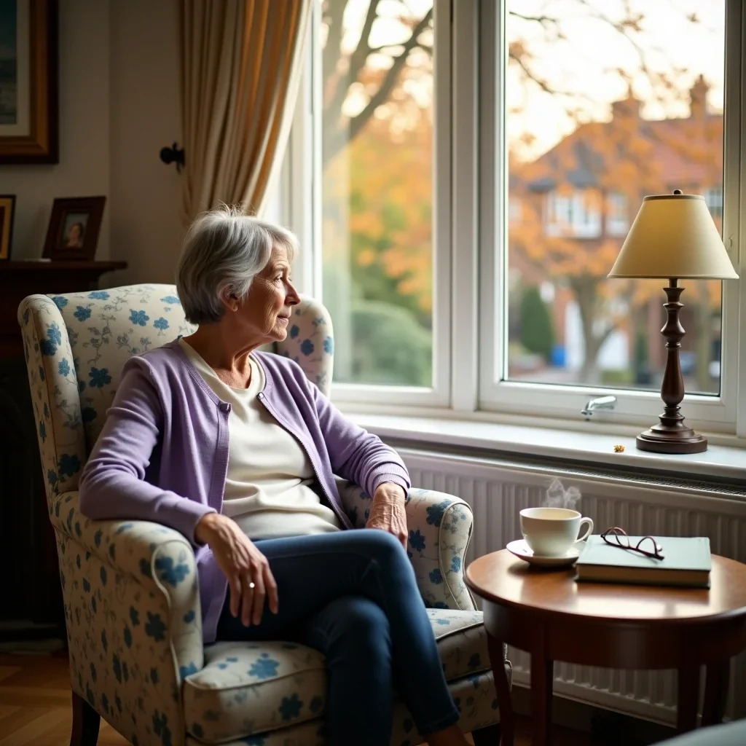
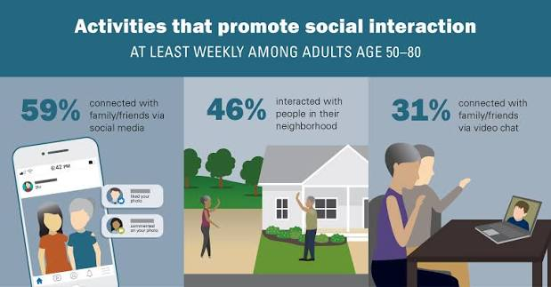
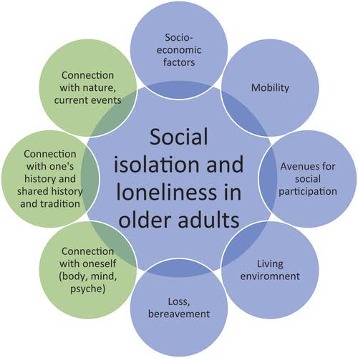
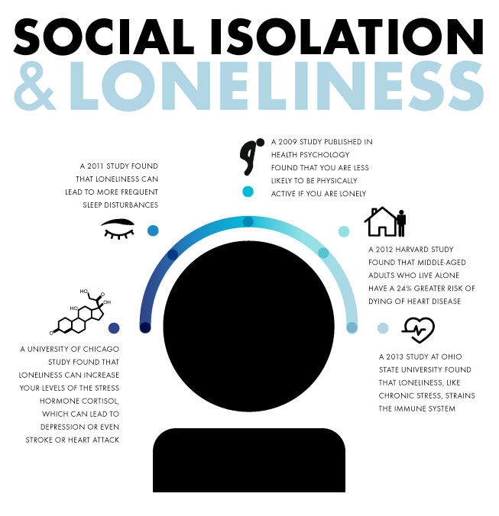
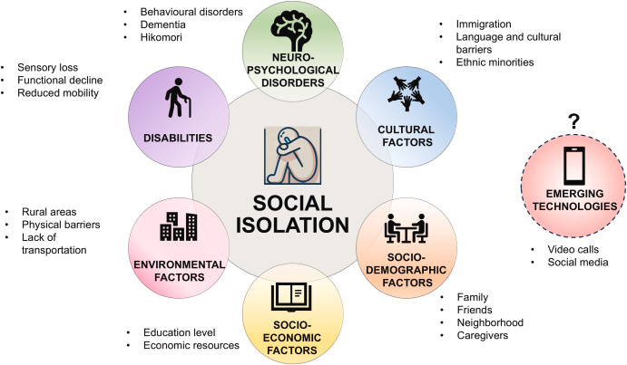

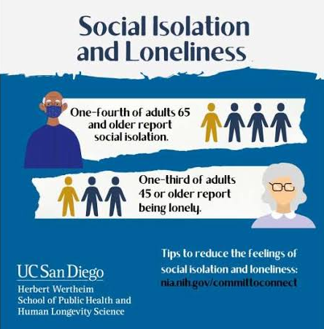

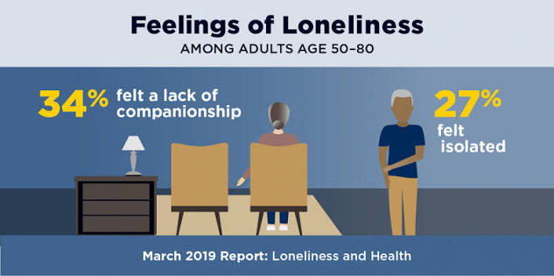
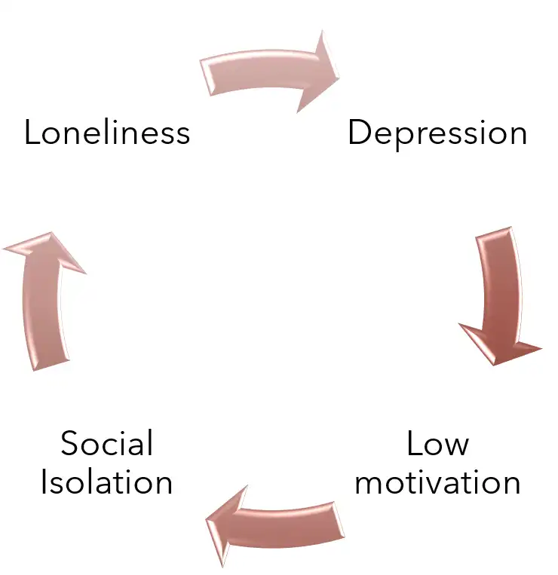
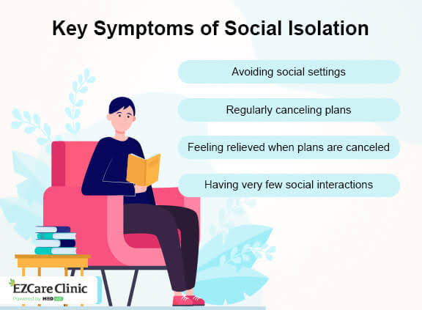
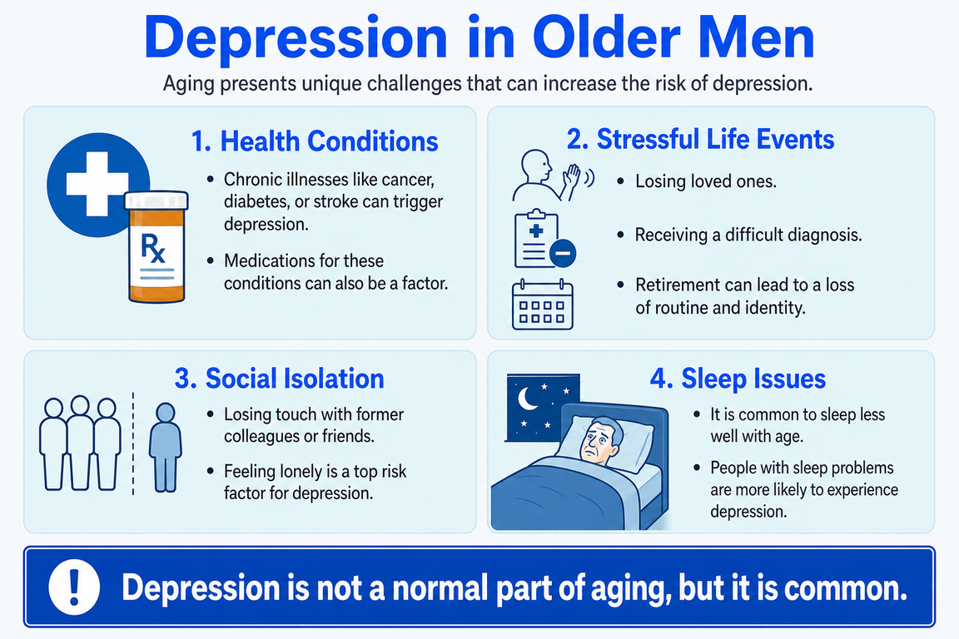
The Association Between Social Isolation and Depressive Symptoms Among Adults Aged 70 Years and Above Living Alone in the United Kingdom
1
Introduction
3
Research Rationale
5
Proposed Research Methodology
Living alone and experiencing social isolation is a widespread public health issue among older people in the UK (Wang et al., 2024).
Social isolation is the objective lack of social contacts, while loneliness is the individual perception of lacking social connections (Elovainio et al., 2022).
Understanding this association may support early mental health assessment and preventative social care.
Bereavement, reduced mobility, health problems and fewer community interactions may increase isolation among older adults (Jin and Bae, 2023).
Green et al., 2021, found older adults who lived alone had higher depressive symptoms and loneliness than those living with a partner.
Living alone does not necessarily mean being socially isolated.
Understanding this relationship may help identify older adults who need targeted emotional and social support.
Approach: Qualitative secondary research using published studies.
Data sources: Peer-reviewed research on older adults’ isolation, emotional wellbeing and independent living.
Analysis: “Braun and Clarke’s (2006) thematic analysis framework.”
Potential themes: Reduced social contact, bereavement, emotional distress and barriers to support.
Ethics: Accurate reporting, appropriate referencing and transparent interpretation of findings.
2
Prevalence of the Problem
Methodological note: as a qualitative secondary study, findings explore experiences and reported associations; they do not measure effects or establish causation.
“8.4 million”
4.3 million
940,000
people “lived alone in the UK in 2024, up from 7.6 million in 2014”
(ONS, 2025)
of those living alone were aged 65 and over
(ONS, 2025)
people aged 65+ often experienced loneliness
(Age UK, 2024b)
~90%
1 in 4
of often-lonely older people felt unhappy or depressed
(Age UK, 2024b)
older people globally experience social isolation
(WHO, 2025)
4
Research Question, Aim and Objectives
Research question
Is there an association between “social isolation and depressive symptoms in adults aged 70+ living alone” in the UK?
Research aim
To investigate the “link between social isolation and depressive symptoms among older adults” (age 70+) living alone in the UK.
Research objectives
Explore experiences and indicators of social isolation among older adults living alone.
Examine how social isolation relates to depressive symptoms.
Identify implications for early mental health assessment and community-based support.
6
Potential Research Impact
Help GPs, community nurses and social workers recognise risks associated with social isolation.
Inform referrals to NHS social prescribing link workers and Age UK befriending services.
Support access to local lunch clubs, community transport and social activities.
Help local authorities develop accessible, person-centred services for older adults.
Conclusion
Social isolation may be associated with depressive symptoms among older adults living alone.
Understanding older adults’ experiences may reveal unmet emotional needs and barriers to social participation.
Findings could inform earlier identification of distress and better coordination between health, social care and voluntary services.
7

Slide 2
Reference list
Office for National Statistics (ONS), 2025. Families and households in the UK: 2024. Available at: https://www.ons.gov.uk/peoplepopulationandcommunity/birthsdeathsandmarriages/families/bulletins/familiesandhouseholds/2024 (Accessed: 14 October 2026).
Age UK, 2024a. Building on success to beat loneliness. Available at: https://www.ageuk.org.uk/discover/2024/december/building-on-success-to-beat-loneliness/ (Accessed: 14 October 2026).
Age UK, 2024b. Age UK’s new report shows you are not alone in feeling lonely. Available at: https://www.ageuk.org.uk/latest-press/articles/age-uks-new-report-shows-you-are-not-alone-in-feeling-lonely/ (Accessed: 14 October 2026).
Braun, V. and Clarke, V. (2006) ‘Using thematic analysis in psychology’, Qualitative Research in Psychology, 3(2), pp. 77–101. Available at: https://doi.org/10.1191/1478088706qp063oa.
Green, M.J., Whitley, E., Niedzwiedz, C.L., Shaw, R.J. and Katikireddi, S.V. (2021) ‘Social contact and inequalities in depressive symptoms and loneliness among older adults: A mediation analysis of the English Longitudinal Study of Ageing’, SSM – Population Health, 13, article 100726. Available at: https://doi.org/10.1016/j.ssmph.2021.100726.
World Health Organization (WHO) (2025) From loneliness to social connection: Charting a path to healthier societies. Geneva: World Health Organization. Available at: https://www.who.int/activities/reducing-social-isolation-and-loneliness-among-older-people.
Wang, Y., Liu, M., Yang, F., Chen, H., Wang, Y. and Liu, J., 2024. The associations of socioeconomic status, social activities, and loneliness with depressive symptoms in adults aged 50 years and older across 24 countries: findings from five prospective cohort studies. The Lancet Healthy Longevity, 5(9).
Elovainio, M., Lahti, J., Pirinen, M., Pulkki-Råback, L., Malmberg, A., Lipsanen, J., Virtanen, M., Kivimäki, M. and Hakulinen, C., 2022. Association of social isolation, loneliness and genetic risk with incidence of dementia: UK Biobank Cohort Study. BMJ open, 12(2), p.e053936.
Jin, M.J. and Bae, S.M., 2023. The effect of social isolation, loneliness, and physical activity on depressive symptoms of older adults during COVID-19: A moderated mediation analysis. International journal of environmental research and public health, 21(1), p.26.
Stuart, A., Yan, R.J., Harkin, L.J., Katz, D., Stevenson, C., Mehta, V., Giles, E., Talbot, C., Gooch, D., Bennasar, M. and Self, T., 2023. Digital intervention in loneliness in older adults: qualitative analysis of user studies. JMIR Formative Research, 7(1), p.e42172.
Lapane, K.L., Lim, E., McPhillips, E., Barooah, A., Yuan, Y. and Dube, C.E., 2022. Health effects of loneliness and social isolation in older adults living in congregate long term care settings: A systematic review of quantitative and qualitative evidence. Archives of gerontology and geriatrics, 102, p.104728.
Ryu, S.I., Park, Y.H., Kim, J., Huh, I., Chang, S.J., Jang, S.N. and Noh, E.Y., 2022. Impact of COVID-19 on the social relationships and mental health of older adults living alone: A two-year prospective cohort study. PLoS One, 17(7), p.e0270260.
Giebel, C., Hassan, S., Harvey, G., Devitt, C., Harper, L. and Simmill‐Binning, C., 2022. Enabling middle‐aged and older adults accessing community services to reduce social isolation: Community Connectors. Health & social care in the community, 30(2), pp.e461-e468.
Goodwin, V.A., Low, M.S., Quinn, T.J., Cockcroft, E.J., Shepherd, V., Evans, P.H., Henderson, E.J., Mahmood, F., Ni Lochlainn, M., Needham, C. and Underwood, B.R., 2023. Including older people in health and social care research: best practice recommendations based on the INCLUDE framework. Age and ageing, 52(6), p.afad082.
Galvez-Hernandez, P., González-de Paz, L. and Muntaner, C., 2022. Primary care-based interventions addressing social isolation and loneliness in older people: a scoping review. BMJ open, 12(2), p.e057729.

