Slide 1
Topic 5 – Files, Reading and Writing
Dr Stephen Hole

Slide 2
Streams
Java programs perform I/O through streams.
A stream is an abstraction that either produces or consumes information.
A stream is linked to a physical device by the Java I/O system.
All streams behave in the same manner, even if the actual physical devices to which they are linked differ.
Thus, the same I/O classes and methods can be applied to any type of device.

Slide 3
Streams
An input stream can abstract many different kinds of input:
  Disk file, a keyboard, or a network socket.
Likewise, an output stream may refer to the:
  Console, a disk file, or a network connection.
Streams are a clean way to deal with input/output without having every part of your code understand the difference between a keyboard and a network.
Java implements streams within class hierarchies defined in the java.io package.

Slide 4
Byte Streams and Character Streams
Java defines two types of streams:
  byte and character.
Byte streams provide a convenient means for handling input and output of bytes.
Byte streams are used, for example, when:
  Reading or writing binary data.
Character streams provide a convenient means for handling input and output of characters.
They use Unicode and, therefore, can be internationalised.

Slide 5
Reading Console Input
The preferred method of reading console input is to use a character-oriented stream, which makes your program easier to internationalize and maintain.
To read a character from a BufferedReader, use read( ).
The version of read( ) that we will be using is
  int read( ) throws IOException
Each time that read( ) is called, it reads a character from the input stream and returns it as an integer value.
It returns –1 when the end of the stream is encountered.

Slide 6
IOException
As you can see, it can throw an IOException.
The following program demonstrates read( ) by reading characters from the console until the user types a "q.”
Notice that any I/O exceptions that might be generated are simply thrown out of main( ).
Such an approach is common when reading from the console, but you can handle these types of errors yourself, if you chose.

Slide 7
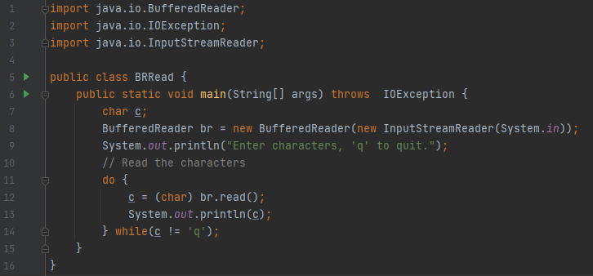

Slide 8
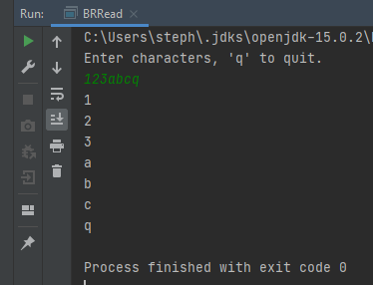
Sample Output

Slide 9
Reading Strings
To read a string from the keyboard, use the version of readLine( ) that is a member of the BufferedReader class.
Its general form is shown here:
  String readLine( ) throws IOException
As you can see, it returns a String object.
The following program demonstrates BufferedReader and the readLine( ) method; the program reads and displays lines of text until you enter the word “stop”:

Slide 10
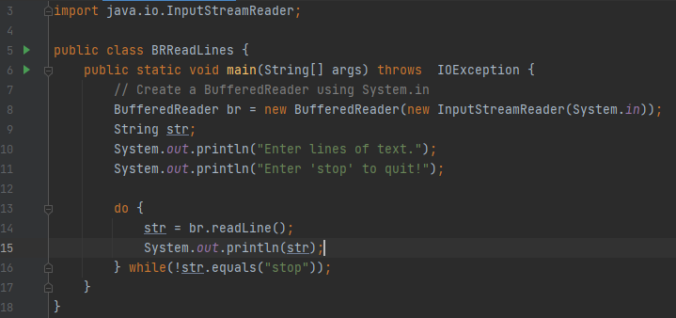

Slide 11
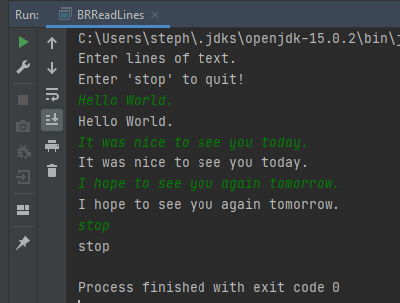
Sample Output

Slide 12
Simple Text Editor
The next example creates a tiny text editor.
It creates an array of String objects and then reads in lines of text, storing each line in the array.
It will read up to 100 lines or until you enter “stop.”
It uses a BufferedReader to read from the console.

Slide 13
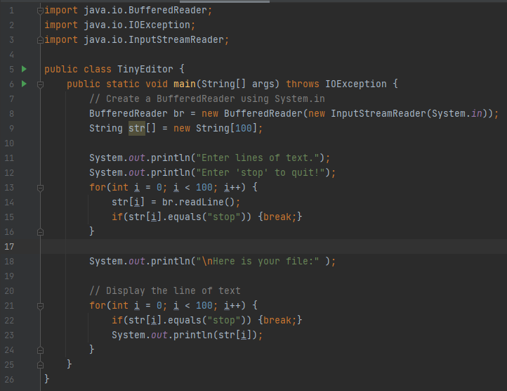

Slide 14
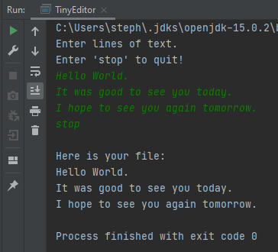
Sample Output

Slide 15
Files
Files are a very popular source and destination for data.
Some of the fundamental mechanisms for reading and writing files are:
  InputStreams;
  OutputStreams.

Slide 16
Files, InputStreams & IOExceptions
To demonstrate the use of InputStreams create:
  A new project and name it InputOutput;
  Create a file inside the project’s src directory and name it bytes.txt;
  Add some random characters to the file, for example:
    ax3dF78zxcvbmn
  Create a Java class named ReadFile;
  Add a main to this class;
  Add the code that is on the next slide.

Slide 17
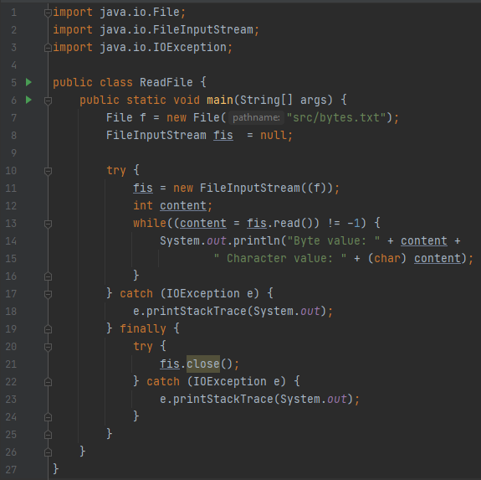

Slide 18
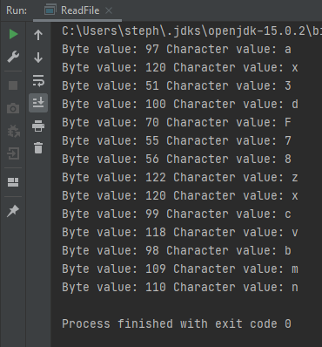
Sample Output

Slide 19
Files, InputStreams & IOExceptions
The program starts by defining the File that will be read:
The location of the File is relative to the root directory of the project.
FileInputStream can accept a String representing the file path, but it is best practice to encapsulate the file path in the File object as this gives access to a set of utility methods:
  f.exists, f.canRead,
  f.canWrite, f.length.

Slide 20
Files, InputStreams & IOExceptions
Constructing a File object does not ensure a corresponding file exists.
Next create a FileInputStream and pass it to the file as a parameter.
This is occurring inside a try/catch block:
  If the file does not exist a FileNotFound exception will be thrown at this point.
  This exception extends IOException, therefore the code will simply catch IOException.

Slide 21
Files, InputStreams & IOExceptions
The next portion of code loops through all the contents in the file one byte at a time, and assigns the content of each location to the variable content.
If the value of this is -1 then the end of the file has been reached, and the loop ends.
The catch block prints out any exception that occurs bypassing a stream (System.out) to the printStackTrace method of Exception.

Slide 22
Files, InputStreams & IOExceptions
Notice that printStackTrace accepts an OutputStream, therefore it could be passed any kind of OutputStream including a FileOutputStream this highlights the flexibility of programming to a common interface.
After the catch block you will notice a finally block that closes the FileInputStream.
Always attempt to close the FileInputStream regardless of whether the method completed successfully, because an error may have occurred during the read operation.

Slide 23
Files, InputStreams & IOExceptions
Also notice you also need to wrap the call to close in a further try/catch block, because this will generate an exception if the File did not exist originally.
It is important to always close files after using them.
Otherwise the file descriptor will continue to utilise Operating System resources.

Slide 24
Files, OutputStreams & IOExceptions
The next example demonstrates how to use the FileOutputStream to write files.
We create a File object representing the file you want to write to, even though this does not exist at present.
The process of writing to the file well implicitly create it.

Slide 25
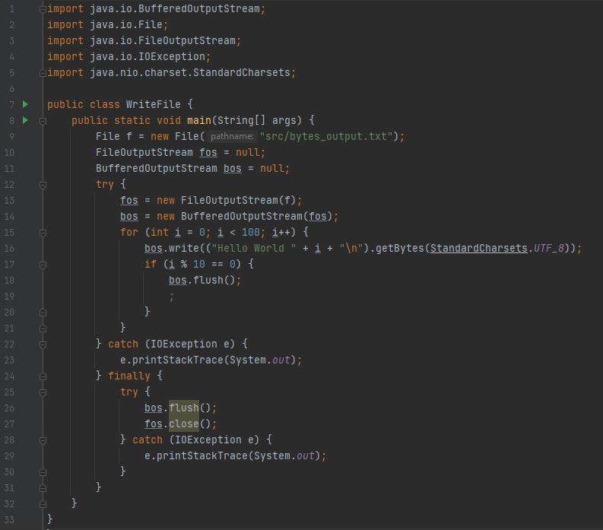

Slide 26
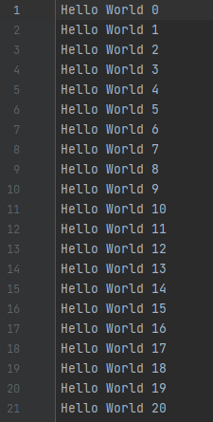
Sample File Output

Slide 27

Files, OutputStreams & IOExceptions
Notice that the FileOutputStream is nested inside a BufferedOutputStream.
In addition, you need to call flush on the buffered output stream whenever you wanted to write data to the file.
If you do not call flush before closing the file then any data in the BufferedOutputStream will be lost.

Slide 28
Readers and Writers
Readers and writers are similar to streams.
Not only can readers and writers be nested inside one another to add additional functionality, the names of the various readers and writers provided by Java tend to match the names of the stream counterparts relatively closely.
We will write a program for reading data one line at a time and storing the line in a String this is a very common operation with textual data, and as you have already seen, can be achieved with the streams API.

Slide 29
Readers and Writers
This example will be slightly more complicated because it will read all the files in the src directory one by one.
In order achieve this create a File and pass it to the path of the src directory.
Files and directories are both represented by the File object in Java, but they can be distinguished by the isDirectory and isFile methods.

Slide 30
Readers and Writers
Once you have a reference to a File representing the directory, you can use it to list all the files in the directory and store the list in an array of Files.
This array will contain both files an child directories of the SRC directory, therefore when you look through the files you only read the contents if the isFile method evaluates the true.

Slide 31
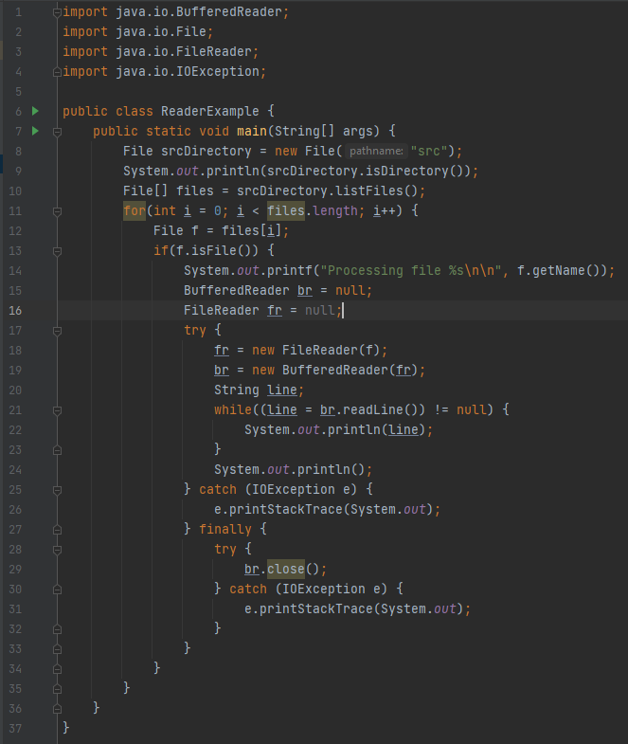

Slide 32
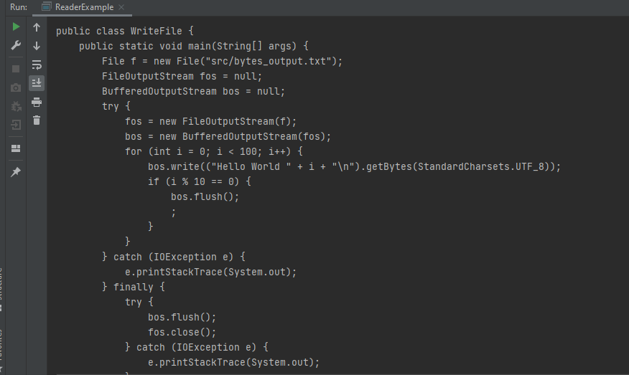
Sample Output

Slide 33
Exercise Tasks
Write a Java program to get a list of all file/directory names from the given file path.
Write a Java program to get specific files by extensions from a specified folder and display their contents.
Write a Java program to check if a file or directory specified by pathname exists or not.
Write a Java program to check if a file or directory has read and write permission.
Write a Java program to check if given pathname is a directory or a file.
Write a Java program to compare two files lexicographically.
Write a Java program to get last modified time of a file.

Slide 34
Exercise Tasks
Write a Java program to append text to an existing file.
Write a Java program to find the longest word in a text file.
Write a Java program to read the following vehicle details from the keyboard:
  Make, Model, Year Registered, Mileage, Gearbox, Fuel and Drivetrain.
  Minimum of 6 vehicles.
  Write the vehicle details to as a line of comma delimited text to a file.
  Create a class to hold the details of a vehicle.
  Read the comma delimited text file and create and populate 6 instances of the Vehicle class.
  Write the contents of the 6 instances of the Vehicle class to a separate file.
  Compare the contents of the two files you have created.

