Slide 1
CSR
Concepts and Theories

Slide 2
What is Corporate Social Responsibility?
Theory of CSR
CSR is an evolving concept that currently does not have a universally accepted definition.
An early definition by Archie Carroll in 1979 was:
‘the social responsibility of business encompasses the economic, legal, ethical and discretionary expectations that society has of organisations at a given point in time.’

Slide 3
Core Characteristics of CSR
There are six core characteristics that are evident in the study of CSR:
Voluntary
Internalising or managing externalities
Multiple stakeholders orientation
Alignment of social and economical responsibilities
Practices and Values
Beyond Philanthropy

Slide 4
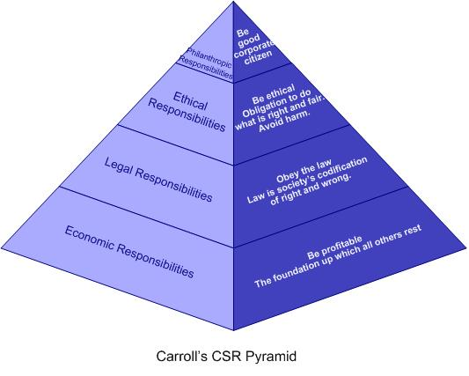
The Pyramid of CSR
Archie Carroll

Slide 5
Economic and Legal Responsibilities
Economic 1st ( bottom) Tier
Historically – designed to provide goods and services to make a profit.
Seen as basic economic unit and aimed to maximise profit.
Root of a business organisation and its responsibilities.
Legal 2nd Tier
Runs alongside the need to make profit, but society dictates the laws and regulations that a business must adhere to.
“Social contract”
“Codified Ethics” – fair operations.

Slide 6
Economic Components | Legal Components
It is important to perform in a manner consistent with maximising earnings per share It is important to be committed to being as profitable as possible It is important to maintain a strong competitive position It is important to maintain a high level of operating efficiency It is important that a successful firm de defined as one that is profitable. | It is important to perform in a manner consistent with the expectation of government and law It is important to comply with various federal, state and local regulations It is important to be a law-abiding corporate citizen It is important that a successful firm be defined as one that fulfils its legal obligations It is important to provide goods and services that at least meet minimal legal requirements

Slide 7
Ethical and Philanthropic Responsibilities
Ethical – 3rd Tier
Protects the ethical activities and practices that are not codified by the law.
Constantly pushes the legal components to expand and evolve.
Philanthropic – 4th Tier
Is the response to society’s expectations that businesses be good corporate citizens.
Includes contributions to education, the arts, the community.
More discretionary and voluntary.
“Icing on the cake”

Slide 8
Ethical Components | Philanthropic Components
It is important to perform in a manner consistent with expectations of societal mores and ethical norms It is important to recognise and respect new or evolving ethical/moral norms adopted by society It is important to prevent ethical norms from being compromised in order to achieve corporate goals It is important that good corporate citizenship be defined as doing what is expected morally and ethically It is important to recognise that corporate integrity and ethical behaviour go beyond mere compliance with laws and regulations | It is important to perform in a manner consistent with the philanthropic and charitable expectations of society It is important to assist the fine and performing arts It is important that managers and employees participate in voluntary and charitable activities within their local communities It is important to provide assistance to private and public sector educational institutions It is important to assist voluntarily those projects that enhance a communities ‘ quality of life’.

Slide 9
Not perfect as a theory and there is plenty of room for tensions between the tiers.
“concern for profit” v “concern for society”
Business tries to fulfil all obligations to’ strive to make a profit, obey the law, be ethical and a good corporate citizen’.
Conflicts with Friedman’s theory that a business has only one responsibility – to maximise profit.

Slide 10
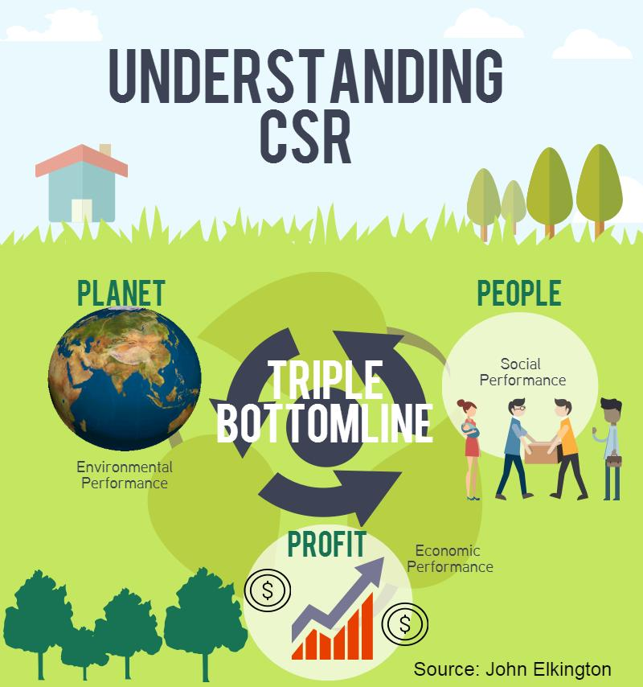

Slide 11
CSR in Different Organisational Contexts
CSR and the private sector
Large Corporations :- have a fairly structured and formalised approach with annual reports. More visible
Small and medium sized Enterprises (SMEs) :- Less structured and more informal. Less visible.

Slide 12


Slide 13

We have always believed Starbucks can – and should – have a positive impact on the communities we serve. One person, one cup and one neighbourhood at a time.
As we have grown to now more than 25,000 stores in over 75 countries, so too has our commitment to create global social impact.
So it is our vision that together we will elevate our partners, customers, suppliers and neighbours to create positive change. To be innovators, leaders and contributors to an inclusive society and a healthy environment so that Starbucks and everyone we touch can endure and thrive.
https://www.starbucks.com/responsibility
https://news.starbucks.com/news/starbucks-ethical-sourcing-program

Slide 14
What does ethically sourcing mean?
CAFÉ Practices
The green coffee sourcing standard used by Starbucks to purchase their coffee is known as the CAFÉ (Coffee and Farm Equity) Practices program. The standard was developed in partnership with Conservation International and an independent third-party company, SCS Global Services.
CAFÉ Practices operates on a points system, with points awarded for compliance with individual “indicators, 185 indicators in total.
“Preferred supplier” status is awarded to those that score at least 60 percent, and suppliers that score 80 percent or greater get “strategic supplier” status.
Other standards exist, eg Rainforest Alliance
https://www.scsglobalservices.com/services/starbucks-cafe-practices?scscertified=1

Slide 15
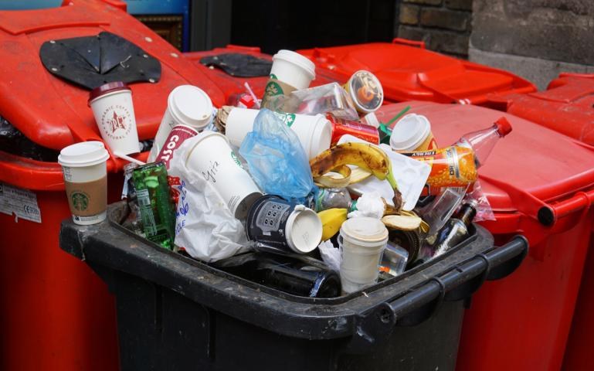
Starbucks Falls Short on Environmental Commitments
Reports suggest that caffeine lovers’ iconic mermaid may not be so green after all - single-use plastic cups

Slide 16
Starbucks: Social responsibility and tax avoidance
Starbucks had been successful in growing its stores and presence in the United Kingdom (UK), and described the profitable growth to investors as something it wanted to build on in other international markets. However, in its 15 years of operations in the UK, the company had paid UK corporate income taxes only once. Using a combination of legal tax avoidance practices (e.g., transfer prices, royalty payments, interest expense), Starbucks UK had effectively shifted taxable income to other Starbucks subsidiaries where it would be taxed at lower rates.
https://www.sciencedirect.com/science/article/pii/S0748575115300130

Slide 17
CSR in the Public Sector
How does this apply?
40 – 50% of governments in some countries supply large amounts of all goods and services, e.g. schools, hospitals and universities.
Example BBC’s annual CSR annual report.
Governments try to take an active role in encouraging and promote CSR in private sector.
E.G. Ethical Trading Initiative and CSR Academy in UK

Slide 18

The BBC is committed to running its business in a way that is responsible and which has a positive impact for our licence fee payers.

Slide 19
https://www.bbc.co.uk/responsibility/reports

Slide 20
CSR and Organisational Stakeholders
‘Stakeholders’ – groups or persons who have a stake, a claim, or an interest in the operations and decisions of the firm.
EG- shareholders, consumers, employees, suppliers, community, social activists groups.
Requires Stakeholder management.
Five major questions:
Who are the stakeholders?
What are their stakes?
What opportunities and challenges are presented by our stakeholders?
What corporate social responsibilities do we have to our stakeholders? (economic, legal, ethical, philanthropic)
What strategies, actions, or decisions would we take to best deal with these responsibilities?

Slide 21
Moral Management and Stakeholders
First discussed by Archie Carroll in 1991 Business Horizons
Isolating the ethical component of CSR pyramid in the context of stakeholders.
Three major approaches –
immoral management – only concerned with profit and success, exploit opportunities for corporate gain e.g. Charles Keating
amoral management - lack ethical awareness, careless and inattentive to the implications of their action, unintentional amorality e.g. Old police qualifications, tobacco industry, MacDonald's.
moral management- adhere to a high standard of ‘right’ behaviour

Slide 22
Type of management | Owner/ Shareholder
Immoral Management Amoral Management Moral Management | Shareholders are minimally treated and given short shrift. Focus is on maximising positions of executive groups – maximising executive compensation, perks, benefits, done without shareholders being aware. Self-interest. No special thought given to shareholders: they are there and must be minimally accommodated. Focus on profit, no ethical consideration, limited to legal requirements. Shareholders’ interests is a central factor. The best way to be ethical to shareholders is to treat all stakeholders in a fair manner. Code of ethics established.

Slide 23
Type of management | Employee
Immoral Management Amoral Management Moral Management | Viewed as factors of production to be used and exploited for gain of company. No concern for employee needs/rights/expectations. Treated as law requires. Still seen as factors of production but remunerative approach used. Self –interest to treating employees with minimal respect. A human resource to be treated with respect and dignity. Mutual confidence and respect. Rights given maximum concern. Mutual confidence

Slide 24
Type of Management | Customer
Immoral Management Amoral Management Moral Management | Viewed as opportunities to be exploited for corporate gain. Active intent to deceive/ cheat and mislead. Customer taken advantage of at all points. Does not think through the ethical consequences of its actions. Makes decisions that comply with the law an to make profit. Does not focus on what is fair for the customer. Viewed as an equal partner in the transaction Customer treated fairly and needs considered. Rights honoured.

Slide 25
Type of Management | Local Community
Immoral Management Amoral Management Moral Management | Exploits to the fullest, pollutes the environment. Disregards communities needs, takes advantage of its resources and does not give anything in return. Does not take needs into business decision making. Assumed to be irrelevant to business decisions. Legal considerations are followed but nothing more. see community as vital. Seeks to be a leading citizen gets actively involved and helps institutions. Sees community and company goals as mutually interdependent.

Slide 26
Conclusion
Pyramid theory – economic, legal, ethical, philanthropic. Depends on firm’s size, management philosophy, corporate strategy, industry characteristics, the economy.
Stakeholder management – needed to organise and analyse its decision making.
Moral Management – provides the best exemplar for a business and a standard to attain to.

