Slide 1

Energy Efficiency at Delta Marriott Waltham Abbey
BMIH6001
-Contemporary Themes-
Lecturer : Lola Villard-Coles
Student : Mihai-Andrei Matei (2021030)

Slide 2

Marriott – How it started ?
www.marriott.com
Founded in 1927 by J. Willard and Alice Marriott, originating from a humble root beer stand (www.marriott.com).
Commenced a transformative journey, prioritizing exceptional guest experiences and innovation.
Over 8500 properties worldwide; 31 brands.

Slide 3
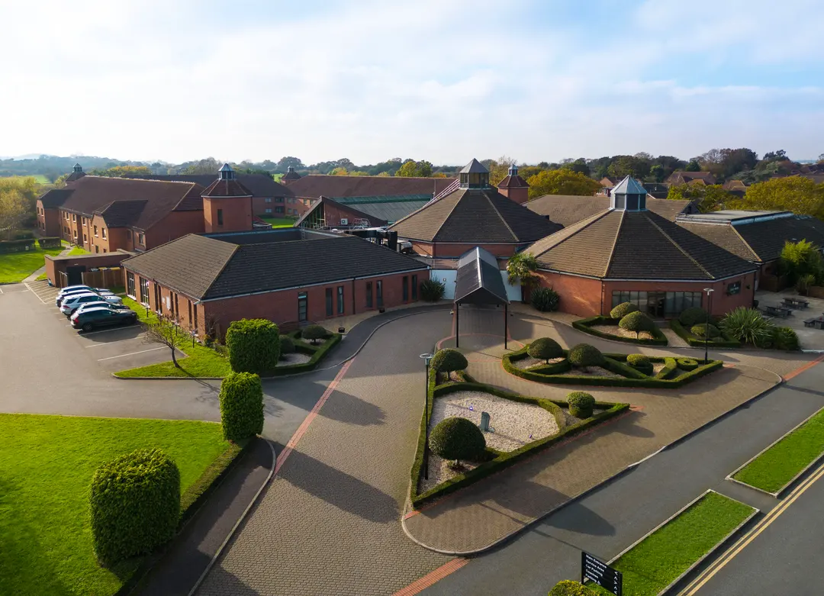
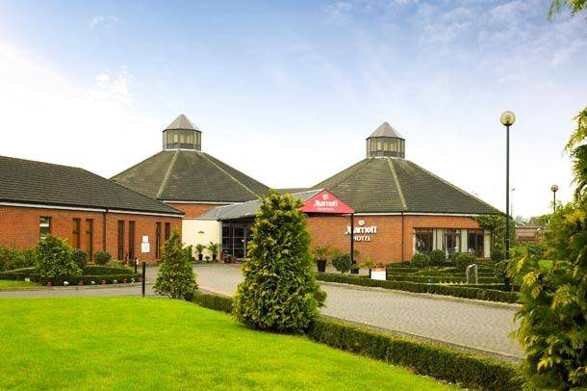
www.marriott.com
Introduction
Location: Waltham Cross, Hertfordshire, close to Stansted Airport and central London.
Recent Revitalization: Comprehensive property refurbishment to meet modern guest expectations.
Sustainability Commitment: Reflects a carbon footprint of 17.72 kg per room night and a water footprint of 424.97 litres per room night. (www.marriott.com)
Ongoing Challenges: Persisting legacy systems like aging air conditioning and inefficient lighting.
Research Aim: Explore enhancing energy efficiency within refurbishment for sustainable hospitality, beyond immediate guest comforts.

Slide 4

Energy efficiency at Delta Marriott Waltham Abbey
Emphasizes the hotel's commitment to sustainable practices and their influence on operations and guest satisfaction.
Explores the alignment of sustainability initiatives with broader refurbishment strategies and economic objectives within the industry.
Details specific energy efficiency initiatives at Delta Marriott Waltham Abbey and their impact on performance and guest experience.
Identifies challenges and barriers faced in pursuing greater energy efficiency, concluding with recommendations and best practices for the hotel and the industry (Tsoutsos & Samboulis, 2005).
Aims to shed light on the journey towards sustainable hospitality and the important role of energy efficiency within this context.
www.istockphoto.com

Slide 5



Importance of energy-efficiency
Definition of energy-efficiency
Highlight benefits :
Cost savings
Sustainability
Guest satisfaction (Wu, et al., 2016).
www.wallpaperflare.com
www.smartmanager.com
www.ifco.com

Slide 6


Key theories & Concepts
www.ogocindia.com
CSR (Corporate Social Responsibility)
High contribution to economic development, and positively impact society and the environment.
Marriott Serve 360 plan
“Doing good in every direction” (www.marriott.com)
www.serve360.marriott.com

Slide 7
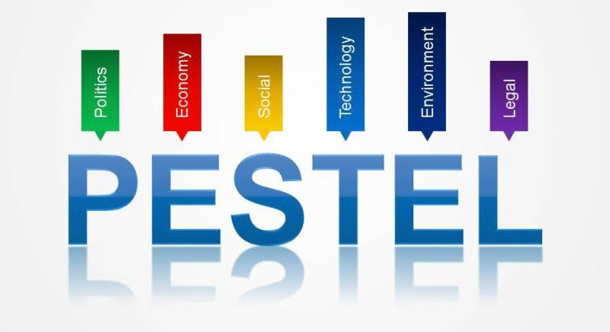
PESTLE
Strategic tool analysing factors that are influencing the business (Marmol & Feys, 2015)
Political
Economical
Social & Cultural
Technological
Legal
Environmental

Slide 8
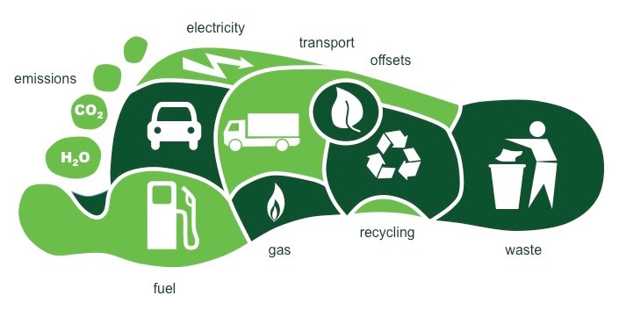
Environmental Footprints of Delta Marriott in Waltham Abbey
Carbon Footprint: 17.72 kg per room night
Water Footprint: 424.97 litres per room night ( Saidur, et al., 2011).
www.wp.edu

Slide 9

Challenges and Barriers
Legacy Systems and Cost Considerations: Upgrading outdated infrastructure (AC & lighting) poses financial and logistical challenges.
Adapting to Evolving Expectations: Balancing guest comfort, style, and sustainability while meeting regulatory standards and ensuring staff alignment with new practices (Xu & Gursoy, 2015).

Slide 10

Recommendations – Enhancing Energy Efficiency
Technology Upgrades: Invest in modern, energy-efficient technologies for lighting, HVAC, and other systems.
Employee Training: Provide comprehensive training to staff for efficient system use and sustainability practices.
Guest Engagement: Educate and engage guests on energy-saving practices during their stay for collective impact (Teng, et al., 2012).

Slide 11
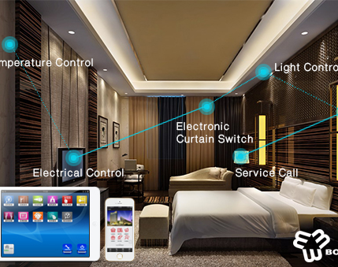
Smart Lighting
www.bonwinlocks.com
LED Implementation: Deploy energy-efficient LED lighting throughout common areas and guest rooms (Jesus & Gago-Calderon, 2020).
Occupancy Sensors: Install sensors to automatically adjust lighting based on room occupancy, minimizing energy waste.
Smart Controls: Utilize centralized controls to regulate lighting intensity and timing for optimal energy use (www.bonwinlocks.com) .

Slide 12
Conclusion
Achievements in Efficiency: Outline accomplishments in energy efficiency initiatives and their impact on the hotel's operations and sustainability goals.
Ongoing Commitment: Emphasize the continuous dedication to further improvements and embracing new energy-efficient technologies.
Guest-Centric Sustainability: Highlight the integration of energy efficiency with guest satisfaction and environmental responsibility.

Slide 13
Reference list :
https://www.wallpaperflare.com/person-holding-earth-illustration-sustainability-energy-globe-wallpaper-zpsss
https://smartermanager.com/blog/foster-customer-satisfaction/
https://www.ifco.com/how-to-generate-more-cost-savings-in-2018/
https://www.istockphoto.com/illustrations/energy-efficient
https://www.marriott.com/about/culture-and-values/history.mi
https://www.marriott.com/en-gb/hotels/lonwd-delta-hotels-waltham-abbey/overview/
https://www.ogocindia.com/en/company-profile/11-csr
https://serve360.marriott.com/wp-content/uploads/2019/10/Serve-360-goals-page-tabloid_2-updated-20180916-English.pdf
https://bstrategyhub.com/grab-your-mortar-pestle-analysis-explained/
https://wp.wwu.edu/marketing474gill/tag/ecological-footprint/
https://www.bonwinlocks.com/Article/hotelintelligent.html
Wu, H., Ai, C., & Cheng, C., (2016). Synthesizing the effects of green experiential quality, green equity, green image, and green experiential satisfaction of green switching intention. Pp. 2080-2107. Available at : https://www.emerald.com/insight/content/doi/10.1108/IJCHM-03-2015-0163/full/html
Tsoutsos, T. D., & Samboulis, Y. A., (2005). The sustainable diffusion of renewable energy technologies; an example of an innovative policy. Vol 25(7) (2005), pp. 753-761. Available at : https://www.scopus.com/record/display.uri?eid=2-s2.0-13244270100&origin=inward&txGid=5252ed741a58d34ccb1bbefb34ccc8b5

Slide 14
References (continued)
Marmol, T., & Feys, B., (2015), PESTLE Analysis. Available at : https://r3.vlereader.com/EpubReader?ean=1782806268372
Saidur, N., Hsanuzzaman, M., Mahlia, T. M. T., Rahim, N. A., Mohammedd, H. A., (2011). Chillers energy consumption, energy efficiency and emission analysis in institutional buildings. Vol (36) (8) (2011), pp. 5233-5238. Available at : https://scholar.google.com/scholar_lookup?title=Chillers%20energy%20consumption%2C%20energy%20savings%20and%20emission%20analysis%20in%20an%20institutional%20buildings&publication_year=2011&author=R.%20Saidur&author=M.%20Hasanuzzaman&author=T M.I.%20Mahlia&author=N.A.%20Rahim&author=H.A.%20Mohammedd
Teng, C., Horng, J., Hu, M., Chien, L., & Shen, Y., (2012). Developing energy conservation and carbon reduction indicators for the hotel industry in Taiwan. Journal of hospitality Management, 31(1), pp. 199-208. Available at : https://www.sciencedirect.com/science/article/abs/pii/S0278431911000983?via%3Dihub
Nastu, J., (2021). Marriott Taps Artificial Intelligence for HVAC, Reduces Gas Consumption with 25%. Online article, Available at : https://www.environmentenergyleader.com/2021/01/marriott-taps-artificial-intelligence-for-hvac/
Xu, X., & Gursoy, D., (2015). Influence of sustainable hospitality supply chain management on customer’s attitudes and behaviours. Vol (49) (2015), pp. 105-116. Available at : https://article.nadiapub.com/IJCA/vol8_no2/11.pdf
Jesús, H. O., Gago-Calderón, A., (2020). Energy Efficiency and Sustainable Lighting - a Bet for the Future. IntechOpen. Available at: http://dx.doi.org/10.5772/intechopen.85907

