Slide 1
Overview of Workshop
Schedule until the end of term
Finance – costs, profit and loss, cash flow, pricing
Activity
Break
Finish activity/preparation for presentation

Slide 2
Finance
Cost identification and itemisation
The first step is to establish your costs
Your price has to be high enough to cover your costs
Business costs fall into 3 categories:
Fixed costs or overheads
Direct or variable costs
Capital costs
Notes:
.

Slide 3
Fixed costs must always be paid
Fixed costs include
Utility bills e.g. telephone, gas and electricity
Advertising
Insurance
Travel
Legal and accountancy
Rent

Slide 4
Variable costs change as sales increase
Variable costs include
Raw materials
Direct labour costs for staff
Packaging
Delivery charges
Warehouse costs
Depreciation of equipment

Slide 5
Capital costs are on long term items
Capital costs include
Machinery
Equipment
Business vehicles
These items also lose value
This is known as depreciation
Usually at about 25% each year

Slide 6
Assets and Liabilities
Assets
Current Assets
Short term asset e.g. cash, stock, debtors i.e. people who owe you money and prepaid expenses
Fixed or Long- Term Assets
Property and equipment
Goodwill and patents

Slide 7
Assets and Liabilities
Assets
Current Assets
Short term asset e.g. cash, stock, debtors i.e. people who owe you money and prepaid expenses
Fixed or Long- Term Assets
Property and equipment
Goodwill and patents
Notes:
Customer loyalty, brand equity, name/brand recognition and company reputation – all of the things that make a company worth more than its book value, or quantifiable assets – count as goodwill. Goodwill only shows up on a balance sheet when two companies complete a merger or acquisition. When a company buys another firm, anything it pays above and beyond the net value of the target's identifiable assets becomes goodwill on the balance sheet.
Say a soft drink company was sold for $120 million; it had assets worth $100 million and liabilities of $20 million. The sum of $40 million that was paid over and above $80 million (the value of the assets minus the liabilities) is the worth of goodwill and is recorded in the books as such.
Read more: Goodwill versus other intangible assets: What's the difference? | Investopedia https://www.investopedia.com/articles/investing/100614/goodwill-vs-other-intangible-assets-whats-difference.asp#ixzz5I76obAPb

Slide 8
Profit and Loss statement
Required for all companies
This looks at costs compared to sales
If sales are greater than costs then profit is achieved but…

Slide 9
Example Profit and Loss Account
Violet’s Florists – Profit and Loss Account – Year Ending 31/12/2012
Violet’s Net Profit for the period is £21,600 pre-tax.
Sales
Sales made | £75,000
Cost of Sales | £26,250
Gross Profit | £48,750
Overheads & Operating Costs
Wages | £5,500
Rent | £7,200
Insurance | £600
Electricity / Gas | £1,000
Stationery, Printing and Postage | £750
Motor expenses | £2,000
Telephone and Internet | £600
Professional fees | £500
Equipment | £7,000
Marketing | £2,000
Total overheads and operating costs | £27,150

Slide 10
Pricing
There are two ways to arrive at your prices
Cost plus
This is the total of all costs plus a % on top as profit for the owner
Used by many businesses but has disadvantages
e.g. ignores demand for the product,
Customers may prepared to pay more,
Your competitors may charge less so you lose customers

Slide 11
Pricing continued
Market based price
In this example you estimate what the customer is likely to pay for your product based on competitors prices
In this example the business must understand changes in the market e.g. interest rates.
Also depends on how much customers value your product

Slide 12

Examples of market – based pricing
People are happy to pay more at a local shop than travel to a large and cheaper supermarket
A brand name might sell at a higher price because people trust the brand name
People may pay more for latest fashion or gadgets
You may be the only supplier of the product in
^{the area}
If demand is more than supply e.g. concert tickets
You must check out competitors prices – are they
giving discounts or special offers
Keep asking your customers what they want

Slide 13
Differential pricing
This means deciding to sell at a different price to different customers at different times
E.g. seasonal,
lower price if bought online,
items sold directly to customers such as farm shops,
offers if bought in bulk
timing e.g. emergency plumber

Slide 14
Differential pricing tactics
Odd value e.g. charging £9.99 not £10
Loss leaders e.g. selling at a low cost to attract customers
Price skimming e.g. charging a higher price at the launch of a product such as new gadgets or toys
Discounting
Bundling e.g. pc and printer for a discount

Slide 15
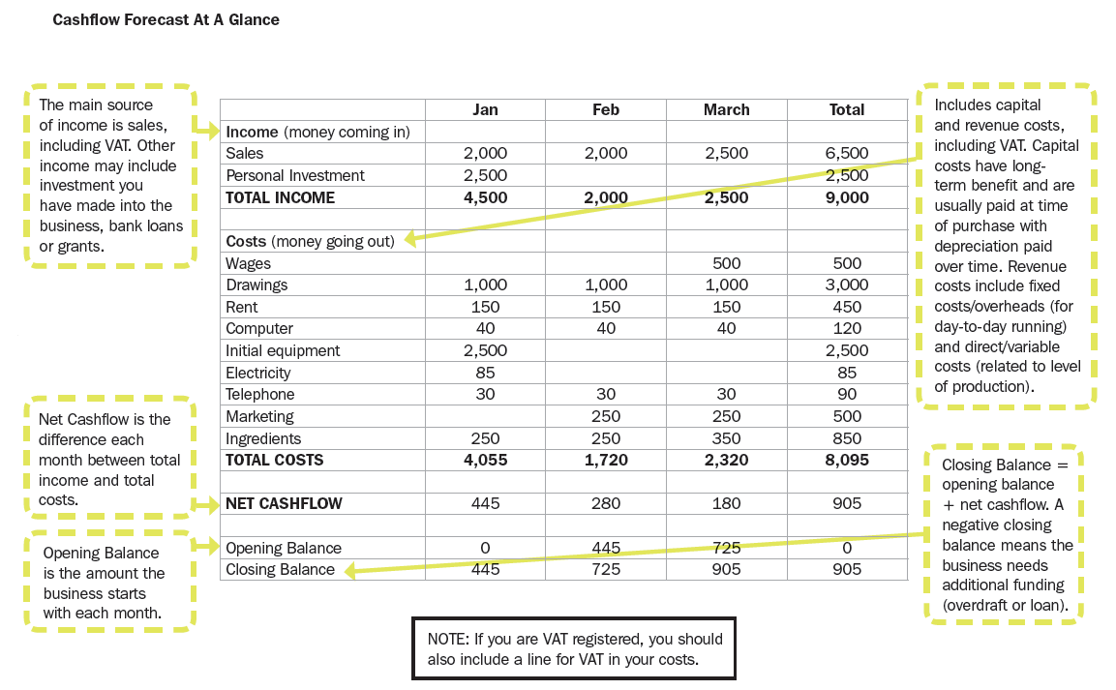

Slide 16
Activity
List your costs – fixed, variable, capital.
Decide on your price – explain how you have come to your decision and which strategy you used (cost plus/market based).
Complete a cash flow forecast for the first 12 months.

