Slide 1

Understanding
Shona’s Development
Bowlby’s Attachment Theory
Module: Psychology in Health and Social Care
Module code: LCHS4010
Assignment Title: Assignment 1: Individual Presentation
Submitted By: Rabiya Bi
Student ID: 2521424
01

Slide 2

Shona’s Transition to Nursery
3 years old
01
Anxiety when separated from carers
02
Limited verbal communication
03
Difficulty joining group play
04
Challenges adjusting to a new setting
Focus: attachment, nature and nurture, and support for development
Opie et al. (2021)
02
Notes:
Some children may find it stressful when they move to the nursery. Practitioners can identify the causes of behaviour and make the right kind of supporting decisions to ensure wellbeing and healthy development by understanding different theories about development (Opie _et al._, 2021).

Slide 3
Bowlby’s Attachment Theory
Children have an inborn tendency to form
attachments with primary caregivers.
Emotional security
Responsive caregiving
Attachment supports survival and helps children feel safe.
Consistent, sensitive responses support secure attachment.
Internal working model
Separation distress
Early relationships can shape expectations of the self and others.
Separation from familiar caregivers can cause distress.
Robledo et al. (2022), O’Shaughnessy et al. (2023), Allen (2023)
03
Notes:
Bowlby believed attachment is essential for healthy psychological development. Relationships in the early stages have an impact on children's self and others' perceptions for the rest of their life (Allen, 2023).

Slide 4
Applying the Theory to Shona
Observed difficulty
Possible attachment-based interpretation
Separation anxiety
Shona may need time and familiar support to feel confident in the nursery.
Limited communication
Feeling safe can support responsive interaction and communication.
Difficulty with group play
Uncertainty may reduce confidence in exploration and peer engagement.
Emotional security can provide a foundation for learning.
McLeod (2024), Behrens et al. (2025)
04
Notes:
Emotional security is believed to be a basis for development. When Shona is feeling unsafe or uncertain, they may find communication and interaction challenging (Behrens _et al._, 2025).

Slide 5
Nature and Nurture Work Together
Nature
Nurture
Biological influences
Environmental influences
Temperament
Genetics
Neurological development
Emotional sensitivity
Parenting style
Quality of caregiving
Nursery environment
Social experiences
For Shona, temperament and recent environmental changes
may both contribute to current behaviours.
Twohig et al. (2024), Stroebe (2021)
05
Notes:
Today in developmental psychology, it is understood that genes are not acting alone; there is an interaction between both genes and environment. These influences, varying frequently over time, combine together to influence children's outcomes (Stroebe, 2021).

Slide 6

Support 1: Secure Relationships
A consistent key worker
A trusted adult can provide continuity
and emotional support in nursery.
Daily practice
A familiar greeting and predictable routine
Consistent caregiver presence
Positive reassurance
Recognition and validation of feelings
Trust, confidence and emotional regulation
Vertel (2023), Twohig et al. (2024)
06
Notes:
A key worker can be a trusted adult in the nursery. Children feel safe and ensuing interaction helps to decrease separation anxiety over time (Vertel, 2023).

Slide 7

Support 2: Communication and Play
Communication
Interactive storytelling
One-to-one conversations
Language-rich activities
Positive reinforcement
Support at Shona’s pace
Group play
Small-group activities
Cooperative games
Guided peer interactions
Emotional safety can help her explore,
communicate and participate.
Jethava et al. (2022)
07
Notes:
Support of communication and peer interaction should be provided in an environment in which Shona feels safe, emotionally secure. It should be done slowly and according to her needs (Jethava _et al._, 2022).

Slide 8
Benefits for Early Years Practice
Strengths
Relationships
help explain
emotional
behaviour
Research support
Focus on caregiver–child relationships
Relevance to health and social care
Professional value
Recognising attachment-related difficulties
Planning targeted support
Promoting children’s wellbeing
The theory links early caregiving
to emotional and social development.
Twohig et al. (2024), Vertel (2023), Karbowa-Płowens (2021)
08
Notes:
The reason why Bowlby's theory can have an impact is because it is easily applied. It assists practitioners to gain an understanding of the impact of early relationships on children's emotional and social development (Karbowa-Płowens, 2021).

Slide 9
Limits of an Attachment-only Explanation
The theory can overemphasise the mother–child relationship
and give less attention to multiple caregivers and cultural differences.
Other factors matter for Shona
01
02
03
04
Temperament
Language
development
Developmental
conditions
Environmental
stressors
Attachment theory should complement broader developmental evaluation.
Nganyu (2023)
09
Notes:
While Bowlby's theory is very influential, it should not alone be used. Children's conduct is multi-dimensional and the product of several developmental, social and biological factors (Nganyu, 2023).

Slide 10
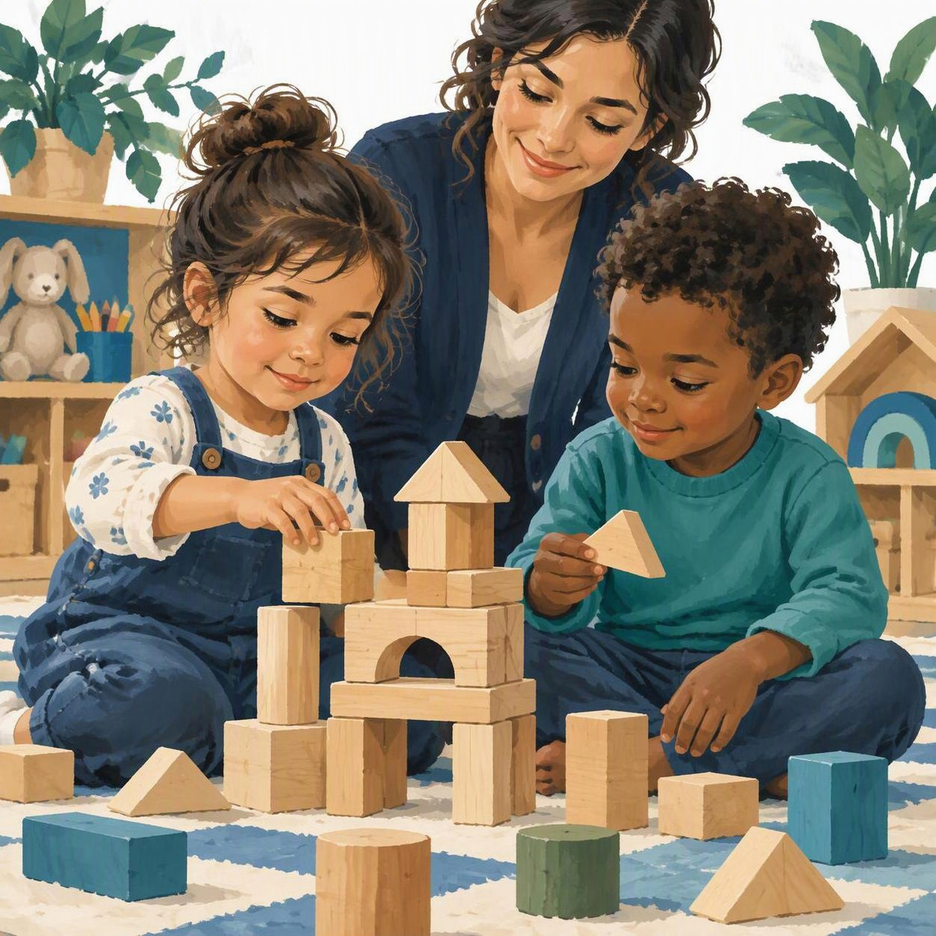
Supporting Shona’s Development
01
Emotional security
Relationships can help Shona adjust to nursery.
02
Communication and participation
Gradual opportunities can support confidence.
03
Nature and nurture
Biology and experience both shape development.
04
A balanced approach
Attachment theory offers one useful perspective.
10

Slide 11
References 1 of 2
Allen, B. (2023) ‘The Historical Foundations of Contemporary Attachment Theory: From John Bowlby to Mary Ainsworth.’
Behrens, K.Y., Jones-Mason, K. and Forslund, T. (2025) ‘John Bowlby’s Theory of Attachment and Separation: Revisiting His Original Visions after 50+ Years, What We Know Today, and Where to Go from Here?’ Attachment & Human Development, 27(5), pp. 657–661.
Jethava, V. et al. (2022) ‘Early Attachment and the Development of Social Communication: A Neuropsychological Approach’. Frontiers in Psychiatry, 13, p. 838950.
Karbowa-Płowens, M. (2021) ‘John Bowlby and Attachment Theory’. In Encyclopedia of Evolutionary Psychological Science. Springer, pp. 4286–4289.
McLeod, S. (2024) ‘John Bowlby’s Attachment Theory’. Simply Psychology.
Nganyu, G.N. (2023) ‘The Role of Attachment Theory in Understanding and Treating Psychological Disorders’. ShahidiHub International Journal of Education, Humanities & Social Science, 1(1), pp. 38–55.
11

Slide 12
References 2 of 2
Opie, J.E. et al. (2021) ‘Early Childhood Attachment Stability and Change: A Meta-Analysis’. Attachment & Human Development, 23(6), pp. 897–930.
O’Shaughnessy, R. et al. (2023) Attachment Theory: The Basics. Taylor & Francis.
Robledo, J.-P. et al. (2022) ‘Back to Basics: A Re-Evaluation of the Relevance of Imprinting in the Genesis of Bowlby’s Attachment Theory’. Frontiers in Psychology, 13, p. 1033746.
Stroebe, M. (2021) ‘The Study of Security and Separation: An Unexpected Forerunner of Attachment Theory?’ OMEGA-Journal of Death and Dying, 84(1), pp. 146–156.
Twohig, A., Lyne, J. and McNicholas, F. (2024) ‘Attachment Theory: Survival, Trauma, and War through the Eyes of Bowlby’. Irish Journal of Psychological Medicine, 41(3), pp. 273–275.
Vertel, A. (2023) ‘John Bowlby’s Attachment Theory as an Alternative to Psychoanalytic Concepts of the Early Social-Emotional Development of a Child’. Naukovyi Visnyk Melitopolskoho Derzhavnoho Pedahohichnoho Universytetu. Seriia: Pedahohika–Scientific Bulletin of Melitopol State Pedagogical University. Series: Pedagogy, 2 (31), pp. 17–24.
12

