Slide 1
Module: Food & Beverage Operations
Lecturer: Laurence Blake
Student Number: 2027272
Student Name: Alexandra Grigorcea

Slide 2
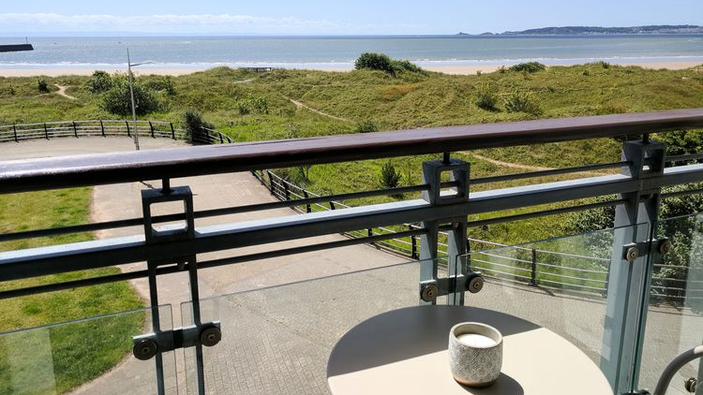


Hotel Trinity 4*
Take away menu
Monday-Sunday
Our premise is following the Government guidance regarding Cov-19, so please wear a face covering mask and keep the social distance. Thank you for cooperating.
Opening time: 11:30 am to 11 pm
Order now through:
Our website at: www.hoteltrinity/takeaway .uk.com
Walk in take away
Uber Eats Delivery app
We are cashless, sorry for any inconvenience.
For any requirements or allergies, please contact us on 01236547883, or ask to speak with one of the managers.

Slide 3

STARTERS
MAINS
SALADS
Cornish Cod 12.80
(Cauliflower, Grenoble’s, matelote sauce)
Cotswold White Chicken 13.20
(Bacon, artichoke, hazelnut, chanterelle)
T-Bone Steak 25.60
Spiced olives 4
(Mixed of black and green marinated olives)
Fried green tomato 4
(Buttermilk battered fried green tomato wedges, served with garlic aioli)
Houmous 4
Served with 2 toasted pitta bread)
Calamari 4.5
(Battered lightly and served with house made marinara)
Stuffed Tomato 4
(Stuffed Roma tomatoes on a bed of Romaine lettuce, topped with red onion and sliced cucumber)
House Salad 5
(Fresh lettuce, marinated olives, baby tomatoes, cucumber and grilled pepper)
SIDES
BURGERS
Chips 2.7
Garlic bread 2.5
Spice rice 2.7
Creamed spinach 2.6
Creamy mash 2.7
Spice beans 2.7
Mozzarella mushroom 3
Corn 2.5
DESSERTS
Wholesome Veg 5.5
(Potatoes and mix of veg double patty, vegan thousand island dressing, jalapenos)
Chicken Burger 5.5
(Crispy chicken, mozza cheese, grilled onion and tomatoes, lettuce and garlic sauce)
Beef Burger 5.5
(Beef patty, mozza cheese, onions, tomatoes, lettuce, mayo, BBQ sauce)
Double Chocolate Fudge 5.60
(Premium Vanilla Bean ice cream, raspberry custard Brule)
Vegan Apple Crumble 4
DRINKS-CANS
Soft Drinks 2.50
Coca-Cola
Fanta
Sprite Zero
Wines 250 ml 6.50
Sauvignon Blanc (Perfect with our house cod)
Cabernet (Perfect with our house steak)
Bottles 250 ml 2.50
Still Water
Sparkling Water
EXTRAS
Grilled pineapple 0.8
Feta 1.2
Grilled chicken 3.2
Grilled Haloumi 1.5
Grilled mushroom 1.5

Slide 4
References
Sykes Holiday Cottages, Driftwood 2022, Available at https://www.sykescottages.co.uk/cottage/South-Wales-Pembrokeshire-West-Pier/Driftwood-1006584.html
Bar and Restaurant, Sorrento Menu, Available at https://static-cse.canva.com/blob/567040/GoldBeigeLeavesFancyElegantRestaurantMenu.jpg
Happy Cow, Vegan Burger Kitchen, Available at
https://www.happycow.net/reviews/vegan-burger-kitchen-mumbai-144306
Charger, Charger Menu, 2019, Available at https://www.chargerburger.com/charger-menu/
The Social Salad, Home of the best salads in Hua Hin, Available at
http://www.thesocialsalad.org
Sirved, Four Star Family Restaurant, 2022, Available at
https://www.sirved.com/restaurant/peru-illinois-usa/four-star-family-
restaurant/228859/menus
The Herd Steak Restaurant, Steakhouse Menu, 2022, Available at
https://www.theherdrestaurant.co.uk

Slide 5
Olive Magazine, The best Vegan Desert, 23 January 2021, Available at
https://www.olivemagazine.com/recipes/collection/best-vegan- desserts/?fbclid=IwAR3JpSWh3oOhBDoj3kILUhF0ajvqgGMXgPMMKp80D2poeBWI6Nn_t1cH0uU
Nandos, Our Menu, 2022, Available at
https://www.nandos.co.uk/food/menu/
Wikipedia, Wines, 22 February 2022, Available at
https://en.wikipedia.org/wiki/Wine
Etsy, Vegan Design, 2022, Available at
https://www.etsy.com/uk/listing/766636397/vegan-vinyl-decal?gpla=1&gao=1&&utm_source=google&utm_medium=cpc&utm_campaign=shopping_uk_en_gb_d-craft_supplies_and_tools-party_and_gifting-labels_stickers_and_tags-stickers&utm_custom1=_k_EAIaIQobChMIxcjtt5WY9gIVF4jVCh04gw_DEAQYBCABEgI8d_D_BwE_k_&utm_content=go_12576471571_119982013575_507650078572_pla-361618678037_c__766636397engb_482643868&utm_custom2=12576471571&gclid=EAIaIQobChMIxcjtt5WY9gIVF4jVCh04gw_DEAQYBCABEgI8d_D_BwE

