Slide 1
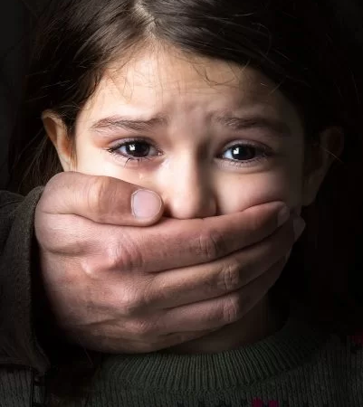

CHILD ABUSE
Student name: Unsa Pal
Student ID: 1918294
(Family Builders, 2017)

Slide 2
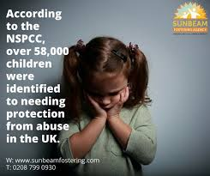
What is Child Abuse?
Child abuse can be referred to any sort of abuse like emotional, sexual or any physical mistreatment. Any neglection from an adult who has a responsibility of a child under 18 years of age also comes under as child abuse. Going through any sort of abuse at a young age can be traumatising for the young child/adolescent, which is why it is important to look out for your children at all costs and as a parent/guardian it is their duty to provide them with care, always protect them and keep them safe. Any sort of abuse a child goes through at a young age will more likely have an affect on their future too, they can suffer for long term consequences from the abuse which equals to affecting their future well-being.
“Child Physical Abuse causes in addition to immediate physical and psychological damage, effects in the child’s future life” (Annerbäck.et al.,)
The campaign that we will be discussing about is called the National Society for the Prevention of Cruelty to Children also known as the NSPCC. This campaign stands up for any sort of abuse towards children and provide all types of support to prevent any harm towards young children/people. They are a children’s charity and have been taking care of them for more than 130 years, and fight for every child to have a good childhood.
(Finnalamos 2017)

Slide 3
Task 1: Mind map
NSPCC is a campaign that helps children move on who have suffered from any sort of abuse, they also support the families and parents in caring for their child and helping them all settle together as a family. The NSPCC also support communities to help prevent any incidents from happening and raise awareness within communities of child abuse or any sort abuse happening.
“Child abuse potential has been linked with harsh parenting style & more frequent use of parent-child aggression including abusive tactics” ( Rodriguez 2010)
In relations to the NSPCC, child abuse is their main subject. On their website they provide help for all sorts of problems related to abuse and help individuals with settling in with their family. NSPCC have been raising money to which they ensure that every £1 is towards young children, families, helplines and their awareness campaigns
NSPCC & Child Abuse
Neglection is the most common form of child abuse and is mostly shown by parents or guardians. In often cases when a child feels they are getting neglected at a young age they feel mentally tortured as they are not receiving the love and affection they deserve at a young age, which specifically effects their mental health and clashes with a child’s education. Lack of attention from home can affect an individual’s daily routine making them being upset and feeling lonely. Isolating themselves from everyone.
Additional support for children suffering from abuse can be providing them residential care homes, go through counselling to improve their mental health and have mentoring. All the support mentioned above is also provided by the NSPCC as they intend to guide individuals to the right path.
My reason to support this campaign is because I am passionate about the work and services they provide towards young children/people. Their real aim to spread positivity and happiness for everyone including the ones who have been through traumatic experiences. Seeing this campaign’s dedication and hard work towards the community motivates me as an individual to support and raise enough awareness for children and young adults suffering from abuse. For my future career choices, seeing the support they provide inspires me and makes me become more passionate about helping people recover from all types of abuse.

Slide 4
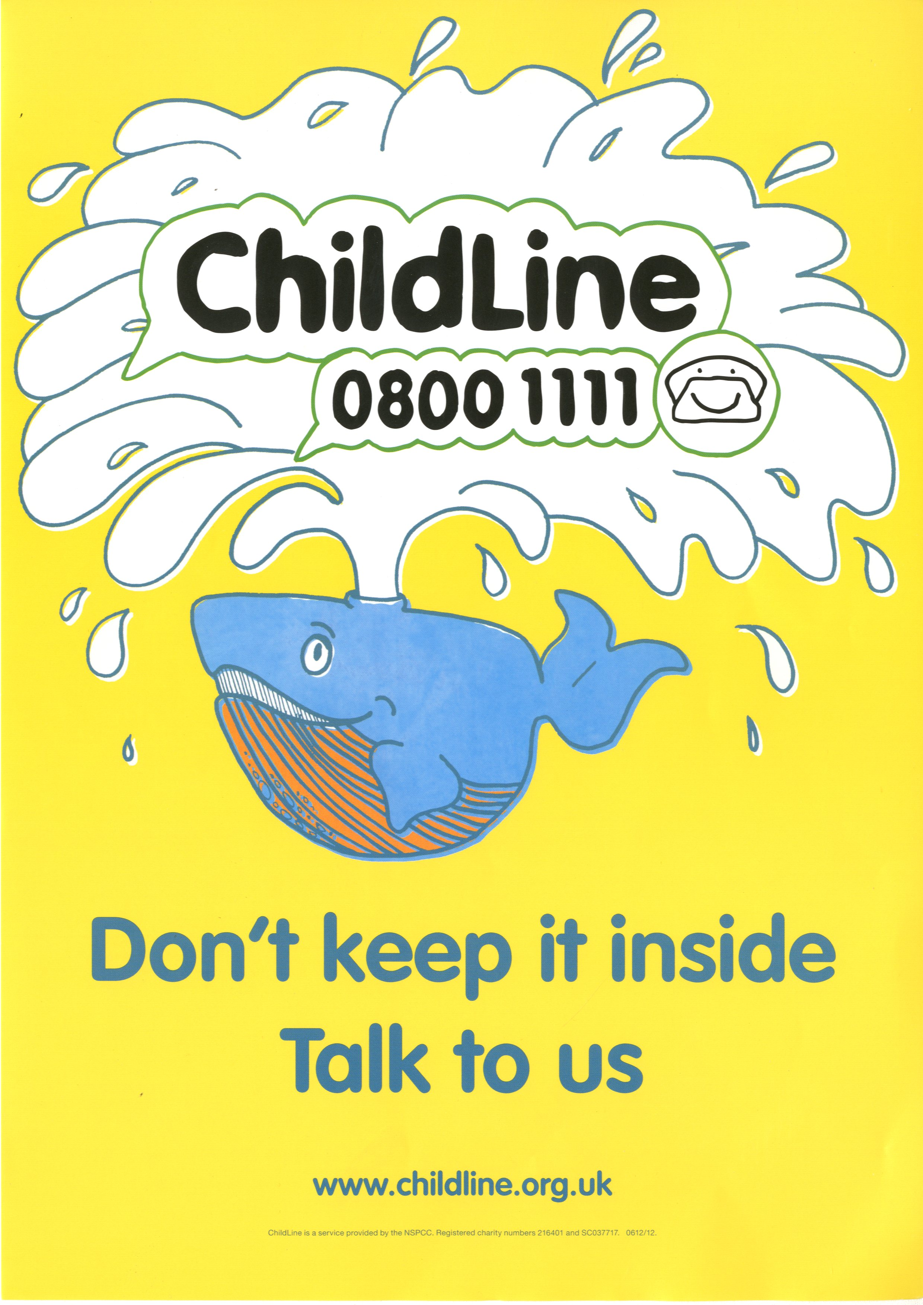

Task 3: Pitch Style Speech
Good Morning! My name is Unsa Pal and today I will be talking you through a well-known campaign named NSPCC and how beneficial and successful this campaign has become over the years for the young generation who may be suffering from any sort of abuse from their family members, guardians or anyone. My involvement into this campaign became more active when I had taken part into learning more about the behaviour towards child abuse and seeing the NSPCC’s involvement and dedication towards children and helping their homes become a better place, had made me become more passionate towards this issue. It has motivated me to make awareness of this issue as much as I can. For the children suffering everyday, having mental health issues and for the families that are being broken down. To save them all.
In 2006, another company that takes a stand against child abuse for the past 36 years called ChildLine, had merged with the NSPCC. They have a helpline (also being free) which is open 7 days a week with child counsellors available and are more than happy to offer help to all the individual’s out there who are struggling/going through a hard time due to family issues. If not phone calls, they are available via email 1-2-1 chats online. Providing the best help, they can and to make sure anyone contacting them is feeling safe and secure. “Childline is here for every child and young person” (NSPCC,2014). The NSPCC’s website provides all the information we need to know about different types of abuse an individual can go through, what resources are out there to prevent any incidents from happening and how you can create awareness and save a child from suffering. Other than child abuse, the NSPCC take encounter of any other issues related to children, for example parents being concerned about their child getting into underage drugs or alcohol, or support for the parents who may be going under family issues, including issues like divorce or separation which would most likely have a massive effect on their child’s mental health. This campaign is ready to support everyone out there in all their problems, providing you with different services in different ways. As a society, we can all create awareness for the children who are suffering from abuse, their childhood is getting taken away from them.
Thank you for listening and attending my talk!
(www.hpac.cdd.nhs.uk,n.d.)
(Academy, 2019)

Slide 5

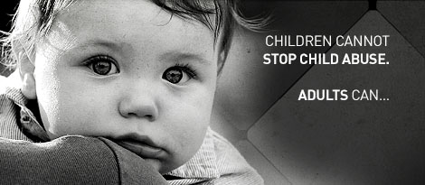
Task 5: Conference Poster:
KEEP YOUR CHILD SAFE!
It shouldn’t hurt to be a child! Be aware of the incidents and cruelty that can happen to your child and raise enough awareness around you!
“The National Society for the Prevention of Cruelty to Children (NSPCC) is the UK’s leading charity specialising in child protection and prevention of cruelty to children” (Brown, n.d.)
This campaign is all about creating awareness and speaking up for those children are going through a traumatic childhood. We are here to make a change!
Primary audience: parents and carers of children aged between 5-11 years.
Our main aim is to influence parents and carers to interact with their child , make them feel comfortable and always make sure they are feeling safe around others. We want the younger generation to feel confident enough to speak up for something they are not feeling safe and comfortable with!
The types of child abuse everyone should be aware of:
Physical abuse
Emotional abuse
Sexual abuse
Neglection
Look over on our website for more information on how to keep your child secure and aware!
For information please visit: https://www.nspcc.org.uk/
Notice an unhappy child? Want to help in creating awareness? Contact the NSPCC on 0207825 2505
Or
Childline: 0800 1111
(Qlocal.co.uk, 2017)

Slide 6

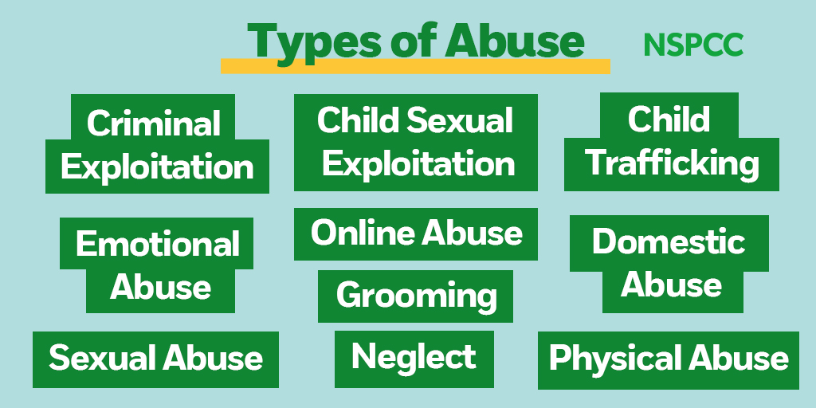
Task 4: Leaflet
NSPCC
The Children Act 1989 provides the framework for child protection in England
The key elements are the child’s welfare, the expectations and requirements around duties of care to children. Any child related legislation will always mention on how important it is to always keep a child out of risk. Any minor/major incident a child witnesses or goes through would be affecting their future abilities, it can mentally affect them; to prevent any PTSD ( Post Traumatic Stress Disorder), parents and guardians should always be aware of what is going on their child’s life.
Every childhood is worth fighting for!
Who Are we?
NSPCC is here to end cruelty to children by influencing legislations, policies, attitudes and behaviours for the benefit of children and young people. “Our service include the NSPCC helpline, for adults worried about a child, and Childline, the UK’s free, confidential helpline for children and young people” (Brown, n.d.).
The NSPCC have produced a rule, named The Underpants Rule:
This rule teaches a child that their body only belongs to them. A child has the right to say no, and that they should always tell an adult if they are worried or upset. At a young age children can be manipulated and forced into doing sexual things, that would later affect their mental health. It is highly important we stay aware and interact with our children and make sure they are safe.
The Department for Education (DfE) is responsible for the child protection in England. They have set out policies and legislations on how the child protection should work out. Any local safeguarding partners are in duty for child protection policy and the procedure.
(Twitter, n.d.)
(Twitter, n.d.)

Slide 7
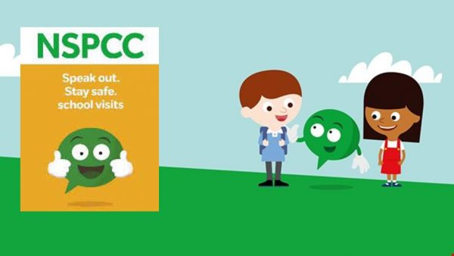
NSPCC
Contact us!
Helpline: 080800 5000
Email: help@nspcc.org.uk
Twitter: NSPCCLearning
Facebook: NSPCC
The smallest donation or awareness you make will make a big impact an on-individual’s life, save a child from suffering from abuse TODAY. It will make a change.
Child abuse is usually hidden from view, you will never be able to count the number of children being abused, however there are various types of sources that include data from services who work with children, and they research into a children’s and adult’s self-reported abuse; when it had happened and what sort of abuse. From this it helps build a picture of the scale of abuse going around.
(St.Francis, 2019)

Slide 8
References:
Annerbäck, E.-M. ., Sahlqvist, L., Svedin, C.G., Wingren, G. and Gustafsson, P.A. (2012). Child physical abuse and concurrence of other types of child abuse in Sweden—Associations with health and risk behaviors. Child Abuse & Neglect, 36(7-8), pp.585–595.
Academy, P. (2019). NSPCC - Speak out and Stay Safe. [online] Park Academy. Available at: https://www.parkacademyboston.net/nspcc-speak-out-and-stay-safe/ [Accessed 1 Jul. 2021].
Brown, J. (n.d.). The NSPCC Underwear Rule Campaign Encouraging and enabling parents to talk with children to help keep them safe Head of Strategy, Sexual Abuse. [online] . Available at: https://rm.coe.int/16804711ab [Accessed 1 Jul. 2021].
finolamoss (2019). NSPCC- Child abuse, Politics and Power? [online] finolamoss. Available at: https://finolamoss.wordpress.com/2019/08/23/nspcc-child-abuse-politics-and-power/ [Accessed 6 Jul. 2021].
Family Builders. (2017). Recognizing and reporting child abuse. [online] Available at: https://familybuildersok.org/2017/01/recognizing-and-reporting-child-abuse/.
NSPCC (2014). Childline. [online] NSPCC. Available at: https://www.nspcc.org.uk/keeping-children-safe/our-services/childline/.
Qlocal.co.uk. (2017). Children affected by domestic abuse rise in referrals from NSPCC in the North West. [online] Available at: https://ormskirk.qlocal.co.uk/ormskirk/news_list/Children_affected_by_domestic_abuse_rise_in_referrals_from_NSPCC_in_the_North_West-55024372.htm [Accessed 3 Jul. 2021].
St. Francis. (2019). NSPCC Stay Safe Speak Out Programme. [online] Available at: https://st-francis.wilts.sch.uk/news/nspcc-stay-safe-speak-out-programme/ [Accessed 8 Jul. 2021].
Twitter. (n.d.). https://twitter.com/blackwell_de55/status/1049579915652358144. [online] Available at: https://twitter.com/blackwell_de55/status/1049579915652358144 [Accessed 8 Jul. 2021].
Twitter. (n.d.). https://twitter.com/nspcc/status/1360255112506187777. [online] Available at: https://twitter.com/nspcc/status/1360255112506187777 [Accessed 7 Jul. 2021].
Rodriguez, C.M. (2010). Parent–Child Aggression: Association With Child Abuse Potential and Parenting Styles. Violence and Victims, 25(6), pp.728–741.
www.hpac.nhs.uk. (n.d.). Resource Details for id 15229. [online] Available at: https://www.hpac.nhs.uk/HPAC//MoreDetailsv4.jsp?id=15229&subjectId=30&referrer=https://www.hpac.nhs.uk/HPAC/BrowseSearch.jsp?subjectId=30&typeId=P&submit=true&sort=relevance&page=2&viewLogin=true&sitename=www.hpac.cdd.nhs.uk&dsn=hpdurhamdarlington?sitename=www.hpac.cdd.nhs.uk [Accessed 27 Jun. 2021].

