Slide 1
Are students confident in using technology to collaborate?
1) Lebbeus 2) Keria 3) miria

Slide 2
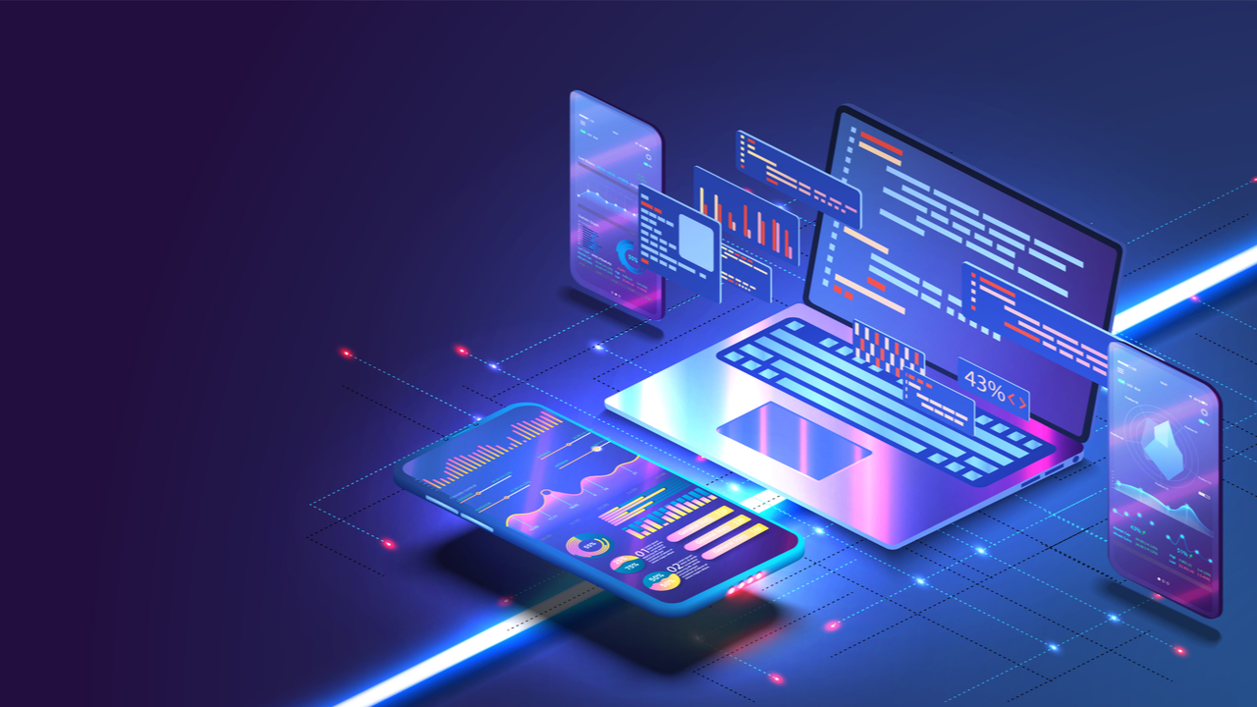
introduction
Research question: are student confident in using technology to collaborate?
In the modern world technology plays a vital part in our everyday life (Home et al., 2022).
WHY?

Slide 3

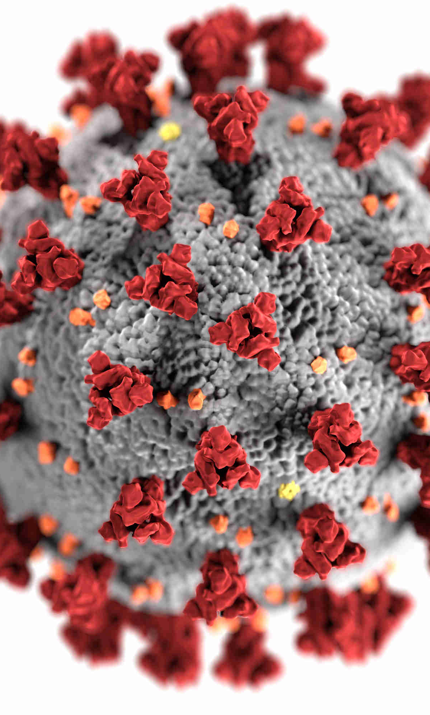
rationale
Before covid= less usage of technology (Home et al., 2022)
More job opportunities (Home et al., 2022)
BuiltIn outline that 92% of teachers understands the importance of technology.

Slide 4



rationale
59% of middle school clams technology has made their grades better (Home et al., 2022)
No equality (Home et al., 2022)
Risk on depending only on artificial intelligence. (Home et al., 2022)

Slide 5
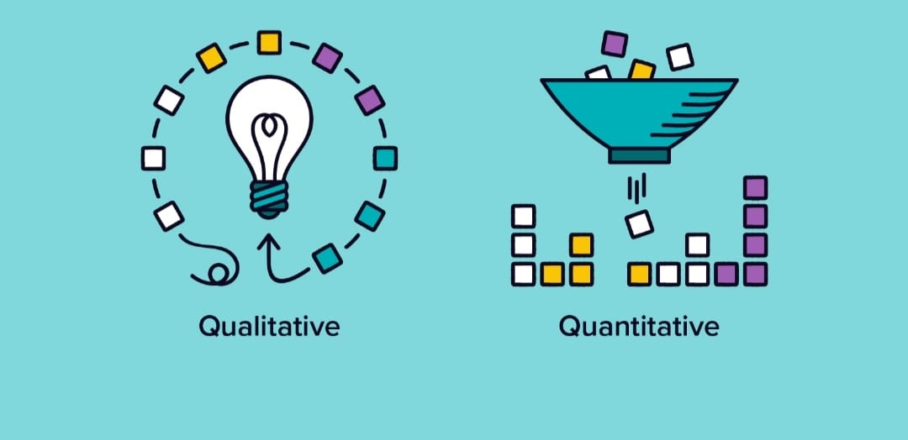
Proposed method
Quantitative and qualitative method using primary and secondary resources by personal, third parties and by some research conducted by Built In (Home et al., 2022).

Slide 6

Ethical considerations
Equality
Security
addiction

Slide 7
Hypothesis
(Ph.D., 2022) states that technology can be linked to improve learning which makes them more confidents
Infants learn more by being more physical and interacting with technology can have a bad effect on their development. (Ph.D., 2022)

Slide 8

Conclusion/summary
Students are more confident in using technology as it make it easier to accumulate knowledge.
In the new age it is a must for students to have the skills to use technology

Slide 9
Reference list
1. (Home et al., 2022) Home, O., Home, S., Teaching, O., Leadership, O., Leadership, O., Aid, T., Tuition, M., Tuition, M. and Tuition, E., 2022. How Important Is Technology in Education? Benefits, Challenges, and Impact on Students. [online] Soeonline.american.edu. Available at: <https://soeonline.american.edu/blog/technology-in-education> [Accessed 27 June 2022].
2. (Ph.D., 2022) Ph.D., S., 2022. Is technology good or bad for learning?. [online] Brookings. Available at: <https://www.brookings.edu/blog/brown-center-chalkboard/2019/05/08/is-technology-good-or-bad-for-learning/> [Accessed 27 June 2022].

