Slide 1
The Support Vector Machine
(SVM)
A versatile and capable classifier

Slide 2
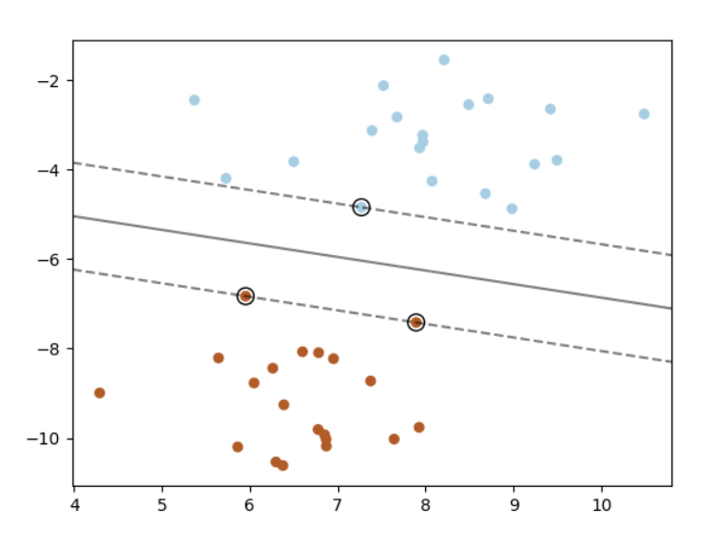
Support Vector Machines
This diagram illustrates the idea behind an SVM.
https://scikit-learn.org/stable/auto_examples/svm/plot_separating_hyperplane.html#sphx-glr-auto-examples-svm-plot-separating-hyperplane-py

Slide 4
Support Vector Machines
This diagram illustrates the idea behind an SVM.
The black line separates the classes and stays as far away from the training instances of each class as possible.

Slide 5
Support Vector Machines
This diagram illustrates the idea behind an SVM.
The black line separates the classes and stays as far away from the training instances of each class as possible.
The dotted lines represent the widest possible “street” between the classes

Slide 6
Support Vector Machines
A SVM tries to fit the widest possible street between the classes.

Slide 7
Support Vector Machines
A SVM tries to fit the widest possible street between the classes.
This is called large margin classification.
The instances at the edge of each class cluster (circled) help define the width of the street. These are called the support vectors.

Slide 8
Support Vector Machines
Adding new instances of training data “off the street” does not affect the decision boundary at all.
It is fully determined (supported) by the support vectors.

Slide 9
Support Vector Machines
Beware: SVMs are sensitive to scaling so normalize your features before use.
The big idea is we are separating classes of a p-dimensional dataset with a (p-1) dimensional hyper-plane.

Slide 10
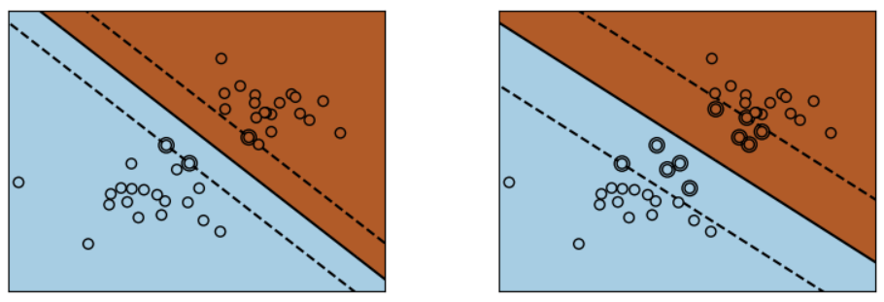
Support Vector Machines https://scikit-learn.org/stable/auto_examples/svm/plot_svm_margin.html
Hard Margin
No instances are allowed on the street
Potential for overfitting here.
Soft Margin
Widening the street allows instances to exist on the street. Regularises the SVM – allowing better generalisation.

Slide 11
Support Vector Machines https://scikit-learn.org/stable/auto_examples/svm/plot_svm_margin.html
Hard Margin
No instances are allowed on the street
Potential for overfitting here.
Soft Margin
Sk-learn svm classifier allows the margin to be adjusted using the C parameter. Reducing the value of C increases regularization- it generalizes better.

Slide 12
Non-Linear SVM classification
Linear SVMs separate classes with a hyper plane. The classes are said to be linearly separable.
Sometimes classes overlap each other and so are not linearly separable.
SVMs can be extended to fit classes non-linearly by adding extra dimensions to your dataset (extra features).

Slide 13


Non-Linear SVM classification
-3 -2 -1 0 1 2 3 $x$ Non-linearly separable data
$$x^{2}$$
Add an extra dimension
-3 -2 -1 0 1 2 3 $x$ Linearly separable data

Slide 14
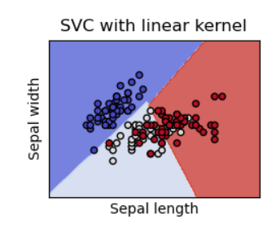
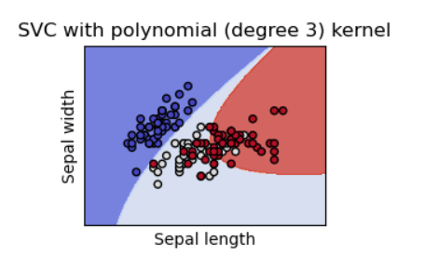
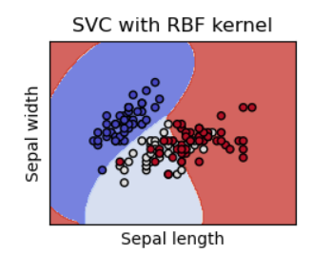
Kernels
Linear Polynomial Radial Basis Function
https://scikit-learn.org/stable/modules/svm.html

Slide 15
Common transformations used.
Dot product
Polynomials
Radial basis function

Slide 16
Kernel Trick
Applying these transformations of n –dimensional datasets into a higher dimensional space makes the transformed dataset linearly separable. Yay! But…
It takes a lot of calculations and sometimes you need to map your dataset into a very large number of dimensions. Boo!
The Kernel trick (see Geron) allows us to short cut the calculations.

Slide 17
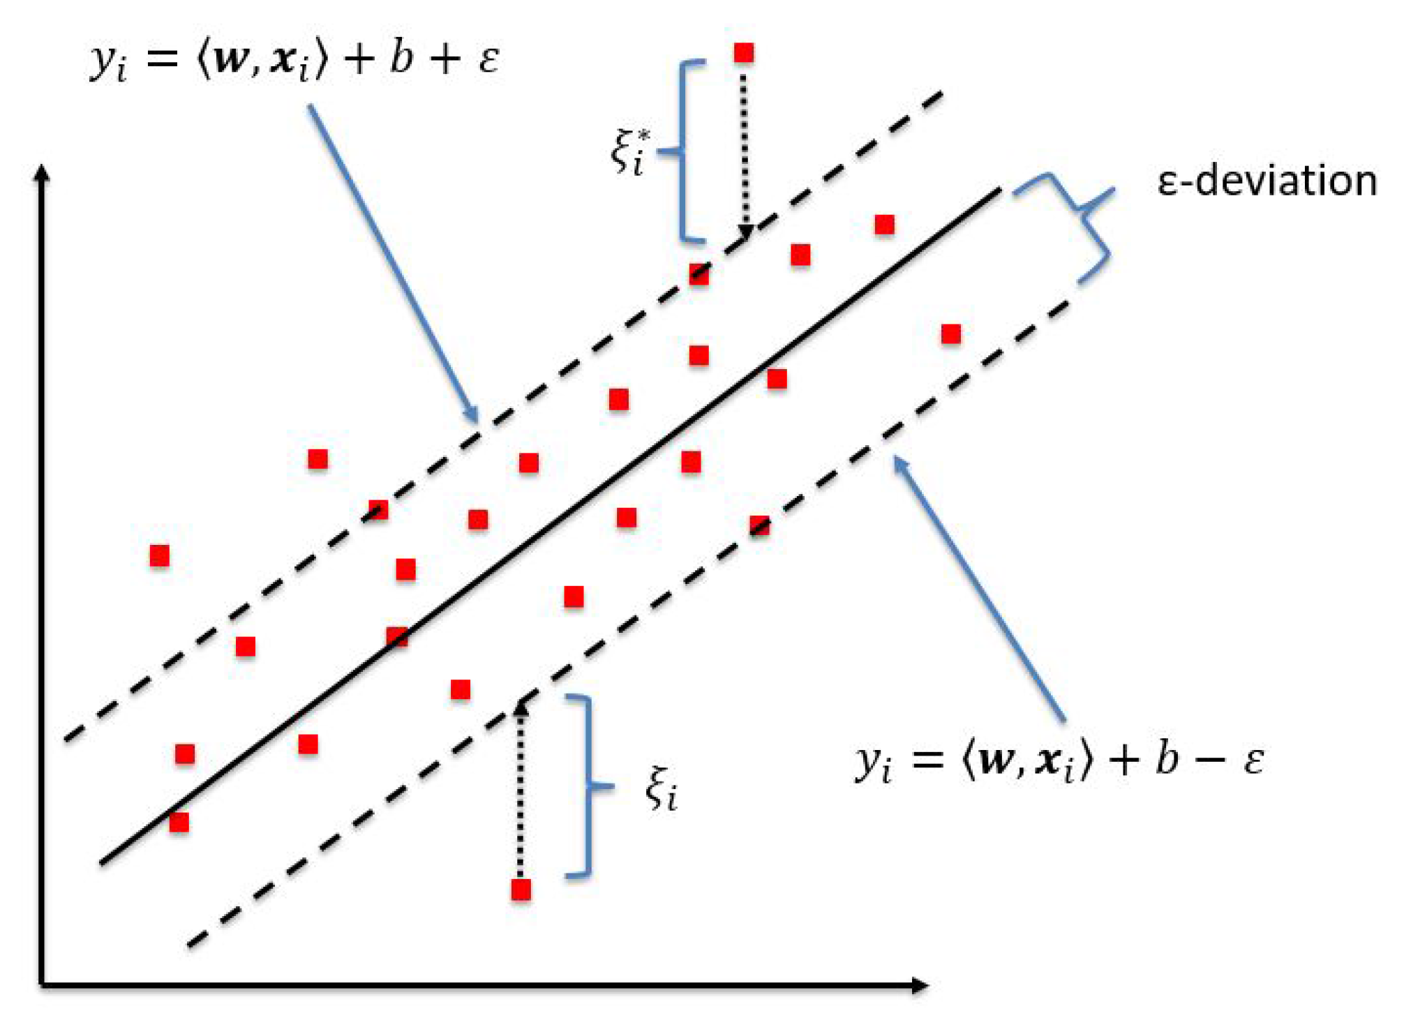
Regression using SVMs
Unlike logistic regression and other classifiers, SVMs give a binary result - True or False.
If we want to use SVMs as a regressor then we can invert the problem. Find the street that encloses data and the decision boundary is the regressed curve.
Kleynhans, T.; Montanaro, M.; Gerace, A.; Kanan, C. Predicting Top-of-Atmosphere Thermal Radiance Using MERRA-2 Atmospheric Data with Deep Learning. Remote Sens. 2017, 9, 1133.

