Slide 1
Module Name: Contemporary Themes in the Hotel and Hospitality Sector
Module Code: BMIH6001
Assignment Title: Presentation
Student Name: Ana Nica
Student ID:
Component 2

Slide 2
Table of Contents
Introduction …………………………………………………………………………..3
Literature Review …………………………………………………………………4
Method and Theme Impact Analysis ……………………………………………..7
Conclusion ……………………………………………………………………………………..9
Recommendations …………………………………………………………………10
References ……………………………………………………………………………………11

Slide 3
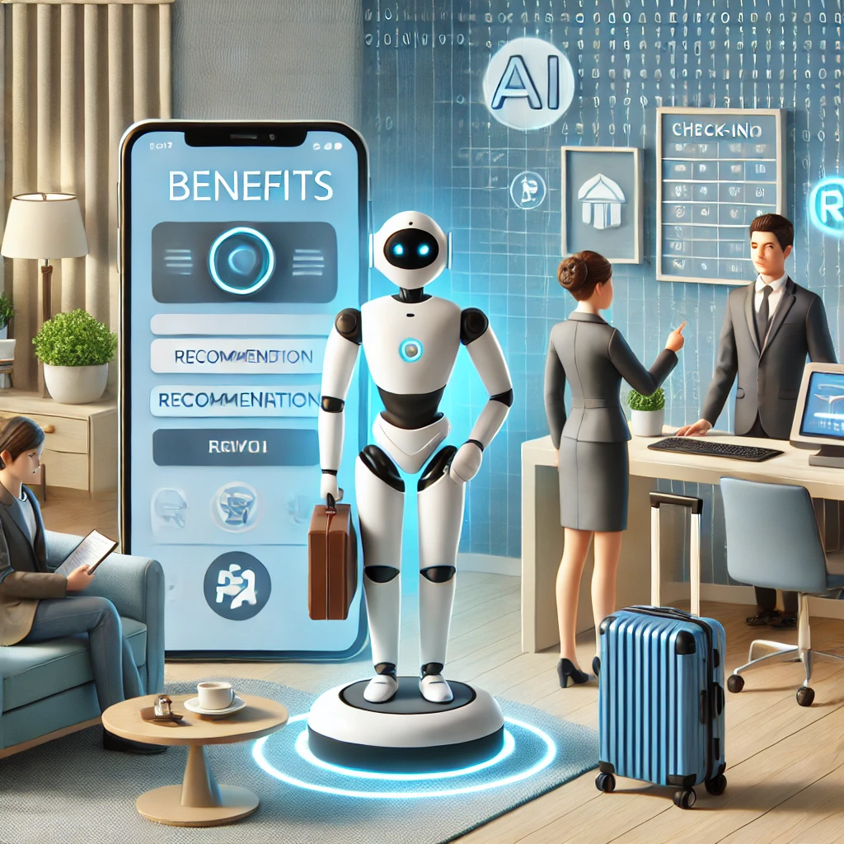
Introduction
Artificial Intelligence (AI) is one of the latest trends in business dynamics which plays a crucial role in accelerating business operations and optimising various services.
This presentation will deal with the theme of AI in the hospitality and tourism industry for the reason of increasing AI trends in the industry.
The first part of this study has provided an overview of AI in the industry and conducted a literature review for concise illustration.
Notes:
Notes
Artificial Intelligence (AI) is one of the latest trends in business dynamics which plays a crucial role in accelerating business operations and optimising various services. This presentation will deal with the theme of AI in the hospitality and tourism industry for the reason of increasing AI trends in the industry. The first part of this study has provided an overview of AI in the industry and conducted a literature review for concise illustration. In the review, aspects such as AI-driven personalisation, its impact and theoretical analysis have been included. The study has also talked about the PEST factor impacting this trend. This presentation will conduct concise research on the topic and provide several deep insights into the topic.

Slide 4

Literature Review
Description of AI-enabled personalisation
Hospitality organisations are focused on integrating personalisation features in the customer service process.
The successful adoption of AI tools enables modern hotels and resorts to predict consumer demands and modify the offerings of services.
The use of smart tools like AI-powered customer assistance can enable the organisation to attract a wide range of guests and satisfy them as well.
(Lytras and Visvizi, 2021)
Notes:
Notes
Specific area: AI-driven personalization in improving guest experience
Description of AI-enabled personalisation
The growth of the tourism and hospitality industry is reliant on guest satisfaction and loyalty. Hospitality organisations are focused on integrating personalisation features in the customer service process. As stated by Lytras and Visvizi (2021), hotels use different AI-powered technologies such as natural language processing, data analytics and machine learning. The successful adoption of AI tools enables modern hotels and resorts to predict consumer demands and modify the offerings of services. For instance, Hilton Hotel has implemented an AI-driven virtual assistant named Connie to improve the guest service process. It offers tailored recommendations to the guests regarding the dining facilities, local tour options and other services. The implementation of AI enables hotels to eliminate repetitive tasks and enhance scalability while introducing cost-cutting measures. The use of smart tools like AI-powered customer assistance can enable the organisation to attract a wide range of guests and satisfy them as well.

Slide 5

Contd…
Assessing different areas of AI-based personalisation
Improving marketing capacities: AI-enabled tools guide marketing managers to optimise revenue by analysing the market demands and pricing strategies of competitors.
Consumer loyalty using AI: The hotels in the industry can improve customer satisfaction scores by introducing AI-enabled room services, accommodation and other services.
Customer feedback and sentiment analysis: One of the major AI trends in the hospitality industry is an analysis of consumer sentiments by assessing complaints and queries regarding service quality.
(Iyelolu et al., 2024)
Notes:
Notes
Assessing different areas of AI-based personalisation
Improving marketing capacities: According to Iyelolu et al. (2024), marketers use AI-driven algorithms for gathering real-time insights from customer data. It is helpful for marketers to introduce the right marketing strategies and pricing policies as well. AI-enabled tools guide marketing managers to optimise revenue by analysing the market demands and pricing strategies of competitors.
Consumer loyalty using AI: The hotels in the industry can improve customer satisfaction scores by introducing AI-enabled room services, accommodation and other services. For example, InterContinental Group introduces different loyalty programs for improving guest engagement rates and accelerating repeat purchases.
Customer feedback and sentiment analysis: One of the major AI trends in the hospitality industry is an analysis of consumer sentiments by assessing complaints and queries regarding service quality. As per the opinion of Lytras and Visvizi (2021), the delivery of quality hospitality services depends on AI-powered sentiment analysis. Different large hotels like Marriott are focused on using AI algorithms for addressing customer complaints and minimising their waiting times. The customer service providers can resolve customer queries and improve conversation rates as well through using AI-driven insights.

Slide 6
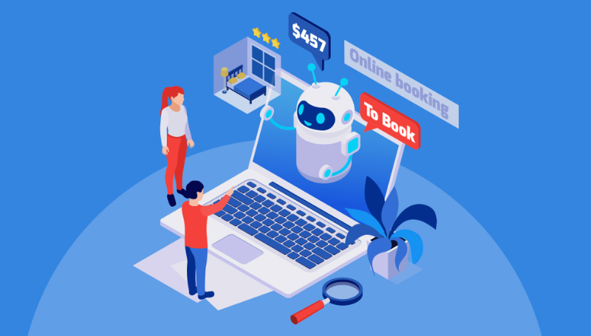
Contd…
Strategies to enhance AI-directed personalisation
Providing training: Hotels must deliver mentorships and ongoing training programs to the marketing managers to enhance their knowledge and skills.
The application of the TAM Model: The professionals of hotels must focus on adhering to the principles of the Technology Acceptance Model for managing guest services.
The use of a Resource-based view: Managers of the hospitality organisation may improve their strategic capabilities by implementing resource-based views.
(Na et al., 2021)
Notes:
Notes
Strategies to enhance AI-directed personalisation
Providing training: Hotels must deliver mentorships and ongoing training programs to the marketing managers to enhance their knowledge and skills. The management team should design and implement suitable training courses for the improvement of the technical knowledge of staff.
The application of the TAM Model: According to Na et al. (2021), the professionals of hotels must focus on adhering to the principles of the Technology Acceptance Model for managing guest services. Through using this model, hotel managers can understand the perceived usefulness of targeted guests.
The use of a Resource-based view: According to Gerhart and Feng (2022), the managers of the hospitality organisation may improve their strategic capabilities by implementing resource-based views. This theory can be helpful for hotels to differentiate their services and products considering the competitor's performances. The application of this model can guide the hotels to improve operational capabilities and business efficiency. The right use of resources on the AI implementation can enable the organisation to foster innovation and improve the market position of the brand.

Slide 7

Method and Theme Impact Analysis
Political Factor: The UK government has leveraged data protection activities and laws such as GDPR in order to enhance business practices and stability.
Economic Factor: Hospitality businesses such as TUI Group have integrated various AI-driven tools and technology to optimise their operational cost and enhance the experience of customers.
Social Factor: In order to cater to this demand, Hilton Hotels has incorporated an AI-enabled platform, named ‘Connie’. This platform promotes automated management facilities and enhances the guest experience (Grandey & Morris, 2023).
(Grandey & Morris, 2023)
Notes:
Notes
Political Factor: Political factors underpin the strategies and initiatives adopted by the UK government affecting business operations of businesses in the hospitality industry. For instance, the UK government has leveraged data protection activities and laws such as GDPR in order to enhance business practices and stability. It emphasises data protection and security in the hospitality industry which helps maintain transparency and accountability. Considering these regulations and laws, Hilton Hotels has adopted a security framework to ensure data security. The company uses AI and robotics including Chatbots and other AI-enabled solutions to enhance customer support. It benefits the business by enabling real-time threat detection and identifying suspicious activities. However, the threat of data breaches and biases also increases because of AI and other AI-driven tools.
Economic Factor: Economic factors are those elements which impact the financial aspects of hospitality businesses. Inflation and corporate tax are some of the crucial elements. The inflation rate has significantly increased in the past few years and challenged business profitability. Hospitality businesses such as TUI Group have integrated various AI-driven tools and technology to optimise their operational cost and enhance the experience of customers. For instance, TUI Group has employed AI tools in order to streamline customer service. This has helped the company increase the efficiency and productivity of employees and boost the overall customer experience (tuigroup, 2024). However, because of technical complexity, the company also faces issues in its operations.
Social Factor: Social factors cater to socio-cultural elements affecting the business operations of the hospitality industry. Sustainability is one of the major industrial trends in hospitality and consumers prefer accessing sustainable and eco-friendly services. In order to cater to this demand, Hilton Hotels has incorporated an AI-enabled platform, named ‘Connie’. This platform promotes automated management facilities and enhances the guest experience (Grandey & Morris, 2023). Yotel Hotels has also integrated a tool called ‘Yobot’ which also streamlines the service of the business and enhances guest experience. However, these applications and tools have security concerns which adversely impact the experience of customers and challenge their ethical demand for ethical operations.

Slide 8

Contd…
Technological Factor: Trafalgar has effectively integrated modern technologies such as Nano needle pod, AI-driven contactless services and robotics to execute many operational tasks.
Environmental Factor: British Airways has integrated AI tools, ML and automation which helps the business minimise its carbon emissions by streamlining its operation (britishairways, 2024).
Legal Factor: As an example, in 2018, British Airways faced legal trouble because it failed to secure the personal data of its customers and suffered a cyberattack (bbc, 2020).
(bbc, 2020)
Notes:
Notes
Technological Factor: Technological factors are some of the most driving tools in the hospitality industry. Tools such as artificial intelligence, robotics, cloud computing and big data are broadly impacting the industry and businesses are integrating these technologies to boost tourists' experience. For instance, Trafalgar has effectively integrated modern technologies such as Nano needle pod, AI-driven contactless services and robotics to execute many operational tasks. It streamlines the operational process and benefits the company collectively. However, as the integration of these technologies has benefited the company, it also poses various challenges. The high integration costs and maintenance complexities are issues impacting the overall experience of the company as well as customers (Sunde-Brown, 2020).
Environmental Factor: Environmental factors broadly impact the operations of businesses operating in the hospitality industry. These factors cause negative consequences such as climate change and global warming which impacts businesses as well as different stakeholders. Artificial intelligence and AI-powered tools can have potential impacts on the mitigation of environmental concerns. For instance, these technologies can help streamline operations and provide a seamless experience for both guests and staff. Moreover, businesses can also increase their operation efficiency which leads to reduced carbon emissions. For instance, British Airways has integrated AI tools, ML and automation which helps the business minimise its carbon emissions by streamlining its operation (britishairways, 2024). Regardless of this, the business faces issues because of outdated infrastructure and poor data quality which reduce its effectiveness.
Legal Factor: Legal factors imply rules and regulations that businesses have to comply with that are determined for them. For instance, the UK government has implemented the Data Protection Act of 2018 which encourages businesses to safeguard data privacy. Hospitality businesses are required to follow the guidelines mentioned in the act, especially while leveraging AI technologies in their operations. It can provide legal benefits to businesses and ensure business ethics. However, in case businesses fail to comply with the rules, they may face legal lawsuits. As an example, in 2018, British Airways faced legal trouble because it failed to secure the personal data of its customers and suffered a cyberattack (bbc, 2020).

Slide 9

Conclusion
Concluding the discussion, it has been observed that AI and AI-powered have been a key driving force in the hospitality and tourism industry.
In this context, this presentation has evaluated various literature sources to gain a deep insight into the subject.
Moreover, conducting PESTEL analysis, the theme of AI in tourism and hospitality has been critically evaluated in which various factors such as political, economic and social factors have been considered.
Notes:
Notes
Concluding the discussion, it has been observed that AI and AI-powered have been a key driving force in the hospitality and tourism industry. They impact the internal and external factors of a business. In this context, this presentation has evaluated various literature sources to gain a deep insight into the subject. Moreover, conducting PESTEL analysis, the theme of AI in tourism and hospitality has been critically evaluated in which various factors such as political, economic and social factors have been considered.

Slide 10

Recommendations
Based on the above findings, it has been found that data security and privacy concerns are some of the major challenges that can adversely impact the use of AI in hospitality and tourism.
However, it can be recommended that the industry put efforts into integrating multilayered security while leveraging AI.
It can ensure a comprehensive strategy to protect and preserve data while implementing AI-powered tools and technologies (Alles, 2024).
(Alles, 2024)
Notes:
Notes
Based on the above findings, it has been found that data security and privacy concerns are some of the major challenges that can adversely impact the use of AI in hospitality and tourism. It is important for businesses to make effective strategies to negate this issue. However, it can be recommended that the industry put efforts into integrating multilayered security while leveraging AI. They can consider multiple encryptions including network security, data protection and cloud security. It can ensure a comprehensive strategy to protect and preserve data while implementing AI-powered tools and technologies (Alles, 2024).

Slide 11
References
Alles, M., (2024). Cybersecurity In The Aftermath: Rethinking Strategies After The Global IT Outage. [Online] Available at: https://www.forbes.com/councils/forbesbusinesscouncil/2024/09/17/cybersecurity-in-the-aftermath-rethinking-strategies-after-the-global-it-outage/ [Accessed 12 February 2025].
bbc, (2020). British Airways fined £20m over data breach. [Online] Available at: https://www.bbc.com/news/technology-54568784 [Accessed 12 February 2025].
britishairways, (2024). British Airways unveils new website and app as part of its £7bn transformation plan. [Online] Available at: https://mediacentre.britishairways.com/pressrelease/details/19166#:~:text=The%20airline%20is%20investing%20%C2%A3,departures%20and%20respond%20to%20disruption. [Accessed 12 February 2025].
Gerhart, B. and Feng, J., (2021). The resource-based view of the firm, human resources, and human capital: Progress and prospects. Journal of management, 47(7), pp.1796-1819.
Grandey, A. A. & Morris, K., (2023). Robots Are Changing the Face of Customer Service. [Online] Available at: https://hbr.org/2023/03/robots-are-changing-the-face-of-customer-service [Accessed 12 February 2025].
Notes:
Notes
Alles, M., (2024). Cybersecurity In The Aftermath: Rethinking Strategies After The Global IT Outage. [Online] Available at: https://www.forbes.com/councils/forbesbusinesscouncil/2024/09/17/cybersecurity-in-the-aftermath-rethinking-strategies-after-the-global-it-outage/ [Accessed 12 February 2025].
bbc, (2020). British Airways fined £20m over data breach. [Online] Available at: https://www.bbc.com/news/technology-54568784 [Accessed 12 February 2025].
britishairways, (2024). British Airways unveils new website and app as part of its £7bn transformation plan. [Online] Available at: https://mediacentre.britishairways.com/pressrelease/details/19166#:~:text=The%20airline%20is%20investing%20%C2%A3,departures%20and%20respond%20to%20disruption. [Accessed 12 February 2025].
Gerhart, B. and Feng, J., (2021). The resource-based view of the firm, human resources, and human capital: Progress and prospects. Journal of management, 47(7), pp.1796-1819.
Grandey, A. A. & Morris, K., (2023). Robots Are Changing the Face of Customer Service. [Online] Available at: https://hbr.org/2023/03/robots-are-changing-the-face-of-customer-service [Accessed 12 February 2025].
Iyelolu, T.V., Agu, E.E., Idemudia, C. and Ijomah, T.I., (2024). Leveraging artificial intelligence for personalized marketing campaigns to improve conversion rates. International Journal of Engineering Research and Development, 20(8), pp.253-270.

