Slide 1
This Digital Journey that matters to me
Stephen Byrne
02/07/2026

Slide 2
how my digital skills have developed
A NEW BEGINNING
A CONSTANT STRUGGLE
THE 3 FINGER MAGIC
ILL GET THERE IN THE END

Slide 3
how my digital skills have developed
ROBERT THE BRUCE
STUDENT SERVICES
PELENTY OF ENCOURAGEMENT

Slide 4
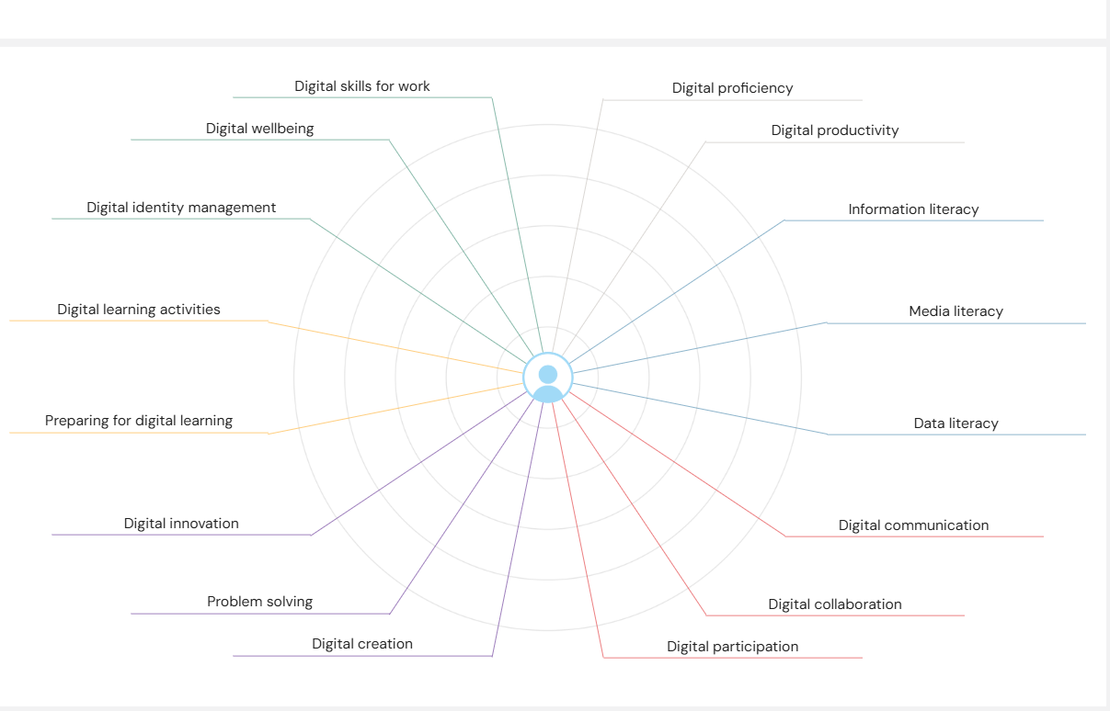
JISC Digital Capability assessment & action plan
Notes:
Digital Proficiency

Slide 5
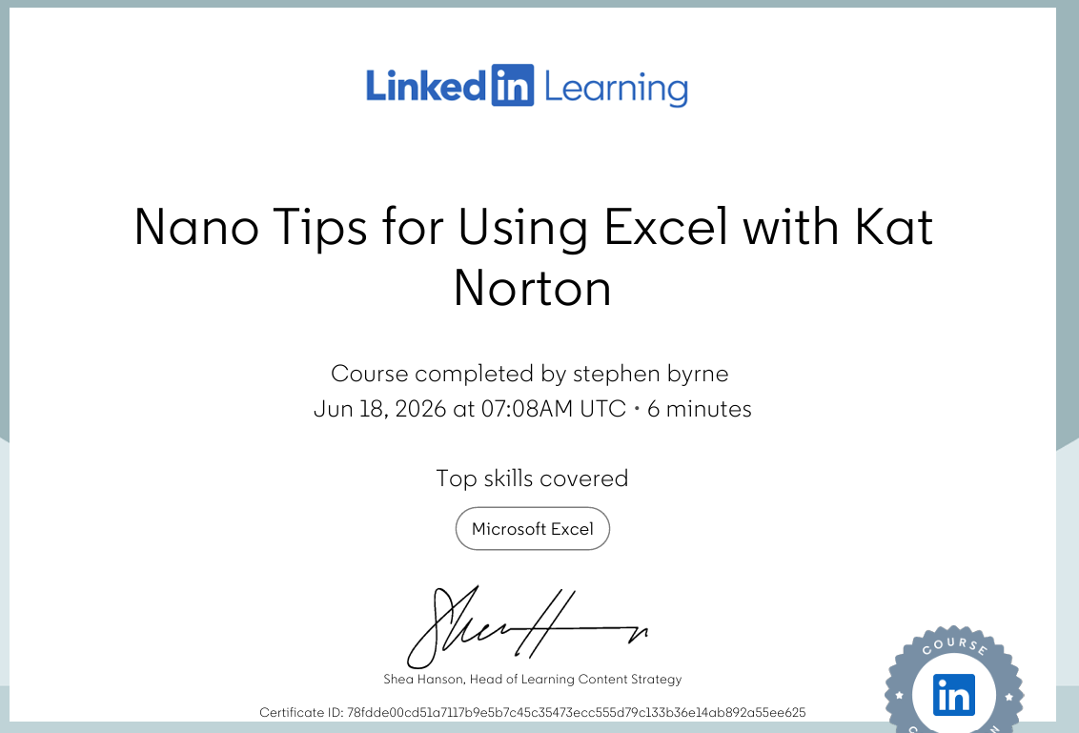
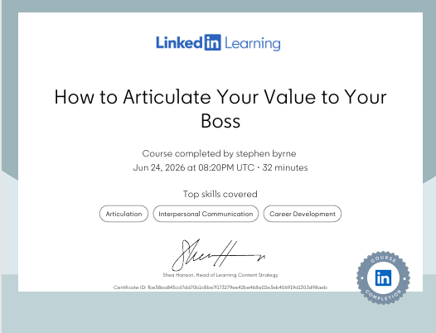
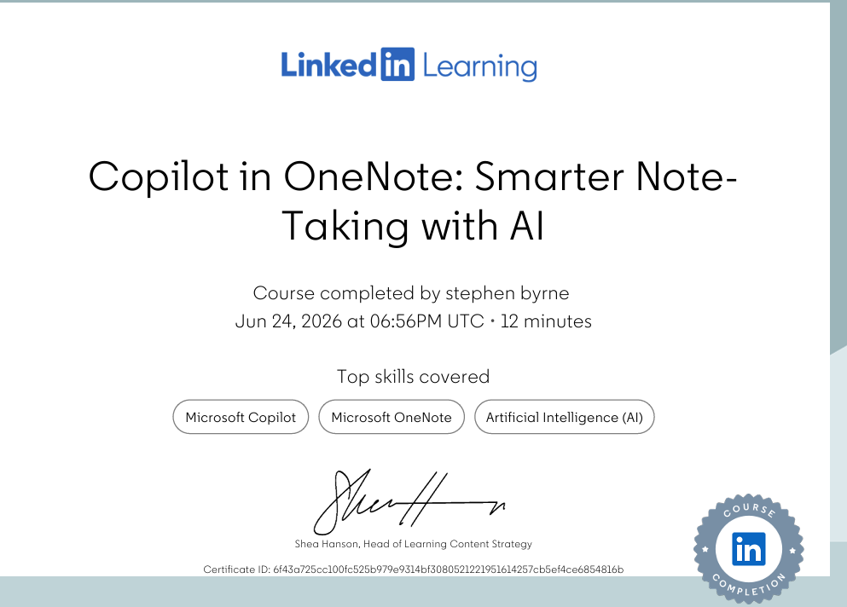
LinkedIn Learning Office 365 certificates

Slide 6
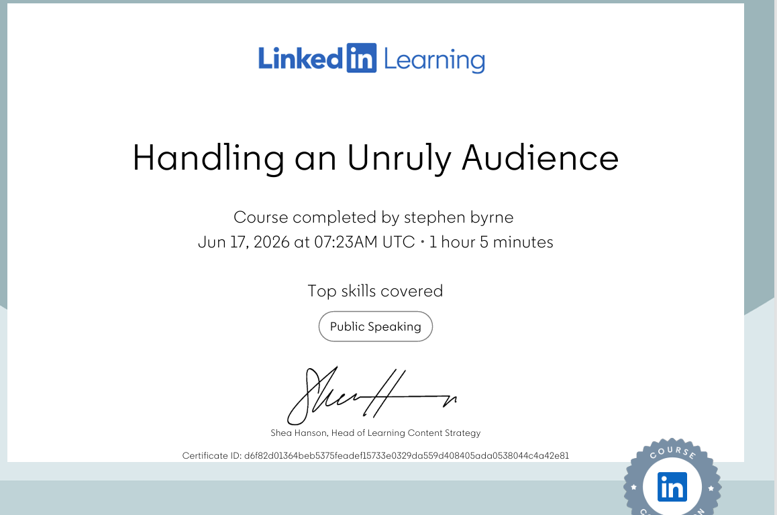
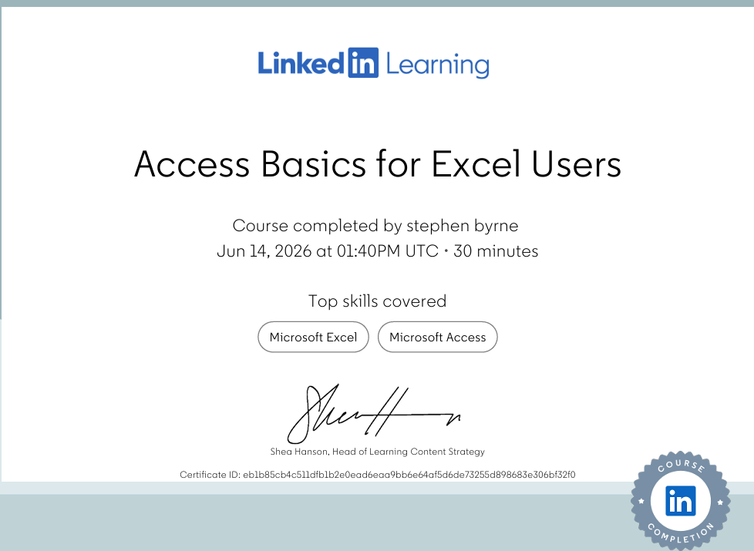
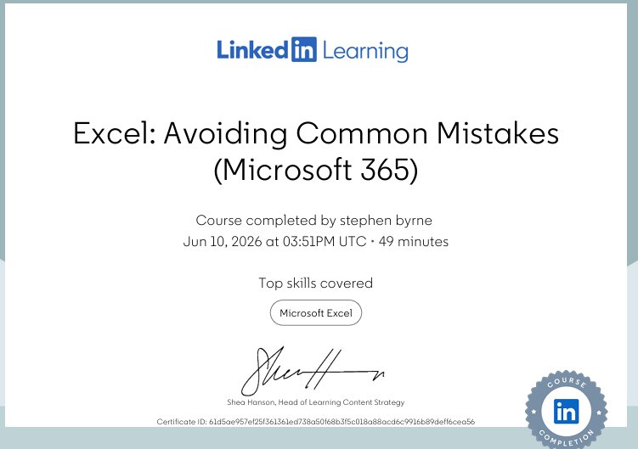

Slide 7
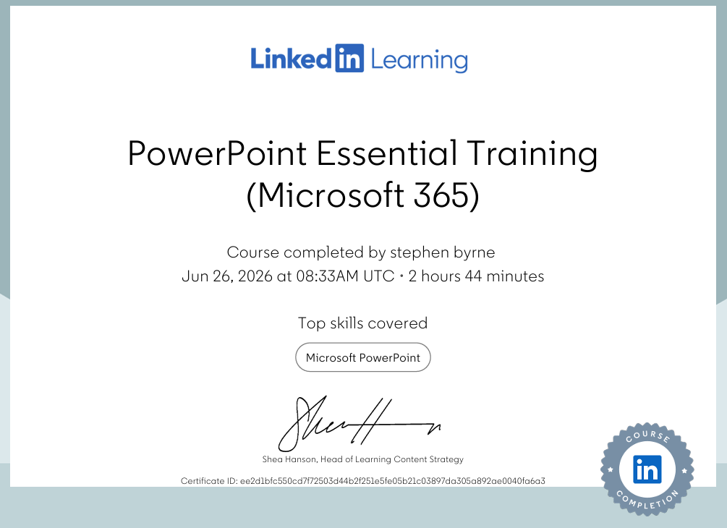
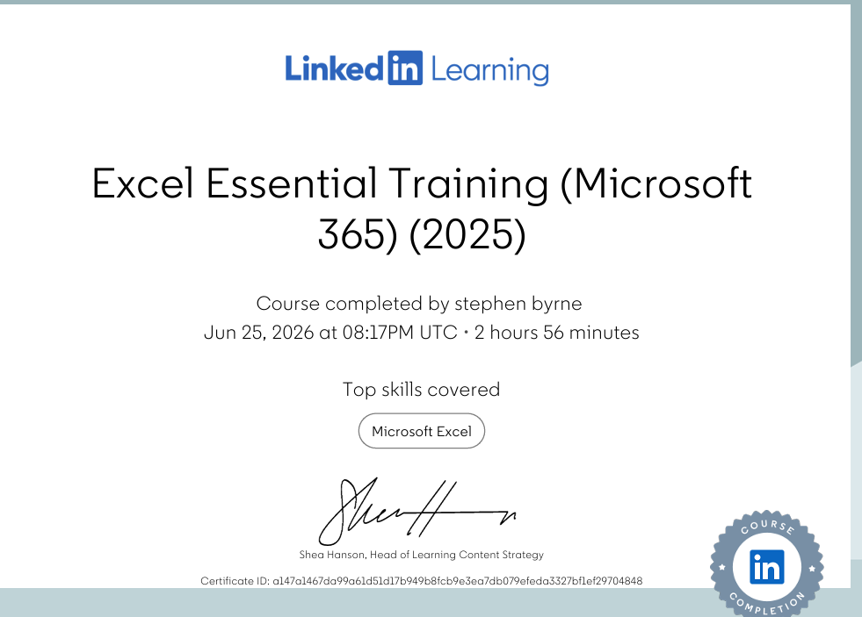
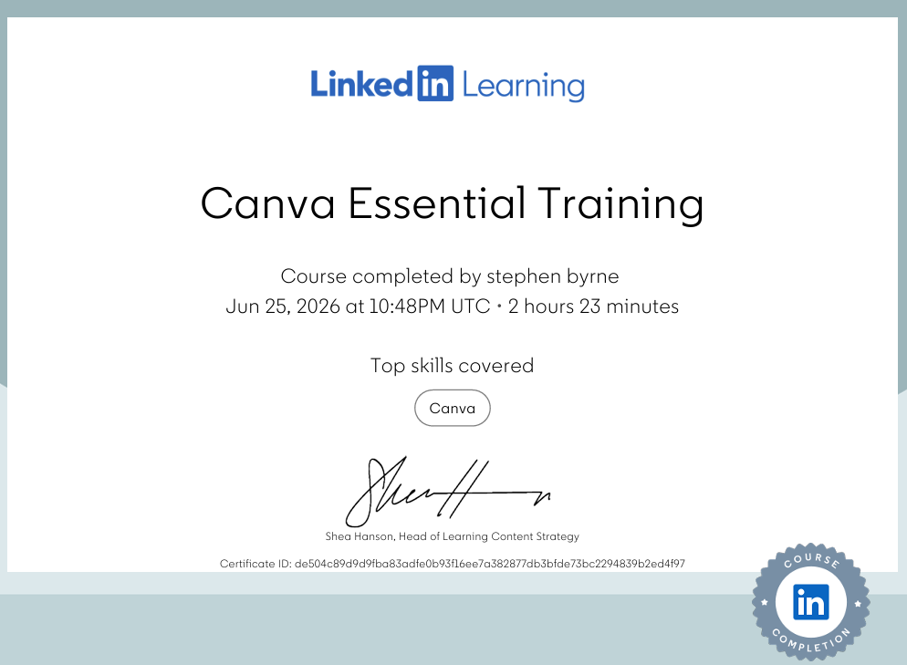
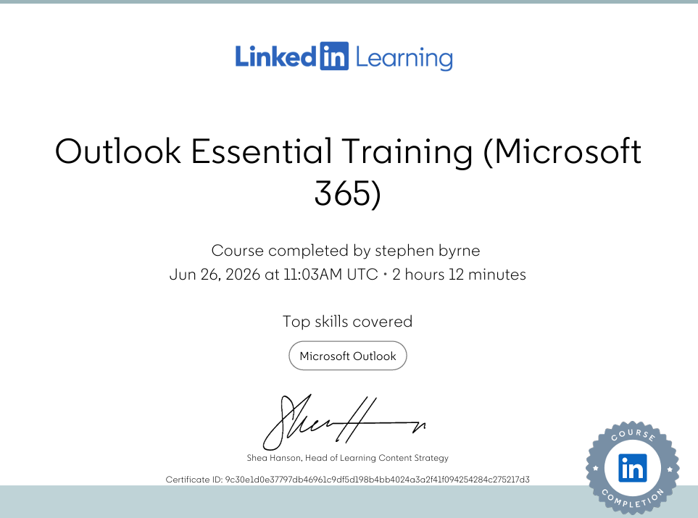

Slide 8
Thankyou for your time
I HOPE YOU HAVE ENJOYED THIS AS MUCH AS ME.
ANY QUESTIONS PLEASE

