Slide 1
THE SKELETAL SYSTEM
An Introduction

Slide 2
The Skeletal System
https://www.youtube.com/watch?v=RW46rQKWa-g

Slide 3
The skeleton is a hard framework of 206 bones that supports and protects the muscles and organs of the human body. It is divided into two parts:
The axial skeleton – this supports the head, neck and torso. It consists of the skull, the vertebral column, the ribs and sternum.
The appendicular skeleton – this supports the appendages or limbs and attaches them to the rest if the body. It consists of the shoulder girdle, the upper limbs, the pelvic girdle and the lower limbs.

Slide 4
The skeleton is made up of bones. There are 206 individual bones and five different type,
according to their shape.
Long Bones
Short Bones
Flat Bones
Irregular Bones
Sesamoid Bones

Slide 5
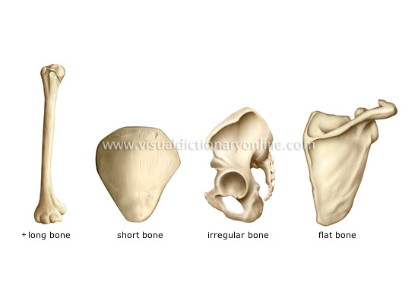

Slide 6
Long Bones
Long bones are the body's levers. They allow movement, particularly in the limbs e.g. the femur,tibia and fibula, clavicle, humerus, radius, ulna, metacarpals, metatarsals and phalanges.
Working in pairs locate these long bones in the body.

Slide 7
Short Bones
These are strong and compact bones, usually grouped in parts of the body where little movement is required e.g. tarsals and carpals.
Working in pairs locate these bones in the body.

Slide 8
Flat Bones
These are protective bones with broad, flat surfaces for muscle attachment e.g.scapula and sternum.
Working in pairs locate these bones in the body.

Slide 9
Irregular Bones
These are bones that do not fit into the above categories and have different characteristics e.g. vertebrae, sacrum, coccyx, mandible and temporal.
Working in pairs locate these bones in the body.

Slide 10
Sesamoid Bones
These are bones within the tendons. There are only two sesamoid bones in the human body, the patella and the hyoid.
Working in pairs locate these bones in the body.

Slide 11
The skeletal system supports the body.
It allows and enables movement.
It protects delicate body organs such as the brain, heart and lungs.
It forms red blood cells.
It forms joints which are essential for the movement of the body.
It provides attachment for muscles which moves the joints and pulls them into different directions.
It provides a store of calcium salts and phosphorus.

Slide 12
Bones are the living tissue made from special cells called osteoblasts. The tissue varies considerably in density and compactness. The closer the surface to the bone the more compact it is. Many bones have a central cavity containing marrow, a tissue which is the source of most of the cells of the blood and is also a site for the storage of fats.

Slide 13
Compact Bone
To the naked eye this looks like a solid structure but under a microscope it looks like honeycomb. Compact bone is found on the outside of most bones and in the shaft of long bones.

Slide 14
Cancellous Bone
This type of bone looks like a sponge and it is found at the ends of long bones and in irregular, flat and sesamoid bones. Bone marrow only exists in cancellous bone.

Slide 15
The bones are linked together by joints, there are six different types of joint:
Ball and Socket Joint
Hinge Joint
Gliding Joint
Ellipsoid Joint
Saddle Joint
Pivot Joint

Slide 16
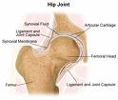
Ball and Socket Joint
This is the most moveable of all joints. Allow flexion, extension, adduction, abduction, rotation, and circumduction. The shoulder and hips are both examples of the ball and socket joint.

Slide 17
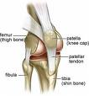
Hinge Joint
This joint allows movement in one direction only. Movements are flexion and extension. The elbow and knee are both examples of hinge joints.

Slide 18
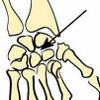
Gliding Joint
In this joint the bones glide over each other. It is the least moveable of the joints. The tarsals and carpals are an example of this joint.

Slide 19

Saddle Joint
This joint provides movement around two axes, allowing flexion, extension, adduction, abduction and circumduction. This is only found between the thumb and the metacarpal.

Slide 20

Pivot Joint
.
This joint provides movement around one axis only and a rotary movement. The cervical vertebrae is an example of this.

