Slide 1

Network Security
Cryptography
Dr. Carlene Campbell

Slide 2
Learning Outcome
Upon completion of this material, you should be able to:
  Understand Cryptography
  Know the types of Cryptography
  Know about Ciphers
  Understand Advances Encryption Standard (AES)
  Know about RC4, RC5, RC6 Algorithms
  Understand RSA (Rivest Shmair Adleman)
  Understand Message Digest Function: MD5
  Know How Secure Hashing Algorithm (SHA) works
  Understand Public Key Infrastructure (PKI)
  Understand digital signature and Secure Sockets Layer (SSL)
  Understand Disk Encryption and Cryptography attacks

Slide 3
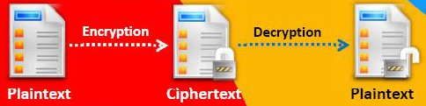
Cryptography
Cryptography is the conversion of data into scrambled code that is decrypted and sent across a private and public network
Cryptography is used to protect e-mail messages, credit card information, and corporate data
Objectives of Cryptography:
  Confidentiality
  Integrity
  Authentication
  Non-Repudiation

Slide 4
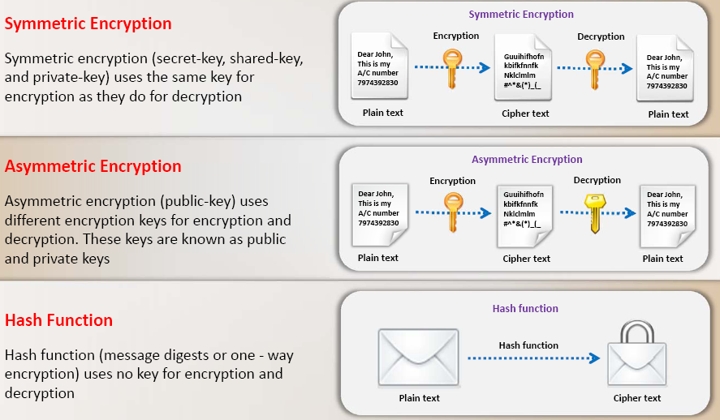
Types of Cryptography

Slide 5
Government Access to Keys (GAK)
The GAK is also called Escrow key
Government Access to keys means that software companies will give copies of all keys, (or at least enough out of the key that the remainder could be cracked) to the government
The government promises that they will hold on to the keys in a secure way, and will only use them when a court issues a warrant to do so
To the government, this issue is similar to the ability to wiretap phones

Slide 6
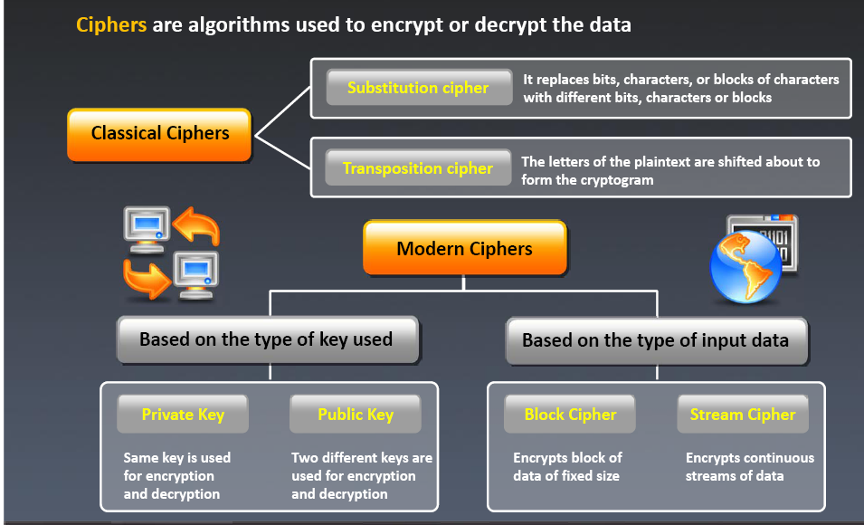
Ciphers
Ciphers are algorithms used encrypt or decrypt the data

Slide 7
Advanced Encryption Standard (AES)
AES is a symmetric key encryption standard adopted by the US government.
AES is an iterated block cipher, which works by repeating the same defined steps multiple times.
It has a 128-bit block size, with keys sizes of 128, 192 and 256 bits, respectively for AES-128, AES-256

Slide 8
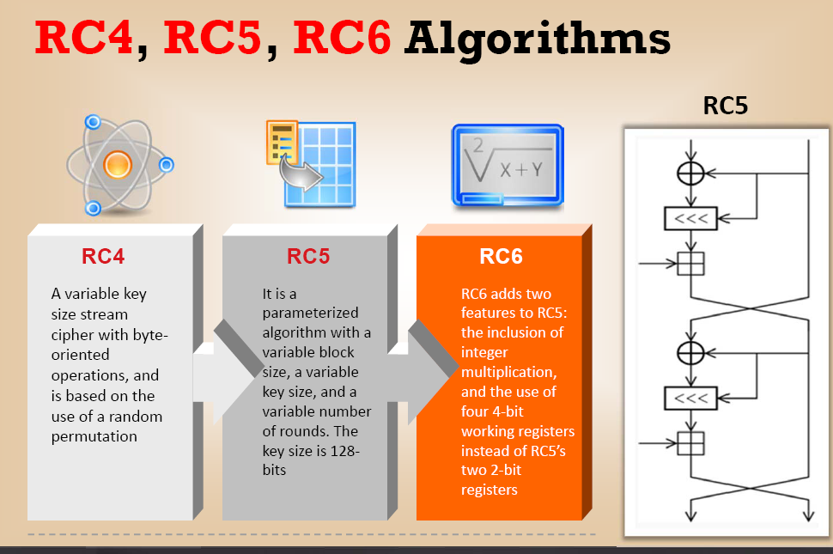
RC4, RC5, RC6 Algorithms

Slide 9
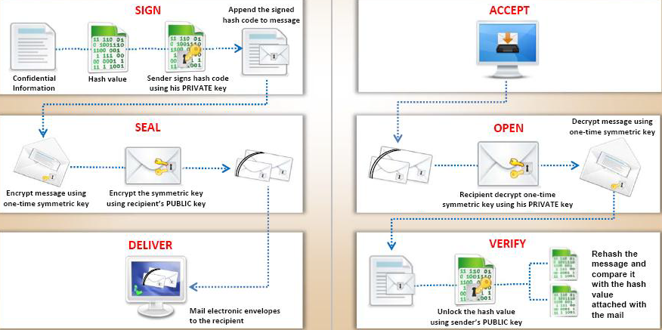
Digital Signature
Digital signature used asymmetric cryptography to simulate the security properties of signature in digital, rather than written form
Digital signature schemes involve two algorithms; a private key for signing the message and a public key for verifying signatures

Slide 10
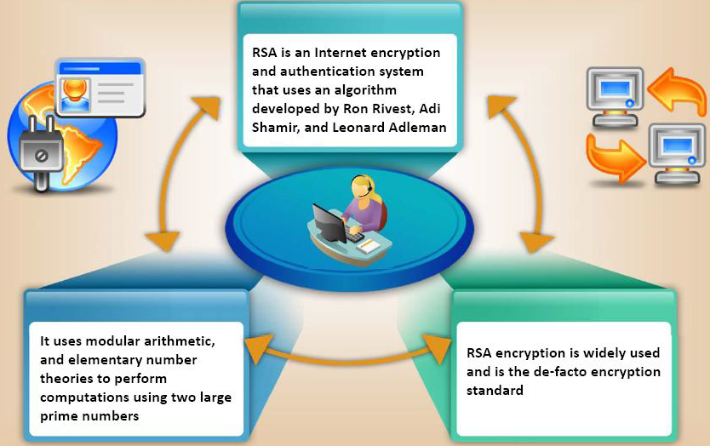
RSA (Rivest Shamir Adleman)

Slide 11
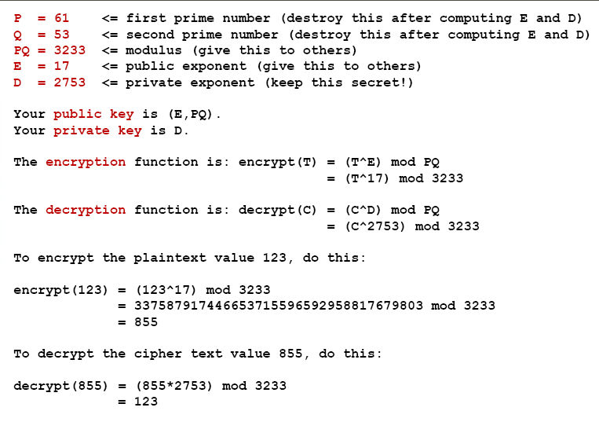
Example of RSA Algorithm

Slide 12
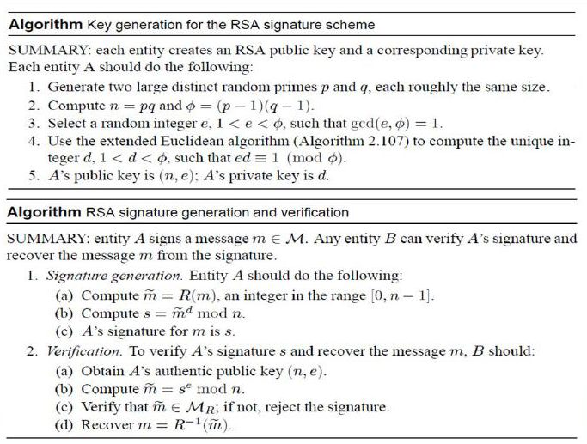
The RSA Signature Scheme

Slide 13
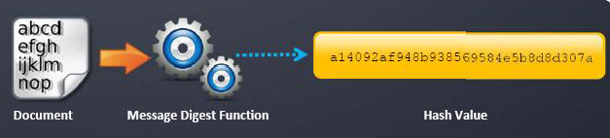
Message Digest (One-way Bash) functions
Message digest functions calculate a unique fixed-size bit string representation called Hash value of any arbitrary block of information
If any given bit of the function’s input is changed, every output bit has a 50 percent chance of changing
It is computationally infeasible to have two files with the same message digest value

Slide 14
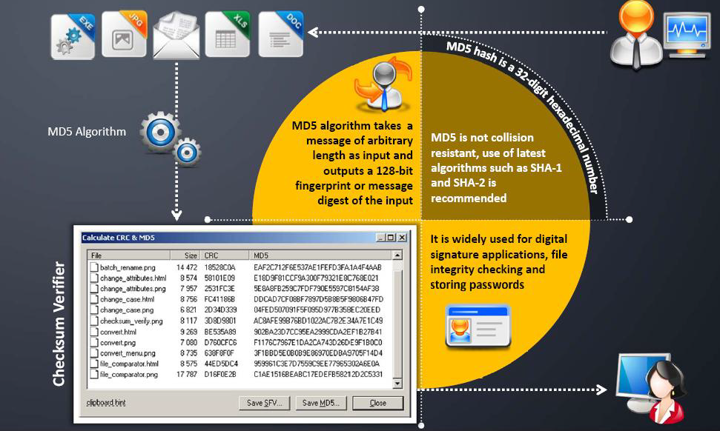
Message Digest Function: MD5

Slide 15
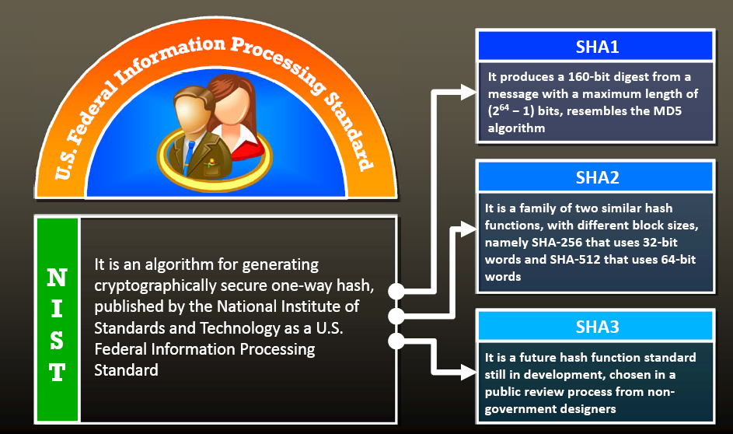
Secure Hashing Algorithm (SHA)

Slide 16
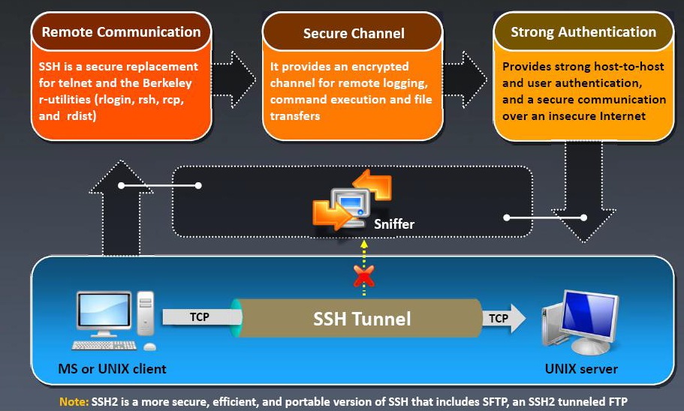
What is SSH (Secure Shell)?

Slide 17
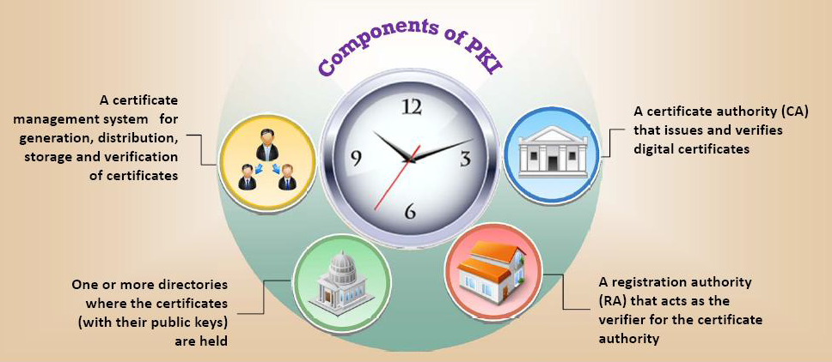
Public Key Infrastructure (PKI)
Public Key Infrastructure (PKI) is a set of hardware, software, people, polices, and procedures required to create, manage, distribute, use, store and revoke digital certificates.

Slide 18
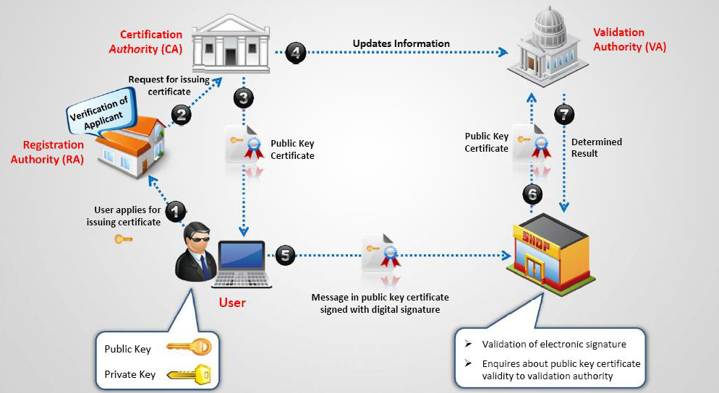
Public Key Infrastructure (PKI)

Slide 19
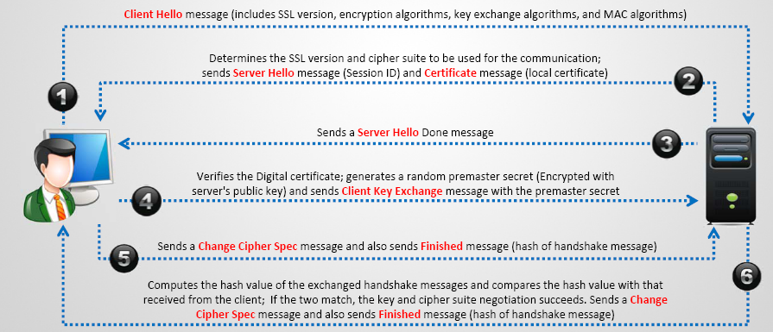
SSL (Secure Sockets Layer)
SSL is an application layer protocol developed by Netscape for managing the security of a message transmission on the Internet
It uses RSA Asymmetric (public encryption to encrypt data transferred over a secure connection

Slide 20
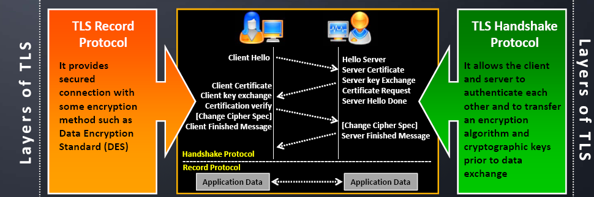
Transport Layer Security (TLS)
TLS is a protocol to establish a secure connection between a client and a server and ensure privacy and integrity of information during transmission
It uses RSA algorithm with 1024 and 2048 bit strengths

Slide 21
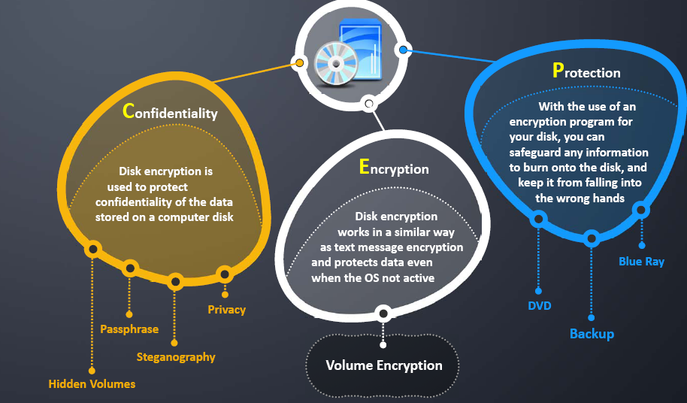
Disk Encryption

Slide 22
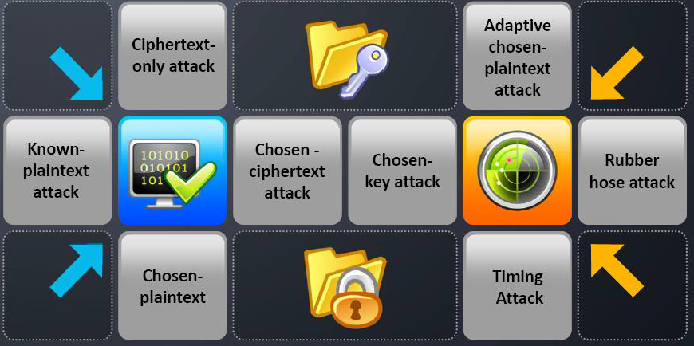
Cryptography Attacks
Cryptography attacks are based on the assumption that the cryptanalyst has knowledge of the encrypted information

Slide 23
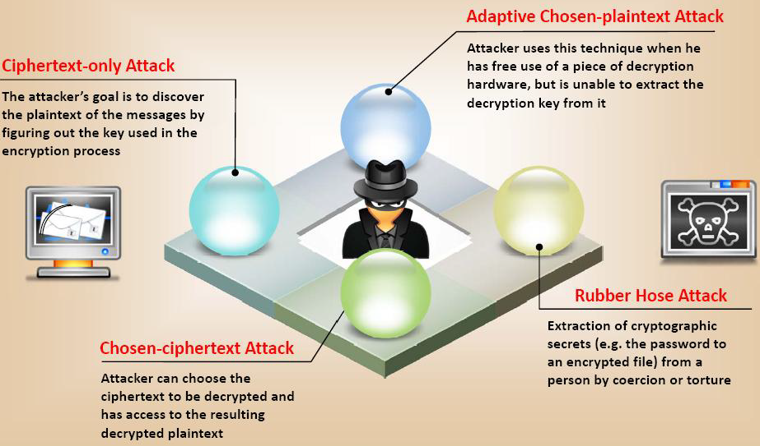
Cryptographic Attacks

Slide 24
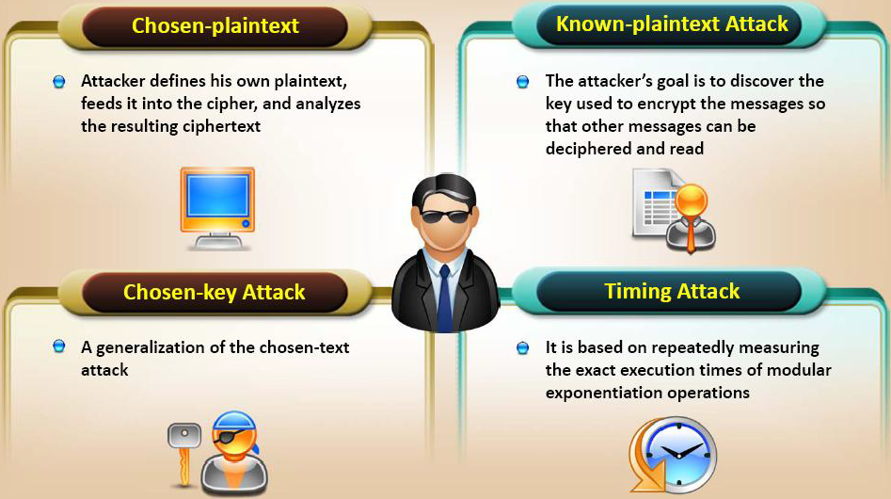
Cryptographic Attacks

Slide 25
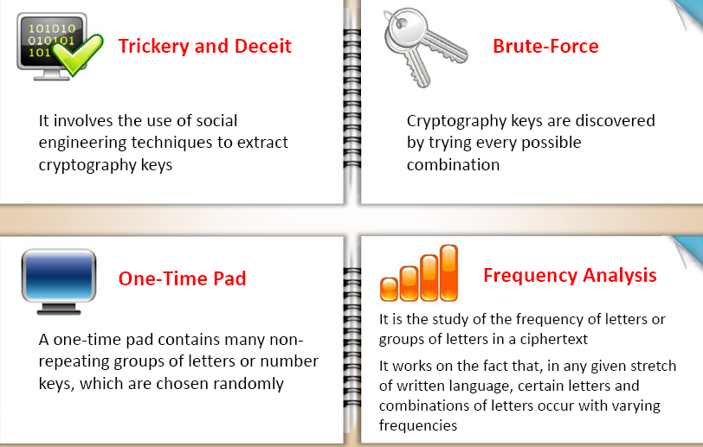
Code Breaking Methodologies

Slide 26
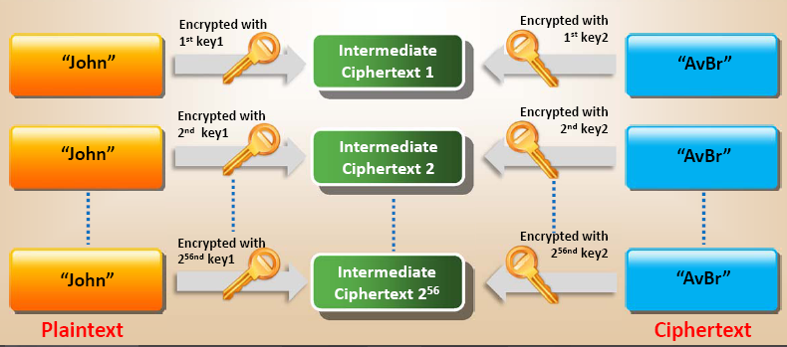
Meet-in-the-Middle Attack on Digital Signature Schemes
The meet-in-the-middle attack breaks a cipher into two parts, work against each separately, and compares results
It can be used for forging signatures on mixed-type digital signatures schemes, and take less time than an exhaustive attack
The attack works by encrypting from one end and decrypting from the other end, thus meeting in the middle

Slide 27
Man-in-the-Middle Attack
Man-in-the-Middle attack is one of the common attacks used to determine the secret key used.
An example to encrypt plaintext:
  Aisha sends her public key to Phillip, and you, the attacker, intercept the key and send Phillip your public key. Phillip thinks he just receive Aisha’s public key, but he received yours.
  Phillip sends Aisha his public key. You intercept this key, too and send Aisha your public key.
  Aisha sends a message to Phillip, encrypt in what she thinks is Phillip’s public key, but because she’s using yours, you can decrypt the message with your private key.
  You then reencrypt the message with Phillip’s public key and send it to Phillip
  Phillip answers Aisha by encrypting his message with what he thinks is Aisha’s public key. You intercept the message, decrypt it with your private, encrypt it with Aisha’s real public key, and then send it to Aisha.

Slide 28
Questions

Slide 29
References
W. Stallings, Cryptography and Network Security, Principles and Practice, 6th ed 2014.
R. Bejtlich, The Tao of Network Security Monitoring, Beyond Intrusion Detection, 2005
M. T Simpson, K. Backman, J. Corley, Hands-On Ethical Hacking and Network Defence, Cengage Learning, 2nd ed 2011.
http://ceh.vn/
S. Oriyana, M. Gregg, Hacker Techniques, tools and Incident Handling, Jones & Bartlett Learning, 2011
J. Stewart, Network Security, Firewalls and VPNs, Jones & Bartlett Learning, 2011

