Slide 1

-Project Initiation Document
Emilian Tuluca
Lecturer: Olu Adegbite

Slide 2


INTRODUCTION
This presentation will provide information about the Project Initiation Document, delivering a general idea about the project, its purpose, its potential impact and a lot of other background information of the project

Slide 3

-What is PID
The document is describing the scope of the project, the management of the project and it does also speak about the aim of the project within which the project will be achieved (Stettner, M. 2018).

Slide 4

-What is the project about
The idea of the project is based on initiating new individual massage rooms in the hotel, to create a great atmosphere to people that want to be individually undertaking the massage session. People will be asked if they want massage sessions and for an extra amount of money they will have daily accesses to massage sessions, if the massage sessions are not taken once with the offer they will become more expensive.

Slide 5
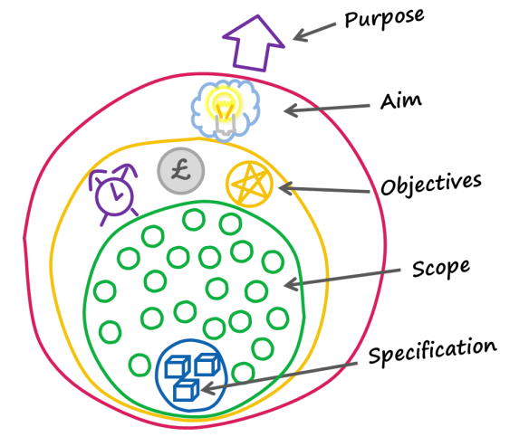
-What is the project delivering
The project has the purpose of delivering great services to support people to have their intimate in an individual massage room.
In terms of business purposes, tit will deliver great innovation to existing and new potential customers and automatically great progresses will be delivered for the hotel as well. For example, once people will get to know about this new project, the hotel will start to show better standards and it will be above other competitors that may not think about this.

Slide 6

-Why is the project undertaken?
¬The project is undertaken to appraise the popularity of the hotel as well as its financial situations and profits.
Once the project will be initiated and started to be built, strong marketing advertising will be in place to start the customer attraction and build suspense that has always worked when it came about new projects¬

Slide 7

-Who is responsible?
The responsible people for this project would be the employed designers that have the capacity to plan a luxury but in the same time not too expensive look of the individual rooms. Moreover, there will be specific engineers to be able to work will all the installation that need to be implemented into the allocated space.
Financially speaking, the ones in charge of the project are the chef of the administrative team and it could be the entrepreneur as well/ director of the hotel to ensure that the money are not spend unnecessarily

Slide 8

-How much will the project cost?
Because the individual massage rooms need to look impeccable, creating a good atmosphere, there will be a minimum of £8000 needed to do most of the things. However, these money do not include the workers payments and only the materials.
Calculating the workers as well, it will get up to £16000, which is double to the initial amount.
These money will be taken from the general profit of the hotel and this because this project will earn back more than that and it does worth. This project has also been initiated in countries as china and now it started to be so developed in terms of hotel’s services

Slide 9
References
Stettner, M. (2018), “Make A Project Initiation Document in a Flash”, [online] available on:https://thedigitalprojectmanager.com/how-make-project-initiation-document/ accessed on: 13/06/2020

