Slide 1

Vygotsky’s Sociocultural Theory
Name: Liliam Lopes Cardoso
Student ID: 2436087
Module Code: LCHS4010-LOND
Module: Psychology in health and Social Care
Lecturer: Lou Wells
Assignment 1
Declaration: AI was not used.

Slide 2
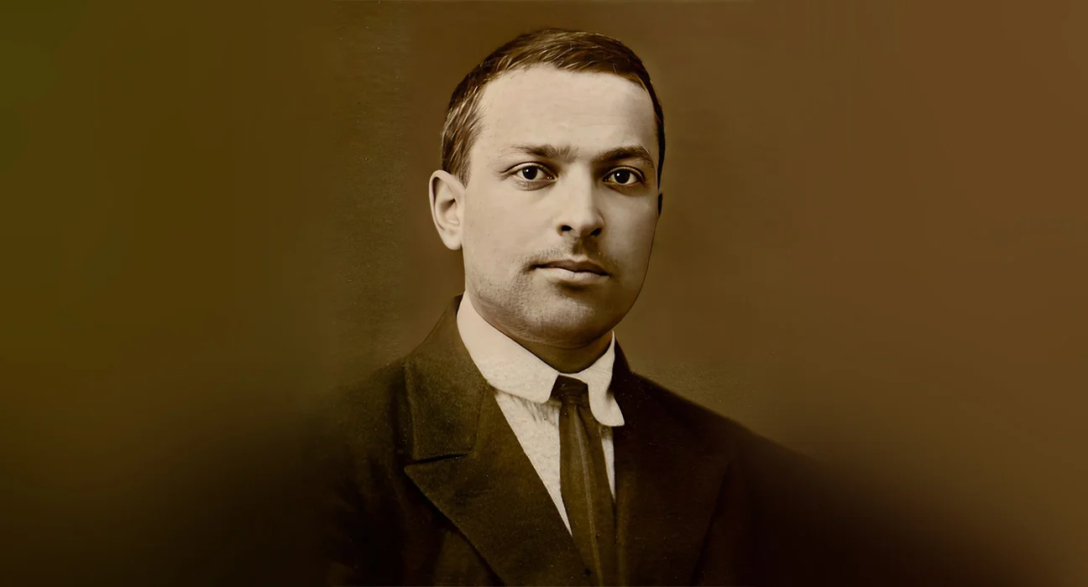
Vygotsky’s Sociocultural Theory
Lev Semyonovich Vygotsky (1896-1934)
Vygotsky’s sociocultural theory emphasizes the fundamental role of social interaction and cultural context in cognitive development.
According to Vygotsky (1978), learning is intrinsically a social process, significantly influenced others.
Vygotsky tell us that cognitive development can not be understood without considering the cultural tools and symbols, especially language, that individuals use in their social environments.

Slide 3
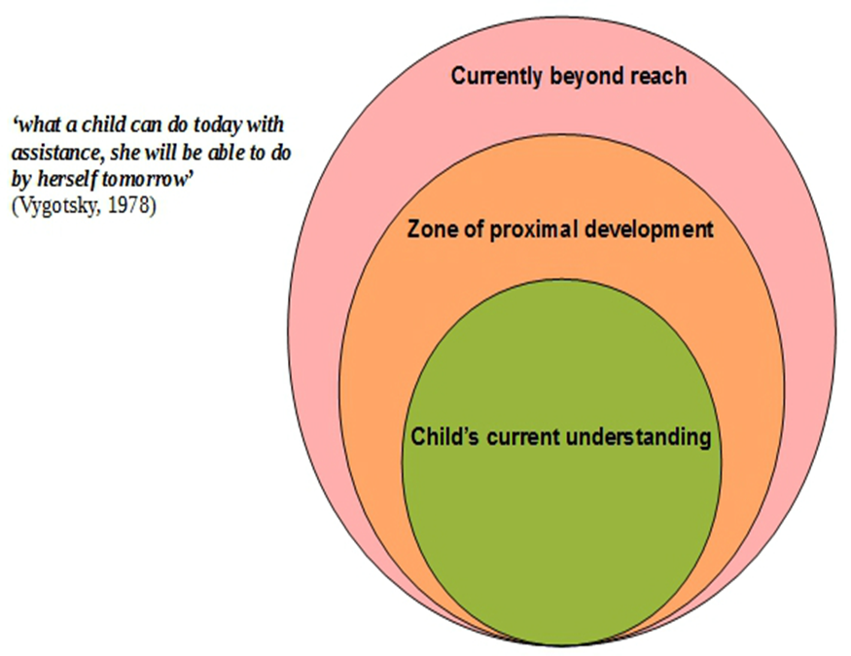
Zone of Proximal Development (ZPD)
The Zone of Proximal Development (ZPD), refers to the range of tasks that a child can perform with guidance and assistance from others, butt which they are not yet able to perform independently.
“ The Zone of Proximal Development defines those functions that Have not yet matured but are in the process of maturation”.
(Vygotsky,1978)

Slide 4

Key Points of Vygotsky’s Theory
Mediated learning: Vygotsky emphasized learning, where the mediator plays a crucial role in the role in the learner’s cognitive development.
Social interaction and language: Language is central to Vygotsky’s Theory, serving as the primary tool for intellectual adaptation. He distinguishes between internal speech and external speech.
Play and Development: Vygotsky stated that play is essential for cognitive, social, and emotional growth in the various stages of childhood. Through play, children experience new tasks, learn to follow rules, and develop problem-solving skills. (Marco Ladesma A., 2014)
Notes:
4

Slide 5
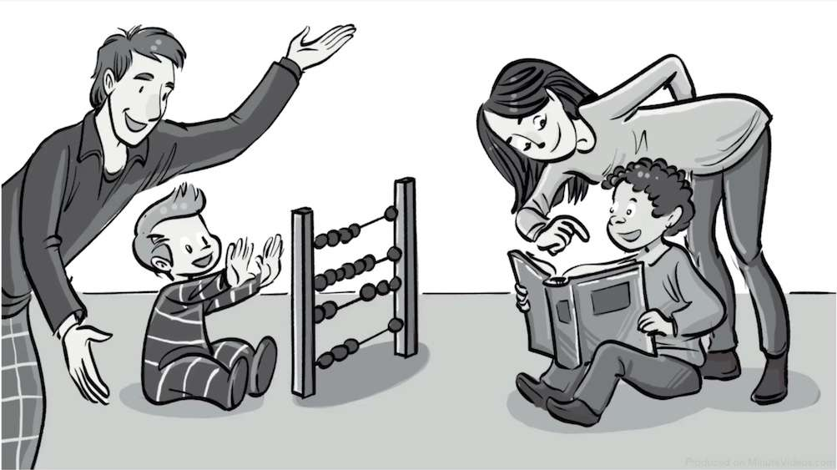
Strengths of Vygotsky’s Sociocultural Theory
The centrality of social interactions- Vygotsky demonstrates that cognitive development does not occur in isolation but is shaped by social relationships and the cultural environment.
The importance of language as a psychological tool, organizer of thought, and structure of internal consciousness.
The concept of the Zone of Proximal Development (ZPD)- Is one of the most influential contributions of educational psychology.
Valuing the cultural context- Broadening the understanding of human development beyond biological factors.
(Wertsch, L. S., 1987)
Notes:
5

Slide 6

Weaknesses of Vygotsky’s Social Theory
Less attention to biological aspects- although it recognizes the biological basis of development, it does not value them and does not explore neurobiological mechanisms.
Dependence on an experienced mediator- the theory presupposes the presence of a competent mediator (adult, teacher, more experienced peer).
Less detailed information about development stages- this can hinder longitudinal comparisons and the prediction of development milestone.
Cultural generalization- although it values culture, the theory was based on specific sociocultural contexts of early 20th-century Soviet Russia.
(Wertsch, L. S., 1987)

Slide 7

Introduction:
Jenny is 16-year-old girl. Jenny has been taking care of her sick mother, who has mobility problems, since her father passed away. Jenny does all the housework and is also responsible for the administrative side, because her mother also has mental health problems.
Based on Vygotsky’s theory, it will be shown how this lifestyle could impact Jenny’s life development over 5 years.
  ​
A good support plan for Jenny will also be shown, considering her well-being and needs, according to Vygotsky’s Theory.

Slide 8

Cognitive Development Impacts on Jenny Through the Lens of Vygotsky’s Theory
Adolescence is a critical period for the development of executive functions, hypothetical-deductive thinking, and psychosocial identity. (Wood, D., Bruner, J. S. & Ross, G., 1976)
Jenny lives in a context of premature adultification, assuming responsibilities typical of an adult.
The absence of a support network and the overload of tasks limit Jenny’s access to rich educational interactions, restricting her Zone of Proximal Development (ZPD).

Slide 9

Expected Cognitive impacts
Accelerated development of executive functions: leading to an early strengthening of executive skills such as planning and organization, task execution, problem-solving, and decision-making under pressure.
ZPD restrictions due to the absence of social mediation: limiting areas that require specialized guidance- abstract thinking, academic skills, vocational exploration.
Cognitive overload and impact on self-regulation: the accumulation of responsibilities generate chronic stress; it interferes with the capacity for emotional and cognitive self-regulation.
Uneven development: development will be asymmetrical, with areas of high maturity coexisting with significant gaps. For examples: accelerated autonomy and responsibility; decreased social participation and collaboration.
(Wood, D., Bruner, J.S. & Ross, G., 1976)
Notes:
9

Slide 10

Biological and environmental influences on psychological development
Biological factors: the prefrontal cortex is still incompletely mature, making functions such as attention, working memory, and emotional regulation more vulnerable.
Environment factors: In Jenny’s case, includes an overload of responsibilities, social isolation, and lack of adequate mediation.
Although biology establishes possibilities. It is the impoverished environment lacking support, shared language, and social “scaffolding” that most compromises the internalization of cultural tools and, consequently, cognitive development. (Vygotsky, 1978, 1987; Wood, Bruner & Ross, 1976).

Slide 11

Strategies and interventions to help Jenny
The intervention, grounded in Vygotsky’s sociocultural theory, emphasizes that the development depends on mediation, social interaction, and support situated within her Zone Proximal Development (ZPD).
Redistribution of responsibilities through the school, social services, and community network.
Develop self-regulation, communication, and organizational skills by cultural tools.
To guarantee psychological support and opportunities for interaction with people of the same age group.
To protect the girl’s well-being, promoting her holistic development and transforming care into a shared and socially sustainable process. (Vygotsky, 1978, 1987; Wood, Bruner & Ross, 1976).

Slide 12

Conclusion
According to Vygotsky’s sociocultural perspective, the cognitive development of this 16-year-old adolescent results from the interaction between biological factors- incomplete maturation, and environmental factors, which in this case includes an overload of responsibilities, social isolation, and a lack of adequate mediation.
The intervention in Jenny’s case, inspired by Vygotsky’s Sociocultural Theory, seeks to reduce the adolescent’s burden by creating external support networks, involving the school, social services, community network, and psychological support .
An approach always aimed at protecting the girl’s well-being, promoting her comprehensive cognitive development.

Slide 13

Bibliographic References
Bruner, J. (1983) Child’s talk: Learning to use language. New York: Norton.
Cole, M. (1996) Cultural psychology: An once and future discipline. Cambridge, MA: Harvard University Press.
Daniels, H. (2001). Vygotsky and Pedagogy. Routledge.
Vygotsky, L. S. (1978) Mind in Society. Harvard University Press.
Vygotsky, L. S. (1987) The Collected Works of L.S. Vygotsky: Volume 1. Plenum Press.
Wertsch, J. V. (1985). Vygotsky and the Social Formation of Mind. Havard University Press.
Wood, D., Bruner, J.S. and Ross, G. (1976) ‘The role of tutoring in problem solving’, Journal of Child Psychology and Psychiatry, 17, pp. 89-100.

