Slide 1
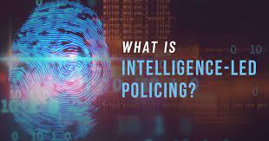
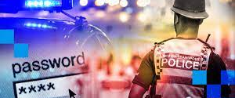
Digital Policing
Intelligence

Slide 2
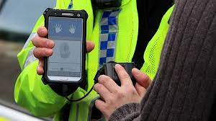
Assessment 2 (50%)
‘Policing in 2022 –
The Impact of Technology.’
Presentations (pairs) | Thursday 31st March 0900-1200hrs
Supporting paper | Monday 25th April 23:59hrs
(Assessment brief with more information on Moodle)

Slide 3

Aims and learning outcomes
Identify
Identify the difference between Information and Intelligence
List
List the sources of information available to police
Explain
Explain how NIM applies to a policing context
Describe
Describe how intelligence is graded according to the 3x5x2 System
Demonstrate
Demonstrate an understanding of MOPI and how this applies to a policing context
Demonstrate
Demonstrate an understanding of the main principles relating to Information sharing
Understand
Understand the main purposes of artificial intelligence

Slide 4

Initial Investigation
What exactly has occurred?
Is the incident a crime?
If so, what sort of crime?

Slide 5
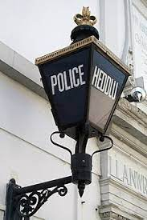
National Crime Recording Standards (NCRS)
The 3 basic principles are:
All reports from victims, witnesses or third parties will result in creation of an incident report
An incident will be recorded as a crime if, on the balance of probability (a) the circumstances as reported amount to a crime by law and (b) there is no credible evidence to the contrary
Once recorded, a crime will remain recorded unless there is credible evidence to disprove that a crime has occurred

Slide 6

National Crime Recording Standards (NCRS)
Reasons not to record a crime:
The incident reported does not amount to a crime in law
The initial incident report is not confirmed by the victim
On the balance of probabilities a crime has not been committed

Slide 7
Modus Operandi (M.O.)
The method by which a crime is committed
The method by which a known criminal operates
“WHAT’S THE MO!?”

Slide 8

The 10 Points of the Modus Operandi System
S tyle
T ime
O bjective
P al
C lass
R eason
I nstrument
M ode
E ntry
S ignature
STOPCRIMES

Slide 9
The points to THINK about when collecting information for the M.O. of a crime report are:
Style – the style of the deception used in deception cases, e.g. dressed as a gas official, documents claiming to be an insurance collector
Time – relative to an event (not to the clock), e.g. crime only committed on market days, early closing days or certain days of the month
Objective – the objective of the crime, e.g. gain, lust, revenge
Pal – is there an accomplice or friend?
Class – the class of person or property attacked
Reason – reason for being in the area, the criminals self-account
Instrument – instrument used to commit the crime, e.g. crowbar, screwdriver, bodily force
Mode – mode of transport used to commit the crime(s)
Entry – the actual point where entry was made
Signature – something unusual done by the criminal, their ‘signature’ e.g. creates an escape route by wedging doors open, closes curtains, eats food from the fridge.
When a crime report is submitted as many of these details should be included, if applicable, to the crime.
It may then be possible to match an offender to a crime because of a similar modus operandi (M.O.)

Slide 10


Crime Reports
Means of disposal of offence
Officers attending scene
Persons wanted or suspected
Circulations if appropriate
Date and by whom victim was informed of result
STATS!!

Slide 11

Police Actions
Obtain all possible information from victims and witnesses
Complete a crime report and submit before going off duty
Inform supervising officers, specialist teams or CID dependent upon type or seriousness of the offence

Slide 12
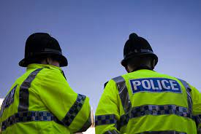


What is ‘information’?

Slide 13
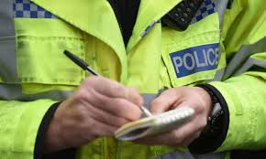
Information
Information is the very life-blood of policing. It may be original & generated by you. It may come from the public or other officers or be fed to you by partner agencies & other sources
Police information is:
All the information obtained & recorded for a policing purpose
Everyday the police collect information, but it should only be collected if deemed relevant for a policing purpose.
This provides the police a legal basis to deal with the information, i.e. recording, sharing it with other agencies or simply retaining it for a future use.
Information normally comes from a source that needs no confidentiality, constraints or protection.
A member of the public calling to report an incident would fit this definition.
All the information obtained must be recorded.
It is essential that all police information is managed lawfully, from its initial collection to its final disposal in order to ensure its lawfulness.

Slide 14
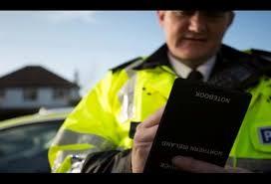
INFORMATION
Policing - need to identify information from a variety of such sources, both human and technical - potential to become intelligence.
Depending on what it is, the information gathered may support both local and national policing objectives and you will need to be able to work in accordance with the requirements of the National Intelligence Model and the principles of managing police information and intelligence.
You will be gathering information, evaluating and conducting an initial assessment of it, grading it, and reporting it in the proper way.
The processes for its review, retention and disposal are unlikely to be something with which you will become intimately involved but they are aspects you need to be aware of.

Slide 15

Where does information come from ?
Internal:
• Directly/Indirectly obtained information
CHIS/Test Purchase by undercover officers
• Police intelligence databases
• Police National database (PND)
• Social networking sites – such as Facebook, Twitter
• Open sources (search engines)
• Supervisors
• Specialist Department (e.g. NPT/Public Protection)
External:
• Partner Agencies – e.g. Local Authority, YOTs, Education/ Schools
• House-to-house enquiries
Policy:
• Force Policy / National Guidelines
• CPS Guidelines

Slide 16
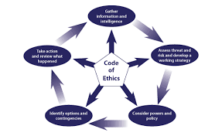
Information Gathering
There are a number of methods for tracing witnesses including:
At or near the scene
Returning to the scene
Watch schemes
Crimewatch UK
Crimestoppers
Road checks
Witness boards
Noticeboards outside Police Stations
Local newspapers & social media

Slide 17

Information Gathering
The information gathered from witnesses may provide details leading to the suspect.
To help trace that person the Investigating Officer may use some of the following methods:
Searching the PNC
Local Intelligence Units
Method Index
(Unsolved/Nicknames)
Witness Albums
Photo-fit, e-fit & artist’s impressions
Section parades & briefings
Enquiries at adjoining stations
Observations
Circulations
Golden Nominal concept

Slide 18

Group Task: Research The Golden Nominal Concept
Golden Nominal is a term used within the Public Sector and concerns the strive towards a single view of citizen information. Police forces and other government agencies have an increasing focus to understand and effectively use the data that is often collected across multiple touch points (Experian, 2021)
The power of better data positively impacts on policing.
The Police collect huge amounts of data, often in challenging circumstances.
The result is a very high number of duplicate and incomplete person records within the main policing system.
The scale of the issue is vast and impossible to quantify.
Removing the need to search through duplicate records would provide a holistic view of one person and their interactions.
This can better expose any potential threat that they pose to the community or how vulnerable they may be and enable a response that’s far quicker and more appropriate to the situation.
Significantly less time would be required to manually link and manage duplicates, saving valuable resources.
Click here

Slide 19

What is the different between
‘Information’ and ‘Intelligence’?
Intelligence is: Collected information that has been developed for action & may also be classified as confidential or sensitive
(Further reading: APP/COP on Intelligence Management)
This means information that has been formally processed (Collated & Analysed) but it does not only relate to crime & criminality. It is NOT necessarily evidence

Slide 20
Discuss: Why do we need Intelligence?
Some reasons…
1. The need for intelligence does not relate only to crime. It relates to all areas of operational policing.
2. Criminals have become far more mobile and no longer commit offences in their own neighbourhood, they travel the length and breadth of the country, overseas, to Europe and other countries further afield. In order to combat this we need to work with other police forces at home and abroad to share intelligence.
3. The nature of crimes committed has become more sophisticated and hi-tech.
4. There has been an upsurge in terrorist incidents involving groups from different parts of the world. On the domestic front groups of activists such as Animal Liberation Front (ALF), environmental groups are prepared to use violence and terrorist tactics to further their cause.
5. Anti-social behaviour has become much more of a problem.
Public disorder at protest marches, demonstrations and sporting events is now more common.
6. Accurate intelligence may predict possible disorder and crimes, and so resources can deployed to prevent their occurrence or to arrest offenders.

Slide 21

The National Intelligence Model (NIM)
Standardised framework to place intelligence at the forefront in reducing crime & disorder
Informs strategic & tactical decision making
Aim of NIM: to ensure that policing is delivered in a targeted manner through the development of information and intelligence. NIM is applicable to all aspects of operational policing because it enables managers to prioritise activities and resources.
Click here for further reading
Notes:
It aims to ensure that policing is delivered in a targeted manner through the development of information and intelligence. NIM is applicable to all aspects of operational policing because it enables managers to prioritise activities and resources.
It is important to note that the NIM is NOT just about crime and NOT just about intelligence - it is a model that can be used for most areas of policing. The National Intelligence Model brings all the best practices in intelligence-led policing together, offering a blueprint for those who wish to develop better their ability to answer critical questions about strategy and tactics
NIM is:
concerned with using intelligence to determine priorities for policing.
It is a model for policing that senior managers can use to help them to determine the strategic direction and make tactical decisions about resourcing and operational policing to support local and national objectives
it also helps manage risk.
Therefore, NIM is not just about intelligence gathering, it is also a business process model that can be used to guide all activities of a police force.
Advantages of NIM:
allows operational strategies to focus on key priorities
allows more officers to focus on solving priority problems and targeting the most prolific and active offenders
informs the management of risk
provides more informed business planning and a greater link to operational policing issues
improves the direction and briefing of patrols
improves integration with partner agencies

Slide 22

The National Intelligence Model (NIM) is a ‘Model for Policing’ that ensures information is fully researched, developed and analysed to provide intelligence to senior managers to:
Provide strategic direction
Make tactical resourcing decisions about operational policing
Manage risk.
Note: It is important to note that the NIM is NOT just about crime and NOT just about intelligence - it is a model that can be used for most areas of policing.

Slide 23
National Intelligence Model (NIM)
National Intelligence
National Crime Agency
Level 3
National and International
Regional Intelligence Force Intelligence Bureau
Level 2
Force and Neighbouring Forces
Level 1
Local Intelligence
Local Intel Units
Neighbourhood and BCU

Slide 24
The National Intelligence Model continued…
Level 1 - deals with crime, incidents and neighbourhood priorities occurring at a local Basic Command Unit (BCU) level. Local Intelligence Units provide intelligence to operational officers within BCUs or areas and will vary in staffing levels. The intelligence you submit as an operational officer will be submitted via Local Intelligence Units.
Level 2 - deals with issues affecting a group of BCUs, neighbouring forces or a group of forces. FIB is the Force Intelligence Bureau, who deal with serious and inter-force intelligence. Within this department are specialists such as interception of communication experts etc.
Level 3 - is dealt with by the National Crime Agency (NCA) and UK Border Agency which operate on a national or international scale. The National Crime Agency handles serious and organised crime as it affects the UK. It is divided between seven regional offices. As well as developing strategic pictures of the different areas in which organised crime operates, the UK Division also collates and analyses intelligence on the UK’s top criminal groups and their key players. NCA is also a one-stop shop for UK law enforcement’s international enquiries.

Slide 25
Management of Information/intelligence
Local Intelligence Officer
LIO -manages/processes/collates local intelligence
Field Intelligence Officer
FIO - actively seeks intelligence from a variety of sources in support of the intelligence function
Single Point of Contact
SPOC - specified person, usually in FIB (Force Intelligence Bureau), who liaises with the telecommunication industry for the purpose of gathering intelligence. Individual officers must not contact telephone companies direct.

Slide 26
The Intelligence Cycle
Direction
Collection
Evaluation
Analysis
Dissemination
This cycle is a formal model that is a sequential process that allows information to be developed into intelligence, particularly during the analysis phase.
The collection, development and dissemination of intelligence allow decisions to be made about priorities and tactical options.
Intelligence collection is a continuous process and there may be specific requirements for its recording and use.

Slide 27
The Intelligence Cycle
Direction
Collection
Evaluation
Analysis
Dissemination
Research Task
Go to the College of Policing Website and research each stage.
Be prepared to report back to the class in your groups.
Group 1: Direction
Group 2: Collection
Group 3: Evaluation
Group 4: Analysis
Group 5: Dissemination

Slide 28

Relevant Legislation
To be effective the NIM relies on information and/or intelligence which can be obtained from a variety of sources.
There are a number of both legislation, policy and procedures that govern the use of information and intelligence by the police.
The Criminal Procedure and Investigations Act 1996
Data Protection Act 2018:
GDPR 2016 (EU) 2016/679
Human Rights Act 1998:
Freedom of Information Act 2000
Regulation of Investigatory Powers Act 2000.
Investigatory Powers Act 2016

Slide 29

Policies and Procedures
National Intelligence Model
3x5x2 grading system
National Briefing Model
Management Police Information 2006 (MOPI)
CHIS National Policy

Slide 30

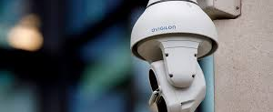
The
3X5X2 Intelligence System

Slide 31

In order to be of use, intelligence must be properly evaluated and its provenance assessed.
The emphasis MUST be on integrity in the use of intelligence.
Evaluation of ‘raw information’ is known as the 3 x 5 x 2 System
There are three different methods commonly associated with the collection of information.
The information can be collected from a variety of sources – officers, investigations, community, social media, crime stoppers, surveillance, CCTV, Registered sources, or computer data…
You need to be aware that sometimes the source of the information may need to be treated in a confidential or sensitive manner.
The 3X5X2 Intelligence System is simply how the information is recorded on intelligence logs, how it is graded and how it should be disseminated…
This is recorded on a 3X5X2 Intelligence Form (mostly electronic today)…

Slide 32
Evaluations
In order to be of use, intelligence must be properly evaluated & its provenance assessed. The emphasis MUST be on integrity in the use of intelligence
Evaluation of ‘raw information’ is known as the
3 x 5 x 2 system
There is a need to separately evaluate both the source and content of each piece of information
This grading affects the sharing, retaining and actioning of the intelligence.
This method establishes the reliability and accuracy of intelligence and identifies who it should be disseminated to.

Slide 33
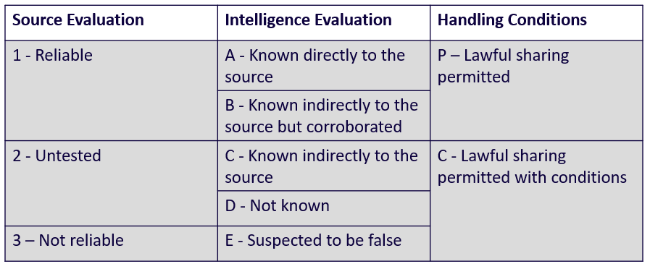

Slide 34

Source Evaluation
The possible grading’s for this part of the assessment are:
1. Reliable
2. Untested
3. Not reliable

Slide 35
Intelligence Assessment
There is a need to accurately evaluate the reliability of each piece of information:
A. Known directly to the source
B. Known indirectly to the source but corroborated
C. Known indirectly to the source
D. Not known
E. Suspected to be false

Slide 36

Handling Codes
The ‘Handling code’ provides a risk assessment before deciding to disseminate the intelligence
The handling codes are based on the knowledge of the circumstances at the time by the person recording the information.
The two handling codes which can be selected from the drop-down menu are:
P. Lawful sharing permitted
C. Lawful sharing permitted with conditions

Slide 37

Intelligence
When intelligence logs are submitted they should be entered so that the source of the information cannot be identified
In some forces the LIO carries this out prior to entering them into the forces intelligence database
This process is known as ‘sanitisation’

Slide 38

What is ‘Sanitisation’?
In some circumstances it may be advantageous to reveal a source’s true identity within the body of intelligence without revealing their identity as the source
Where an officer is concerned that the contents of a report might indicate the source, reference should be made to a supervisor before dissemination or entry onto the intelligence system takes place

Slide 39

Best Practice
All intelligence must be accurately reported
Care must be taken to remove from the text all material that in any way identifies the source
The timing & place of meetings with sources may be relevant & could lead to the source being identified
Repeat intelligence from the same source could lead to the source’s identification

Slide 40
What is Provenance?
Provenance allows the source of intelligence to be protected in order to avoid any unnecessary risks to them
Provenance can be established through the interrogation of other information systems.
For example, part of the information might be that John Kelly is using a red Ford Escort, XYZ 321 and a check on PNC might confirm that John Kelly is indeed the registered keeper of a red Ford Escort XYZ 321 - provenance is established.

Slide 41
Government Security Classifications
OFFICIAL
The majority of information that is created or processed by the public sector. This includes routine business operations and services, some of which could have damaging consequences if lost, stolen or published in the media, but are not subject to a heightened threat profile.
SECRET
Very sensitive information that justifies heightened protective measures to defend against determined and highly capable threat factors. For example, where compromise could seriously damage military capabilities, international relations or the investigation of serious organised crime.
TOP SECRET
HMG‟s most sensitive information requiring the highest levels of protection from the most serious threats. For example, where compromise could cause widespread loss of life or else threaten the security or economic wellbeing of the country or friendly nations.

Slide 42
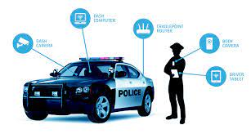
Storage of information and Intelligence
Information & intelligence can be stored in any suitable format.
E.G paper records, computer records, audio tapes, video tape or photographs.
Whatever system is used must be secure from unauthorised access
However, there are two important provisos, namely that the medium in which it is stored must be durable & the information must be retrievable

Slide 43
Management of Police Information (MOPI)

Slide 44
MOPI Guidance
The Code of Practice on the Management of Police Information states:
Information gathered by the police must be :-
For a policing purpose
And
Managed lawfully

Slide 45
MOPI
Gathering & storing information & intelligence
Sharing information & intelligence
Legal considerations
Crime & Disorder Act 1998
Computer Misuse Act 1990
Criminal Procedure & Investigations Act 1996
Data Protection Act 2018/ General Data Protection Regulation (EU) 2018/679 (GDPR)

Slide 46
Review for Retention
Reviewing information held by forces to determine its adequacy & continuing necessity for a policing purpose is a reliable means of meeting the Data Protection Act 2018

Slide 47

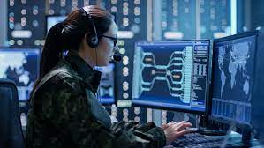
Sources of Information and Intelligence
Open/closed sources
Police National Computer (PNC)
Police National Database (PND)
Policing Registers
Other forces/agencies
Covert Human Intelligence Sources (CHIS)
Social Media
Community Intelligence

Slide 48
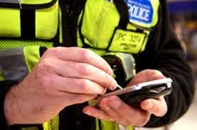
Police National Database (PND)
Allows the Police Service to share, access & search local force information on a national basis
Updated in “near real time”
Information from 3x5x2 may be entered on PND

Slide 49
PND Benefits
Identify new lines of enquiry
Identify new patterns in crime
Remove the current artificial borders
Make much better risk-assessments & improving decision making
Uncover bad character evidence
Notes:
QTS – what are the benefits of the PND?

Slide 50
PND
Witness data should not be included on the PND but some victim data will, in limited cases be available
POLE Searches:
PND searches operate on 4 areas that give structure to the speed & quality of the information that can be searched
People
Objects
Location
Events

Slide 51

Information Sharing
Effective policing in reliant upon the lawful sharing of information with the police service itself, with other agencies, with individuals & with the general public

Slide 52

Benefits of Sharing Information
The lawful sharing of information has a number of benefits for the police service:
A 2 way process with information flowing from & to the police service. Helps provide improved public services. Enables links to be made between people, objects, locations & events using data that might not have been available to the other party without it being shared
Increased openness among partner agencies builds confidence & trust in the police service
It allows police & partners to make better informed decisions on how best to protect the public
Formalised processes increase confidence of individual officers & staff to lawfully share information. Increases expertise & professionalism

Slide 53
Sharing Information within the Police Service
Subject to nay handling codes applied to the information, police forces can freely share information with one another if it is for a policing purpose (see the section covering NIM for an explanation on handling codes)
You have a responsibility to ensure the security of information & you must record your information sharing decisions in accordance with your own force policy. It is vitally important that you submit intelligence in an ‘unsanitised’ format

Slide 54
Sharing Information Outside the Police Service
Before information can be shared with bodies outside the police service there must be one of the following:
Statutory obligation
A specific legal obligation or requirement to disclose police information to another party
Statutory power
A specific legal power, but not an obligation to share police information with another party
Common law
If there is no statutory obligation or power to share information then a common law policing purpose must be established

Slide 55

Information Sharing Agreement (ISA)
The purpose of an ISA is to formalise arrangements between organisations which need to share information on a regular basis
An ISA may be an existing national agreement between agencies or it may be a purely local arrangement

Slide 56
Information Sharing Agreement (ISA)
What is an ISA?
They are formal agreements between organisations that are sharing personal data. They explain why data is being shared & set out the principles & commitments organisations will adopt when they collect, store & disclose personal information about members of the public
Protocols/agreements also explain when information can be shared. Without such formal agreements, public organisations may find themselves falling short of common standards. Also, there may be confusion over responsibilities – both within & between organisations

Slide 57
When Can Information Be Shared?
There are several types of circumstances where information can be shared
Emergency situations
Routine
Ad-hoc
If you genuinely believe that imminent harm will come to someone if you do not disclose information immediately, you should release the information. The DPA does not put privacy above people’s welfare
Notes:
There are several types of circumstances where information can be shared.
Emergency situations
In an emergency situation most organisations will share information without asking for further details. The Data Protection Act allows the processing of personal data if it is in “the vital interests” of the data subject or any other person; usually this would mean that someone was at immediate risk of harm. For example, in cases of life or death, such as where an individual’s identity and/or medical history is disclosed to a hospital’s A&E department treating them after a serious road accident. There should be conditions of real urgency that necessitate the immediate sharing of data without reference to proper procedures. This method of sharing data must not be abused e.g., by the requester exaggerating the gravity of the situation.
Routine
Another circumstance is the routine and systematic dissemination of information between partners for the purposes of a particular initiative. These initiatives can be fairly broad in aspect and include tackling anti-social behaviour, child protection, and social care. Information sharing is vital to these initiatives and protocols should be drawn up outlining the process and method of sharing data. This is likely to happen on a regular basis and in a controlled manner in a multi-agency setting. There will usually be named individuals through whom all requests should be made.
Ad-hoc
In many cases requests are made on an ad hoc basis between organisations and individuals. This covers a very wide range of possibilities and is much more complicated.
In a non-emergency situation a request for personal data should be made via a Section 29(3) form. This will allow the receiving organisation to consider the request and either provide the information or refuse to release it. If the request is refused but the information is still deemed to be necessary then a court order can be applied for. Asking for a court order is seen as a safer option for some organisations as a complaint can be made by the data subject if they feel their data has been shared unlawfully.
Requests from other organisations should state the authority or power that allows the information to be shared, eg the Child Support Agency has several powers that oblige organisations to disclose data. Any request should state that power and should be made under Section 35(1) of the Data Protection Act. These type of requests should always be made in writing with time for the receiving organisation to consider them.
Retrospective Facial Recognition is a technology that can assist the Police in identifying an unknown suspect from a CCTV or other image that has come to light as part of a criminal investigation. The technology is used to check if the image matches any of the photos that we hold of people who have previously come into police custody. All three Emergency situations, routine and ad-hoc processes can give rise to the use of facial recognition tecgnology

Slide 58
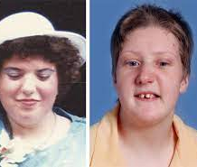
Failing to Share Key Information
The Fiona Pilkington case had its origins in harassment & ASB.
Fiona & her daughter suffered frequent & sustained local disorder, often directed at their home over a period of several years.
This was reported to the police but ‘incidents were too often dealt with by police officers in isolation & with an unstructured approach’ (IPCC 2011).
This & other factors such as not identifying the family as vulnerable & not recognising the harassment & ASB as targeted hate crime caused frustration.
Fiona eventually took her own life & that of her disabled daughter Francesca

Slide 59


Research Task: What is Artificial Intelligence

