Slide 1

LCHS4010:Psychology in Health and Social Care Component1
Appying Erikson's Psychosocial Theory to Support Isaac's Development.
Student Name: Patience Omono Okpiabhele
Student No: 2511530
Lecturer's Name: Dr Rizwan Nadim
Date: 15.6.2026

Slide 2

Introduction
The lifespan perspective in developmental psychology is a theoretical approach that views human development as a lifelong process that does not end with adolescence but continues into old age (Baltes 1987).
Baltes 1987 outlined several key principles of lifespan development as development is lifelong, multidimensional, plastic, influenced by multiple factors and involves both gains and losses.
Also to help us understand ourselves by recognising that individual experiences vary, change is constant and social and cultural factors play a role(Samtrock,2021).
This presentation shall be using Erikson's psychosocial theory and propose evidence-based support strategies suitable for an early years setting (Isaac's case).
ThePhoto by PhotoAuthor is licensed under CCYYSA. (Bing, n.o date)

Slide 3
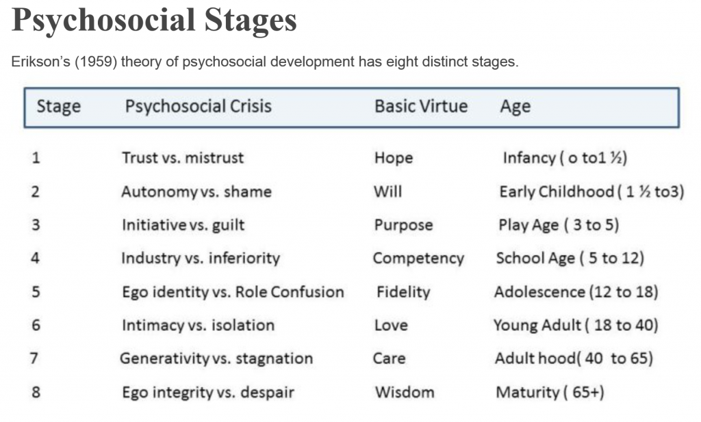
Erikson's Psychosocial Theory
Key concepts : Erik Erikson proposed that development occurs through eight psychosocial stages across the lifespan.
ThePhoto by PhotoAuthor is licensed under CCYYSA. (Bing,.n.o date)

Slide 4

Relevant Stage for Isaac:
Initiative vs Guilt 3-5
Developmental Assumptions:
  Social relationships influence development,
  Successful resolution leads to healthy development,
  Failure may lead to insecurity, guilt, and low self-esteem (Erikson 1963).
Children:
Explore their environment
Develop confidence
Initiate play and social interactions
Build independence
(Bing, n.o.date)

Slide 5
Why Erikson's Theory is Appropriate
Relevance to Early Childhood:
At age 4, Isaac is expected to:
Engage in imaginative play
Build friendship
Develop communication skills
Explore independently.
Why it fits Isaac's situation is because
Isaac demonstrates the following :
Lack of confidence
Social withdrawal
Clinginess towards his mother
Limited participation in activities
These behaviours suggest that difficulties resolving the Initiative vs Guilt stage (Erikson, 1963).

Slide 6
Why Applying Erikson's Theory is Appropriate
Disrupted Childcare Arrangements
Reduced opportunities for consistent relationship
Difficulty developing trust and confidence.
Mother's Mental Health
Postnatal depression may affect responsiveness and emotional availability .
May limit opportunities for secure emotional development .
Limited Social Interaction
Fewer opportunities to develop initiative through play
Increased social anxiety.
Emotional Responses
Separation distress suggest insecurity and dependency.
Language Delays
Reduced communication skills may limit participation and confidence(Berk, 2023).

Slide 7

Nature and Nurture Factors
Nature (Biological Influences)
Possible naturally cautious temperament .
Early brain development influences emotional regulation .
Genetic predispositions may affect resilience.
Nurture( Environmental Influences)
Maternal mental health.
Quality of caregiving.
Social experiences.
Frequent childcare transitions.
Limited peer interaction.
Interaction of Nature and Nurture
Develo0pment results from the interaction between biological factors and environmental experiences (Belsky,2022).

Slide 8
Support Plan
Play-Based Learning
Small group play activities, role-play opportunities,
Child-led play sessions.
Language-Rich Environment
Shared reading, singing, and storytelling
Open-ended questioning, and vocabulary modelling.
Parental Support
Encourage reading at home, model positive interactions
Support confidence-building activities.
Link to Erikson
Promotes initiative, communication skills, and social participation (Vygosky, 1978).
Attachment-based Approaches
Key person system
Consistent daily routines
Gradual separation strategies.
Emotional Regulation Strategies
Emotion couching
Visual emotion cards.
Story books about feelings and calm spaces.
Link to Erikson
These strategies help Isaac develop confidence and security, supporting successful resolution of the Initiative vs Guilt stage(Bowlby, 1988, Erikson 1963).

Slide 9

Multi-Agency working (Professionals involved)
GP
Family support worker
Early years practitioners
Health visitor
Speech and language therapist (SALT)
Mental health services for Isaac's Mum.
Benefits
Improved developmental outcomes, early interventions, holistic support and support for both Isaac and his mun(Department of Education, 2024).
(Bing, n.o date)
ThePhoto by PhotoAuthor is licensed under CCYYSA.

Slide 10
Critical Evaluation
Strengths of Erikson's Theory
Easy to Apply in Practice.
Useful for planning interventions.
Supports understanding of emotional development.
Highlights importance of social relationship.
Limitation
Develo0pment may not occur as fixed in stages.
Limited understanding for cultural differences.
Underestimates biological influences
Stages may be too rigid.

Slide 11
Conclusion
Relevance to London Diverse Communities
Must be adapted to different cultural values and parenting practices.
Recognise importance of family and community support.
Conclusion
Isaac's experiences have affected his emotional, social and language development.
Erikson's psychosocial theory provides a foundational framework for understanding Isaac's needs and planning supportive interventions that promote confidence, emphasizing the role of social interactions and lifelong growth. The concept of initiative vs guilt remain valuable in psychology, education and counselling, helping explain how children in early years develop their sense of purposefulness from interacting with more people
(Vygosky,1978).
However, the theory has limitations, including lack of empirical evidence, cultural biases, and a rigid stage model.

Slide 12
References
Baltes, P.B (1987) Theoretical propositions of life-span developmental psychology : On the dynamics between growth and decline; Developmental psychology pp611626.
Belsky, J(2022) Experiencing the Lifespan 6th edn New York: Worth Publishers.
Berk, L.E(2023) Development Through the lifespan 8th edn. Harlow ;Pearson.
Bing, n.o date mage of human development in blue and red colour accessed 13.6.2026
Bing , n.o date a photo(table) of Erikson 'psychosocial stages of development ,
Access13.6.2026.
Bing, n.o date photo of 2 kids play, accessed 13.6.2026.
Bing, n.o date, photo of medical professio9nals meeting, accessed 13.6.2026.
Bowlby, J. (1988) A Secure Base: Parent-child Attachment and Heathy Human Development. London: Routledge.
Department for Education (2024) Working Together to Safegaurd Children, London: HMSO.
Erikson E.H (1963) Childhood and Society .2nd edn . New York: Norton.
BVygotsky, L.S (1978) Mind in Society : The Development of Higher Psychological Processes. Cambidge, MA: Havard University Press.
Santrock, J.W. (2021) Life-span development 18th edn New York : Mc Graw-Hill

