Slide 2
Understanding Networks
Network Operating Systems
and Services (ACCA5023)
Applied Computing - WISA

Slide 3
  Module Induction
  Understanding Networks
    Components
    Architectures
    IP Addressing
    Servers
  Network Operating Systems
During this session, we shall discuss details of our module (Lectures, Tutorials, Assessments etc.
We shall discuss various Networking Components, functionalities and Operations, Architectures and Network Operating systems
Lab/ Tutorials
Research: IP Address, Network Communication, Network Components.

Slide 4
Useful Further Reading:
  Windows Server: An Introduction
  https://learn.microsoft.com/en-us/windows-server/get-started/overview
  What’s new in Server 2022?
  https://learn.microsoft.com/en-us/windows-server/get-started/whats-new-in-windows-server-2022?source=recommendations
  Configure and Deploy Server roles and functionality in Server 2022
  https://www.ituonline.com/how-to/how-to-install-dhcp-on-windows-server-2022/
An Introduction to Ubuntu Server
https://linuxconfig.org/ubuntu-server-tutorial-for-beginners

Slide 5
Useful Further Reading (Professional development):
  AZ-104: MS Certified Azure Administrator Associate.
  https://www.youtube.com/watch?v=firCQm5nHYQ
  Microsoft learn: Azure Virtual Desktop
  https://learn.microsoft.com/en-us/azure/virtual-desktop/
  MD-102: MD-102: Managing and Securing Microsoft 365 Endpoints by using Intune
  https://learn.microsoft.com/en-us/credentials/certifications/resources/study-guides/md-102

Slide 6
Module Induction
Communication with Lecturer
Two Coursework's (Multiple Dates!!!)
Component 1 50% | Research, build, and deploy, a Virtualised network Configure, and manage a Virtualised network | Report:
Component 2 50% |  | Demonstration:

Slide 7
Teaching plan (Semester 1):
Introduction to topic, network architecture/services.
Virtualisation (Theory/Practical examples).
Directory Services.
Routing.
DNS (Domain Name Services/System).
DHCP (Dynamic Host Configuration Protocol).
VPNs (Virtual Private Networks).
PowerShell scripting concepts.
Cloud Computing/Virtualisation/SDN (Software Defined Networking).

Slide 8
I - Introduction
What is ?
  Computer Networks
  Types of Networks
  Resources in a Network
  Components in a Network
  Hosts and Nodes – Are they same thing?

Slide 9
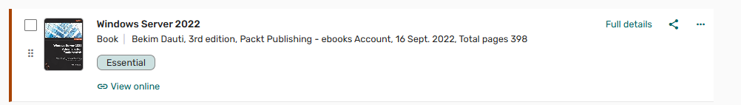
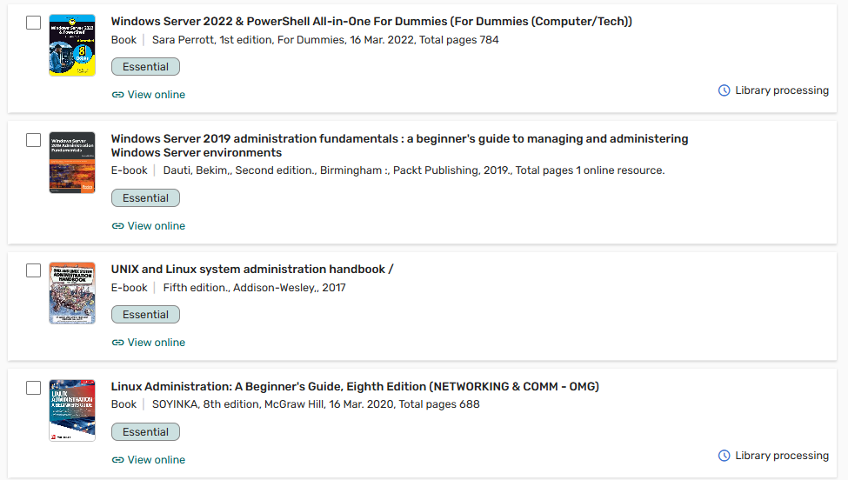
I - Introduction
Windows Server 2022
  Another version of the Microsoft OS for servers, is Windows Server
  Windows Server 2022 is the successor to Windows Server 2019.
  Various implementations available depending on demand (Datacenter, Enterprise, Standard, Essentials).
  Besides introducing Windows Server, an overview of the some of the core, fundamental concepts of computer networks will be provided.

Slide 10
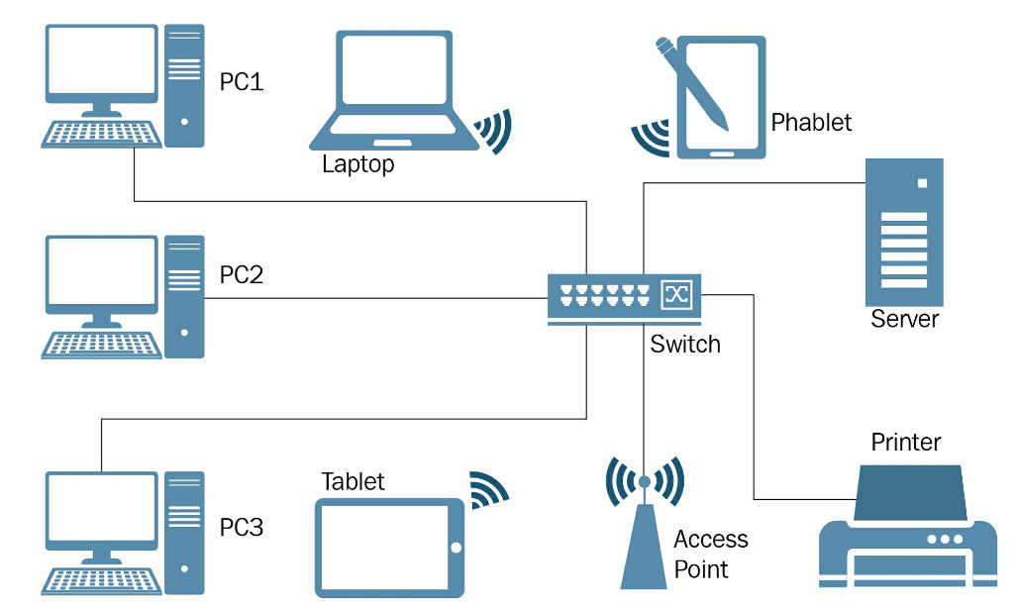
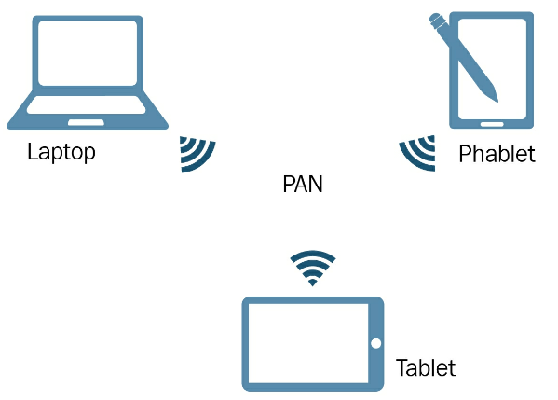
II – Understanding Networks
What is a Computer Network?
  A computer network is a group of computers connected to each other in order to share resources. The resources are usually data, network services, and peripheral devices
Types of Computer Network?
  PAN / Home area Network (HAN)
  LAN
  MAN
  WAN

Slide 11
III – Components
Like PCs have components, computer networks also have their own components.
Usually, while PCs and peripheral devices are known to most people, components such as networking devices, networking media, and network operating systems (NOS) are mostly known by Engineers, Technicians (IT Professionals).

Slide 12
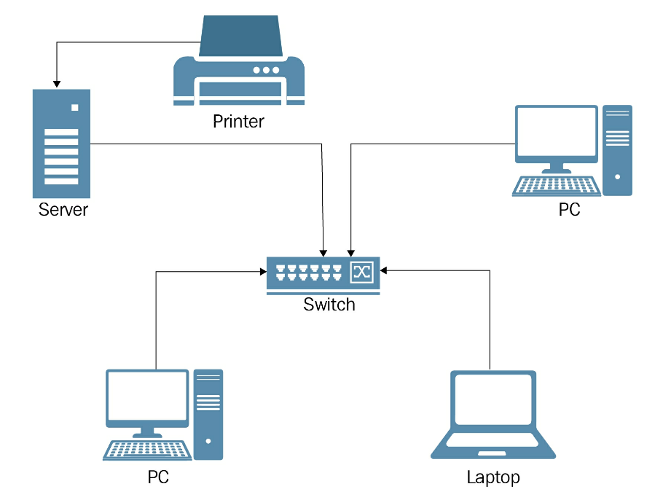
IV - Architecture
The word servers comes from the word serve. It means to provide services that benefit or help.
From that, we can think of a server in a computer network as the computer that provides services to clients.
Let's assume that the network resource is the point of reference for both clients and servers. Clients request access to resources and servers are responsible for providing resources and managing access to those resources.
Both clients and servers play an active role in the computer network.

Slide 13
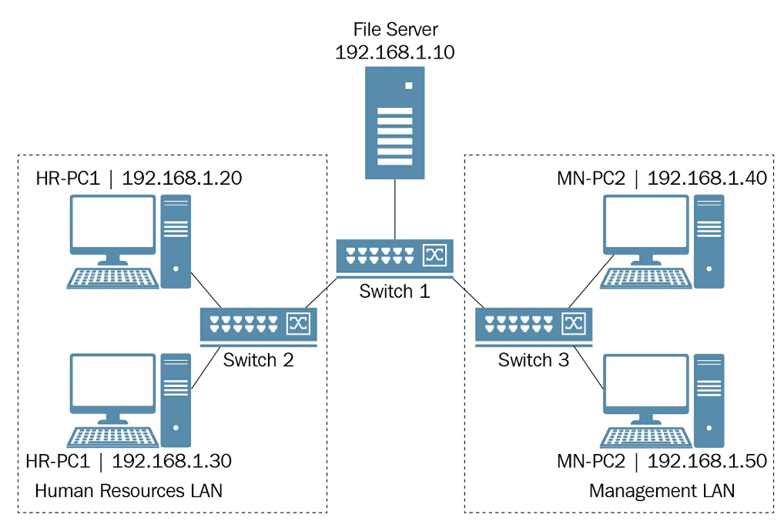
IV – Architecture
Although clients and servers are the most important elements of a computer network, it depends upon hosts and nodes. Are they the same thing?
No, they are not!
While all hosts can be nodes, not every node can act as a host.
A host is any device with an IP address assigned to its network interface that requests or provides networking resources on the network. (E.g. clients, servers, and routers).
A node is any device that can receive and transmit the networking resources on the network. Nodes have a network interface that is used for their management.
Common examples of nodes in a home and enterprise computer networks are Switches and Routers, since these are devices that typically, send, receive, store or forward data.

Slide 14
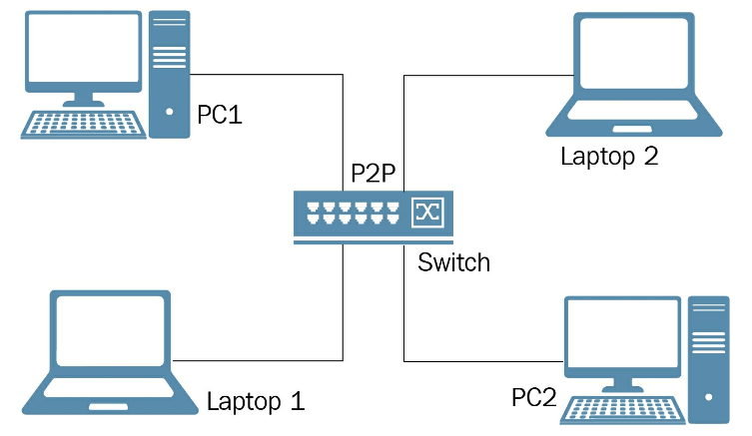
IV – Architecture
Architecture:
  Peer to Peer (P2P)
    Peer-to-Peer (P2P) network architecture refers to a network model in which hosts or computers are equal in terms of capabilities and responsibilities.
    Depending on the circumstances, each host may be a client or server depending on whether it requests or provides services in that network.
  Client/ Server
    A client/server, often known as a domain-based network, is a computer network in which hosts have a predefined role.
    Hosts that request resources act as clients, whereas hosts that provide resources act as servers.
    In general, the client/server network architecture is a network with dedicated servers.
    Usually, LANs, MANs, and WANs represent the best examples of client/server computer networks.

Slide 15
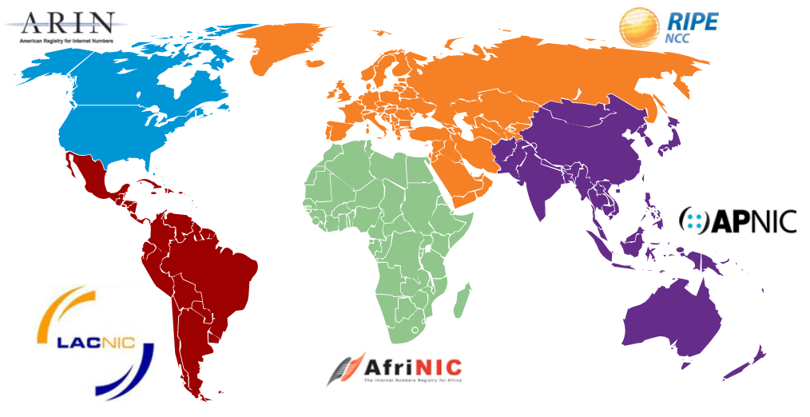
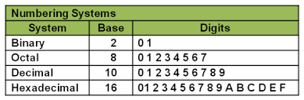
V – IP Addressing – Using Number Systems
An Internet Protocol address, popularly known as an IP address, is a logical element comprised of numbers, assigned to host's network interface in order to uniquely identify it in a computer network.
  The Network address helps the router identify a path within the whole network (e.g. the Internet). This number is assigned by the American Registry for Internet Numbers (ARIN) (or an ISP).
  Host address is assigned by the network administrator according to some internetworking address plan. Host addresses can be assigned dynamically.
  All hosts on the same network will have the same network number but each host is uniquely identified by its own host number.

Slide 16

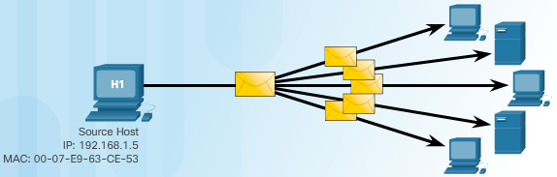
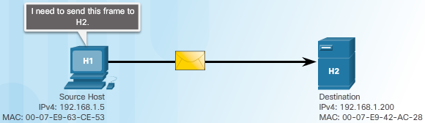
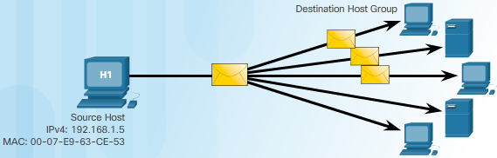
V – IP Addressing: IPv4
  Is a logical network address that identifies a particular host. It is associated with a network interface card and It is unique on the network for communications
  32 Bit | Dotted Decimal Notation (DDN) |
  8 Bit Each (Decimal Octets) | 0 to 255 (4 Octets)
  Public and Private Addresses
    The Public addresses are used on the Internet
    The Private Addresses are used only within LAN’s
    The Private Addresses are not for public routing use (Internet)
  Unicast The Packets are sent to only one device
  Multicast The Packets are sent to many devices
  Broadcast The Packets are sent to all devices in the Network

Slide 17
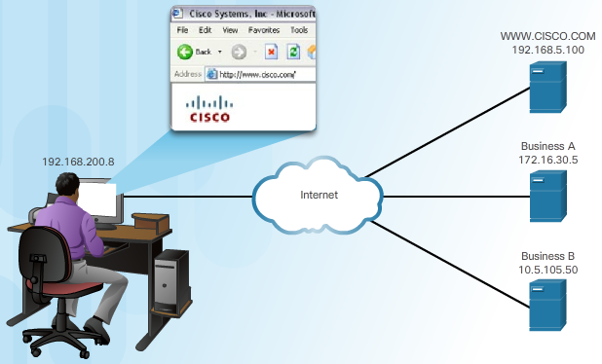
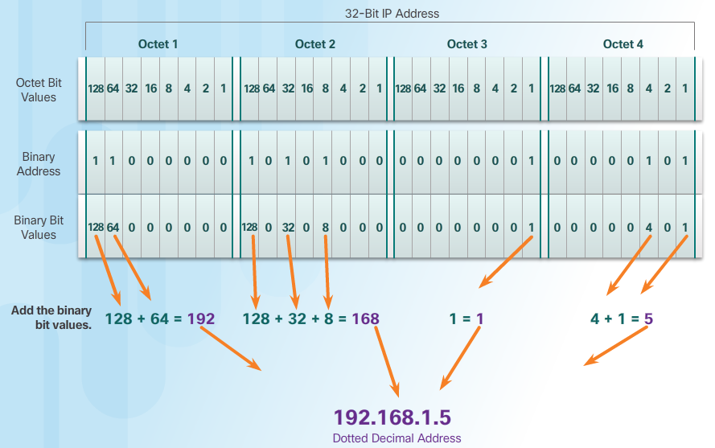
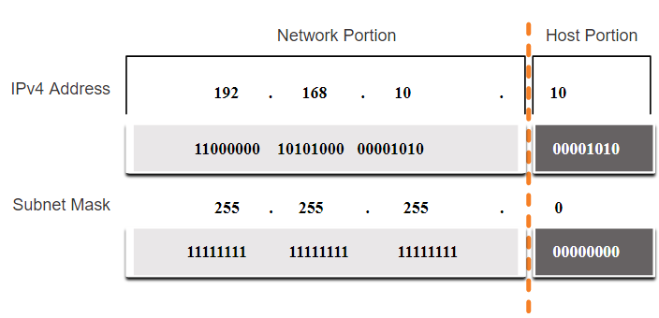
V – IP Addressing: IPv4 Subnet mask
A subnet mask is used to determine the network and host portions. The subnet mask is a critical component to provide since the router uses it to establish which part of an IP address belongs to the ‘Network’

Slide 18
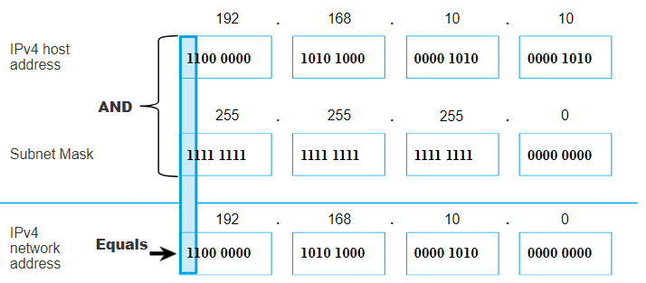
V – IP Addressing: IPv4 Subnet mask
The actual process used to identify the network and host portions is called ANDing.
  1 AND 1 = 1,
  0 AND 1 = 0,
  1 AND 0 = 0,
  0 AND 0 = 0
  1 = True
  0 = False

Slide 19
V – IP Addressing: IPv4 Structure
The prefix length is the number of bits set to 1 in the subnet mask.
It is written in “slash notation” therefore, count the number of bits in the subnet mask and prepend it with a slash.
A prefix length is a less cumbersome method used to identify a subnet mask address.
Within each network are three types of IP addresses:
  Network address
  Host addresses
  Broadcast address
Subnet Mask | 32-bit Address | Prefix Length
255.0.0.0 | 11111111.00000000.00000000.00000000 | /8
255.255.0.0 | 11111111.11111111.00000000.00000000 | /16
255.255.255.0 | 11111111.11111111.11111111.00000000 | /24
255.255.255.128 | 11111111.11111111.11111111.10000000 | /25
255.255.255.192 | 11111111.11111111.11111111.11000000 | /26
255.255.255.224 | 11111111.11111111.11111111.11100000 | /27
255.255.255.240 | 11111111.11111111.11111111.11110000 | /28
255.255.255.248 | 11111111.11111111.11111111.11111000 | /29
255.255.255.252 | 11111111.11111111.11111111.11111100 | /30

Slide 20
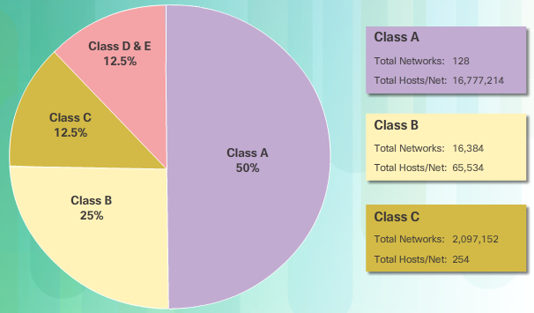
V – IP Addressing: IPv4 Classes
Classful Addressing
  Class A (0.0.0.0/8 to 127.0.0.0/8) supports extremely large networks.
  Class B (128.0.0.0 /16 – 191.255.0.0 /16)
  supports the needs of moderate to large size networks.
  Class C (192.0.0.0 /24 – 223.255.255.0 /24)
  supports small networks with a maximum of 254 hosts.
Classless Addressing
  IPv4 addresses allocated on any address bit boundary
  Delays the depletion and exhaustion of IPv4 addresses
  Classless Inter-Domain Routing (CIDR)

Slide 21
V – IP Addressing: IPv4 Special Addresses
Loopback addresses
127.0.0.0 /8 (127.0.0.1 to 127.255.255.254)
Commonly identified as only 127.0.0.1
Used on a host to test if TCP/IP is operational.
Link-Local addresses
169.254.0.0 /16 (169.254.0.1 to 169.254.255.254)
Commonly known as the Automatic Private IP Addressing (APIPA) addresses or self-assigned addresses.
Used by Windows DHCP clients to self-configure when no DHCP servers are available.

Slide 22
V – IP Addressing: IPv4 Assigning Addresses
Assigning Addresses
Can be done statically or dynamically
Assign an IPv4 address, subnet mask, default gateway and other necessary info for network communications
Static IPv4 addresses
Hosts, such as servers and printers, that need particular addresses
Can be time consuming and error prone
Need to maintain an accurate list of which IPv4 addresses
  Dynamic IPv4 Address Assignment
  Dynamic Host Configuration Protocol (DHCP) allows for automatic assignment of addressing information
  Preferred method of assignment for a large network
  IP addresses can be reallocated when they become available

Slide 23
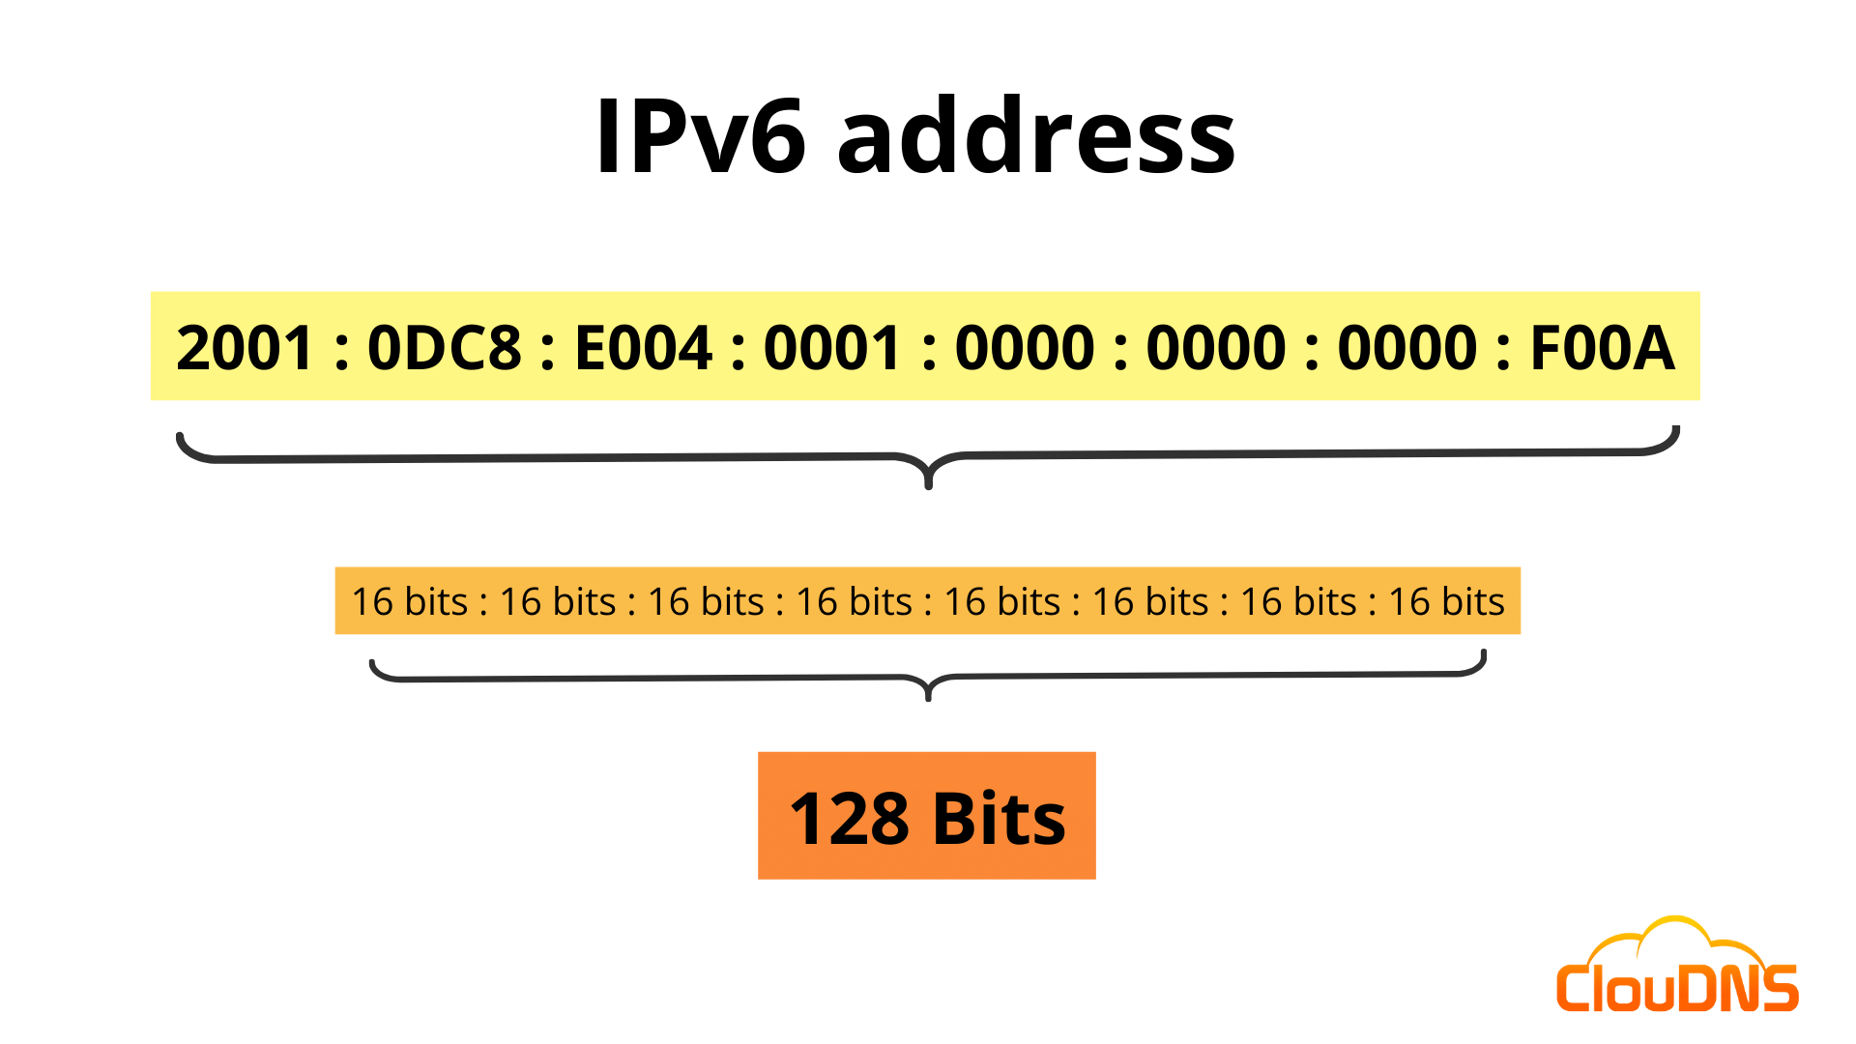
V – IP Addressing: IPv6 Address
What is an IPv6 Address?
Functionally, same purpose as IPv4, but with advantages. Both IPv4 and IPv6 will coexist in the near future, and the transition will take several years.
IPv6 addresses are 128-bits in length and written in hexadecimal. It is not case-sensitive and can be written in either lowercase or uppercase.
The preferred format for writing an IPv6 address is x:x:x:x:x:x:x:x, with each “x” consisting of four hexadecimal values. In IPv6, a hextet is the unofficial term used to refer to a segment of 16 bits, or four hexadecimal values.
Examples of IPv6 addresses in the preferred format:
        2001:0db8:0000:1111:0000:0000:0000:0200
        2001:0db8:0000:00a3:abcd:0000:0000:1234
IPv6 address is split into two 64-bit blocks, firstly identifying the Network prefix and the second block identifying the interface ID.

Slide 24
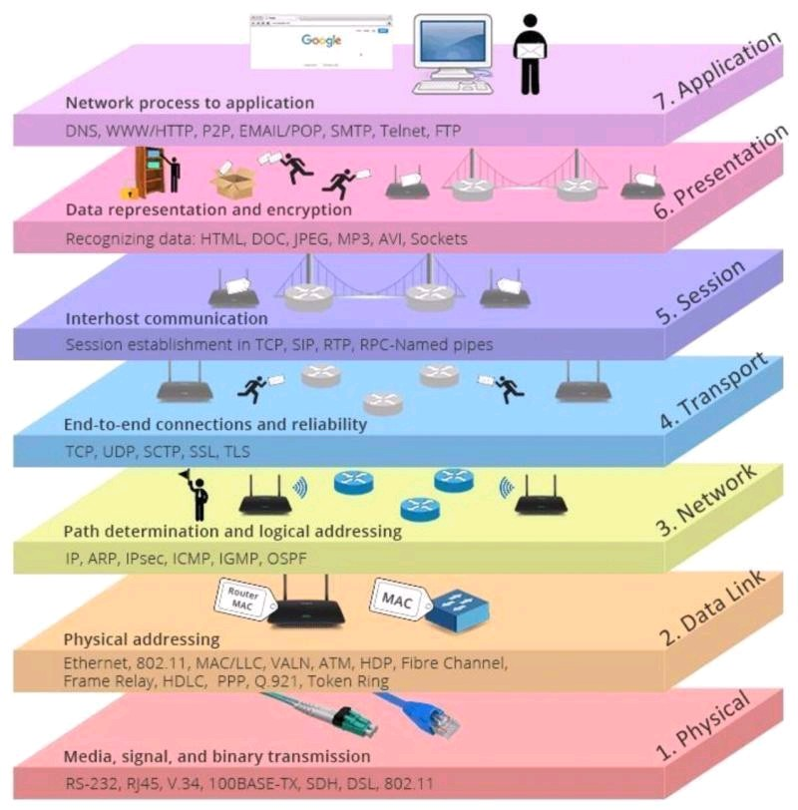
VI – Infrastructure: Standards
Protocol Model | Reference Model
TCP/IP Model | Open Systems Interconnection (OSI) Model
Protocol Model | Reference Model
TCP/IP Model | Open Systems Interconnection (OSI) Model
FTP, SMTP, HTTP, POP3…
FTP, SMTP, HTTP, POP3…
4. APPLICATION
3. TRANSPORT
2. INTERNET
1. NETWORK INTERFACE
7. APPLICATION
6. PRESENTATION
5. SESSION
4. TRANSPORT
3. NETWORK
2. DATA LINK
1. PHYSICAL
TCP & UDP
TCP & UDP
IP
Ethernet
OSI/ TCP-IP Protocol Suite

Slide 25
VI – Infrastructure: Devices
Main routing components include:
ROUTERS
Routers are Layer 3 devices
A router makes routing (best path) decisions based on Network Addresses.
It examines packets and chooses the best path for them through the network.
Routing is sometimes known as Layer 3 switching.
Routing interface
Routing protocol
Routing table
Router types | Example
Hardware router | A device that performs routing as a dedicated function
Software router | A router that is not dedicated to performing routing only, but performs routing as one of multiple processes running on the router computer

Slide 26
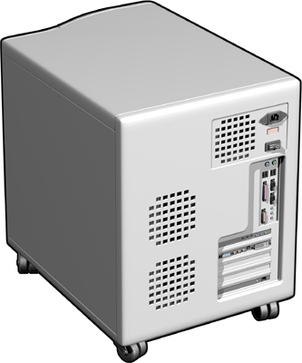
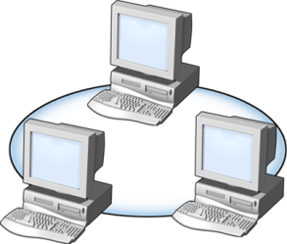
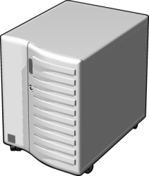
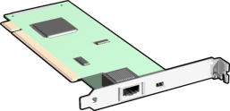
VI – Infrastructure: Devices
A routing interface is an interface over which IP packets are forwarded
For a router to be able to route a packet it must know:-
  Destination address of packet
  Neighbour routers
  Possible routes to all remote networks
  The best route to each remote network
  How to maintain and verify routing information
The networks connect to the router's interfaces are known as Directly Connected networks
Either the administrator must add all routes to the remote networks, or the router must learn them itself.

Slide 27
VI – Infrastructure: Operations
Packet Forwarding…
Host on network A generates packet for network B
Host applies network mask to destination network address of packet and realises it is on a different network
Host knows the IP address of the router (Default Gateway), so recovers the MAC address for the router using ARP
Host encapsulates the packet in a Layer 2 frame using its own source MAC address and the destination MAC address of the router
Router receives frame and recognises its own MAC address, so it strips of the layer 2 framing and passes it to the Layer 3 IP network layer
Router compares destination IP address with router table to determine the interface by which the packet should be sent
If the destination network is an Ethernet network directly connected to the router then ARP is used again to determine MAC address of destination host
Router creates a layer 2 frame using its MAC address for the source and the destination host MAC address

Slide 28
VI – Infrastructure: Operations
IP Packet
DEST= 207.33.43.2 SRC = 205.10.20.2
205.10.20.2
Layer 3
Layer 2
207.33.43.2
Layer 1
Ethernet
207.33.43.1
Ethernet
205.10.20.1

Slide 29
VI – Infrastructure: Operations
Routing Table…
Routing table can be configured by many methods.
Static:
  Routing information is configured manually, no overhead on routers CPU, No bandwidth usage between routers.
  Security – administrator only configures routes to certain networks
  Administrator must fully understand the network to create the routing tables correctly, Not feasible for large networks
  If a new network is added all the routers must be configured manually
Default:
  Used to send packets with a destination network number which doesn’t match an entry in the routing table, to the next (default) router.
  Used for routers on stub networks, which only have one exit from the network segment
Dynamic:
  To learn routes for themselves, routers must exchange routing information (updates) about the networks they each know about. This information is exchanged by Routing Protocols. If changes occur in the network, then the routers inform each other of the change. This process is known as Dynamic Routing.

Slide 30
VI – Infrastructure: Operations
Feature | Dynamic Routing | Static Routing
Configuration complexity | Independent of network size | Increases with network size
Topology changes | Automatically adapts to topology changes | Administrator intervention required
Scalability | Suitable for simple to complex network topologies | Suitable for simple topologies
Security | Security must be configured | Security is inherent
Resource Usage | Uses CPU, memory, and link bandwidth | No additional resources needed
Path Predictability | Route depends on topology and routing protocol used | Explicitly defined by the administrator

Slide 31
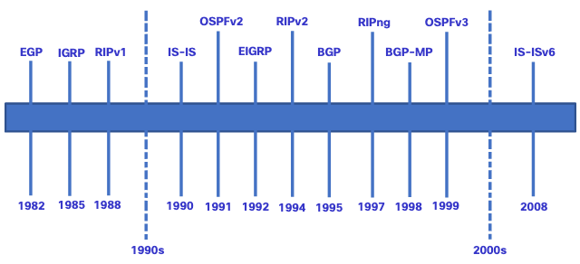
VI – Infrastructure: Operations
 | Interior Gateway Protocols |  |  |  | Exterior Gateway Protocols
 | Distance Vector |  | Link-State |  | Path Vector
IPv4 | RIPv2 | EIGRP | OSPFv2 | IS-IS | BGP-4
IPv6 | RIPng | EIGRP for IPv6 | OSPFv3 | IS-IS for IPv6 | BGP-MP

Slide 32
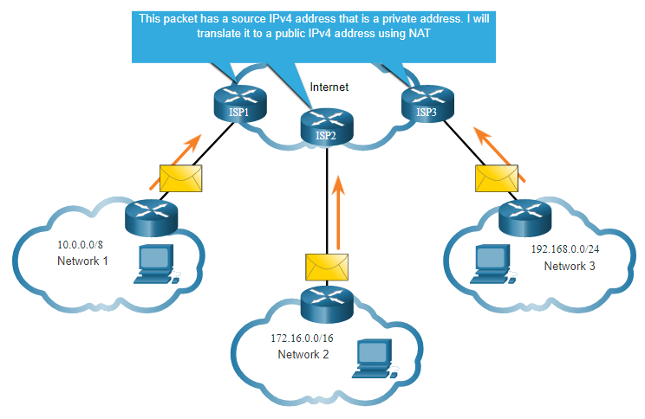
VI – Infrastructure: Operations
Network Address Translation (NAT) translates private IPv4 addresses to public IPv4 addresses.
NAT is typically enabled on the edge router connecting to the internet.
It translates the internal private address to a public global IP address.
Port Address Translation (PAT)
  Translates multiple local IP addresses to a single external IP address supplied by ISP
  Remembers source port number used by local machine when requesting a network service (e.g. web)
  Responses are routed to correct local machine by looking up port number → now the destination port
NAT & PAT can be applied together

Slide 33
VII – Servers
  Windows Server has evolved from a simple file server to an operating system that is capable of handling multiple network services in complex environments, such as corporate/enterprise networks.
  Windows Server OS is one example OS platform, that can provide network services such as domain controllers, web servers, print servers, and file servers.
  It often acts as a separate platform in which enterprise applications such as Exchange Server, SQL Server, SharePoint Server, and others are executed.
  With its robust performance, advanced functionality and security, nowadays, Windows Server is shaping cloud computing.
  MS Azure, runs off a specialised Windows Server version and ‘minimalistic Hyper-V architecture’.

Slide 34
VII – Servers: Hardware & Software
  Computer hardware represents physical components of a server and software represents logical components of a server.
  The primary role of the server is to provide network services to the clients, a server requires powerful hardware too, because software such as Windows Server is designed to process large workloads.
  The hardware is required to be durable and constructed from high-quality materials so it can continually deliver services and support network-based operations. Hence, distinguishing it from the ‘consumer computer system’.
  A server has more substantial hardware requirements (e.g. Intel Xeon base/AMD Threadripper CPU, Large dedicated
  storage (e.g. Storage Area Networks), (Very low latency networking e.g. Integrated switches e.g. Cisco Ethernet
  switch modules, or Fiber channel switch modules, which provide local high speed internal (SAN) and external
  network connectivity, or powerful converged NIC’s (CNAs) or Mezzanine cards.
  Servers are also specific to the types of services it provides; e.g. a database server requires more memory and storage space, a compute cluster would require a server-class CPU as opposed to a consumer based CPU.
  The CPU, memory, disk, and networking are key components for performance.

Slide 35
VII – Servers: Hardware – Memory, Disk
  RAM represents the server's working memory, which is used by Windows Server 2022 and server applications. Thus, the more RAM on the server, the more applications can run simultaneously.
  Data is usually stored on a disk. In servers, it is common to have multiple disk (Volumes), which is referred to as the server's disk sub-system. As for disk performance, read/write speed is an element that must be taken into consideration, because the faster the disk's throughput, the higher the performance of your disk sub-system.
  One common performance metric used to evaluate a Server’s performance is IOPS (Input Output Operations per second)
  IOPS is a measurement of how many read and write operations a storage system can perform in one second.
  Applications that depend heavily on IOPS capability are Databases, Virtual Machines and AI/ML applications/workloads.

Slide 36
VII – Servers: Types
  Rack-mountable servers are designed to be installed in a frame called a rack. These servers usually populate on-premises server rooms or data centers:
  Blade servers are small modules known as blades that are installed on a server's chassis to save space and power. These servers usually populate data centers or supercomputer facilities.
  Tower servers are single big case servers that stand upright. These servers are usually either used for testing purposes or to provide local services in a SOHO (Small office Home network).

Slide 37
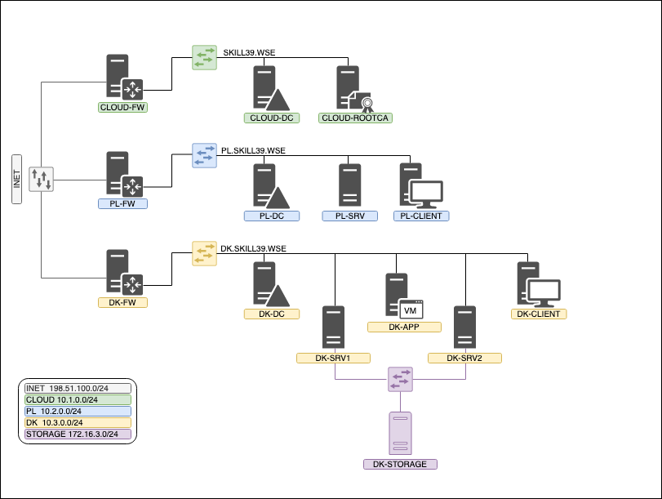
VIII – Network Operating Systems
  A Network Operating System (NOS) is software:
    To manage, maintain and provide resources in a network.
    manage, maintain and provides access to resources.
    That shares files and applications and provides web services.
    Which administers users, computers and provides tools for configuration, maintaining and providing resources, as well as other functions related to network resources.
  An NOS could be a Windows Server, Linux Server (e.g. Debian), and macOS Server (e.g. Mac OS X Server) as all of them are capable of hosting network services.
  A NOS is critical component when it comes to managing computer network resources.

Slide 38
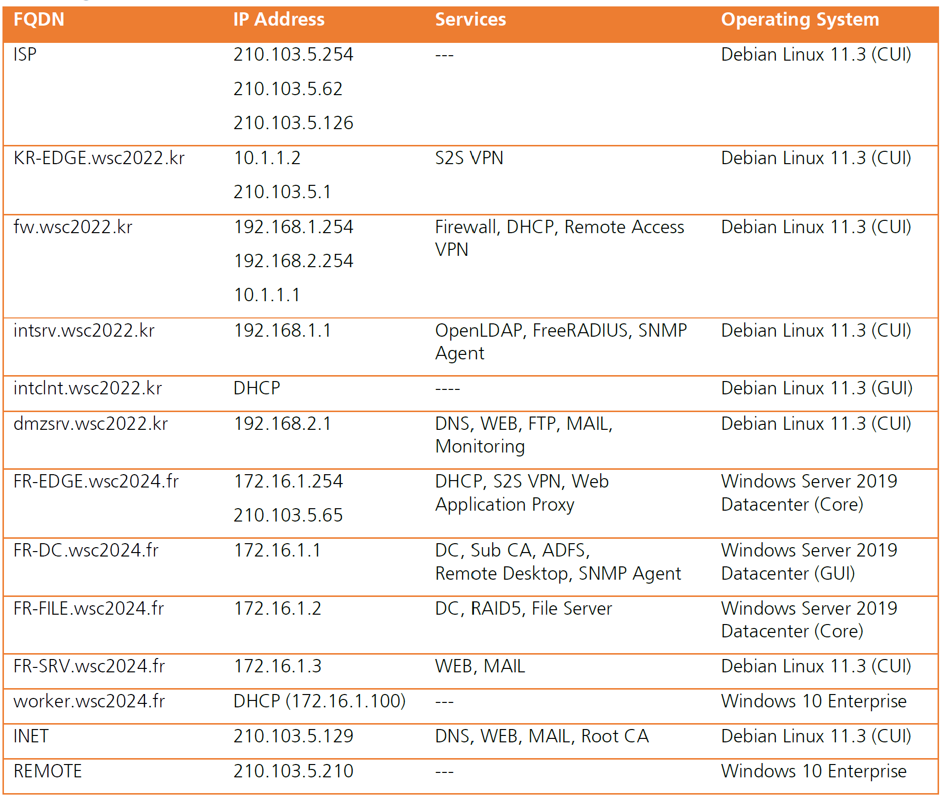
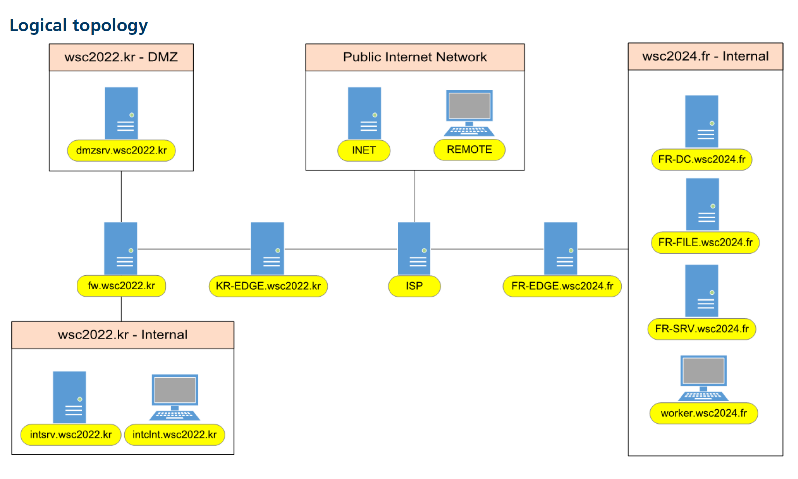
VIII – Network Operating Systems

Slide 39
VIII – Network Operating Systems: Windows
  Windows OS is a Microsoft product. Windows Server powers many organizations' backend systems and provides network services for Windows-based hosts as well as to hosts with a non-Windows OS.
    1990’s → Windows NT 3.5
    2000 → Windows Server 2000. It's a GUI-based OS;
      The New Technology File System (NTFS) is the native files system.
    2003 → Windows Server 2003 (architecture: both 32-bit, and 64-bit)
    2008 → Windows Server 2008,
    a Server Core edition was introduced, which is a CLI-based OS
    2012 → Windows Server 2012 (only 64-bit).
    Resilient File System (ReFS) was introduced to replace NTFS.
    For more details on ReFS:
    https://docs.microsoft.com/en-us/windows-server/storage/refs/refs-overview
    2016 → Windows Server 2016
    2019 → Windows Server 2019 NTFS is a native file system.
    Present → Windows Server 2022, 2025

Slide 40
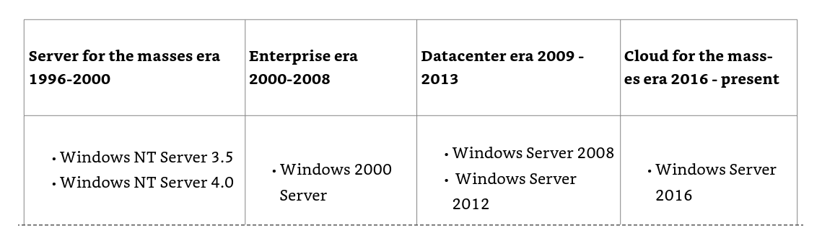
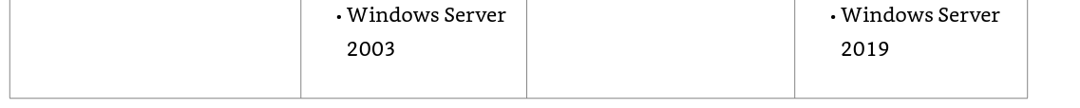
VIII – Network Operating Systems: Windows

Slide 41
VIII – Network Operating Systems: Linux
  Linux operating system is completely Open Source, meaning that its code is indisputable and open to global inspection, examination and review.
  From MINIX → To improve functionality
  1990s → Linus Torvalds developed a new operating system called Linux.
  Due to its security and open-source nature, Linux Servers dominates majority of web servers and supercomputers.
  (the GNU GPL project took over the licensing of Linux, the penguin became a Linux mascot, the first Linux booklet published was Linux Installation and Getting Started)
  To know more on how to run Linux distros on Windows Server
  https://docs.microsoft.com/en-us/windows/wsl/install-on-server.

Slide 42
Summary
Networks Components
Architecture
IP Addressing
Infrastructure
Servers,
Server hardware and size(CPU, memory, disk, network interface)
NOS

Slide 43


