Slide 1


Skills for Academic Success
BMAH4006
Applied Health and Social Care
Dr Simona Ferraraccio
s.ferraraccio@uwtsd.ac.uk
IM14
Week 4 – 19 Oct 2026

Slide 2
Scheme of work
WEEK 1
WEEK 2
WEEK 3
WEEK 4
WEEK 5
WEEK 6
WEEK 7
WEEK 8
WEEK 9
WEEK 10
ONLINE
Academic Integrity and responsible use of AI
Critiquing AI output and Digital skills
Funding and using reliable and credible information
Assignment 1 workshop and draft session
Action planning and module overview
Introduction to the module and assignments
Referencing fundamentals
Reading
Week
Reflective practice and writing
Understanding feedback and reflection

Slide 3
Can we trust AI?
Learning outcomes:
Evaluate AI-generated content: Fact-checking
Comparing AI output with academic literature
Identify bias, inaccuracies, and omissions
Read critically rather than passively
Write academically about what you discovered from the AI-generated essay

Slide 4
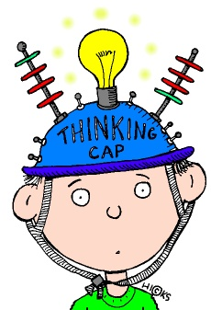
What does “Critical”?

Slide 5
Criticality is not being negative.
Criticality means:
Questioning information
Evaluating evidence
Considering alternative viewpoints
Identifying strengths and weaknesses
Reaching justified conclusions
Thinking beyond first impressions

Slide 6
Which statement demonstrates critical thinking?
Statement 1
AI is useful for university students.
Statement 2
Research suggests AI can support university students with planning and idea generation, but concerns remain regarding accuracy, bias, and over-reliance.
Uses evidence
Considers limitations
It is balanced
It is not simply an opinion
WHY?

Slide 7

Critical thinking, critical writing, critical reading

Slide 8
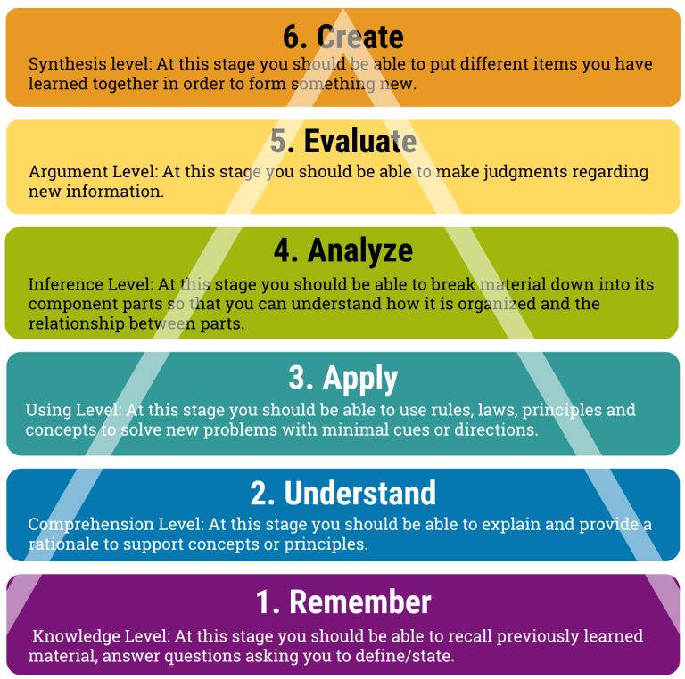
Critical thinking – Bloom’s Taxonomy
Critical
Being critical pulls evidence together to build your arguments; what does it all mean together? It uses more complex processes: analysing, evaluating and creating. You might make comparisons, consider reasons and implications, justify choices or consider strengths and weaknesses.
Descriptive
Being descriptive shows what you know about a topic and provides the evidence to support your arguments. It uses simpler processes like remembering, understanding and applying. You might summarise previous research, explain concepts or describe processes.

Slide 9
Descriptive writing
Descriptive writing demonstrates the knowledge you have of a subject, and your knowledge of what other people say about that subject.
Descriptive writing often responds to questions framed as ‘what’, ‘where’, ‘who’ and ‘when’.
Descriptive writing might include the following:
  Description of what something is or what it is about (an account, facts, observable features, details): a topic, problem, situation, or context of the subject under discussion.
  Description of where it takes place (setting and context), who is involved and when it occurs.
  Re-statement or summary of what others say about the topic.
  Background facts and information for a discussion.
  Description usually comes before critical content so that the reader can understand the topic you are critically engaging with.

Slide 10
Critical writing
Critical writing requires you to apply interpretation, analysis, and evaluation to the descriptions you have provided. Critical writing often responds to questions framed as ‘how’ or ‘why’. Often, critical writing will require you to build an argument which is supported by evidence.
Some indicators of critical writing are:
  Investigation of positive and negative perspectives on ideas
  Supporting ideas and arguments with evidence, which might include authoritative sources, data, statistics, research, theories, and quotations
  Balanced, unbiased appraisal of arguments and counterarguments/alternative viewpoints
  Honest recognition of the limitations of an argument and supporting evidence
  Plausible, rational, convincing, and well-reasoned conclusions

Slide 11

Critical reading
There are lots of ways to define critical reading, four key factors:
Knowing your purpose
Focusing on the things you need
Choosing appropriate reading strategies
Thinking critically about what you read

Slide 12
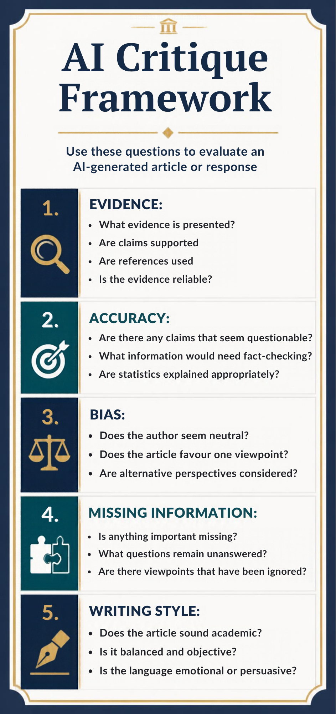
The AI critique Framework

Slide 13

Evidence
Questions to ask?
What evidence is presented?
Are claims supported ?
Are references used ?
If used, is the evidence reliable?

Slide 14
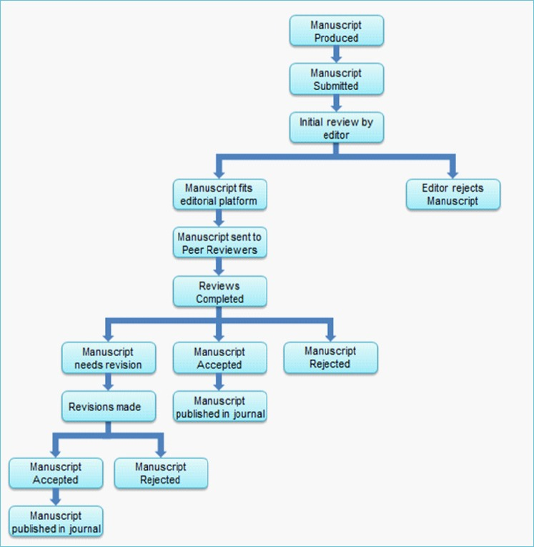
Peer-reviewed literature
Clinical research papers
Cohort studies
Randomised controlled trials
Qualitative research \studies.
Database
PubMed
Scopus
Web of Science
Google Scholar
(Kelly, Sadegheih, and Adeli, 2014)

Slide 15
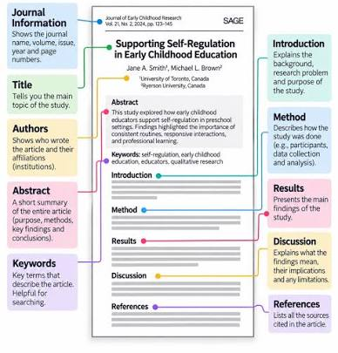
Structure of a journal article
IMRaD Structure

Slide 16
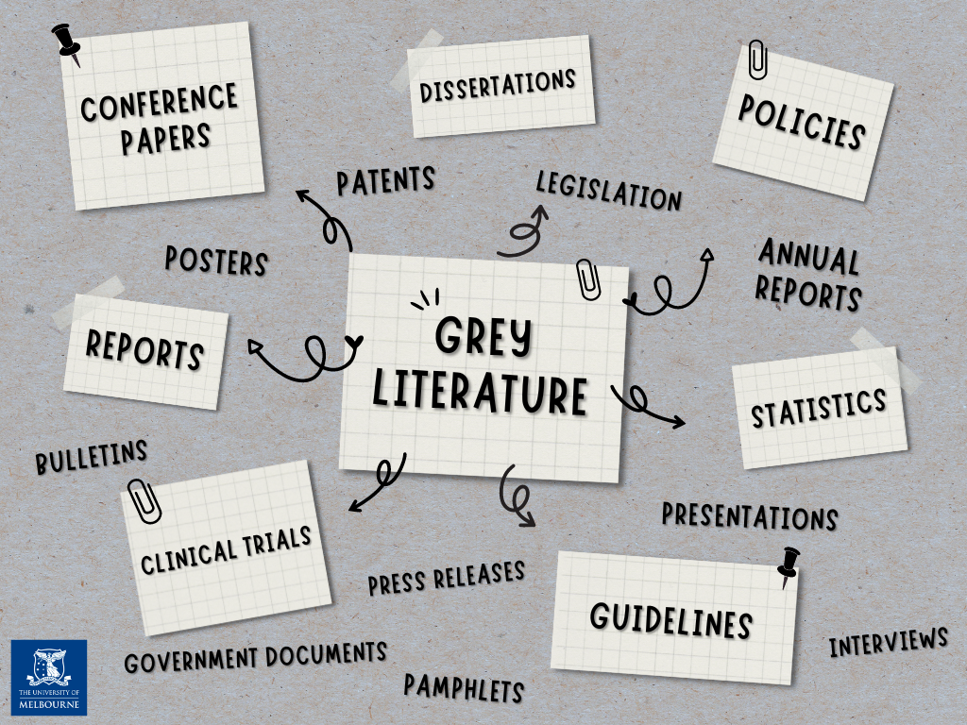
Grey Literature
Government reports
NHS publication
Professional body guidance
Policy documents
Conference proceedings
Technical reports
Organisation reports
Websites
The King’s Fund
WHO
NHS
Welsh Government
Other Think tank websites

Slide 17
Peer-reviewed vs Grey literature
Feature | Peer-Reviewed Literature | Grey Literature
What is it? | Research reviewed by experts before publication | Information published outside traditional academic journals
Quality assurance | Undergoes peer review and editorial scrutiny | May not be peer reviewed
Examples | Research articles, clinical trials, cohort studies, qualitative studies | Government reports, NHS publications, professional guidance, policy documents, conference papers
Purpose | Generate and share new knowledge and evidence | Inform practice, policy, services, and decision-making
Strengths | Usually rigorous, transparent, and evidence-based | Current, practical, often provides real-world context and statistics
Limitations | Can take a long time to publish | Quality and reliability can vary considerably
Use in your assignment | Main source of evidence for Results and Discussion | Useful for background information and context in the Introduction

Slide 18
Example of critique
“The AI claims that AI improves healthcare efficiency, but provides no evidence or references to support this statement.”
“The essay makes several assertions regarding the benefits of AI in healthcare; however, these claims are not supported by academic literature.”
“The AI references "research" in general terms but does not identify specific studies, making it difficult to verify the information presented.”
“While the AI discusses the advantages of digital health technologies, it fails to cite research studies that would strengthen the credibility of its arguments.”

Slide 19
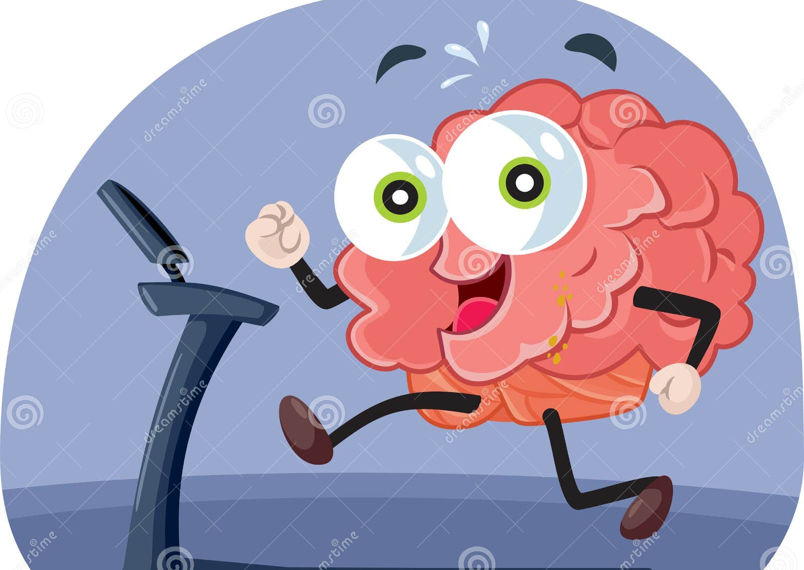
Activity - Evidence
Read you AI-essay and ask these questions:
Does the essay provide facts, data, examples, or research?
What evidence is presented?
Are claims supported ?
Are references used ?
If used, is the evidence reliable?
Write a critique about the evidence in your AI-essay.

Slide 20

A step beyond the critique
Don’t stop here:
Go Further:
The AI claims that AI improves healthcare efficiency, but provides no evidence or references to support this statement.
The AI claims that AI improves healthcare efficiency, but provides no evidence or references to support this statement. However, a study by Erkan (2026) found that AI-supported triage systems reduced administrative workload and improved patient flow in selected healthcare settings. This suggests that the claim may have some validity, although the effectiveness of AI depends on the context in which it is implemented.

Slide 21
Marking criteria
Why do we need to go a step further?
Engagement with literature
Knowledge and Understanding
Cognitive and Intellectual skills
Practical Skills
Transferable skills
Can you find, use, and cite evidence?
Do you understand the topic and the theory behind?
Can you think and write critically?
Can you show that theory works in the real world?
Is your work clear, professional, and easy to follow?

Slide 22

COFFEE BREAK
15 mins

Slide 23

Accuracy
Accuracy refers to whether the information presented is correct, factual, up-to-date, and supported by reliable evidence.
Questions to ask:
Is this information true?
Can the claim be verified?
Is the statistic correct?
Is the information current?
Does the literature support the claim?

Slide 24

Why Accuracy matters?
AI often produces information that sounds convincing and authoritative.
However, AI can:
Make factual errors
Invent statistics
Misrepresent research findings
Present outdated information
State opinions as facts
For this reason, information produced by AI should never be accepted without verification.

Slide 25
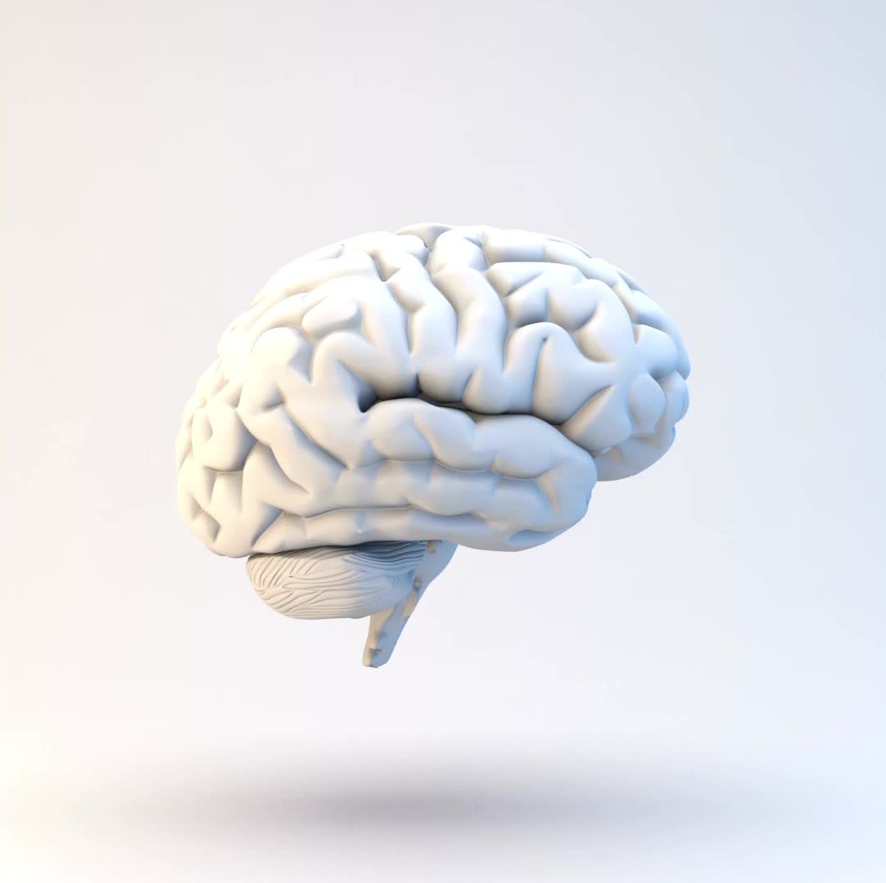
Example of critique
REMEMBER: Accurate information is not information that sounds convincing. Accurate information is information that can be verified using reliable evidence.
AI Output: "This may allow diseases to be detected earlier and enable healthcare professionals to make more informed decisions”.
Weak Critique: The AI provides statistics.
Strong Critique: The AI suggests that AI systems may enable earlier disease detection; however, no evidence is provided to demonstrate this. The statement is broad and does not identify the condition, AI technology, healthcare setting, or research supporting the claim. Therefore, further evidence is required before its accuracy can be established.

Slide 26
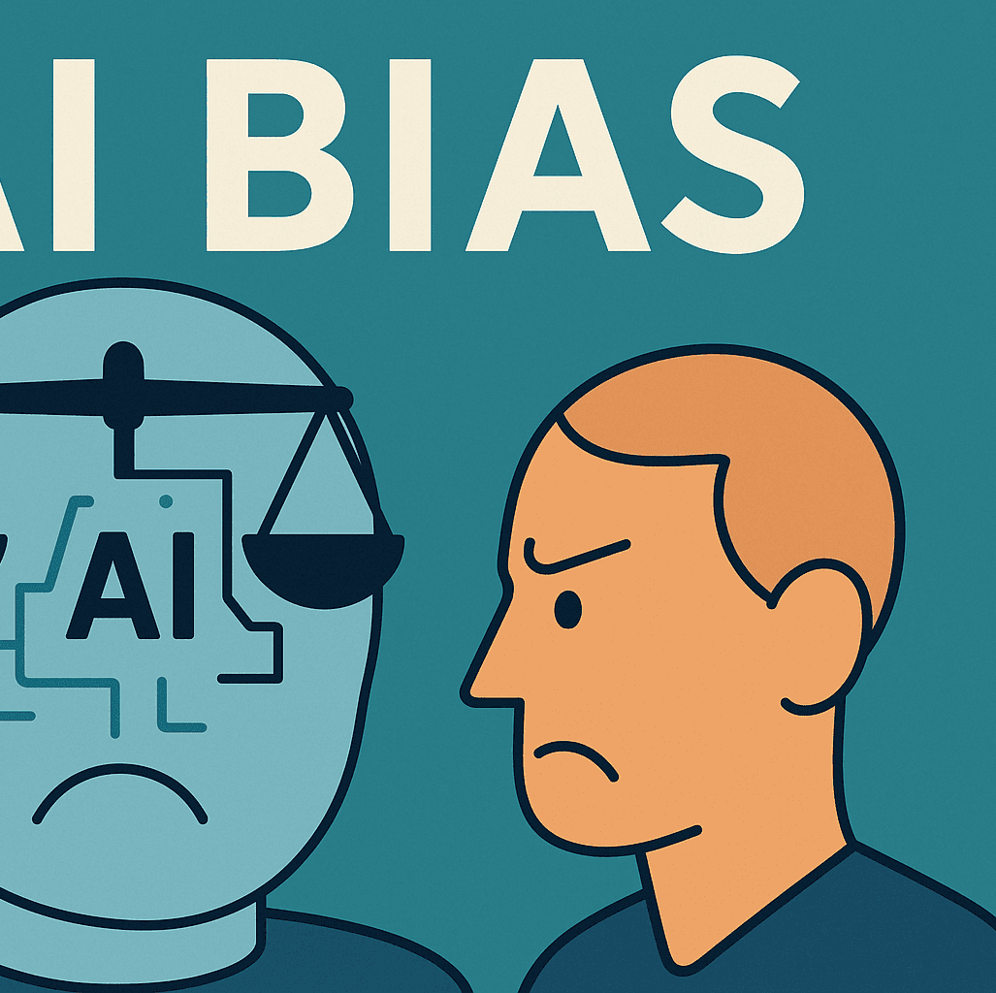
Bias
Questions to ask:
Does the author seem neutral?
Does the article favour one viewpoint?
Are alternative perspectives considered?
Does the discussion acknowledge strengths and limitations?
Is the conclusion justified by the evidence presented?

Slide 27
What is Bias?
Bias is a tendency to favour one viewpoint, perspective, or outcome over others, resulting in an unbalanced presentation of information.
Bias can be intentional or unintentional.
When bias is present, information may:
Highlight certain facts whilst ignoring others
Focus only on benefits or only on risks
Present one viewpoint as unquestionably correct
Omit alternative perspectives
Lead readers towards a particular conclusion

Slide 28

Why Does Bias Matter?
In academic writing, we aim to be:
Balanced
Objective
Evidence-based
Open to different viewpoints
If an AI-generated essay is biased, it may not provide a complete or accurate picture of a topic.

Slide 29

Example of critique
Good academic writing does not simply argue one side. It evaluates different perspectives, considers alternative viewpoints, and reaches a balanced, evidence-based judgement.
AI Output
“Although concerns relating to bias, privacy and reliability need to be addressed, the benefits of AI are likely to outweigh the disadvantages”.
Weak Critique
The paragraph discusses the benefits of AI.
Strong Critique
“The AI concludes that the benefits of AI are likely to outweigh the disadvantages. However, this judgement is not supported by evidence and reflects a predominantly positive perspective on AI. Although risks such as bias, privacy and reliability are briefly acknowledged, they are explored in less depth than the potential benefits.”

Slide 30

Missing information
Missing information refers to important facts, evidence, explanations, perspectives, or context that have been omitted from a discussion.
A piece of writing can contain accurate information and still be incomplete.
Questions to ask:
Is anything important missing?
What questions remain unanswered?
Are there viewpoints that have been ignored?
Has enough context been provided?
Are important risks or limitations missing?
Has the AI considered everyone who may be affected?

Slide 31
Why does it matter?
What is not said can be just as important as what is said.
Missing information can:
Give an incomplete picture of the topic
Oversimplify a complex issue
Leave important questions unanswered
Ignore relevant evidence or perspectives
Lead the reader towards an incomplete conclusion

Slide 32
Example of critique
AI Output
"Digital technologies, virtual assistants and AI-supported services may allow patients to access information and support remotely. This could be particularly valuable for individuals who find it difficult to attend healthcare facilities.”
Weak Observation
The AI does not mention any disadvantages.
Strong Critique
“Although the AI suggests that digital technologies and AI-supported services may improve access to healthcare, the discussion does not consider potential barriers to using these services. This results in an incomplete discussion of accessibility because improved availability of digital services does not necessarily mean that all patients will be able to access or use them effectively.”
Critical reading is not only about questioning what is there. It is also about noticing what isn't there.

Slide 33

Writing style
Writing style refers to how ideas are communicated through language, tone, structure and expression.
Academic writing should normally be:
Clear and precise
Formal and professional
Objective and balanced
Logically structured
Evidence-based
Cautious rather than making exaggerated claims

Slide 34
Writing style
Questions to ask:
Does the writing sound academic?
Is it clear and logically organised?
Is the language balanced and objective?
Does it use appropriate academic terminology?
Is the language emotional or persuasive?
Does it make overly confident statements?
Is the writing analytical or mainly descriptive?
Does it repeat the same ideas?

Slide 35

Example of critique
AI Output
"As AI technologies continue to develop, they will become an increasingly important part of modern healthcare and will ultimately improve the quality of care provided to patients."
Weak Observation
The AI uses academic language.
Strong Critique
Although the AI uses formal language, the statement that AI “will ultimately improve” the quality of patient care is overly certain. The essay does not provide sufficient evidence to justify this prediction, making the language more assertive than would normally be expected in balanced academic writing.”

Slide 36
COFFEE BREAK
15 mins

Slide 37

To summarise
Don't judge the AI essay by how impressive it sounds.
Judge it by:
Evidence → Accuracy → Bias → Missing Information → Writing Style
Academic writing is not about sounding clever. It is about communicating clear, balanced and evidence-based ideas.

Slide 38
Can we trust AI?
Inclusion of citations and references to acknowledge the work of others
Accuracy refers to whether the information presented is correct, factual, up-to-date, and supported by reliable evidence.
Bias is a tendency to favour one viewpoint, perspective, or outcome over others, resulting in an unbalanced presentation of information.
Missing information refers to important facts, evidence, explanations, perspectives, or context that have been omitted from a discussion.
Writing style refers to how ideas are communicated through language, tone, structure and expression.

Slide 39

Question?

Slide 40
References
Boga Erkan (2026) ‘Impact of Artificial Intelligence-supported Triage Systems on Emergency Department Management: A Comparison of Infermedica, Emergency Severity Index, and Manchester Triage System.’ The Western Journal of Emergency Medicine, 27(2), pp. 14. Available at: 10.5811/westjem.48989

