Slide 1
Improving Air Quality: Controlling Mobile Sources
Notes:
1

Slide 2
Understanding
Urban Air Problems

Slide 3
Measuring Urban Air Quality
EPA monitors the air in relatively large metropolitan statistical areas (MSAs) and reports part of its findings using the Air Quality Index (AQI)
AQI is reported as the highest of five pollutant-specific index values (ranging between 0 and 500) for that day and signifies the worst daily air quality in an urban area over a given time period
  The pollutants monitored are five of the criteria pollutants, PM-10, SO₂, CO, O₃, and NO2
  An AQI of 100 is considered to correspond to the standard set by CAA

Slide 4
Photochemical Smog in Urban Areas
Formed from pollutants that chemically react in sunlight to form new substances
Principal component is tropospheric (ground- level) ozone (O₃)
  Ozone is formed from a chemical reaction of NO_{X} and VOCs (smog precursors) and sunlight
  Released by stationary and mobile sources
  Highest emitters of smog precursors among transportation sources are gas-powered cars
    See EPA’s Green Vehicle Guide for information on new cars by model

Slide 5
Mobile Sources

Slide 6
Controlling Mobile Sources
1990 Clean Air Act Amendments
1990 Clean Air Act Amendments strengthened U.S. controls on motor vehicle emissions and fuels through Title II
Includes tougher emissions requirements, fuel quality controls, and incentives to encourage development of cleaner-running vehicles and cleaner alternative fuels

Slide 7
Emissions Reductions: Tier I
Phased in between 1994 and 1998
Aimed at reducing emissions of non-methane hydrocarbons (NMHC), carbon monoxide (CO), nitrogen oxides (NOx), and particulate matter (PM)
Passenger cars and light trucks subject to tighter regulation than heavier SUVs, minivans, pickup trucks
    Stricter controls for initial 5 years or 50,000 miles of use; less stringent controls for remainder of vehicle’s useful life redefined as 10 years or 100,000 miles

Slide 8
Emissions Reductions: Tier II
Phased in between 2004 and 2008
Tougher requirements given for each successive model year
Unique to this tier of controls is:
  an interrelated system of controls on vehicles and fuels
  no distinction for vehicle size

Slide 9
Fuel Quality Controls
Prohibits leaded fuel after 1995
Requires reformulated gasoline in certain ozone nonattainment areas
  Fuels that emit less hydrocarbons, carbon monoxide, and toxics than conventional gasoline
Requires oxygenated fuel in certain CO nonattainment areas
  Formulations with enhanced oxygen content to allow for more complete combustion and hence a reduction in CO emissions

Slide 10
Clean Fuel Vehicles
1990 amendments set up clean fuel vehicles program
  A clean fuel vehicle is certified to meet stringent emission standards for such pollutants as CO, NO_{X}, PM, formaldehyde
In ozone and CO nonattainment areas, a proportion of new fleet vehicles had to be clean fuel vehicles and had to use clean alternative fuels
  These are fuels such as methanol, ethanol blends (e.g., E10, E85), or power sources, such as electricity
Market incentives include credits to fleet owners who surpass requirements in the law, tax credits for hybrids, fuel cell and alternative fuel vehicles, plug-in hybrids

Slide 11
Analyzing
Mobile Source Controls

Slide 12
Policy Characteristics to Analyze
absence of benefit-cost analysis in setting emissions standards
uniformity of auto emissions standards
inherent bias against new vehicles
implications of clean fuel alternatives

Slide 13
Absence of Benefit-Cost Analysis
An Inefficient Decision Rule
New standards were technology forcing, i.e., set specifically to compel auto industry to find solutions
  Perversely gave manufacturers a strong case to seek adjustments and postponements for compliance
New standards were benefit-based
  Set solely to protect public health and welfare
  Implies the standards were set to maximize TSB, where MSB = 0 versus to achieve efficiency, where MSB = MSC

Slide 14
Benefit-Based Emission Standards
$
MSC
Benefit-based standards imply abatement
at A₀ which is higher than Ae. Suggests
over-regulation of mobile sources.
MSB
0
A_{E}
A₀
where MSB = 0
Abatement
© 2010 Cengage Learning. All Rights Reserved. May not be copied, scanned, or duplicated, in whole or in part, except for use as permitted in a license distributed with a certain product or service or otherwise on a password-protected website for classroom use.
Notes:
Blurb from diagram from book - Mobile source standards are set to achieve a benefit-based objective. Such an objective calls for abatement activity that maximizes total social benefits, which corresponds to the point where the MSB curve crosses the horizontal axis (i.e., where MSB = 0), at A0. Notice that A0 is higher than the efficient level, AE (i.e., where MSB = MSC), which implies overregulation.

Slide 15
Uniformity of Auto Emissions Standards
With few exceptions, emission standards are applicable on every model produced with no regard to where the vehicle will be driven
  This overregulates “clean” areas and underregulates “dirty” areas because MSB in more polluted regions should be higher than in cleaner regions, making the efficient abatement level higher in dirtier regions
  This adds to costs with no offsetting benefits
Studies suggest there would be considerable cost savings if a two-tiered standard replaced the uniform standard

Slide 16
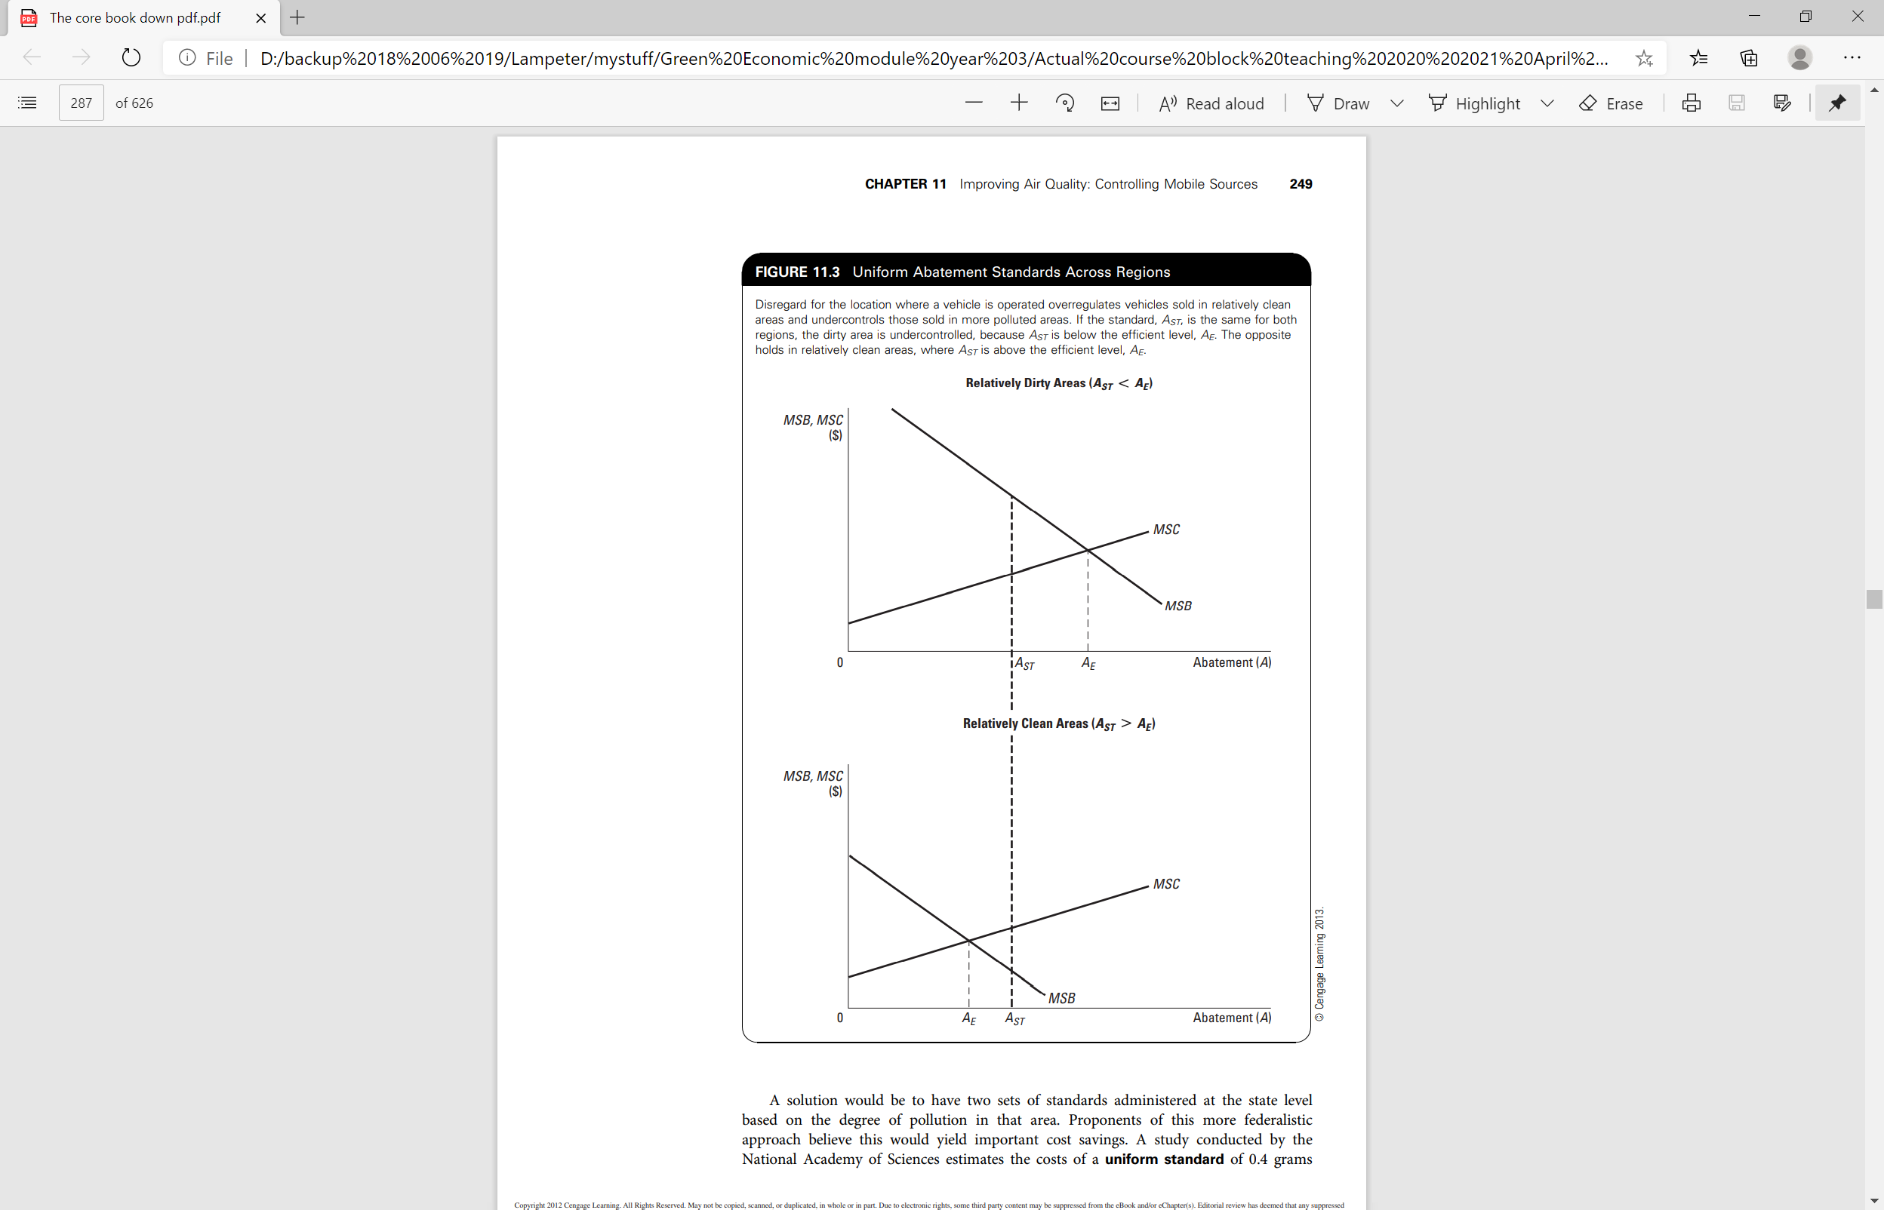
Uniformity Standards Across Regions
Notes:
Blurb from slide Uniformity Standards Across Regions - Disregard for the location where a vehicle is operated overregulates vehicles sold in relatively clean areas and undercontrols those sold in more polluted areas. If the standard, AST, is the same for both regions, the dirty area is undercontrolled, because AST is below the efficient level, AE. The opposite holds in relatively clean areas, where AST is above the efficient level, AE

Slide 17
Two-tiered Standard
One study shows a $23B
savings over 10 years
$
MSC
MSB_{dirty}
MSB_{clean}
0
A_{STclean}
A_{STdirty}
Abatement

Slide 18
Bias Against New Vehicles
More stringent controls on new vehicles creates market distortion
  Biases consumer decisions against new cars by influencing relative price and performance
    Price Effect: regulations on new cars adds to costs which elevates relative price
    Performance Effect: regulations adversely affect acceleration and gas mileage
As P_{NewCars}↑, D_{UsedCars} increases (substitutes), which perversely encourages use of higher-emitting cars

Slide 19
Bias Against New Vehicles
$
S₂
S₁
S₁
P₂
P₁
P₂
P₁
D₁
D₂
D₁
Q₂
Q₁
Q
Q₁
Q₂
Q
New Cars
Used Cars

Slide 20
Implications of Clean Fuel Alternatives
Advanced fuels are required only in the dirtier regions of the country
Since this aligns higher MSC of developing and using new fuels with higher MSB of cleaning up in dirtier regions, it may approach an efficient solution

Slide 21
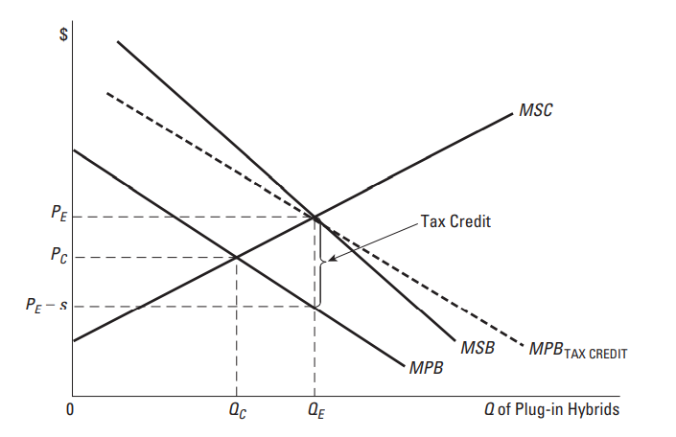
Implications of Clean Fuel Alternatives

