Slide 1



TYPE 2 DIABETES MELLITUS
A Person-Centred Care Plan
DIABETES /HEALTHCARE
University of Wales Trinity Saint David – London Campus
Student Name: Jussara Coser
Student Number: 2442073
Lecturer: Shaila Hussain
Module Code: BMHP5023
Assessment: C.2 Presentation
Date:14 Aug 2026

Slide 2

Fictional Patient Profile
João Silva
Age: 56 years
Nationality: Portuguese
Location: London, UK
Occupation: Taxi driver
Family: Lives with his wife and adult daughter
Current health: Recently diagnosed with Type 2 diabetes
BMI: 31.8 kg/m²
HbA1c: 68 mmol/mol
Blood pressure: 148/92 mmHg
Lifestyle factors
Low level of physical activity
Frequent takeaway meals
Regular sugary drinks
Occasional smoking
Family history of cardiovascular disease
Welnesstreatmentcenterimage

Slide 3
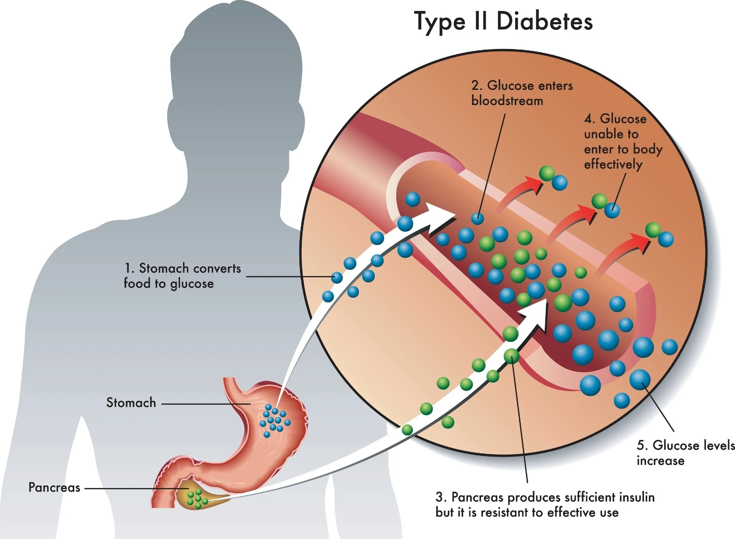
What is Type 2 Diabetes?
Type 2 diabetes is a condition where:
Insulin does not work effectively
↓
Cells cannot use glucose efficiently
↓
Blood glucose increases
↓
Persistent high blood glucose
Key point
Insulin is a hormone produced by the pancreas that helps glucose enter cells and be used for energy.
Type 2 diabetes → insulin resistance + insufficient insulin
(NHS, 2025)
News-Medical.Net

Slide 4
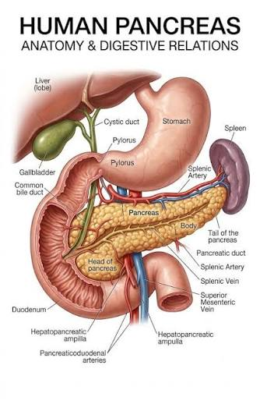
Relevant Anatomy: Endocrine System
Pancreas
Located behind the stomach
Part of the endocrine system
Contains the islets of Langerhans
Pancreatic β-cells
Produce insulin
Insulin
Helps glucose move from the blood into cells
Key relationship
Pancreas → Insulin → Cells → Energy
(NHS, 2025)

Slide 5
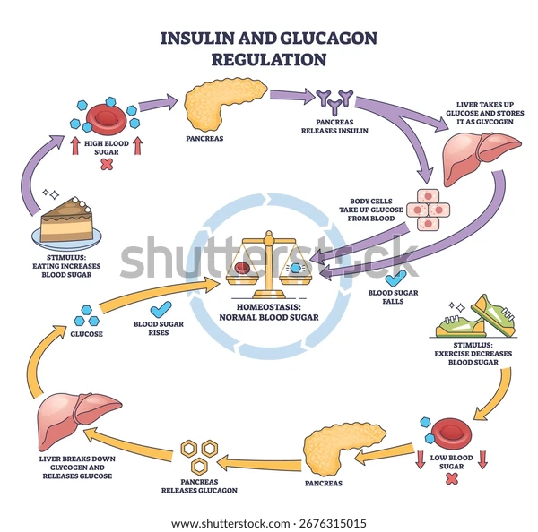
Normal Physiology: Blood-Glucose Regulation
After eating:
Food / carbohydrates
↓
Blood glucose rises
↓
Pancreas detects the increase
↓
Insulin is released
↓
Glucose enters body cells
↓
Glucose is used for energy
↓
Blood glucose returns towards normal
Key point
Insulin helps maintain blood-glucose balance.
(NHS, 2025)

Slide 6
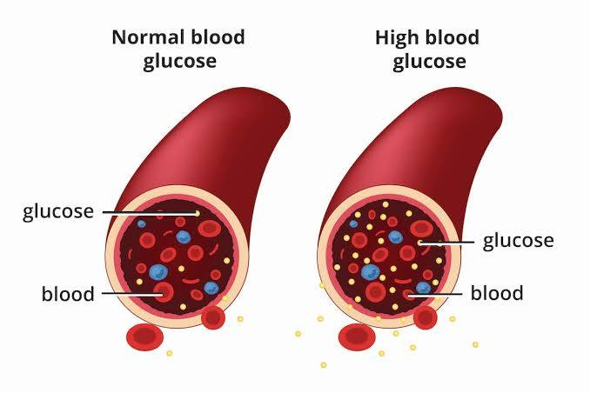
How Type 2 Diabetes Affects the Body
Normal physiology
Insulin works effectively
↓
Glucose enters cells
↓
Energy is produced
↓
Blood glucose remains controlled
Type 2 Diabetes
Insulin resistance
↓
Cells respond less effectively to insulin
↓
Glucose remains in the bloodstream
↓
Hyperglycaemia
Over time
Persistent high blood glucose can damage:
❤️ Heart & blood vessels
🧠 Nerves
👁️ Eyes
🫘 Kidneys
(NHS, 2025; NICE, 2026)
IMTuniversityimage

Slide 7
Risk Factors for João
Modifiable factors 🔄
BMI 31.8 kg/m² — obesity
Low physical activity
Frequent takeaway foods
Sugary drinks
Occasional smoking
Raised blood pressure: 148/92 mmHg
Non-modifiable factors 🔒
Age: 56 years
Family history of cardiovascular disease
Main concern:
❤️ Increased cardiovascular risk
(NHS, 2025; NICE, 2026)
MODIFIABLE
⚖️ Weight
🍔 Diet
🥤 Sugary drinks
🚶 Physical activity
🚬 Smoking
🩺 Blood pressure
NON-MODIFIABLE
🎂 Age
❤️ Family history

Slide 8
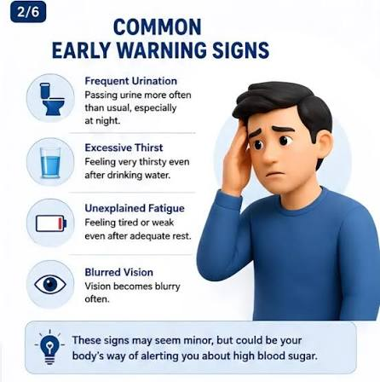
Common symptoms
Increased thirst
Frequent urination
Tiredness / fatigue
Blurred vision
Unintentional weight loss
Slow-healing cuts and wounds
Important
Type 2 diabetes can develop gradually, and some people have few or no symptoms.
(NHS, 2025)

Slide 9
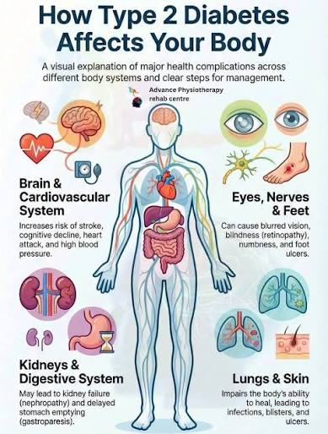
Long-term high blood glucose
Damage to blood vessels and nerves
❤️ Heart & blood vessels
Cardiovascular disease
Stroke
🫘 Kidneys
Kidney damage/disease
👁️ Eyes
Diabetic retinopathy
Vision problems
🦶 Feet & nerves
Neuropathy
Ulcers and infections
Good glucose control + regular monitoring → reduced risk of complications (NHS, 2025)

Slide 10
What to monitor | Why?
HbA1c 🩸 | Blood-glucose control
Blood pressure ❤️ | Cardiovascular risk
Weight & BMI ⚖️ | Weight management
Cholesterol 🧪 | Cardiovascular risk
Kidney function 🫘 | Detect kidney damage
Foot assessment 🦶 | Prevent ulcers/infection
Eye screening 👁️ | Detect diabetic retinopathy
NICE's current Type 2 diabetes guidance was updated in February 2026. It recommends HbA1c monitoring every 3–6 months until stable, then every 6 months when stable. NICE also identifies key diabetes care processes including HbA1c, blood pressure, urine albumin-to-creatinine ratio, foot surveillance and retinal screening. (NICE, 2026; NHS, 2025)

Slide 11
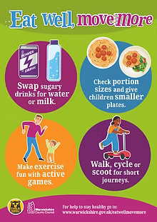
João's Lifestyle Care Plan
🥗 Healthy eating
Reduce sugary drinks and processed foods
Increase vegetables, fruit, wholegrains and pulses
Work with a dietitian
Adapt advice to João's food preferences and culture
🚶 Physical activity
Gradually increase daily activity
Reduce prolonged sitting during taxi work
Aim towards 150 minutes of moderate activity/week
⚖️ Weight management
Set realistic, achievable goals
Monitor weight and BMI
Discuss NHS weight-management support
🎯 Goal
Improve blood glucose + reduce cardiovascular risk

Slide 12

João's Healthcare Team
👨‍⚕️ GP
Diagnosis, medication and overall review
👩‍⚕️ Diabetes Nurse
Education, self-management and monitoring
🥗 Dietitian
Personalised nutritional advice
💊 Pharmacist
Medication support and adherence
🦶 Podiatrist
Foot assessment and prevention
👁️ Eye Screening Team
Retinal screening
Main principle
Shared decision-making + coordinated care = person-centred care
diabetesincontrol.com

Slide 13

Person-Centred Care for João
Clear communication
Use simple, understandable language
Check João's understanding
Shared decision-making
Discuss treatment options
Respect João's choices
Cultural sensitivity
Consider food preferences and cultural needs
Avoid assumptions or stereotypes
Ethical principles
Autonomy – respect his choices
Beneficence – promote wellbeing
Non-maleficence – avoid harm
Confidentiality – protect personal information
nihr.ac.uk

Slide 14
REFERENCE
NHS (2025) What is type 2 diabetes? Available at: https://www.nhs.uk/conditions/type-2-diabetes/what-is-type-2-diabetes/ (Accessed: 10 August 2026).
NHS (2025) Symptoms of type 2 diabetes and how it's diagnosed. Available at: https://www.nhs.uk/conditions/type-2-diabetes/symptoms/ (Accessed: 10 August 2026).
NHS (2025) Treatment for type 2 diabetes. Available at: https://www.nhs.uk/conditions/type-2-diabetes/treatment/(Accessed: 10 August 2026).
NHS (2025) Complications of type 2 diabetes. Available at: https://www.nhs.uk/conditions/type-2-diabetes/complications/ (Accessed: 10 August 2026).
NICE (2026) Type 2 diabetes in adults: management (NG28). Available at: NICE NG28 (Accessed: 10 August 2026).
NHS England (2023) Language matters: language and diabetes. Available at: NHS England – Language matters(Accessed: 10 August 2026).
Nursing and Midwifery Council (NMC) (2018) The Code: Professional standards of practice and behaviour for nurses, midwives and nursing associates. Available at: NMC Code (Accessed: 10 August 2026).
Equality Act 2010 (c.15). Available at: Equality Act 2010 (Accessed: 10 August 2026).
Data Protection Act 2018 (c.12). Available at: Data Protection Act 2018 (Accessed: 10 August 2026).
NICE (2026) Type 2 diabetes in adults: management – individualised care and blood glucose management.Available at: NICE NG28 recommendations (Accessed: 10 August 2026).

