Slide 1

Microsoft Sway
Digital Skills Session

Slide 2

Presenter
Gwen Couch
Digital Skills Advisor
IEH
g.couch@uwtsd.ac.uk

Slide 3

What is Microsoft Sway?
Sway lets you create and share interactive reports, blogs, presentations and more…
Visually appealing
Easy to digest information
Quickly import documents
Embed different media
Interactive and asynchronous
Creative way to present work

Slide 4

Advantages of using Sway
Part of Microsoft 365
Simple, easy to use
Multimedia integration
Basic design options

Slide 5
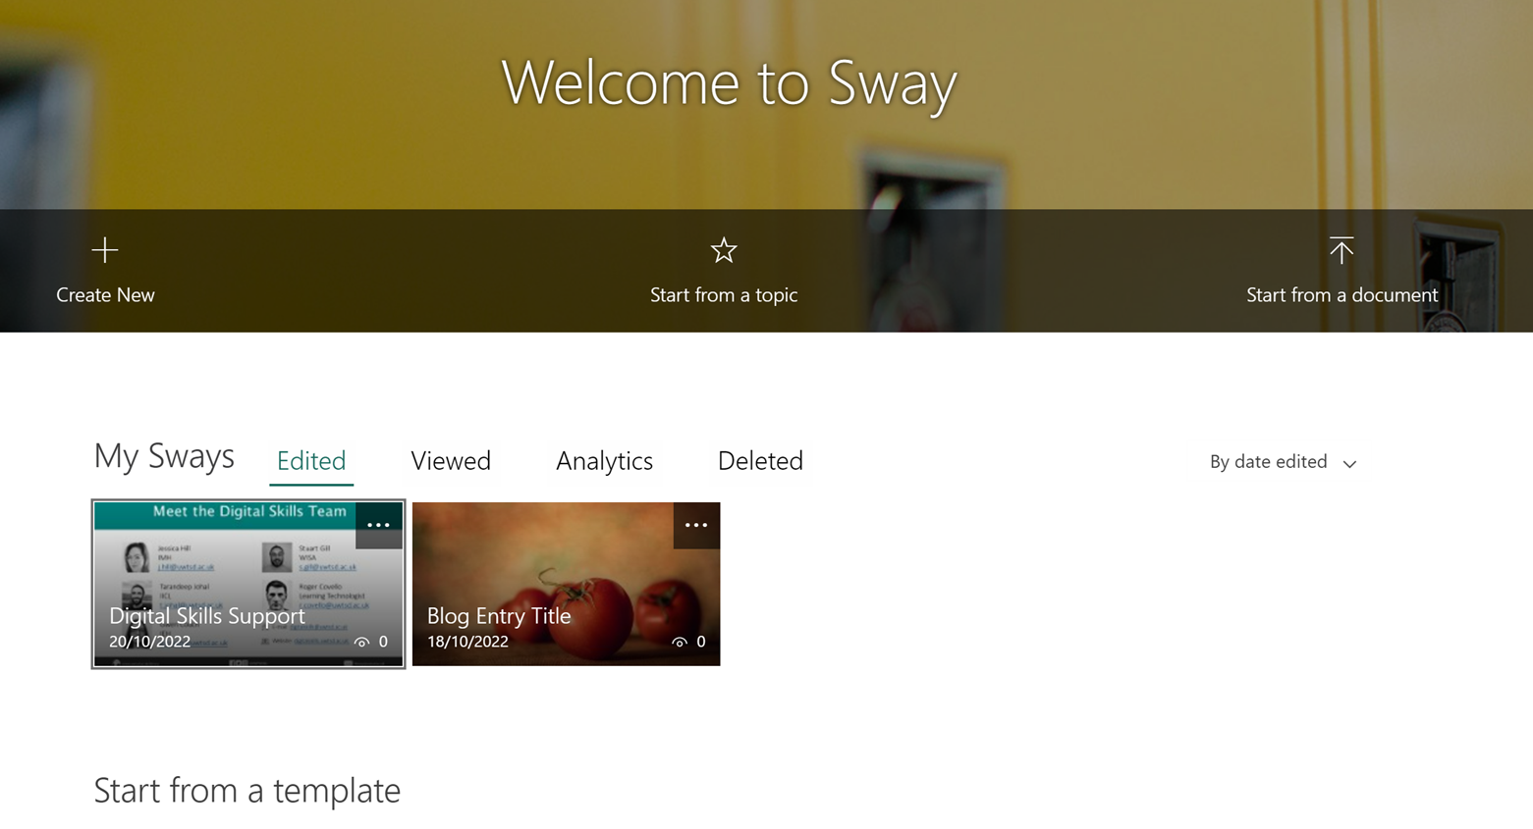
Getting Started
Start from new
Start from topic *not recommended
Use premade template
Start from existing document

Slide 6
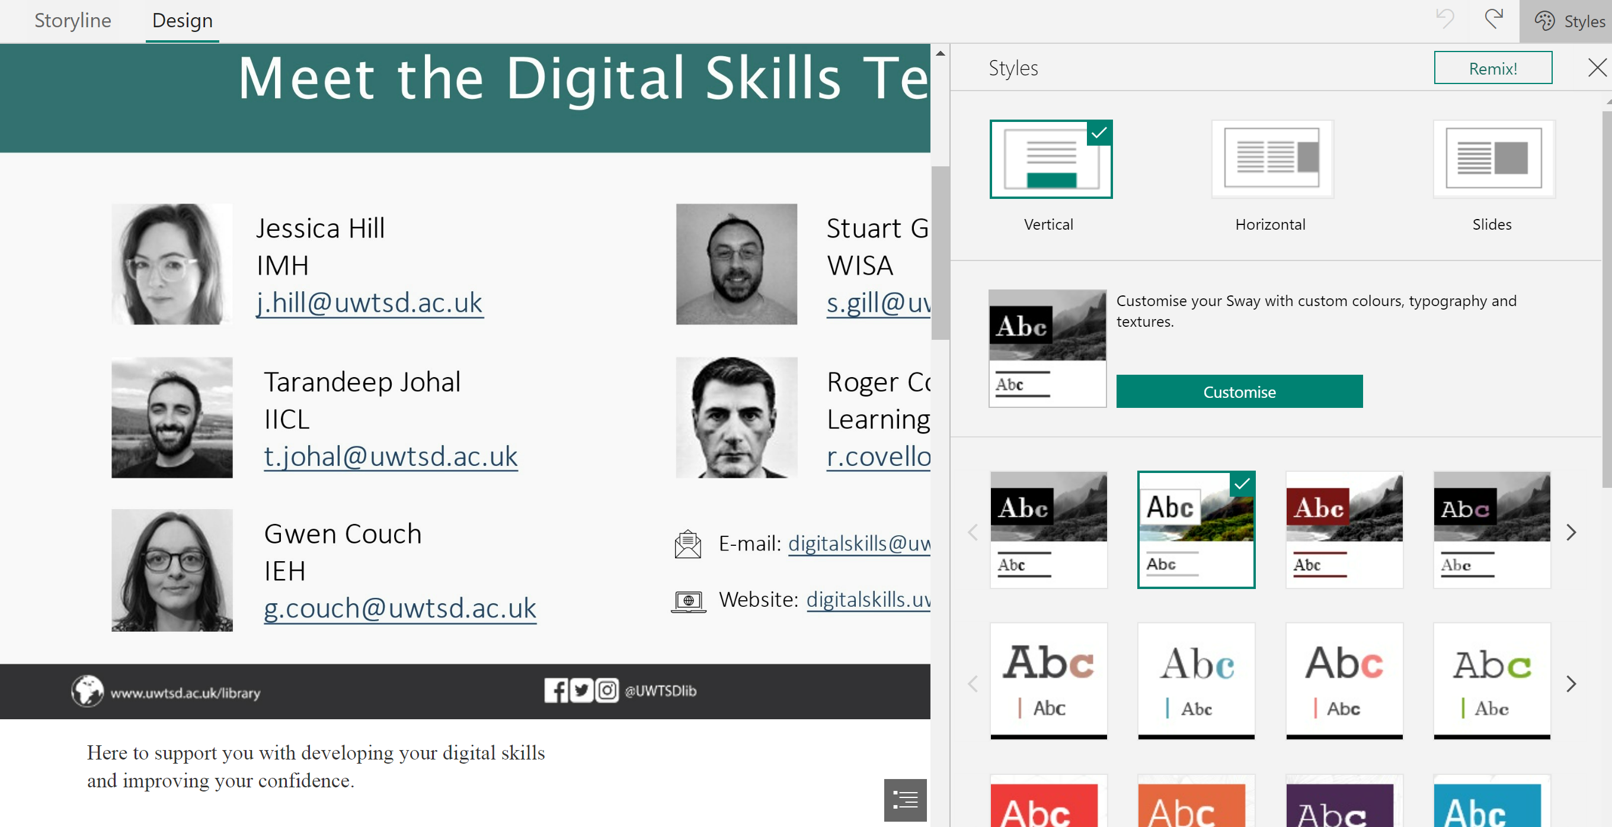
Design
Choose your preferred style.
Experiment with different fonts, colours etc.

Slide 7
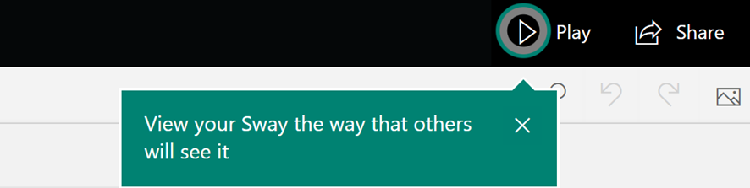
Tips
Keep it simple and readable
review your work as you go along
Be creative!

Slide 8
Additional Resources
Sway Essential Training
How to use Microsoft Sway
Sample Sway
Getting Started with Sway
Sway Pro Tips

Slide 9
Dewch o hyd i ni ar y cyfryngau cymdeithasol!

