Slide 1
Electrical Engineering
(ACDA5001)
Lecture - 11

Slide 2
Content
Pure Resistive circuit
Pure Inductive Circuit
Pure Capacitive Circuit
RL Series Circuit
RC series Circuit
RLC series Circuit
RL Parallel Circuit
RC Parallel Circuit
LC Parallel circuit
LR-C Parallel Circuit

Slide 3
Learning Outcome
The student upon completion of the lecture will be able to:
Demonstrate the ability to design circuits using Resistor, capacitor and inductor

Slide 4
Single Phase AC Circuits
Three Parameters in AC circuits are
Resistance
Inductance
Capacitance

Slide 5
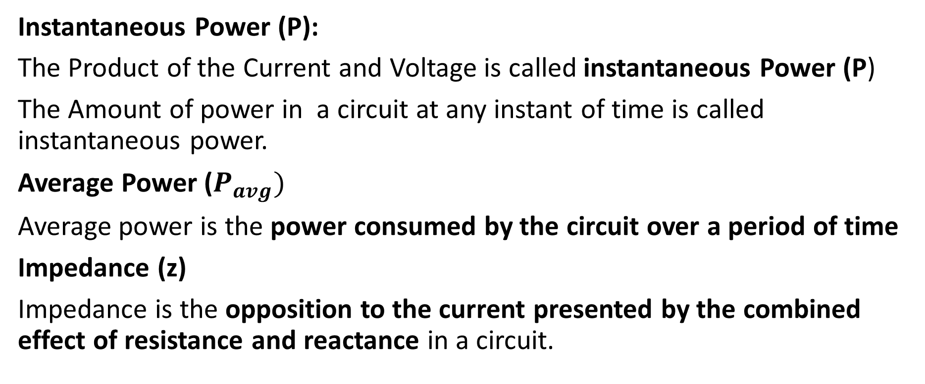
Single Phase AC Circuits
Instantaneous Power (P):
The Product of the Current and Voltage is called instantaneous Power (P)
The Amount of power in a circuit at any instant of time is called instantaneous power.
Average Power ($P_{avg})$
Average power is the power consumed by the circuit over a period of time
Impedance (z)
Impedance is the opposition to the current presented by the combined effect of resistance and reactance in a circuit.

Slide 6
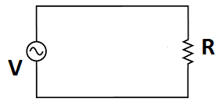
Pure Resistive circuit
The circuit containing only a pure resistance of R ohms and a power supply is known as Pure Resistive Circuit.

Slide 7
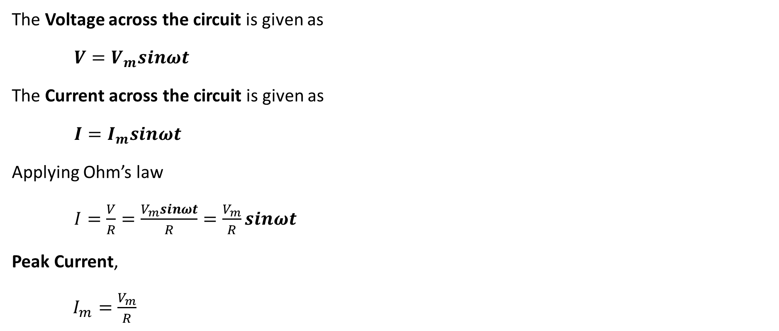
Pure Resistive circuit
The Voltage across the circuit is given as
$V=V_{m}sinωt$
The Current across the circuit is given as
$I=I_{m}sinωt$
Applying Ohm’s law
$I=\frac{V}{R}=\frac{V_{m}sinωt}{R}=\frac{V_{m}}{R}sinωt$
Peak Current,
$I_{m}=\frac{V_{m}}{R}$

Slide 8
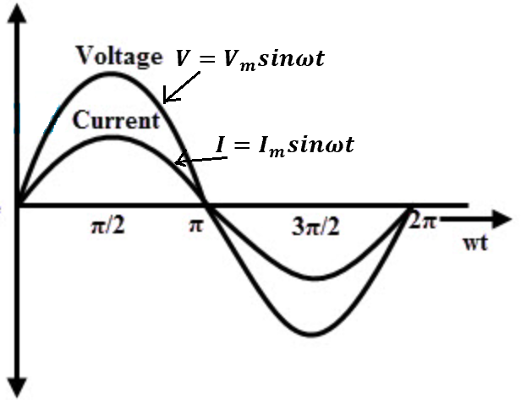
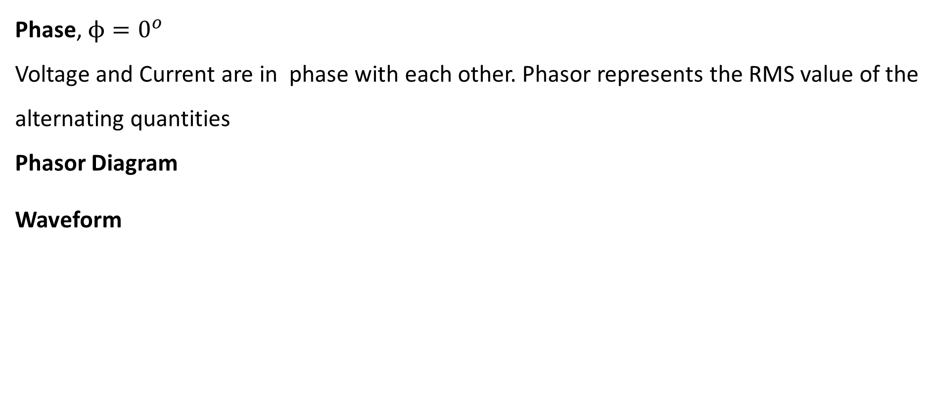
Pure Resistive circuit
Phase, $ϕ=0^{o}$
Voltage and Current are in phase with each other. Phasor represents the RMS value of the alternating quantities
Phasor Diagram
Waveform
I
V

Slide 9
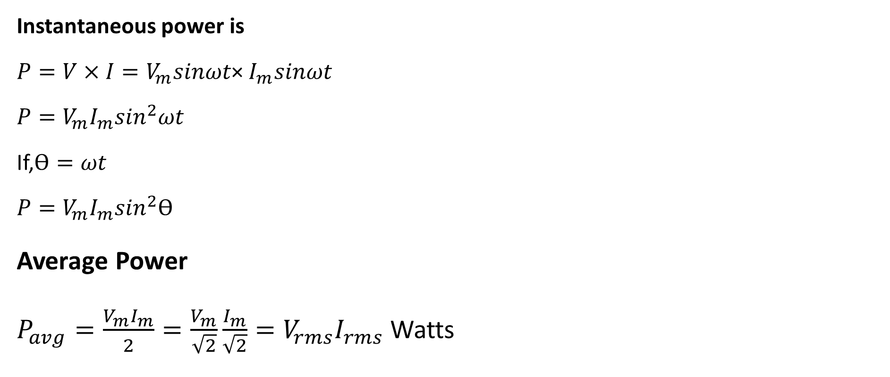
Pure Resistive circuit
Instantaneous power is
${P=V×I=V}_{m}sinωt$× $I_{m}sinωt$
${P=V}_{m}I_{m}\sin^{2}ωt$
If,$\text{ϴ}=ωt$
${P=V}_{m}I_{m}\sin^{2}\text{ϴ}$
Average Power
$P_{avg}=\frac{V_{m}I_{m}}{2}=\frac{V_{m}}{\sqrt{2}}\frac{I_{m}}{\sqrt{2}}=V_{rms}I_{rms}$Watts

Slide 10
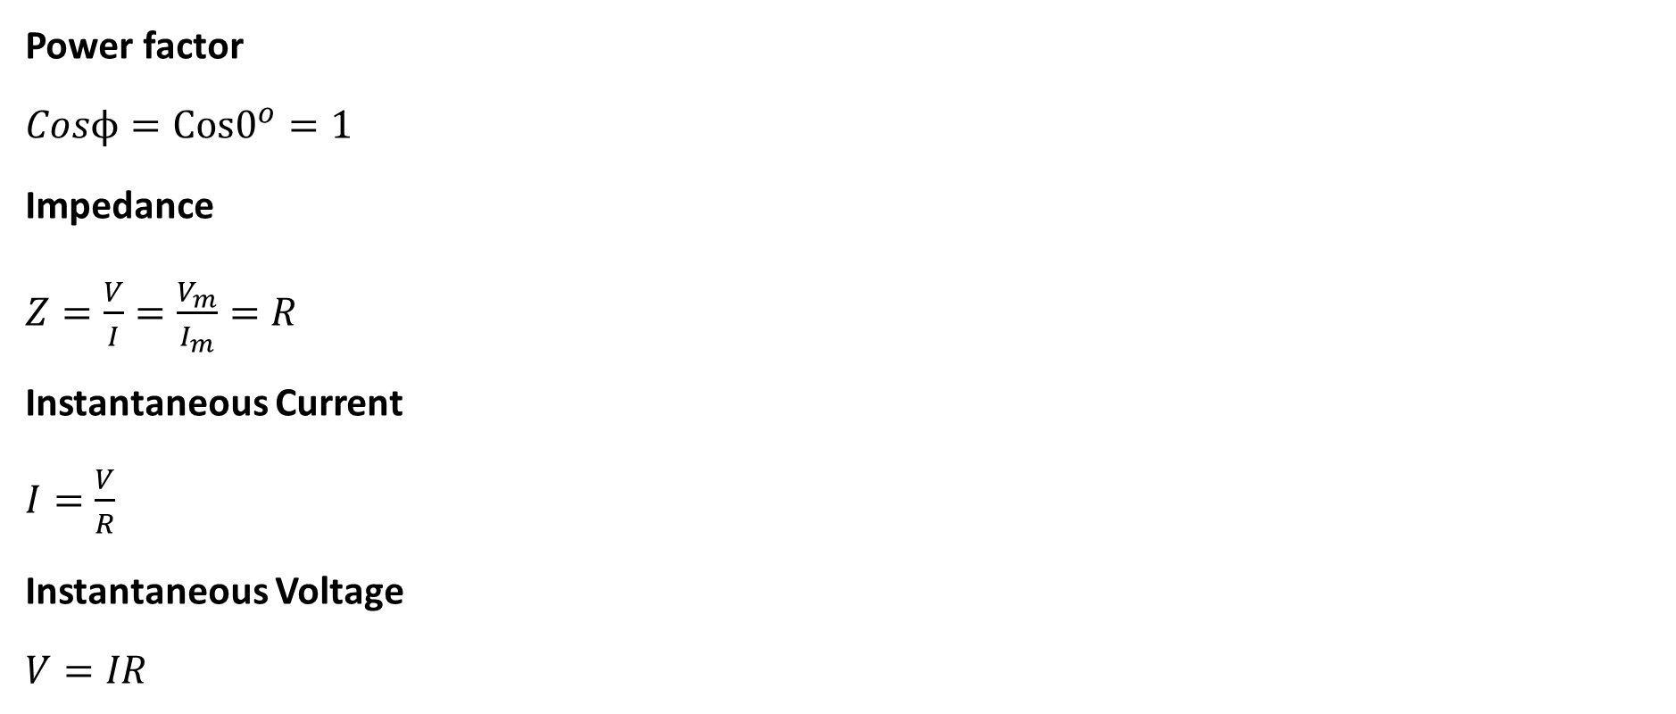
Pure Resistive circuit
Power factor
$Cosϕ=Cos0^{o}=1$
Impedance
$Z=\frac{V}{I}=\frac{V_{m}}{I_{m}}=R$
Instantaneous Current
$I=\frac{V}{R}$
Instantaneous Voltage
$V=IR$

Slide 11
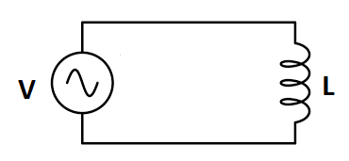
Pure Inductance circuit
The circuit containing only a pure Inductance of L Henry and a power supply is known as Pure Inductive Circuit.

Slide 12
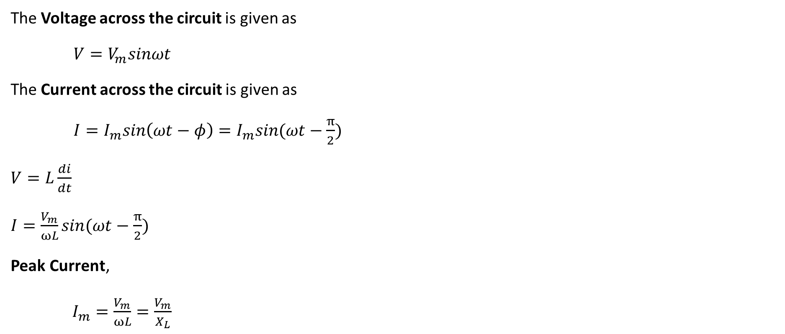
Pure Inductance circuit
The Voltage across the circuit is given as
$V=V_{m}sinωt$
The Current across the circuit is given as
$I=I_{m}sin\left(ωt−φ\right)=I_{m}sin(ωt−\frac{π}{2})$
$V=L\frac{di}{dt}$
$I=\frac{V_{m}}{ωL}sin(ωt−\frac{π}{2})$
Peak Current,
$I_{m}=\frac{V_{m}}{ωL}=\frac{V_{m}}{X_{L}}$

Slide 13
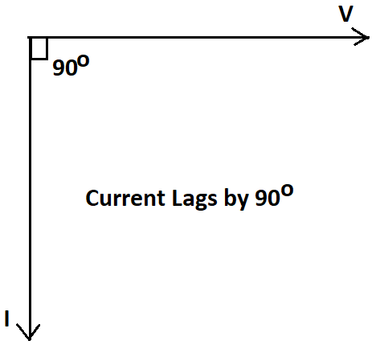
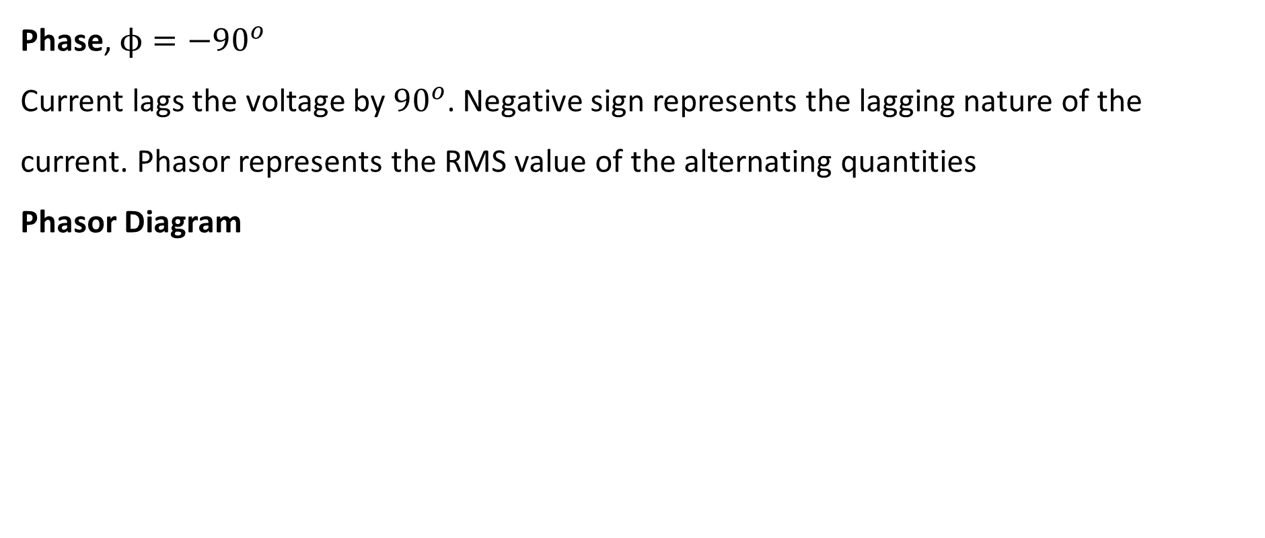
Pure Inductance circuit
Phase, $ϕ={−90}^{o}$
Current lags the voltage by ${90}^{o}$. Negative sign represents the lagging nature of the current. Phasor represents the RMS value of the alternating quantities
Phasor Diagram

Slide 14
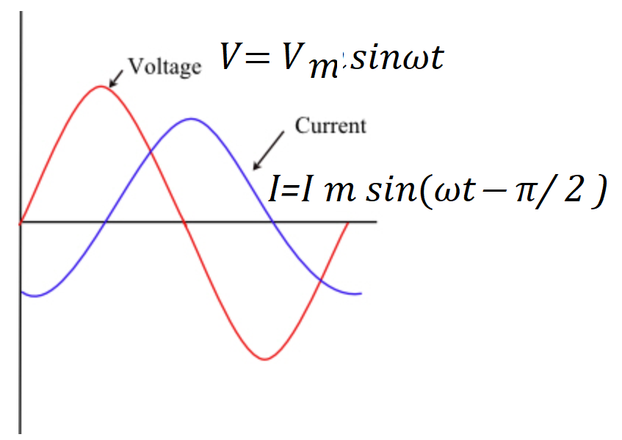
Pure Inductance circuit
Waveform

Slide 15
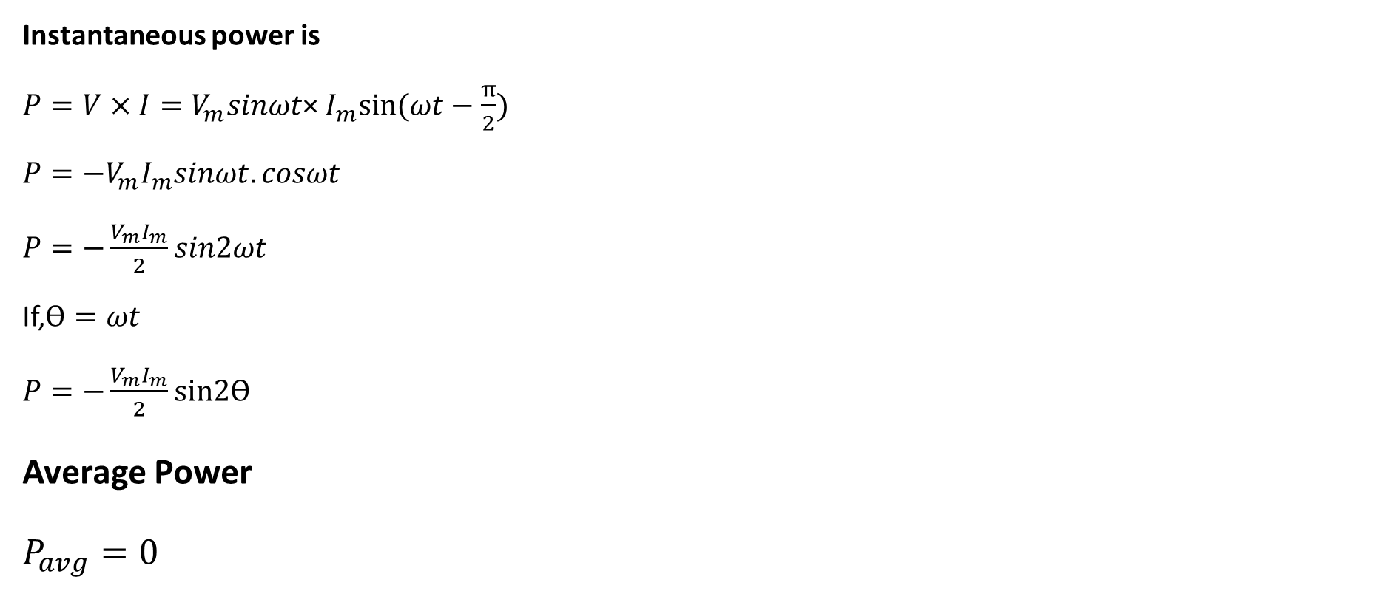
Pure Inductance circuit
Instantaneous power is
${P=V×I=V}_{m}sinωt$× $I_{m}sin⁡(ωt−\frac{π}{2})$
${P=−V}_{m}I_{m}sinωt.cosωt$
$P=−\frac{V_{m}I_{m}}{2}sin2ωt$
If,$\text{ϴ}=ωt$
$P=−\frac{V_{m}I_{m}}{2}\text{sin}\text{2}\text{ϴ}$
Average Power
$P_{avg}=0$

Slide 16
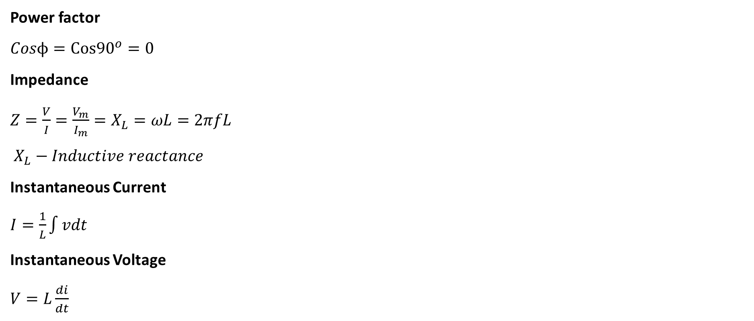
Pure Inductance circuit
Power factor
$Cosϕ=Cos{90}^{o}=0$
Impedance
$Z=\frac{V}{I}=\frac{V_{m}}{I_{m}}=X_{L}=ωL=2πfL$
$X_{L}−Inductive reactance$
Instantaneous Current
$I=\frac{1}{L}\int{vdt}$
Instantaneous Voltage
$V=L\frac{di}{dt}$

Slide 17
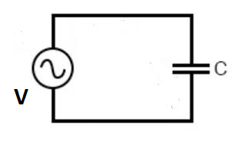
Pure Capacitance circuit
The circuit containing only a pure Capacitance of C Farad and a power supply is known as Pure Inductive Circuit.

Slide 18
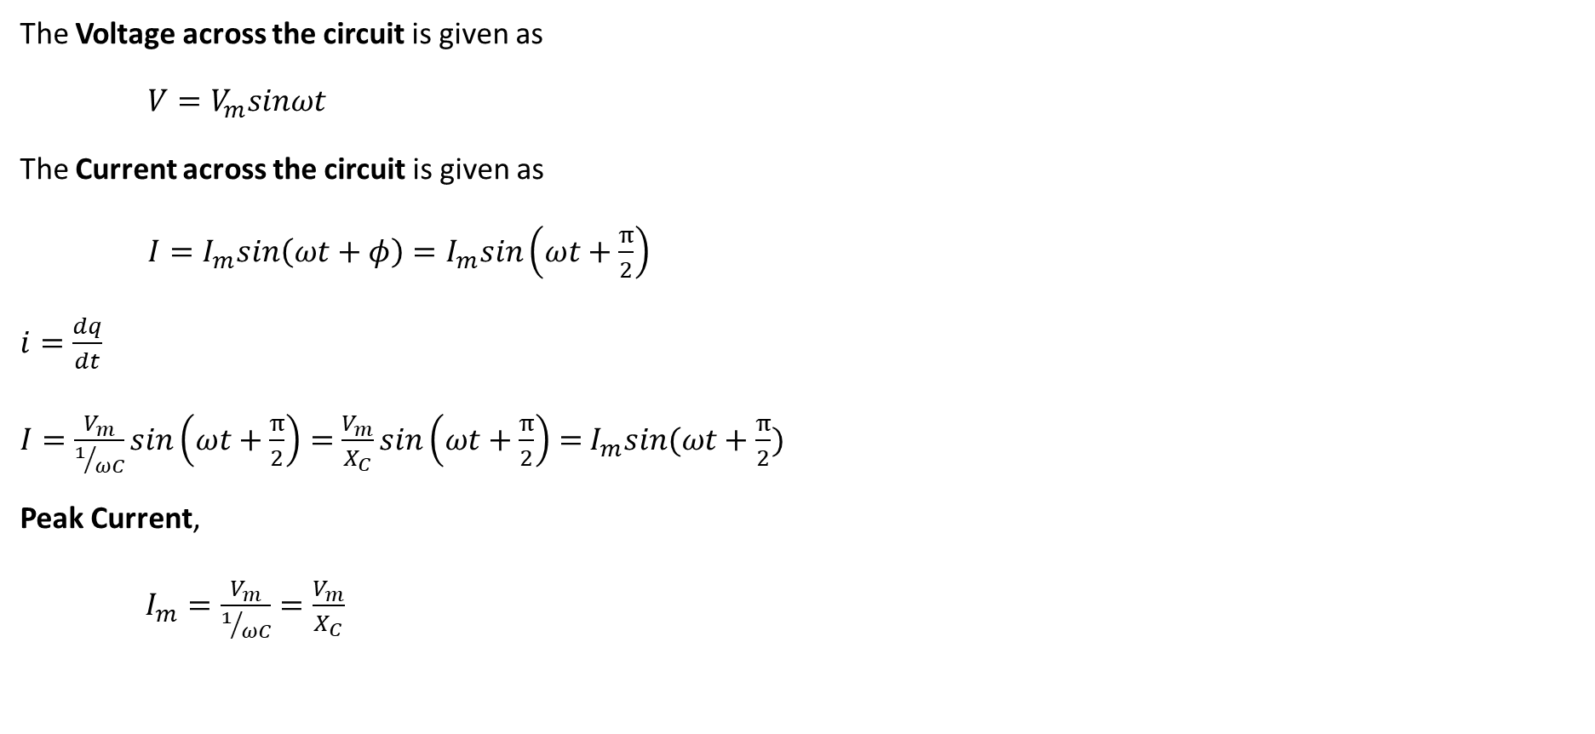
Pure Capacitance circuit
The Voltage across the circuit is given as
$V=V_{m}sinωt$
The Current across the circuit is given as
$I=I_{m}sin\left(ωt+φ\right)=I_{m}sin\left(ωt+\frac{π}{2}\right)$
$i=\frac{dq}{dt}$
$I=\frac{V_{m}}{1/{ωC}}sin\left(ωt+\frac{π}{2}\right)=$ $\frac{V_{m}}{X_{C}}sin\left(ωt+\frac{π}{2}\right)=$ $I_{m}sin(ωt+\frac{π}{2})$
Peak Current,
$I_{m}=\frac{V_{m}}{1/{ωC}}=\frac{V_{m}}{X_{C}}$

Slide 19
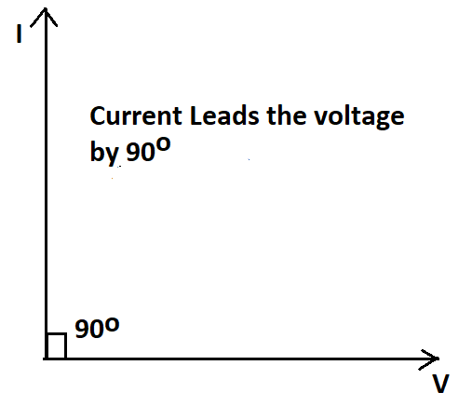
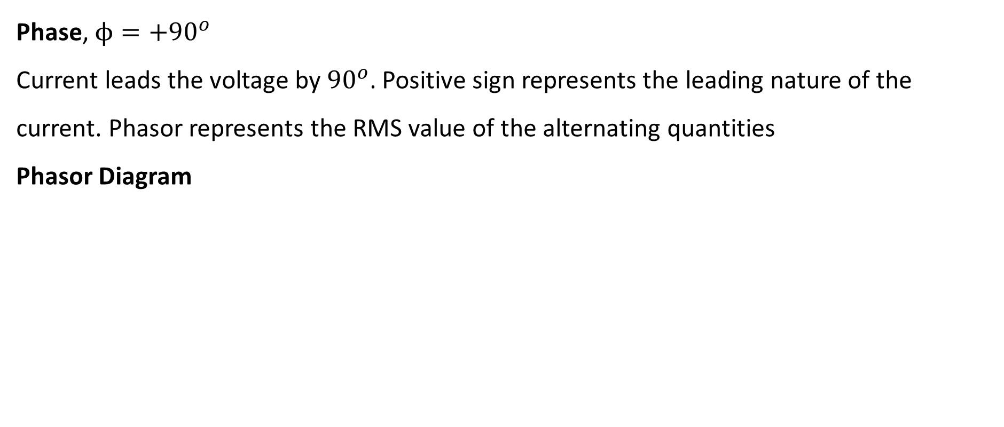
Pure Capacitance circuit
Phase, $ϕ={+90}^{o}$
Current leads the voltage by ${90}^{o}$. Positive sign represents the leading nature of the current. Phasor represents the RMS value of the alternating quantities
Phasor Diagram

Slide 20
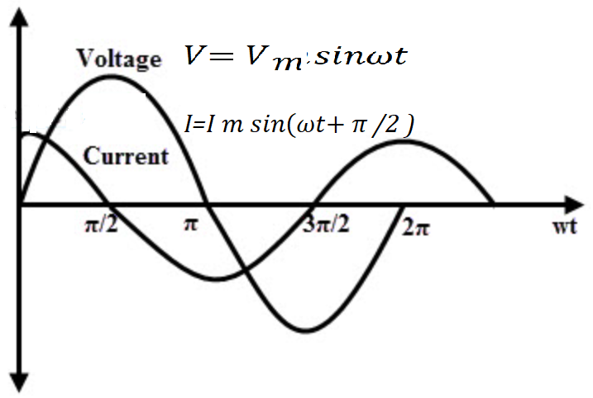
Pure Capacitance circuit
Waveform

Slide 21
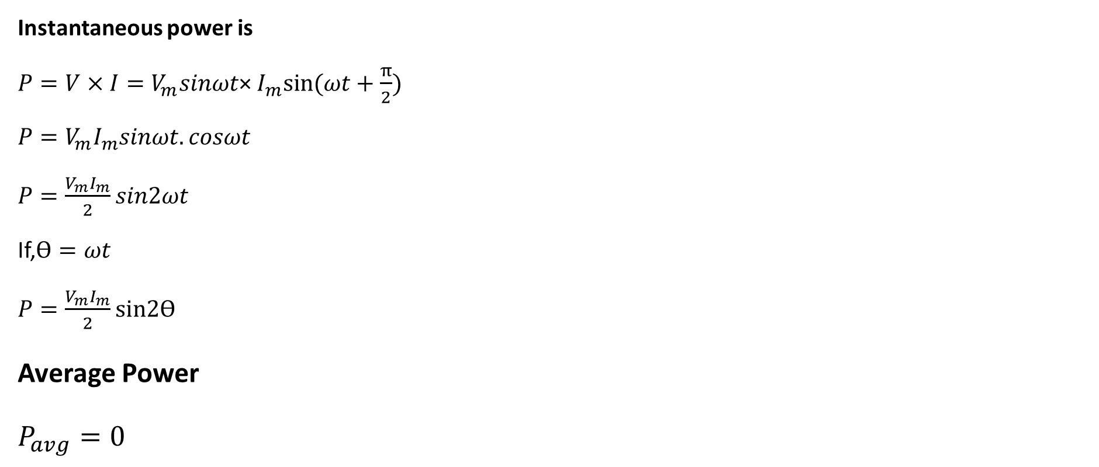
Pure Capacitance circuit
Instantaneous power is
${P=V×I=V}_{m}sinωt$× $I_{m}sin⁡(ωt+\frac{π}{2})$
${P=V}_{m}I_{m}sinωt.cosωt$
$P=\frac{V_{m}I_{m}}{2}sin2ωt$
If,$\text{ϴ}=ωt$
$P=\frac{V_{m}I_{m}}{2}\text{sin}\text{2}\text{ϴ}$
Average Power
$P_{avg}=0$

Slide 22
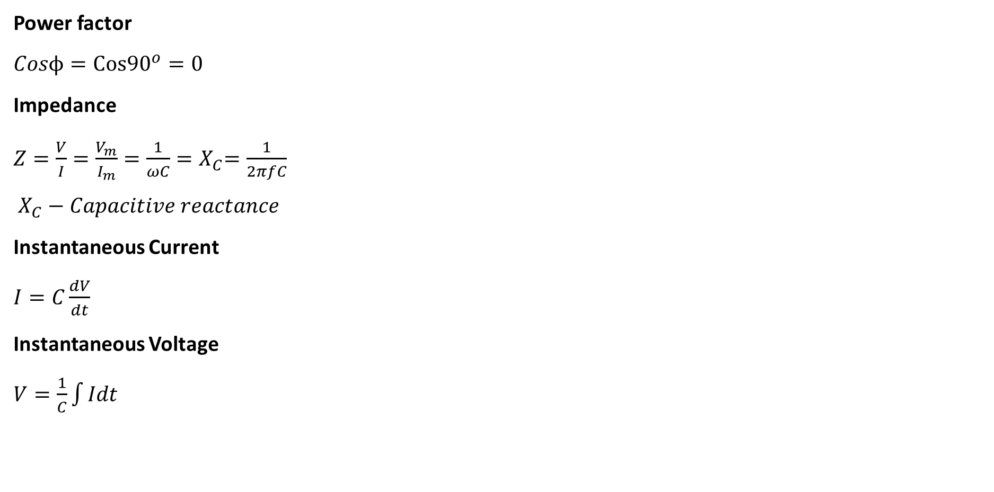
Pure Capacitance circuit
Power factor
$Cosϕ=Cos{90}^{o}=0$
Impedance
$Z=\frac{V}{I}=\frac{V_{m}}{I_{m}}=\frac{1}{ωC}{=X}_{C}=\frac{1}{2πfC}$
$X_{C}−Capacitive reactance$
Instantaneous Current
$I=C\frac{dV}{dt}$
Instantaneous Voltage
$V=\frac{1}{C}\int{Idt}$

Slide 23
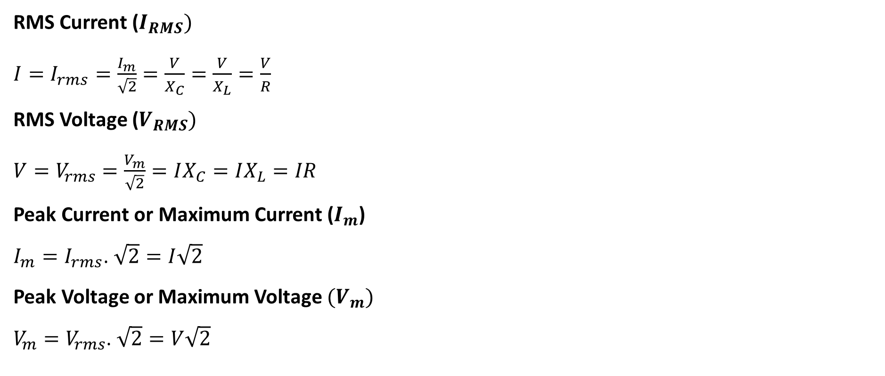
AC circuits
RMS Current ($I_{RMS})$
$I=I_{rms}=\frac{I_{m}}{\sqrt{2}}=\frac{V}{X_{C}}=\frac{V}{X_{L}}=\frac{V}{R}$
RMS Voltage ($V_{RMS})$
$V=V_{rms}=\frac{V_{m}}{\sqrt{2}}=IX_{C}=IX_{L}=IR$
Peak Current or Maximum Current ($I_{m}$)
$I_{m}=I_{rms}$. $\sqrt{2}=I\sqrt{2}$
Peak Voltage or Maximum Voltage ${(V}_{m})$
$V_{m}=V_{rms}$. $\sqrt{2}=V\sqrt{2}$

Slide 24
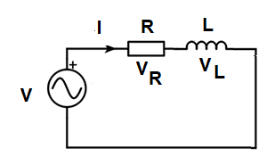
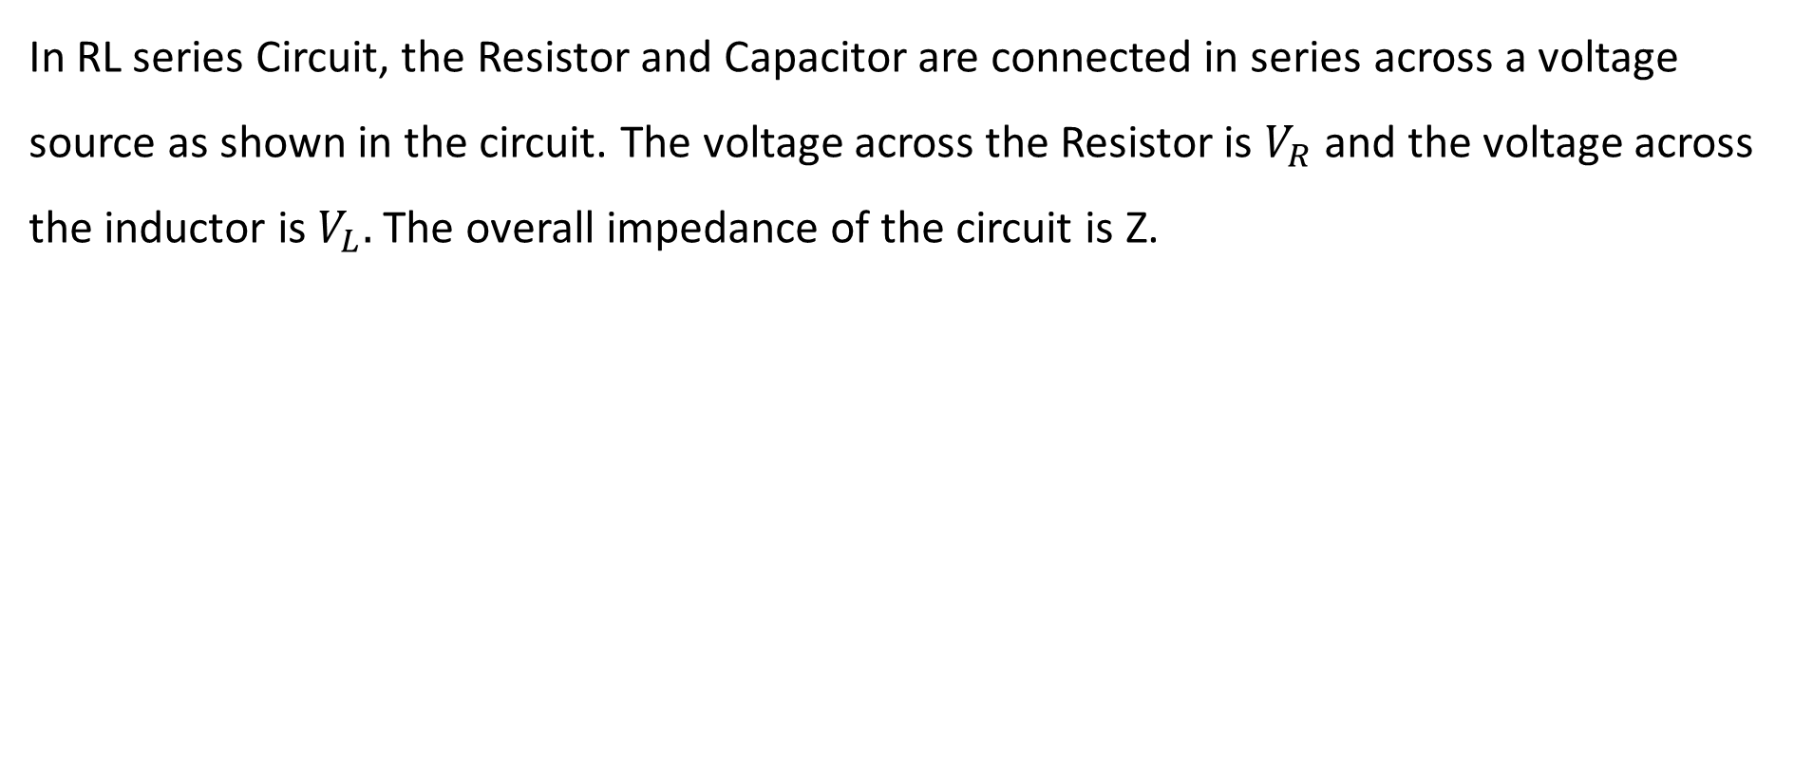
RL series circuits
In RL series Circuit, the Resistor and Capacitor are connected in series across a voltage source as shown in the circuit. The voltage across the Resistor is $V_{R}$ and the voltage across the inductor is $V_{L}.$ The overall impedance of the circuit is Z.

Slide 25
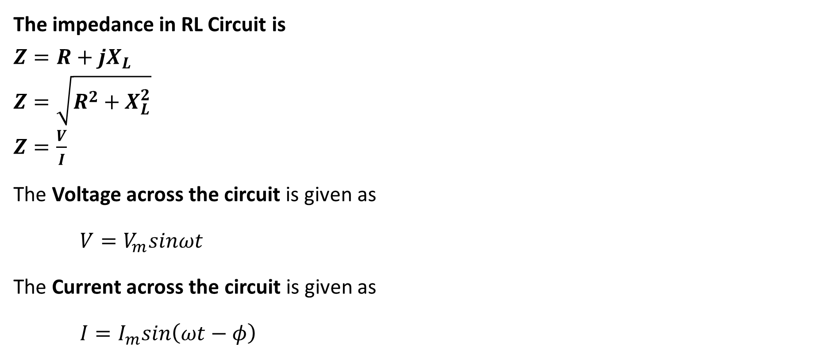
RL series circuits
The impedance in RL Circuit is
$Z=R+jX_{L}$
$Z=\sqrt{R^{2}+X_{L}^{2}}$
$Z=\frac{V}{I}$
The Voltage across the circuit is given as
$V=V_{m}sinωt$
The Current across the circuit is given as
$I=I_{m}sin\left(ωt−φ\right)$

Slide 26
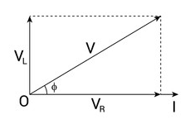
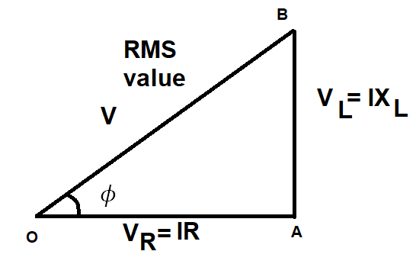
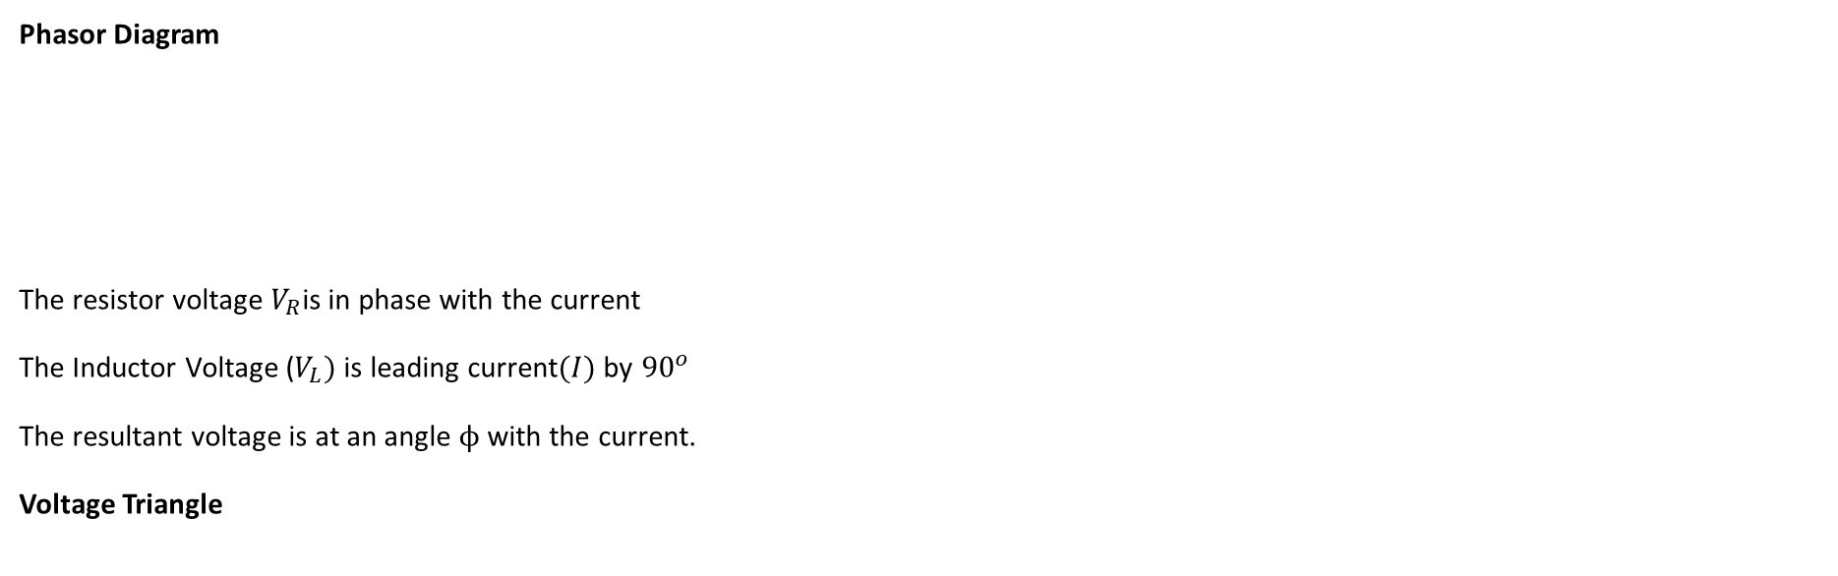
RL series circuits
Phasor Diagram
The resistor voltage $V_{R}$is in phase with the current
The Inductor Voltage ($V_{L})$is leading current$(I)$by ${90}^{o}$
The resultant voltage is at an angle $ϕ$ with the current.
Voltage Triangle

Slide 27
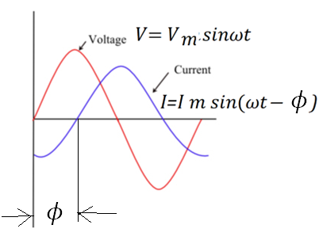
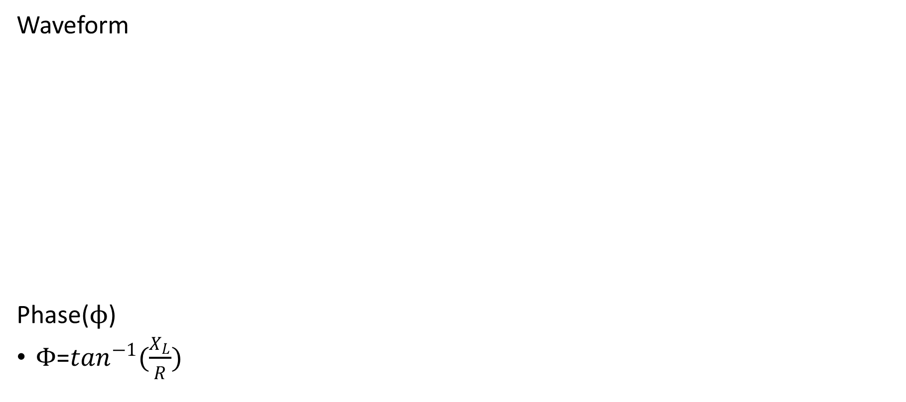
RL series circuits
Waveform
Phase($ϕ$)
$Φ$=$\tan^{−1}(\frac{X_{L}}{R})$

Slide 28
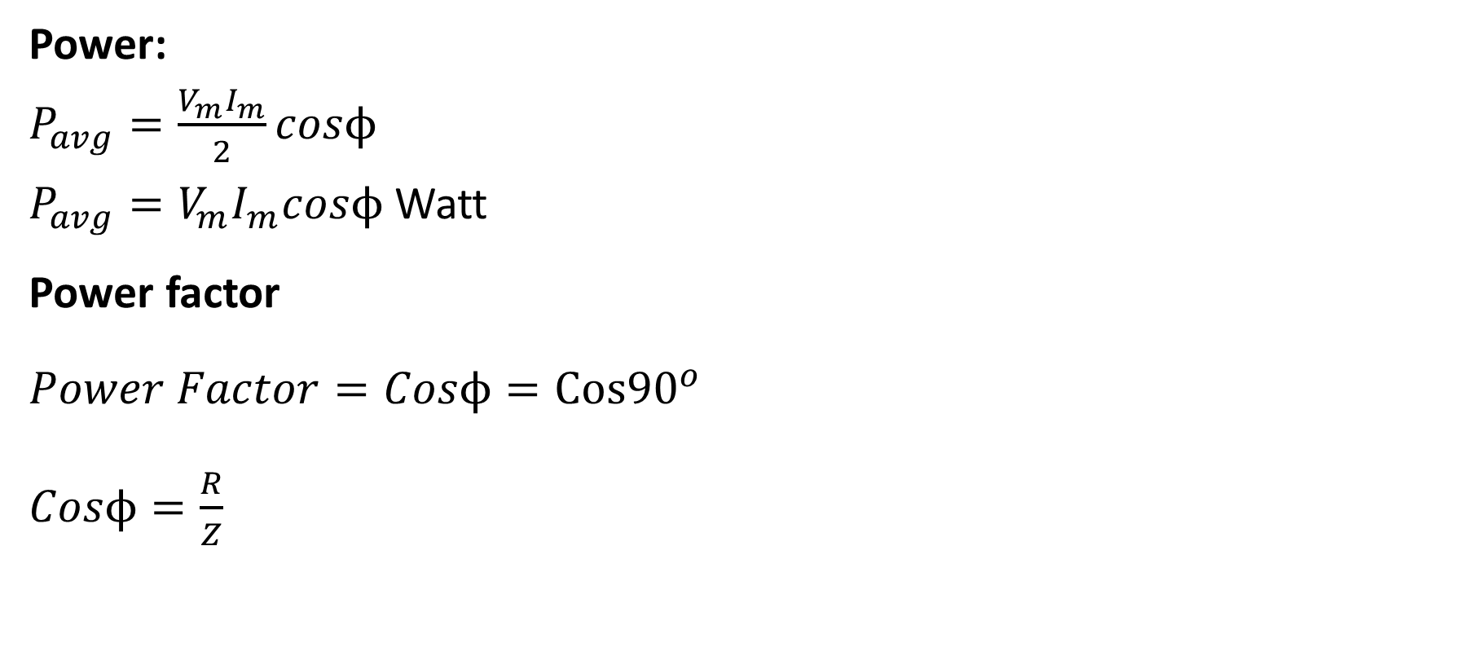
RL series circuits
Power:
$P_{avg}=\frac{V_{m}I_{m}}{2}cosϕ$
$P_{avg}=V_{m}I_{m}cosϕ$ Watt
Power factor
$Power Factor=Cosϕ=Cos{90}^{o}$
$Cosϕ=\frac{R}{Z}$

Slide 29
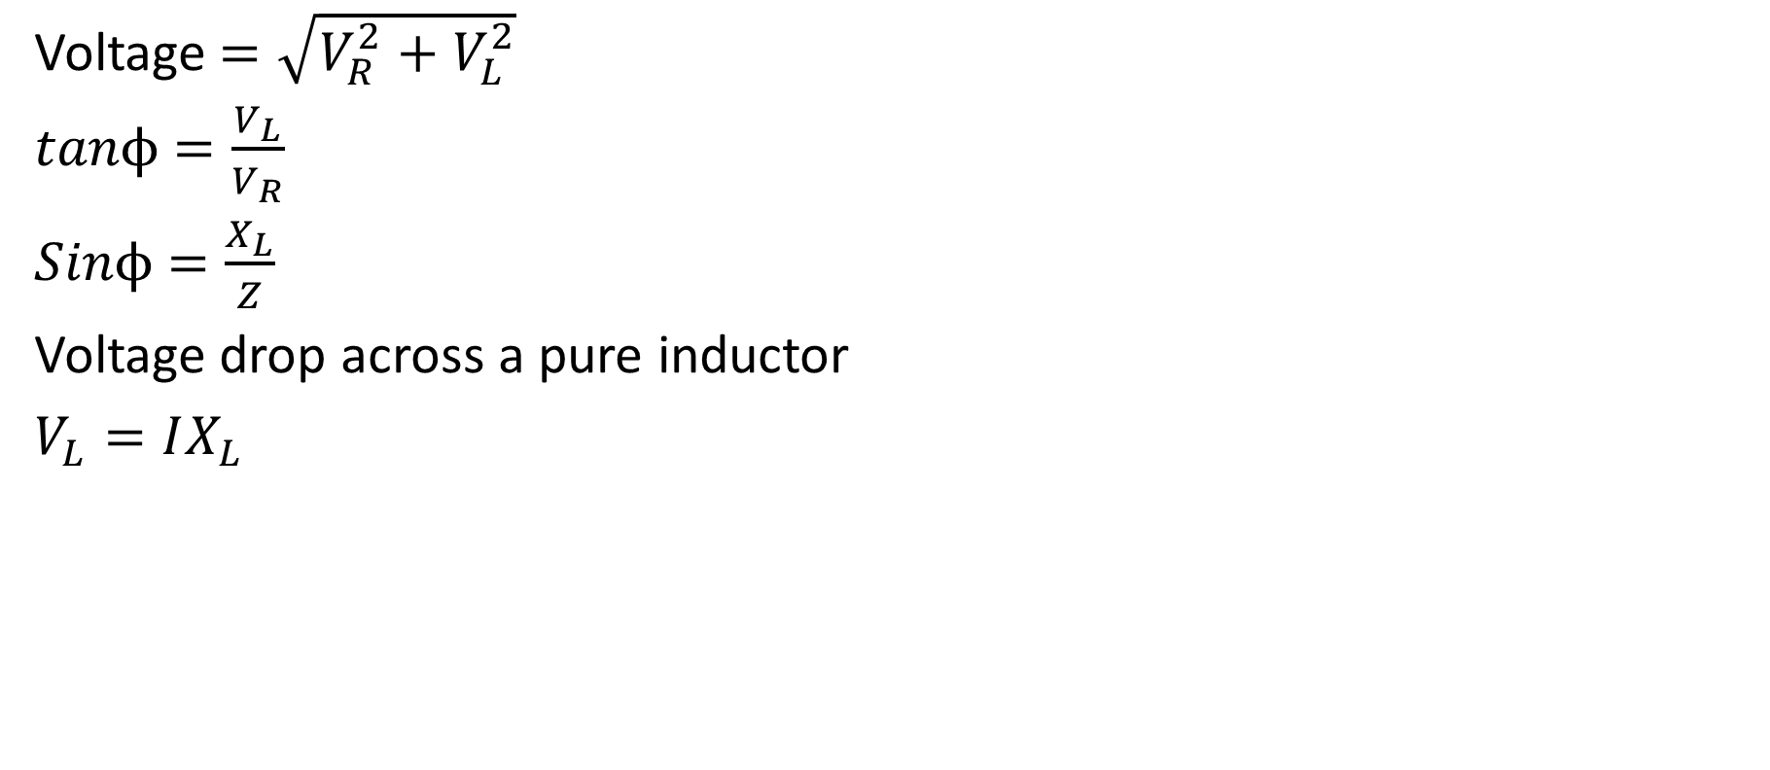
RL series circuits
Voltage $=\sqrt{V_{R}^{2}+V_{L}^{2}}$
$tanϕ$ $=\frac{V_{L}}{V_{R}}$
$Sinϕ$ $=\frac{X_{L}}{Z}$
Voltage drop across a pure inductor
$V_{L}=IX_{L}$

Slide 30
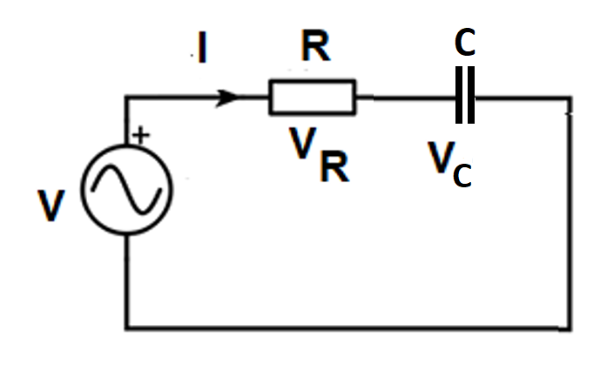
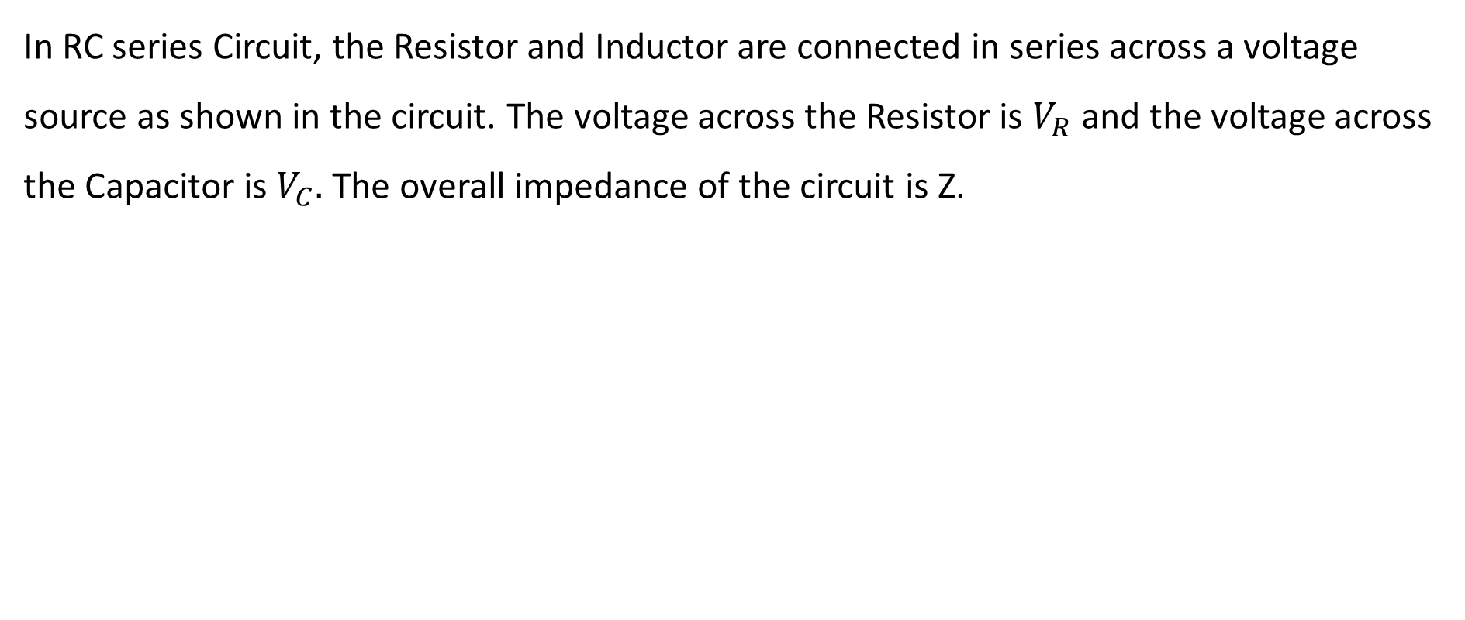
RC series circuits
In RC series Circuit, the Resistor and Inductor are connected in series across a voltage source as shown in the circuit. The voltage across the Resistor is $V_{R}$ and the voltage across the Capacitor is $V_{C}.$ The overall impedance of the circuit is Z.

Slide 31
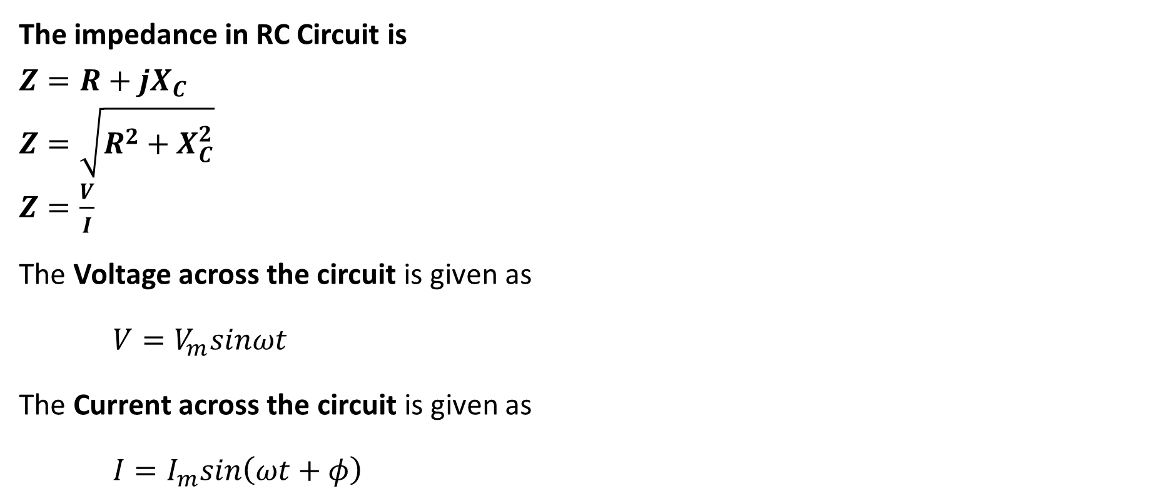
RC series circuits
The impedance in RC Circuit is
$Z=R+jX_{C}$
$Z=\sqrt{R^{2}+X_{C}^{2}}$
$Z=\frac{V}{I}$
The Voltage across the circuit is given as
$V=V_{m}sinωt$
The Current across the circuit is given as
$I=I_{m}sin\left(ωt+φ\right)$

Slide 32
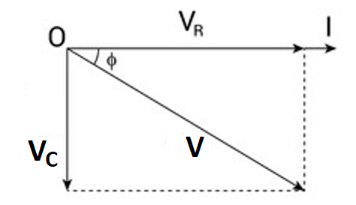
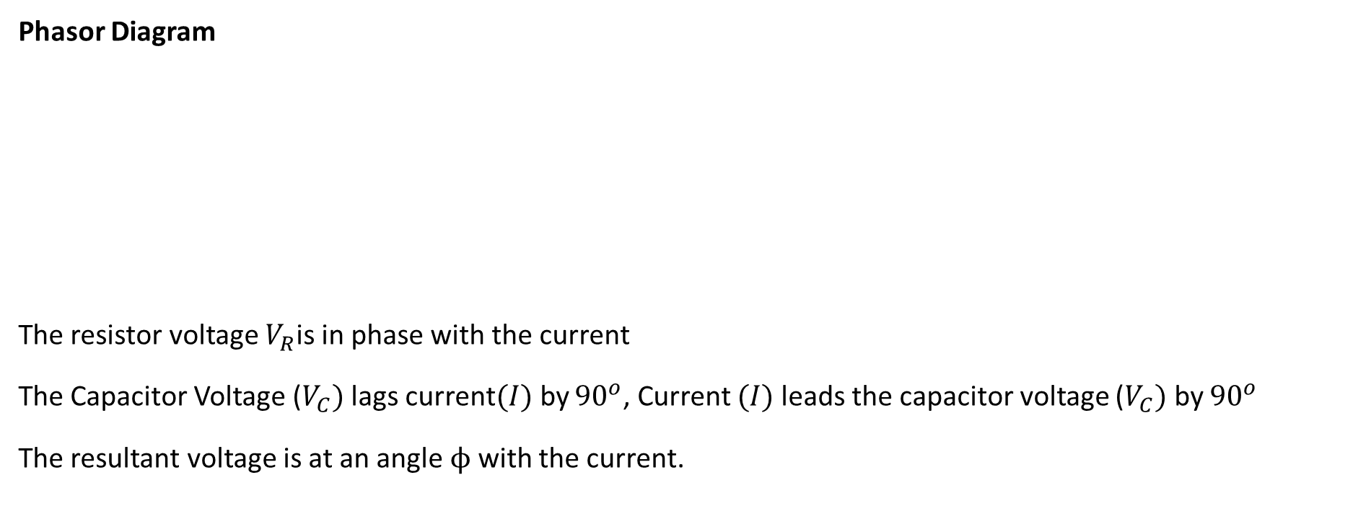
RC series circuits
Phasor Diagram
The resistor voltage $V_{R}$is in phase with the current
The Capacitor Voltage ($V_{C})$lags current$(I)$by ${90}^{o}$, Current $(I)$leads the capacitor voltage ($V_{C})$ by ${90}^{o}$
The resultant voltage is at an angle $ϕ$ with the current.

Slide 33
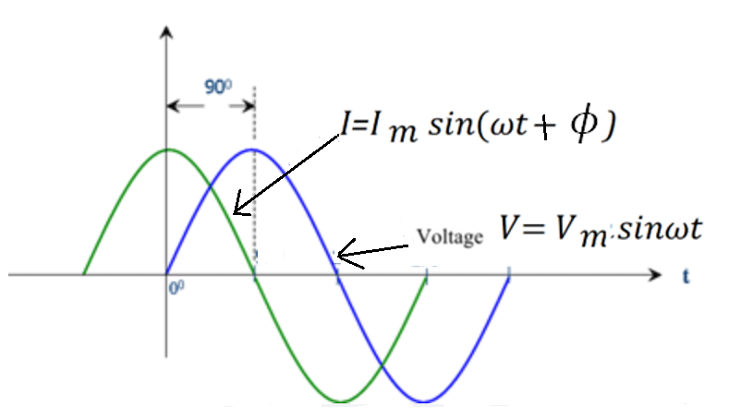
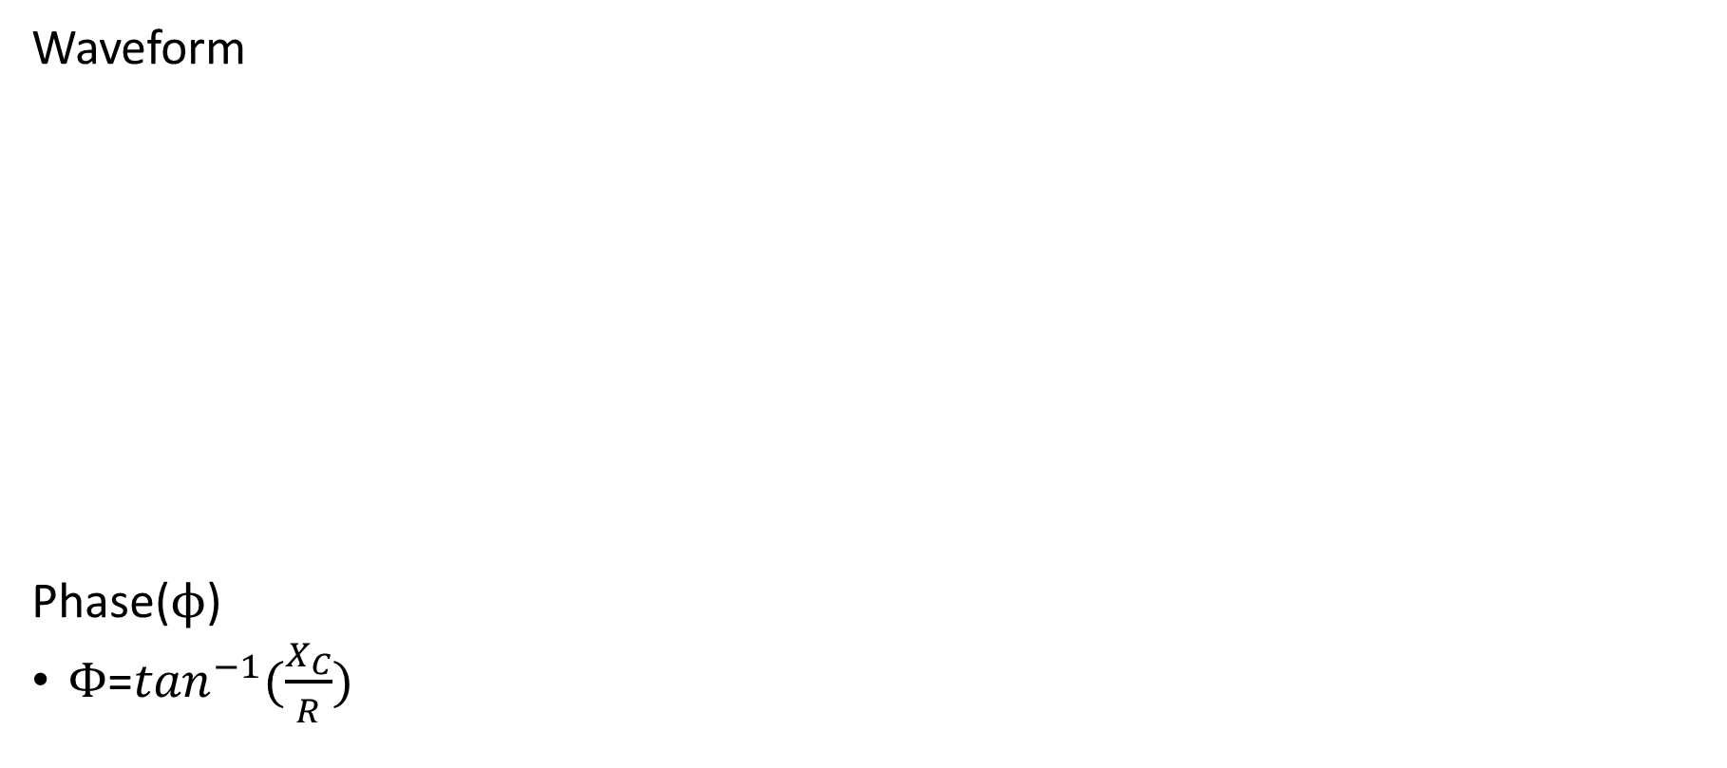
RC series circuits
Waveform
Phase($ϕ$)
$Φ$=$\tan^{−1}(\frac{X_{C}}{R})$

Slide 34
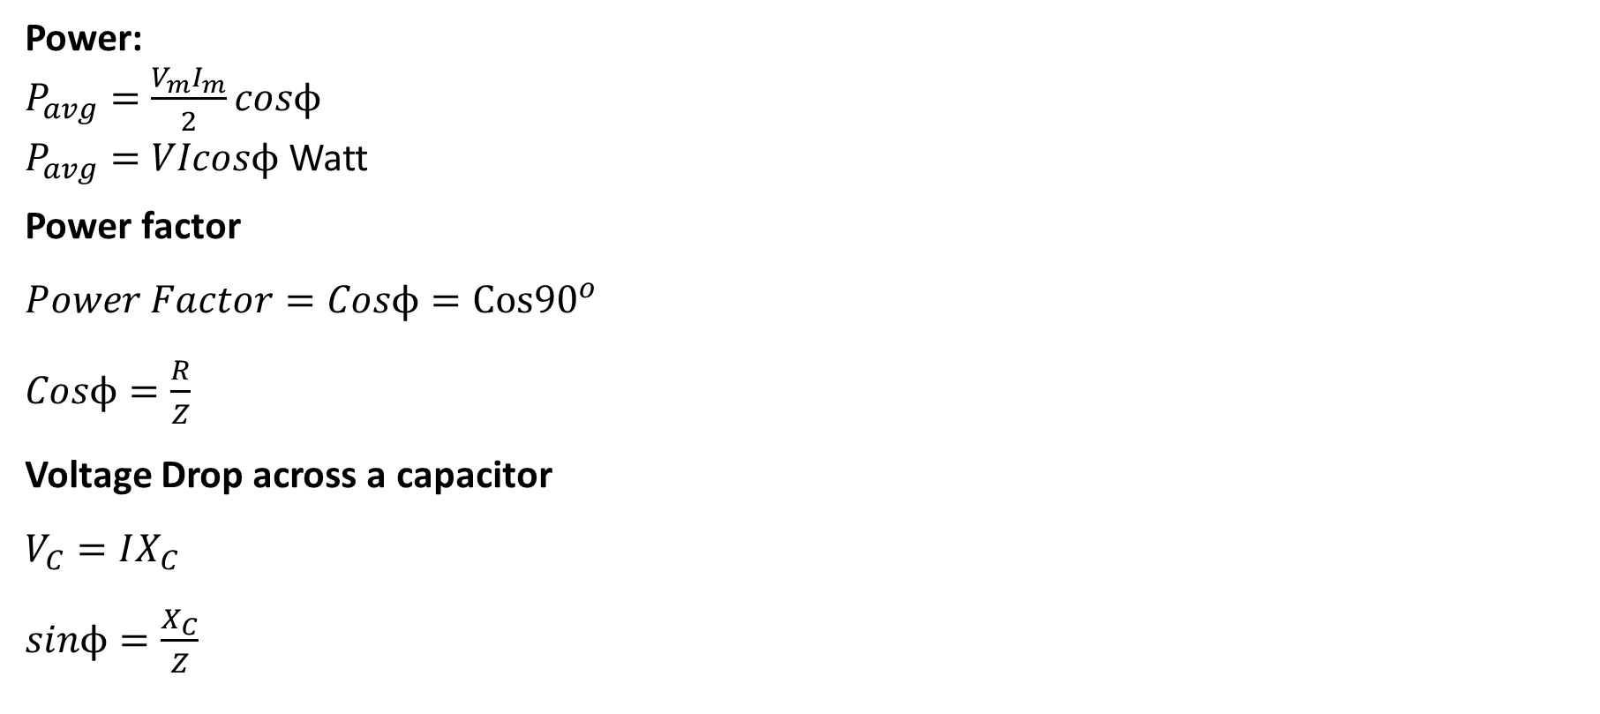
RC series circuits
Power:
$P_{avg}=\frac{V_{m}I_{m}}{2}cosϕ$
$P_{avg}=VIcosϕ$ Watt
Power factor
$Power Factor=Cosϕ=Cos{90}^{o}$
$Cosϕ=\frac{R}{Z}$
Voltage Drop across a capacitor
$V_{C}=IX_{C}$
$sinϕ=\frac{X_{C}}{Z}$

Slide 35

Thank You
Notes:
Health and Safety module – coming soon on Moodle

