Slide 1
Shiné – Traditional Tibetan
Śamatha Meditation
THE NINE STAGES (OF MENTAL SETTING) TO CALM ABIDING
Suzanne Tempel - 2246080

Slide 2
Shiné Meditation (śamatha or calm-abiding)
The Tibetan term Shiné is translated into English as either "calm-abiding" or "serenity," and its Sanskrit equivalent is śamatha.
The syllable "Shi" means "to pacify," "to calm," or "peace," referring to the quieting of mental agitation and distractions caused by both external and internal phenomena.
The second syllable "Né" means "to abide" or "to remain," indicating a stable and continuous presence of mind resting in calm.

Slide 3
Shiné Meditation
The aim of this type of meditation is to train attention,
attain mental stability,
and maintain continuous awareness.

Slide 4
Shiné Meditation
Calm-abiding meditation involves concentrating fully on a single object, maintaining steady and relaxed focus.
In contrast, insight meditation (vipashyanā) involves a deep investigation of the object in order to gain a clear understanding of its nature.
While insight meditation is often used to explore the nature of emptiness (śūnyatā), it can also be applied to a wide range of phenomena.
Likewise, calm-abiding meditation (śamatha) isn’t limited to one type of object—it can be practiced by focusing on anything from a physical object like a stone, to a conceptual object like emptiness, or even mental states such as anger.

Slide 5
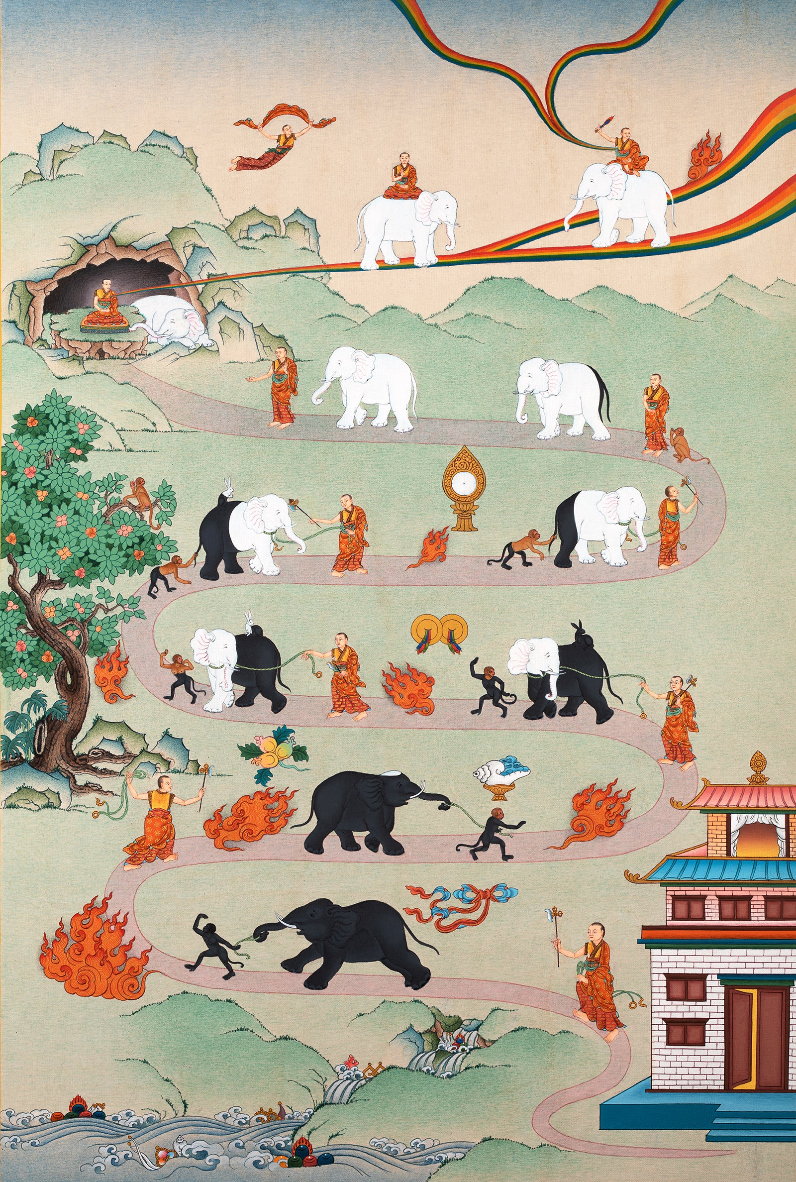

SHINÉ MEDITATION
Introduction to the Samatha Meditation Path Thangka
This traditional Tibetan thangka illustrates the meditative path of śamatha, or calm-abiding meditation. It visually represents the progressive stages of training the mind, moving from distraction and restlessness toward focused attention and mental stability. The winding path depicts the gradual refinement of attention, culminating in effortless concentration and meditative absorption. The monk represents the meditator.
Rooted in classical Buddhist psychology, this imagery serves both as a contemplative aid and as a pedagogical tool for understanding the inner dynamics of attention, effort, and awareness.

Slide 6
32 SHINÉ NAVIGATION POINTS
The Nine Stages of Mental Setting
The Six Powers
The Four Levels of Mental Engagement
The Five Faults
The Eight Antidotes

Slide 7
32 SHINÉ NAVIGATION POINTS – the nine stages of mental setting
The elephant symbolizes the mind—initially dark and unruly, becoming lighter and more disciplined over time.
9
8
7
5
6
4
3
2
1

Slide 8
32 SHINÉ NAVIGATION POINTS – the nine stages of mental setting
Preliminary Stage - The stage where we set intentions, prepare body and mind, and create the right conditions before starting meditation.
1 Setting the Mind
2 Continuously Setting the Mind
3 Fixing and Resetting the Mind
4 Close Setting of the Mind
5 Controlled Setting of the Mind
6 Pacification of the Mind
7 Thorough Pacification of the Mind
8 Making the Mind Single-Pointed
9 Setting the Mind in Equipoise
9
8
7
5
6
4
3
2
1

Slide 9
32 SHINÉ NAVIGATION POINTS – the nine stages of mental setting
Stage 1: Setting the Mind — We place the mind on the object, but focus is weak and brief.
Stage 2: Continuous Setting — Focus lasts a bit longer, though still unstable.
Stage 3: Fixing and Resetting — We notice when focus is lost and bring attention back.
Stage 4: Close Setting — Mindfulness strengthens; we stay focused most of the time.
Stage 5: Controlled Setting — Gross distractions stop; subtle laxity becomes the challenge.
Stage 6: Pacifying the Mind — We begin to catch laxity or excitement before they arise.
Stage 7: Thorough Pacification — Subtle distractions are easily calmed, though effort is still needed.
Stage 8: Single-Pointed Mind — Only slight effort at the start; the mind stays steady.
Stage 9: Mind in Equipoise — Focus remains effortlessly stable; true Shiné is near, bringing bliss of body and mind.
9
8
7
5
6
4
3
2
1

Slide 10
32 SHINÉ NAVIGATION POINTS
– the six powers
Each curve in the path signifies the application of a mental power that helps us move forward.
Each mental power is a quality we can cultivate within ourselves. Developing the power associated with a particular stage helps us reach that stage, while also laying the foundation for developing the next power.
All nine stages contain elements of every power. Identifying a certain power with a particular stage simply highlights the key mental strength needed most at that point in the journey.

Slide 11
32 SHINÉ NAVIGATION POINTS
– the six powers
6
5
4
3
2
1

Slide 12
32 SHINÉ NAVIGATION POINTS
– the six powers
The rope illustrates the power of mindfulness.
The elephant goad (taming hook) represents introspective awareness, which helps monitor and correct the mind.

Slide 13
32 SHINÉ NAVIGATION POINTS
– the four levels of mental engagement
4
3
2
2
2
2
2
1
1

Slide 14
32 SHINÉ NAVIGATION POINTS
– the five faults
In meditation, we must learn to distinguish helpful experiences from inner obstacles. There are five such mental faults that block our progress. To overcome them, we apply eight antidotes — but first, we need to recognize these faults when they appear.

Slide 15
32 SHINÉ NAVIGATION POINTS
– the five faults
1 Laziness
2 Forgetfulness (Both of the Instructions and the Object of Focus)
3 Laxity and Excitement
4 Non-Application of the Antidotes
5 Over-Application of the Antidotes

Slide 16
32 SHINÉ NAVIGATION POINTS
– the five faults
Fault 1: When stabilizing meditation, three forms of laziness may arise:
Physical laziness: A heavy, obvious lethargy — wanting only to rest or sleep, with little interest in activity. It’s easy to spot because it’s so clear.
Mental laziness: A subtle sense of inadequacy — thinking “I can’t do this”, leading to procrastination and avoidance. Harder to recognize and overcome.
Intelligent (or frivolous) laziness: Staying busy with work, social life, or tasks, using busyness as an excuse to delay meditation. This subtle form is common and tricky to notice.

Slide 17
32 SHINÉ NAVIGATION POINTS
– the five faults
Fault 2: Forgetfulness
This is losing mindfulness of the instructions or object of meditation. Without remembering how to practice or what to focus on, concentration is lost. Distraction by sensory input or thoughts often causes this, especially in early meditation stages.

Slide 18
32 SHINÉ NAVIGATION POINTS
– the five faults
Fault 3: There are two kinds of laxity in meditation:
Gross laxity: The mind stays on the object but lacks clarity and strength, feeling dull or heavy, almost as if about to forget the object. A severe form is lethargy, where mind and body feel heavy, concentration fades, and even dreams may arise. This is common in early practice.
Subtle laxity: The mind holds the object with stability and clarity, but without enough sharpness or intensity. It feels slightly too relaxed, making it hard to notice. This is risky because it mimics good meditation, but the mind is slightly dull, so no effort is made to improve.

Slide 19
32 SHINÉ NAVIGATION POINTS
– the five faults
Fault 3: There are two types of excitement in meditation:
Gross excitement: The mind completely leaves the meditation object and becomes caught up in thoughts of something desirable (like food, success, or a person), usually when mental energy is too high.
Subtle excitement: The object of meditation remains, but part of the mind drifts toward pleasant thoughts, like a hidden current beneath stable concentration. This form is harder to detect because stability and clarity seem intact, but attachment quietly pulls the mind away, often when focus is too tight.
These forms of excitement, like the two types of laxity, are key examples of inner distractions that we must learn to recognize and overcome.

Slide 20
32 SHINÉ NAVIGATION POINTS
The monkey stands for mental distractions.
The five sense objects signify distractions related to sensory pleasures.
The five sensory objects symbolize sources of distraction.
1. The scarf (kata) stands for the sense of touch.
2. The fruit symbolizes the sense of taste.
3. The conch filled with perfume represents the sense of smell.
4. The cymbals correspond to hearing.
5. The mirror signifies the sense of vision.

Slide 21
32 SHINÉ NAVIGATION POINTS
The rabbit depicts subtle mental dullness or laxity.
The monkey picking fruit along the path shows how even virtuous thoughts can become distractions during calm-abiding meditation and must be set aside—though such thoughts are generally positive outside of meditation.
The fire illustrates the effort applied—its size changes to reflect how the level of effort needed shifts at different stages of the practice.

Slide 22
32 SHINÉ NAVIGATION POINTS
– the five faults
Fault 4: Non-Application of Antidotes
This is when we fail to apply the needed remedy, even though we notice laxity or excitement. Without addressing these faults, meditation won’t progress.
Fault 5: Over-Application of Antidotes
This happens when we use antidotes unnecessarily—when laxity or excitement isn’t present or has already passed. Overuse disturbs the mind, like correcting a child who’s done nothing wrong.
To deepen meditation, we must recognize these five faults and apply the eight antidotes appropriately.

Slide 23
32 SHINÉ NAVIGATION POINTS
– the eight antidotes

Slide 25
Shiné Meditation
Upon reaching the ninth stage, it's important to keep meditating until a state of both mental and physical bliss is attained—this is known as genuine Shiné.

Slide 26
32 SHINÉ NAVIGATION POINTS
The flying monk indicates a state of bodily bliss.
The white elephant represents mental bliss, and the monk seated on it in meditation posture symbolizes the realization of true Shiné.
The elephant with the monk holding a sword shows the highest level of insight meditation (Lhaktong), where emptiness is used as the object of meditation.

Slide 27
Shiné Meditation –Personal reflection
The method begins not with trying to eliminate thoughts, as is quite common in the West, but simply with learning to stay—again and again—with one object. It’s deceptively simple, yet profoundly challenging.
The structure of the practice feels diagnostic—you can observe which stage your mind is in and adjust your approach accordingly. That makes it both practical and precise.
The progression of the nine stages makes it clear that meditation is not a single-point achievement, but a gradual training of the mind—much like strengthening a muscle.
It surprised me that something as ancient as this method aligns so well with contemporary cognitive science on attention and the brainwave training of the Awakened Mind Method.

