Slide 1

Harvard Referencing:
The why, when and how
Lisa Ellis
Academic Liaison Librarian

Slide 2
Aims...
1
The importance of referencing
2
Creating citations
3
Referencing books and journals
4
RefWorks

Slide 3
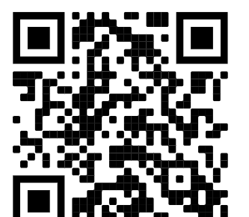
Question
Which part of Harvard Referencing do you find most difficult?
Use your camera on your phone to scan the QR code and answer the question.

Slide 4






Research Process
Make notes, Use critical thinking and apply academic integrity to my work
Explore ideas, information and research from different sources
Original ideas built on attributed sources
Notes:
Read widely and assimilate information from different sources, such as lectures, moodle, web, books, journals, tv, newspapers and more.
Take notes as you go along, making sure to highlight any quotes, paraphrasing, where you got the idea / words/ information from.
Focus on ideas not quoting or paraphrasing. Keep asking yourself, How do you know this information? Whose idea is it? Attribute the information.
Note taking is a skill that is necessary to develop to become a good scholar.
Draw your own conclusions based on your understanding of the evidence and information you have found and reference and acknowledge your sources, also known as attribution.
Repeat to yourself as you are writing How do I know this? Where did I read this? This will help you avoid plagiarism.

Slide 5

Standing on the shoulders of giants...
Image by Pixabay
Notes:
12th century origin, but widely recognized as Sir Isaac Newton in the 17th century.
All creative and academic work builds on what was created before. Your interpretation and ideas are inspired and originate from reading others work. But you must give attribution to those whose ideas, research and work you have read.
So where do we find all this information?

Slide 6

Why we use referencing …
And lend credibility to our arguments
The intellectual work of others
Which ideas belong to others by attribution
Plagiarism
Breadth of reading
Notes:
Quick recap on why referencing is so important.

Slide 7
Plagiarism
Different kinds of plagiarism
Can be deliberate or accidental
Presenting someone else’s work as your own
Forgetting to reference correctly
Self - plagiarism
Essay Mills

Slide 8
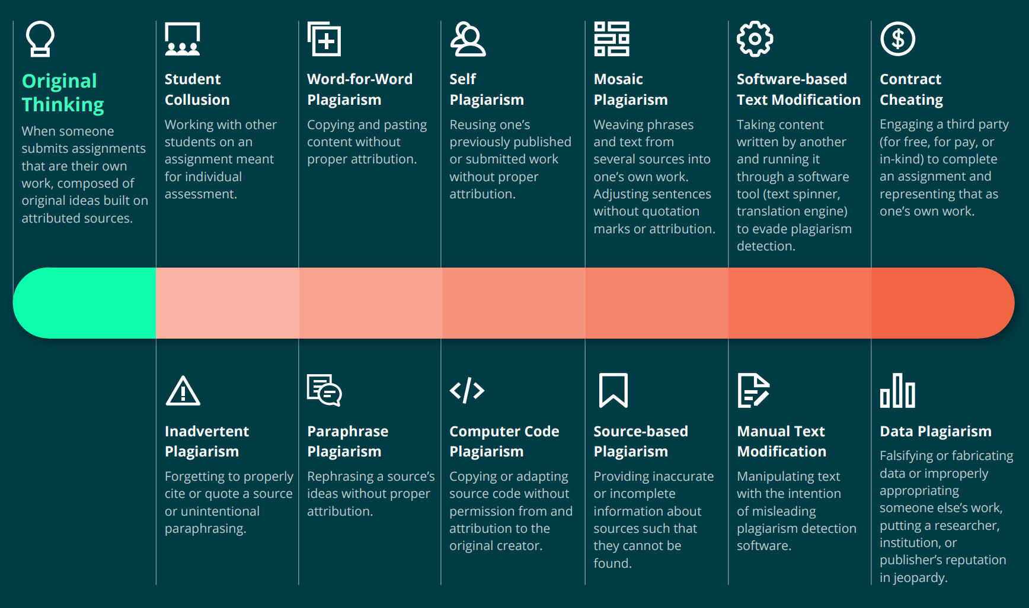
Notes:
Turnitin Plagiarism Instructor guide - Plagiarism Spectrum 2.0 | Turnitin
Student Collusion
Asking somebody you know to write all or part of your assignment
Allowing another student to submit your work as their own
Jointly completing an individual assignment with another person and then each submitting identical or similar pieces of work
Working with another student to jointly plan an assignment e.g. structure, main arguments and sources, even if you then individually write up the assignment.

Slide 9
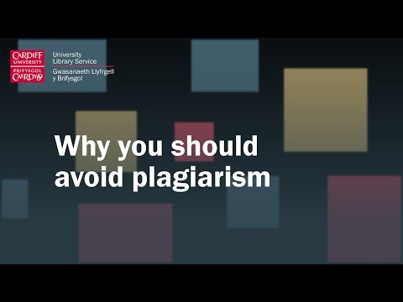
Video
Notes:
A video from a Cardiff University lecturer on why you shouldn’t plagiarise.

Slide 10

Harvard Referencing Style
There are many different styles of referencing.
You must follow UWTSD's version which currently follows the 11th edition of Cite Them Right.
The Cite Them Right Ebook is available online through the library.
Cite Them Right
Trial Cite Them Right Database
Notes:
So we know why, but how do we reference in UWTSD?
Consistency is key!

Slide 11
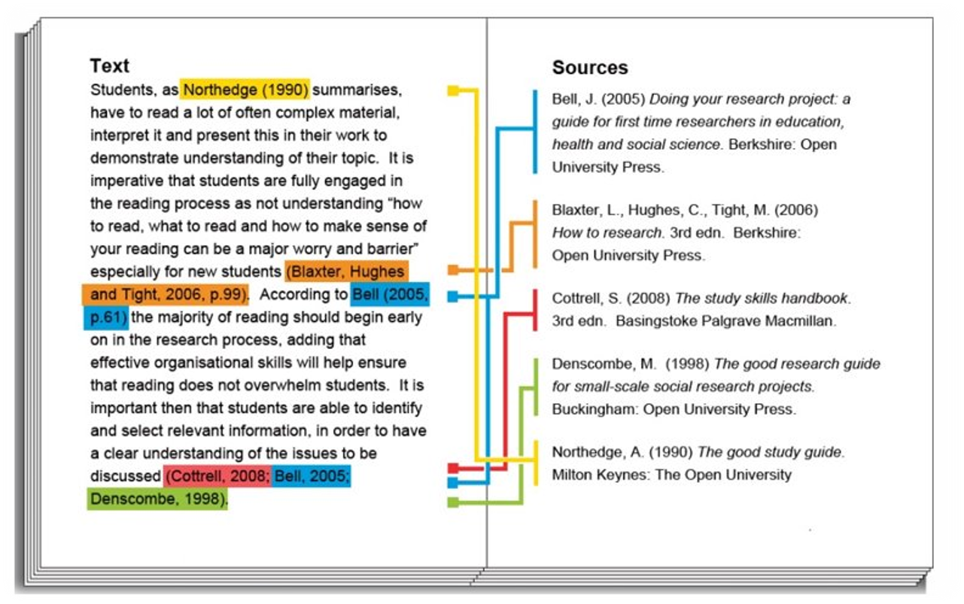
How to Harvard Reference
2 parts to Harvard Referencing:
1. In-text citation
2. full reference list
University of South Wales Libraries and Student Development and Study Skills Service (2019) The University of South Wales Guide to Harvard Referencing. Available at: https://library.southwales.ac.uk/collections-subject-guides/referencing/ (Accessed: 9 June 2020).
University of South Wales Libraries and Student Development and Study Skills Service (2019) The University of South Wales Guide to Harvard Referencing. Available at: https://library.southwales.ac.uk/collections-subject-guides/referencing/ (Accessed: 9 June 2020).

Slide 12

Citations
Every idea you use from your reading must be acknowledged with an in-text citation.
This includes, but not limited to:
Direct quotes
Paraphrased material
Summarising
Images
Tables
Graphs
Notes:
One of the key purposes of referencing is to acknowledge the role that the work of others has played in developing your ideas.
This means that you must include a citation every time you use an idea that you got from someone else – not just when you quote directly. That includes images, tables, graphs etc. if they’re not your own work.
Good note taking skills are important. You must record the information as you go along and highlight which words are exact quotes and which are paraphrased.

Slide 13
1. In-text citation
Goes into the body of your writing and includes:
Author(s) or editor(s) surname/family name
Year of publication
Page number(s) if required​
Notes:
If you are using the author's name in your sentence, you only need the date and page number in brackets. Note the full stop comes after the citation if at the end of a sentence.

Slide 14
Examples
1 author
(Smith, 2016, p.5)
2 or 3 authors
(Phillips and Renton, 2012, p.54)
4 or more authors
(Morton et al., 2014, p.37)

Slide 15
In-text citation
Author's Surname,
(year (& page number if required) in brackets)
  Scotland is taking a radical approach to tackling knife crime by treating it as a public health issue (Roberts, 2019).
  According to Roberts (2019) Scotland is taking a radical approach to tackling knife crime by treating it as a public health issue.
Notes:
If you are using the author's name in your sentence, you only need the date and page number in brackets. Note the full stop comes after the citation if at the end of a sentence.

Slide 16
Direct Quotes
Use "quotation marks"
Integrate into your writing
Show page number if possible
Example: When writing assignments, the “aim should always be to reference reliable sources of information” (Pears and Shields, 2016, p. 2).
Notes:
Don’t just drop a quote into your writing – integrate it into your own sentences. Highlight use of two authors, connected by ‘and’

Slide 17
Quotations
Vary your sentence structure
Date in brackets immediately after author’s name.
Example:
Pears and Shields (2016, p. 2) argue that when writing assignments, the “aim should always be to reference reliable sources of information.”

Slide 18
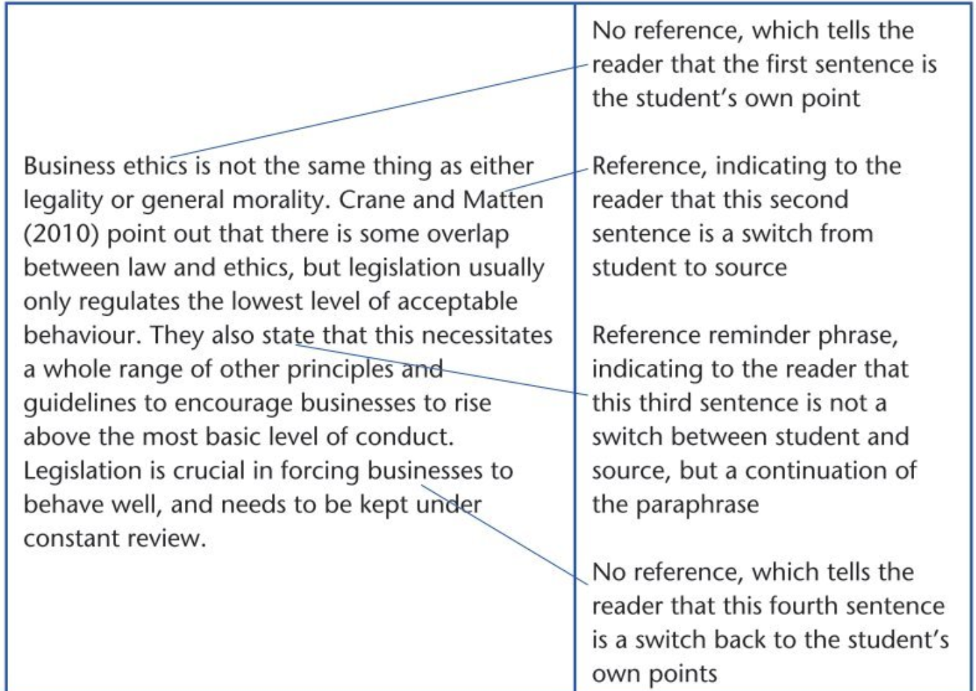
Paraphrasing
Your interpretation of someone else's ideas.
Godfrey, J. (2018) How to use your reading in your essays. 3rd edn. London: Palgrave.

Slide 19
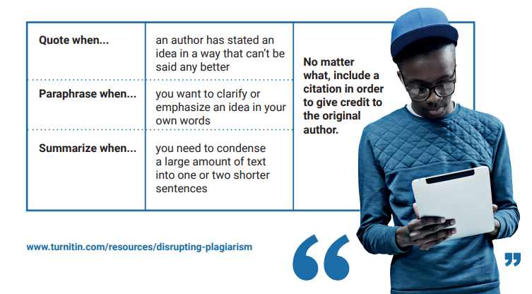

Slide 20
When NOT to cite...
Common knowledge
Not all ideas belong to others
Facts, dates, events generally known in a particular subject
Ask yourself:
Did I know this before I started this course?
Did this idea come from me, or from something I have heard, read, discussed?
If in doubt – CITE!
Notes:
Did I know this before I started this course?
Did this idea come from me or something I have read?
Ig in doubt – cite it!

Slide 21
2. Creating a reference list
Arrange alphabetically by author’s surname - or by title if no author
More than one source by the same author - arrange chronologically
List all sources cited in your writing
Format each reference according to resource cited.
Who
When
What
Where

Slide 22
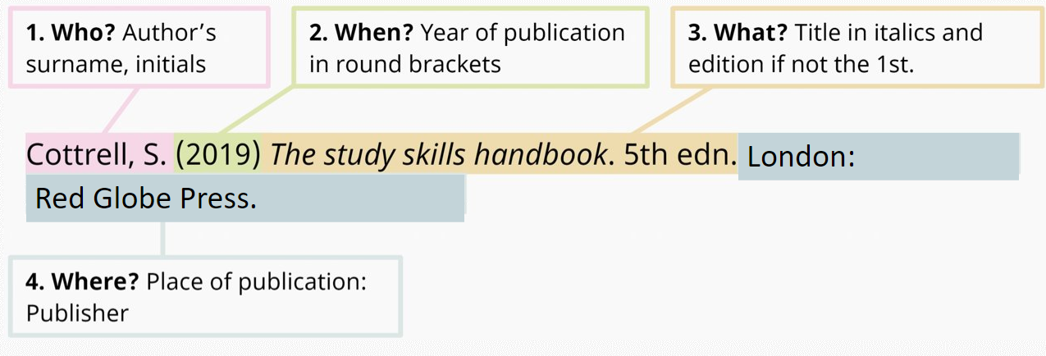
Reference List: book

Slide 23
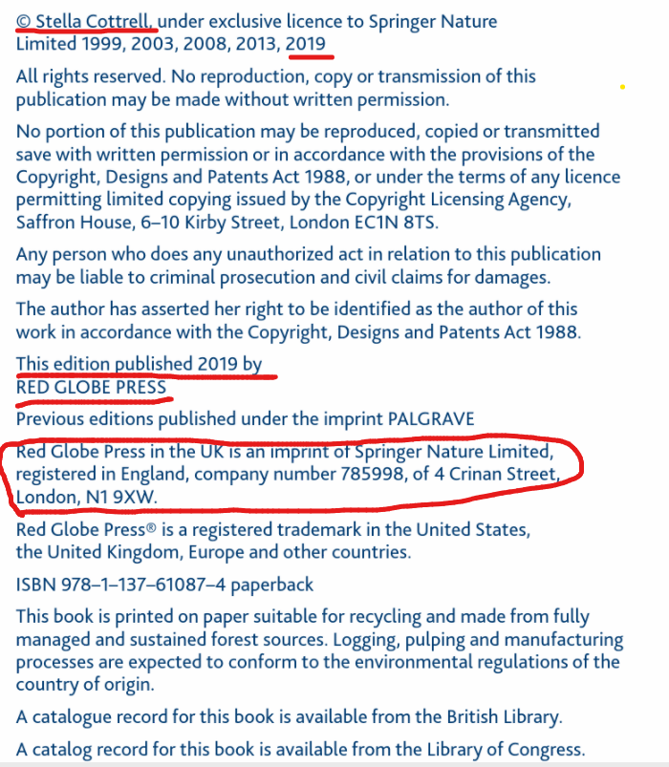
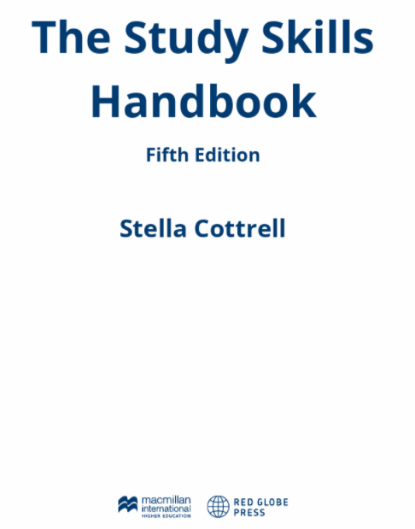
Where to find the information...
Title
Edition
Date
Author ​
Place of Publication (publisher's address).
Publisher

Slide 24
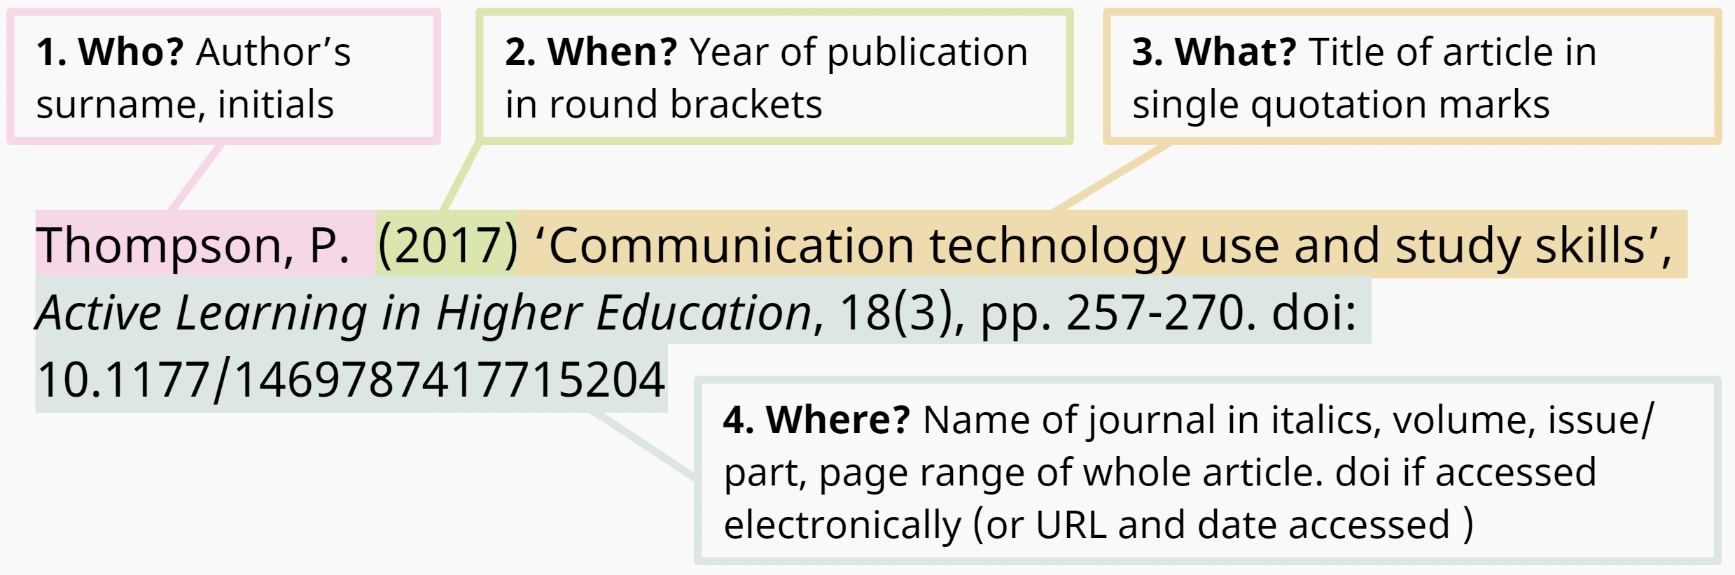
Reference List: journal article

Slide 25
Reference List: journal article
Surname, Initial. (Year of publication) 'Title of article', Title of Journal, Issue information, Page reference. Doi / Available at: URL (Accessed date).
Pascoe, K.M., Waterhouse-Bradley, B. and McGinn, T. (2021) 'Systematic literature searching in social work: A practical guide with database appraisal', Research on Social Work Practice, 31(5), pp. 541-551. doi:10.1177/1049731520986857
In-Text Citation:
(Pascoe, Waterhouse-Bradley and McGuinn, 2021)

Slide 26
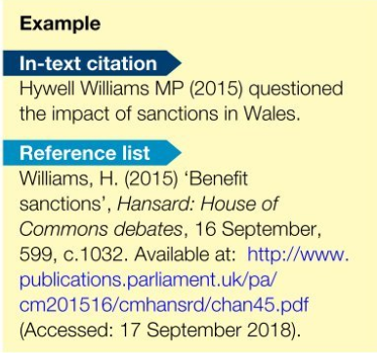
Hansard
Name of speaker / author
Year of publication (round brackets)
Subject of debate or speech (in single quotation marks)
Hansard: Name of House of Parliament (in italics)
Debates/written statement/ Westminster Hall or petitions (in italics)
Day and month
Volume number, column number or page number
Available at: URL (accessed date)
(Pears and Shield, 2019,p 63)

Slide 27
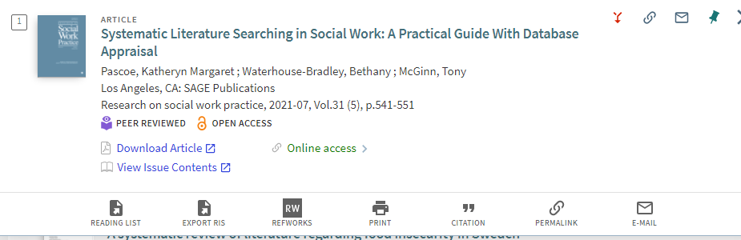
Finding the information
Article title
Authors
Journal title
Date & issue information

Slide 28
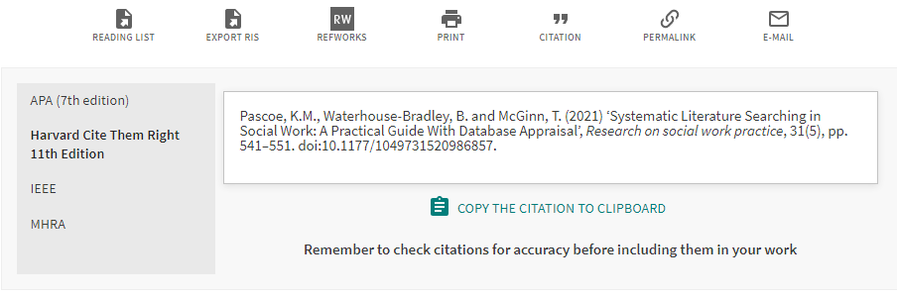
Citation

Slide 29
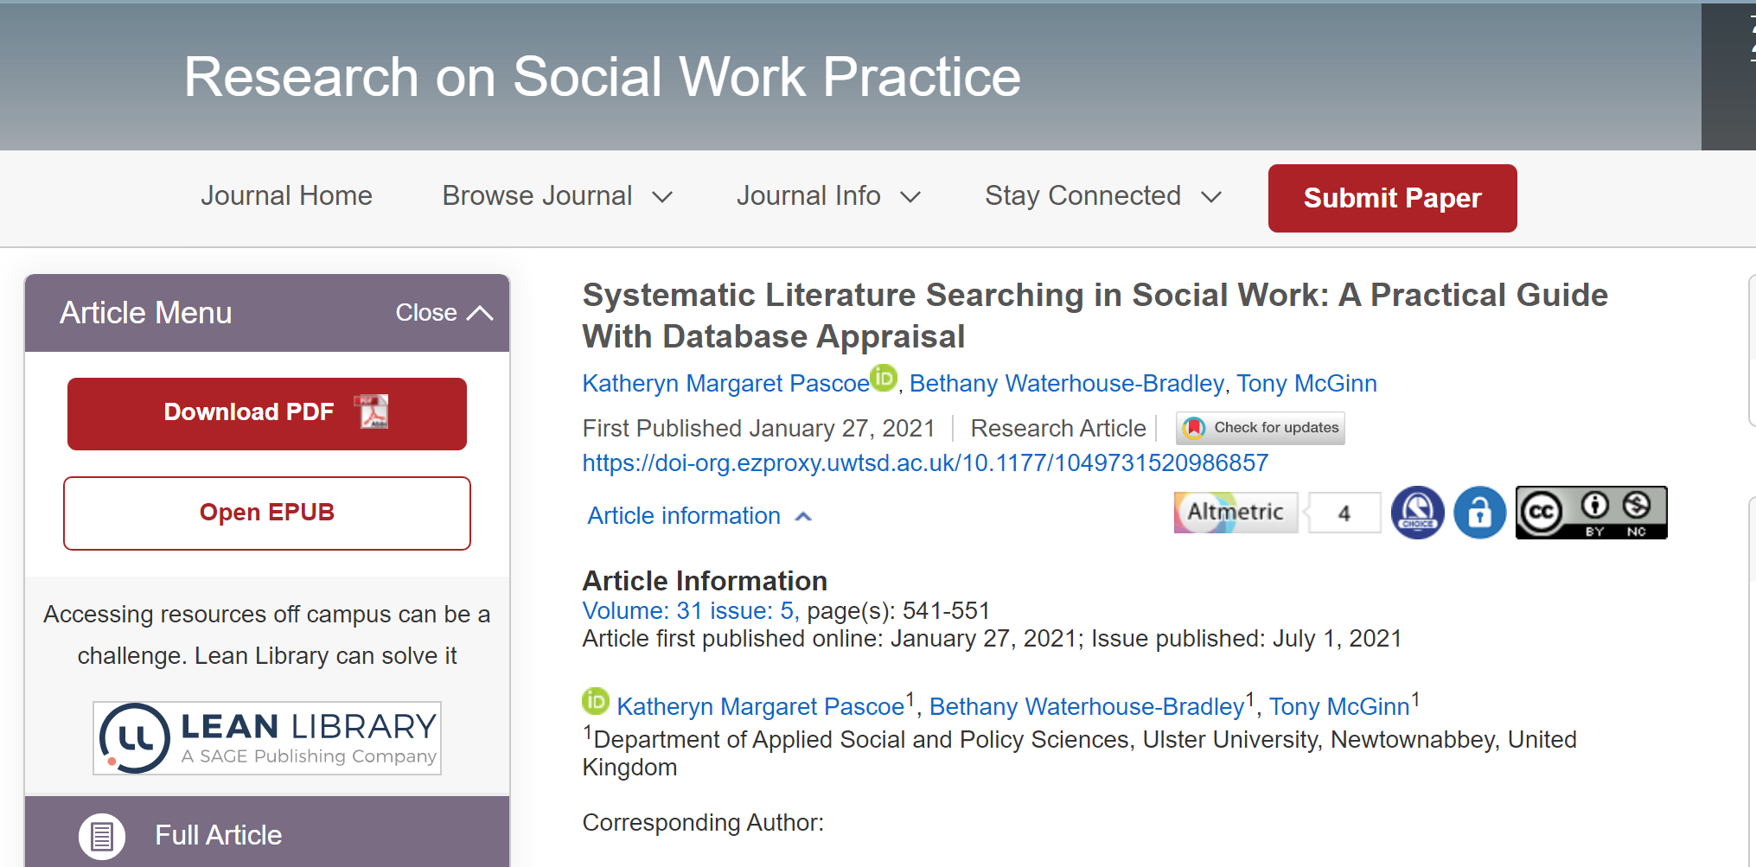
Finding the Information

Slide 30
Secondary Referencing
Always try to locate, read and cite the original (primary) source wherever possible. This will avoid the need to secondary reference. Your interpretation may differ to the (secondary) author whose article you are reading.
If this is not possible, you must only include the source you have actually read in your reference list.
You must however include both authors in your in-text citation and use the words, 'quoted in', or 'cited in' depending if the (secondary) author is directly quoting or summarising.
Examples
Harvey (2015, quoted in Lewis, 2018, p.86) provides an excellent survey...
White's views on genetics (2014, cited in Murray, 2018) support the idea that...
N.B. Only Lewis and Murray will be in your reference list if you secondary reference.

Slide 31
How to cite...
No date available:
Consider if you really want to include this in your work. If you do, use (no date)
No author:
Use corporate author e.g. BBC, NHS, CIPD or title (e.g. Health of the nation, 2011)
Multiple publications, same author in different years:
List chronologically.

Slide 32
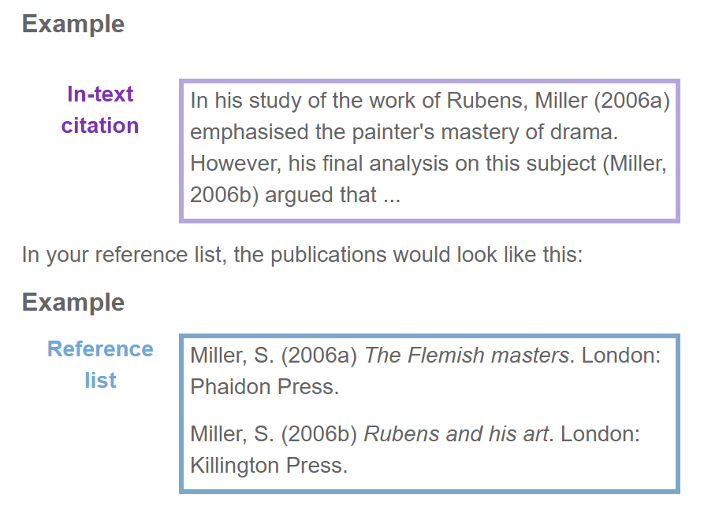
Same author, same year

Slide 33
Reference List
Cottrell, S. (2019) The study skills handbook. 5th edn. London: Red Globe Press
Pascoe, Waterhouse-Bradley, B., & McGinn, T. (2021). 'Systematic literature searching in social work: a practical guide with database appraisal. Research on Social Work Practice, 31(5), 541–551. doi:10.1177/1049731520986857
Thompson, P. (2017) 'Communication technology use and study skills', Active Learning in Higher Education, 18(3) pp 257-270. doi: 10.1177/1469787417715204
N.B. Alphabetical Order

Slide 34
Reminder
In-text citation in your essay
Reference List at end of essay

Slide 35
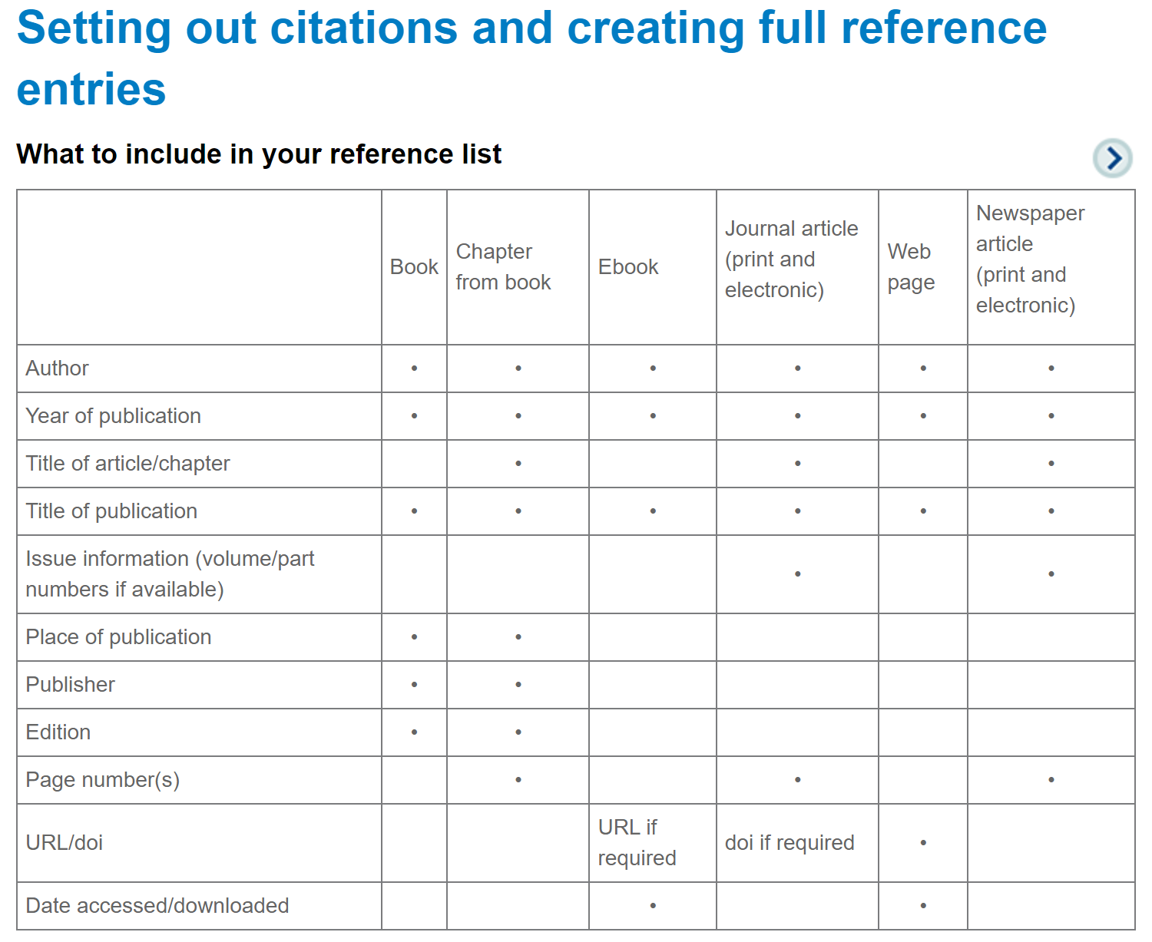
What to include

Slide 36
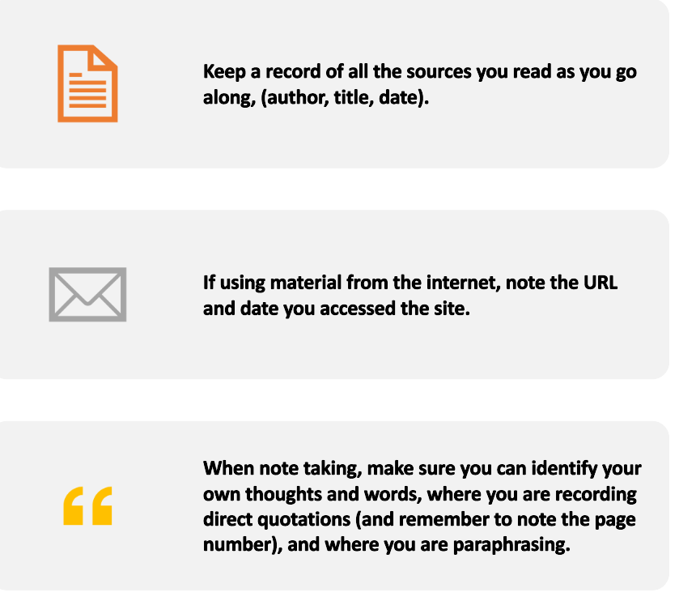
Tips

Slide 37
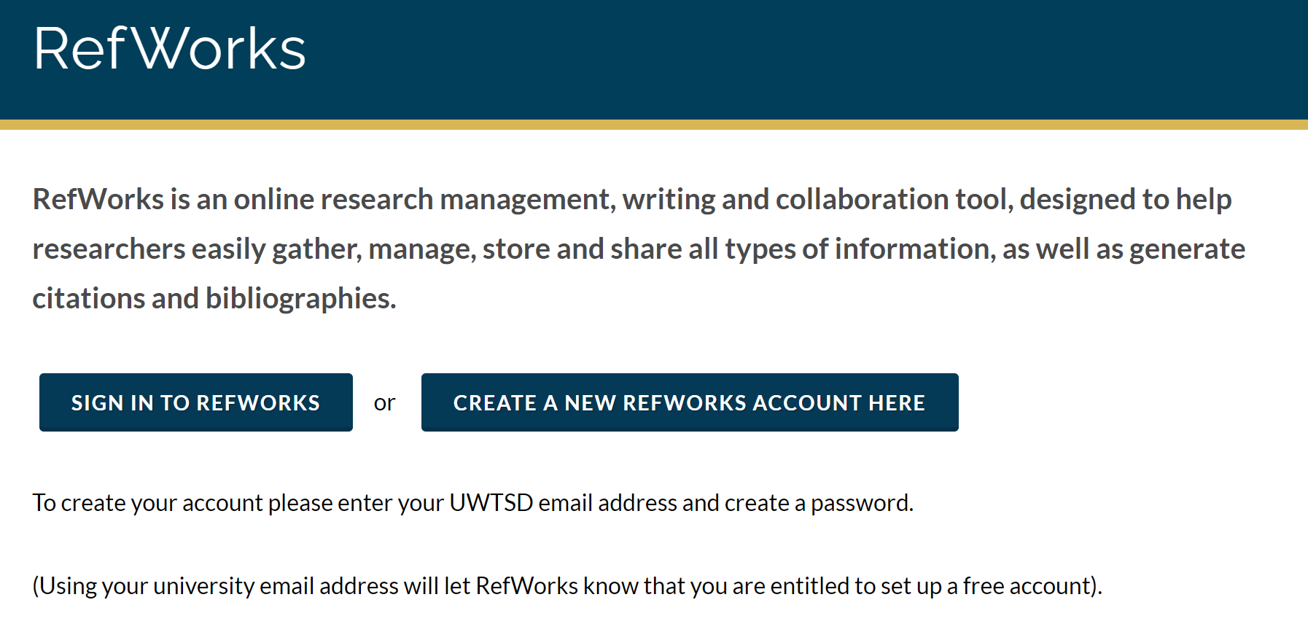
Create a RefWorks Account
RefWorks | UWTSD

Slide 38
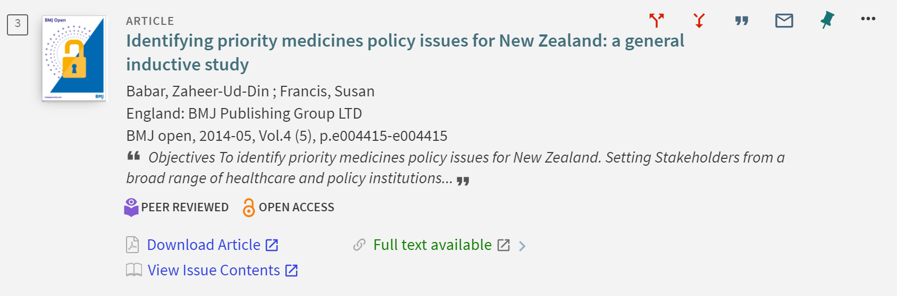

Add to RefWorks

Slide 39

RefWorks Links
Sign up for RefWorks
Exporting references to Refworks
Creating and adding documents to Refworks
RefWorks YouTubeTutorials

Slide 40
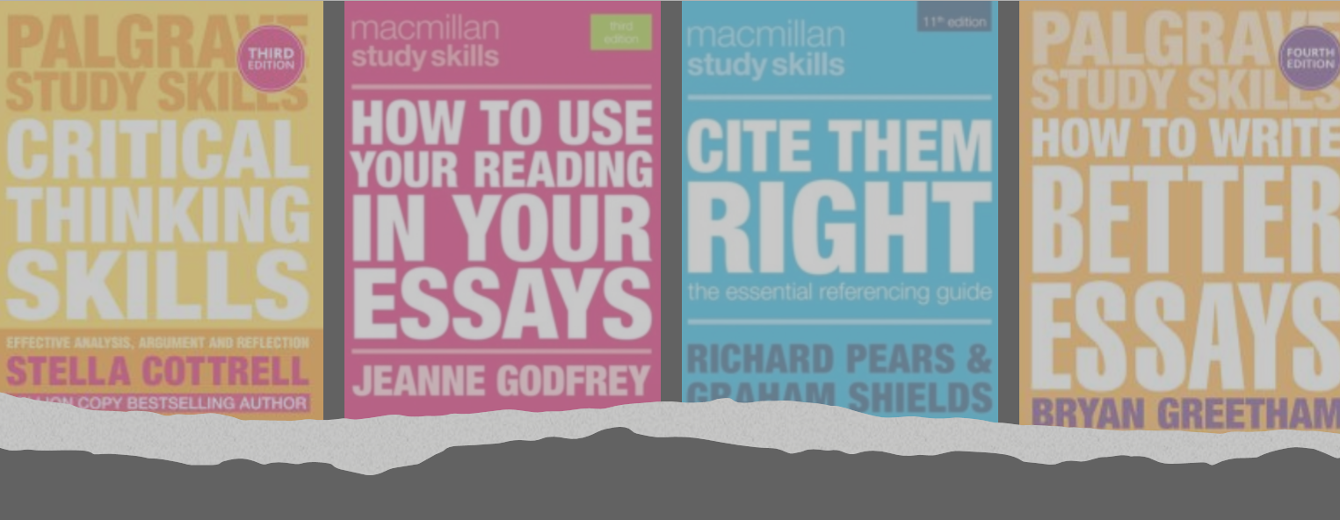
Useful Study Skills Resources
Critical Thinking
Use Reading In Your Essays
Cite Them Right
Write Better Essays
Notes:
Don't forget study support through the HWB pages.

Slide 41
Online Resource List
Study skills & Referencing Online Resource List
A list of useful online resources to help you with your studying and referencing

Slide 42
Library Support
UWTSD Referencing Guides
Library infoskills Sways
Bookable sessions with Academic Liaison Librarian
Harvard Referencing Moodle Course

Slide 43

Contact
Lisa Ellis
IMH Academic Liaison Librarian
Email: l.ellis@uwtsd.ac.uk

