Slide 1
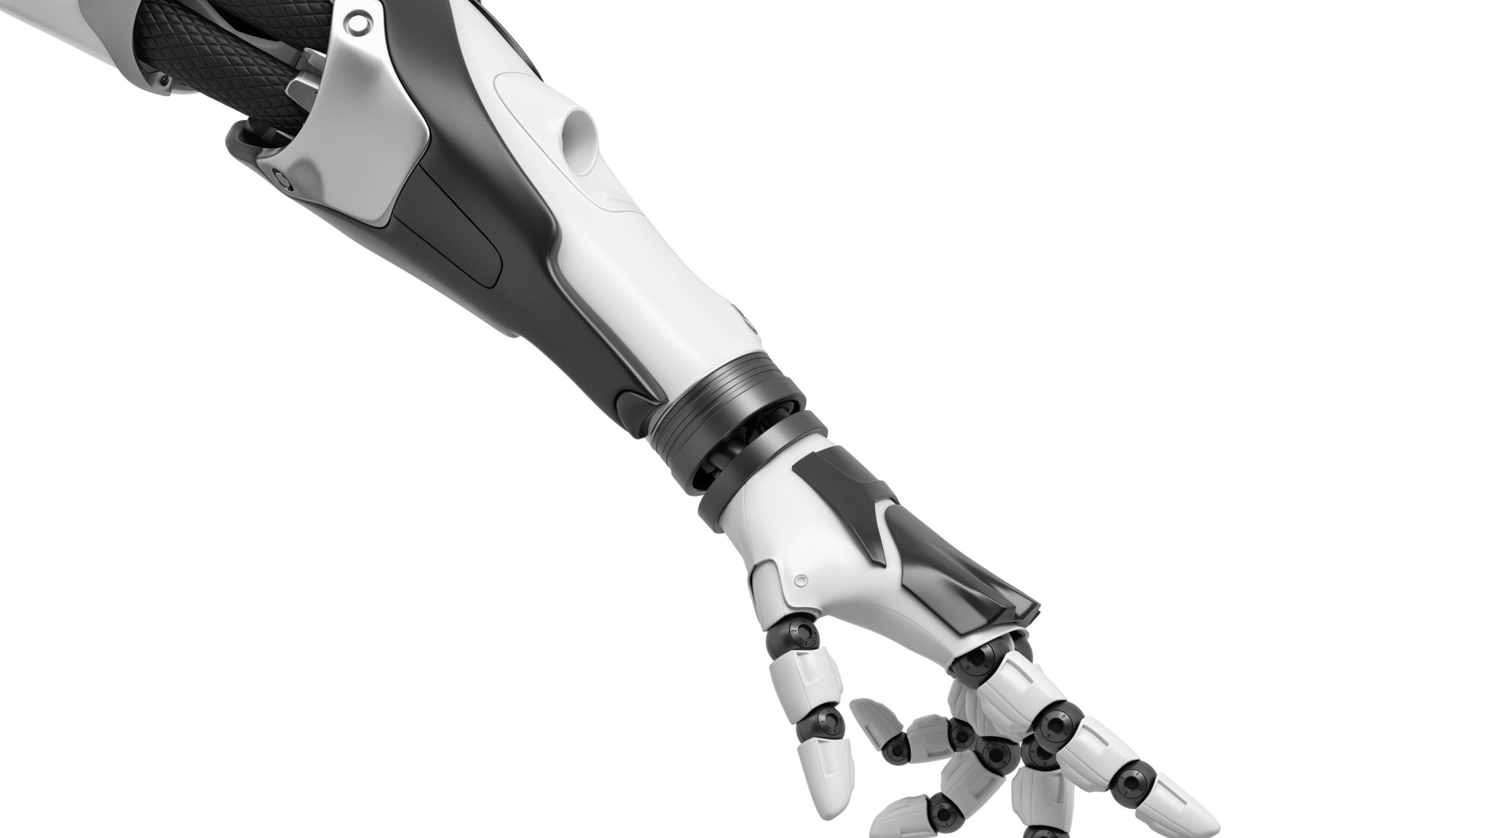
Advanced Industry 4.0

Slide 2
Itinerary
Brief overview of the module
What the module aims are
The learning outcomes for the module
Assessment Strategy
Content overview
Guest Speaker sessions

Slide 3
Module Overview
The advanced industry 4.0 module is the natural progression from the introduction to industry 4.0 module. The content delivered in this module will build upon the knowledge gained from the previous sessions.
Further to the delivery of advanced concepts, you will be required to apply previous concepts to some of the problems posed throughout the module and will be expected to contribute your own thoughts and ideas. We will take a closer look at some of the practices employed within your own organizations and identify processes and technologies that may provide benefit.

Slide 4

Module Aims
To enable students to critically evaluate a range of complex issues that influence and affect an industry 4.0 driven manufacturing environment with particular attention to the total supply chain pressures and delivering authentic economic and societal benefit.

Slide 5
Learning Outcomes
Critically evaluate manufacturing systems at a strategic level to identify opportunities for new and emerging Industry 4.0 technology enablers, whilst identifying the cultural and workforce factors that may contribute to delivering authentic economic and societal benefit.
Identify new business models and forms of operations leading to new sources of value that could be enabled with new and emerging Industry 4.0 technologies.

Slide 6
Assessment Strategy
As with your previous modules there are two assignments for this module:
Assignment One:
1,500 word written report – 25% of the module grade
Assignment Two:
4,500 word essay – 75% of the module grade

Slide 7
Content Overview
Factory Operation
Supply Chain
Customisation (CWK1 Hand-out)
Optimisation
Technology Application
IIOT
Software adaptations
Security (CWK1 Hand-in)
Policies (CWK2 Hand-out)
Implementation Strategies
Standards
Future Limitations
Continuous Adaptation and Adoption
Data Trends and Informing Production

Slide 8
Guest Speaker Sessions
As with previous modules, this module will include some sessions from industry experts:
  Paul Dennis will cover:
    Factory Operation
    Advanced Security – (IT & OT)
    Cybersecurity
    Process Models

Slide 9
The real work

Slide 10
Session Intent
To look at current practice
To look at current situation
Environmental impact
Fore-planning

Slide 11
Looking at other industries
Higher education is a unique industry, though different to those that you may be used to.
What is higher education ?
What is it for ?
Who are the clientele ?

Slide 12
The business of higher education
What product is being sold in higher education ?
What is the desired outcome ?
How is the product provided ?

Slide 13
Nature of the product
The nature of the product in higher education is somewhat intangible, at least during the process.
The product is more realistically a service with an overall end product
The service being tuition and the end product being that of the conferment of awarded qualification

Slide 14
Focusing on the delivery
Most tuition is provided in a face to face manner, particularly with physical sciences, including engineering and manufacturing.
What does this mean for distance learning ?

Slide 15
Handling a crisis
The current social and environmental situation has led to extreme and emergency undertakings
Delivery of lectures is now primarily online
Tuition is achieved through means of technology
Luckily for MADE this was our start point

Slide 16
Requirements of emergency measures
Training provided to staff
Equipment provided to staff
Equipment provided to students in special cases
Purchase of software
Purchase of licenses

Slide 17
Impact of emergency measures
Cost of training
Cost of equipment
License Cost
Research limitations

Slide 18
Impact on operations
Very limited physical presence – essential staff only
Tailoring tuition for online delivery
Design of adequate online activities – time consuming
Can normal operation still continue for such an industry ?

Slide 19
The food industry
Individuals are still able to purchase food
This means several things:
Goods are still being manufactured
Factories are still operating
Transport is still operating
What are the challenges for each of these processes ?

Slide 20
What about manufacturing ?
What impact has the current situation had on the manufacturing industry ?
How has this been detrimental to the welsh economy ?
What areas do you think have been worst hit ?

Slide 21
National Health Service
What is the role of the NHS in England and wales ?
What does normal operation look like for this industry ?
How has this been impacted by the current situation ?
Has normal operation continued ?
What contingencies have been put in place ?

Slide 22
Wishful Thinking
In the event of the creation of a vaccine for a given issue, there are a number of processes involved:
  Identification
  Testing
  Mapping
  Research and testing
  Refinement
  Trials
  Production
  Which of these is the most difficult ?

Slide 23
Manufacturing to scale
The British government has passed legislation that requires conversion of existing industrial manufacturing plants to one that is able to mass produce medical equipment, including ventilators, valves, pumps and vaccines.
What would be required for conversion of your current organization to satisfy the request ?
How could the use of technology be used to limit the impact on current operations ?

Slide 24
Your Turn

Slide 25

Your own organisation
What impact has the lockdown had upon your organization ?
What area has been most affected ?
Do you think your organization was adequately prepared ?

Slide 26
Task
There will be a section on moodle following this session for entry of work and ideas for the following task.
You are required to use the notes from the discussion of the organisations and the impact from the current health situation to identify possible areas where industry 4.0 principles could be applied to mitigate or avoid such impact.

