Slide 1

Identity and Approach in Applied Business Research
Dr caroline jawad 2020

Slide 2

“You will need to ensure that no harm occurs”
There is sometimes the possibility that interactions with participants may inadvertently harm them in some unintended way.
This could include:
Psychological harm.
Financial harm
Social harm.

Slide 3
FOR EXAMPLE:
  Psychological harm—researching the use of nudity in advertising may show participants images that offend them.
  Financial harm—researching unethical behavior within a given firm may provide management with information on individual employees that results in an individual getting fired, or undertaking industry-based research inadvertently shares sensitive information with a firm’s competitors, resulting in financial harm to the organization.
  Social harm—researching how lifestyle affects consumption may unintentionally disclose a person’s sexual orientation when that person wanted to keep this confidential.

Slide 4
Research Approval
Most universities will have a review process to ensure that student (and staff) research is undertaken in an appropriate fashion.
This is designed to:
Protect research participants from harm.
Protect researchers from undertaking risking activities.
Provide oversite that usually results in legal protections to researchers.

Slide 5
Who Approves the Research
There are a range of alternative names for review bodies:
Instructional Review Boards (IRBs)
Human Research Ethics Committees (HRECs)
Ethics Committees (ECs)
The composition of the board and requirements will vary across instutions.

Slide 6
What Is Human Intervention?
Human intervention is defined to encompass a broad range of activities, including interviews, review of corporate records, focus groups, experiments, oral histories, or surveys, where you have information that is not in the public domain.
You are ‘asking’ potential participants to do you a favor and help you out by being involved in your research.

Slide 7
Importance of human participant protection
Nuremberg Trial (US v Karl Brandt et al).
Resulted in the Nuremberg Code (1947).
Informed consent of volunteers must be obtained without coercion.
Human experiments should be based on prior animal studies.
Anticipated scientific results should justify the experiment.
Only qualified scientists should conduct medical research.
Physical and mental suffering and injury should be avoided.
There should be no expectation of death or disabling injury from the experiment.

Slide 8
Declaration of Helsinki
Participation voluntary and can be withdrawn at any time.
Established concepts of minimising risk, risk/benefit ratio, special groups.

Slide 9
Belmont report – Link below
3 basic ethical principles
1. Beneficence - an obligation to first:
  To do no harm - Hippocrates
  Maximize possible benefits - Claude Bernard
  Minimize possible risks.
2. Respect for persons:
  Acknowledge and treat individuals as autonomous
  Protect individuals with diminished capacity.
Notes:
https://www.hhs.gov/ohrp/regulations-and-policy/belmont-report/read-the-belmont-report/index.html
The Hippocratic maxim "do no harm" has long been a fundamental principle of medical ethics. Claude Bernard extended it to the realm of research, saying that one should not injure one person regardless of the benefits that might come to others. However, even avoiding harm requires learning what is harmful; and, in the process of obtaining this information, persons may be exposed to risk of harm.

Slide 10
Continued
3. Justice:
Fairness in the distribution and getting what is deserved
  Who ought to receive the benefits
  Who ought to bear the risks.
Formulations to consider:
  To each person an equal share
  To each person according to need
  To each person according to effort
  To each person according to societal contribution
  To each person according to merit.

Slide 11
Continued
It is the responsibility of the researcher to provide the participants with information regarding the purpose, benefits, and risks of participating in both the interview and surveys.
It is also the responsibility of the researcher to obtain the participants consent and explain concerns that the participants may have regarding their consent and participation.

Slide 12
continued
The researcher is also responsible for ensuring the confidential nature of the information collected and making sure that the information collected is stored safely to maintain anonymity of the participant. Any potential conflict of interest should be identified and explained accordingly.
In addition, the researcher should make sure that the participants are aware of the fact that they are free to terminate their participation and any given point.

Slide 13
About the survey
This research aims to investigate the effectiveness of responsible gambling features in which your participation is requested. It is hoped that the results of this research will contribute to understanding the issues involved and that the results will assist the design and provision of appropriate interventions for individuals who develop problems.
This survey should take about 10-15 minutes of your time. Most questions ask you to place a tick in the box provided and/or may ask you to provide some additional information as well. Any comments you may wish to make will provide the researcher with a greater understanding of any issues involved.
The information recorded on this questionnaire will be kept completely confidential and all information you provide will be recorded on a completely anonymous basis. It will be passed on to the researcher from UWTSD, who will ensure that the information you provide is kept securely stored. You are not asked to provide your name at any point during the survey. If you find the research interesting you can find a copy of the results at http://gamblingandconsumers.blogspot.com/.
If you have any problems completing the survey or would like to speak to the researcher, then please contact caroline.jawad@uwtsd.ac.uk

Slide 14
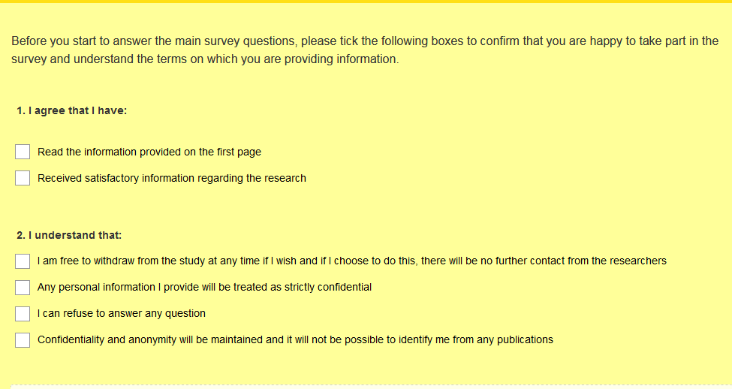

Slide 15
The Module
To write a Research Proposal 0%
To write a Dissertation 100%

Slide 16
Codes of Ethical Conduct/Practice
The University and most professional organizations have approved codes of conduct in regards to research.
There are also laws dealing with privacy, which relates to research ethics.

Slide 17
Ethical Philosophies
Deontological philosophies emphasize “moral obligations that should be binding or necessary for proper conduct” (Skinner, Ferrell, and Dubinsky 1988, 213); or you should not harm participants in any way, no matter what the potential benefit.
Teleological philosophies emphasize “the consequences that result from an action. In other words, they deal with the moral worth of the behavior as determined by the consequences of the behavior” (p. 213). Do the benefits out weigh the harm?

Slide 18
Activity

Slide 19
Ethical Issue | Right Violated | Compensation Available
Table 1 Potential Ethical Problems Relating to Researching Consumers

Slide 20
Ethical Issue | Right Violated | Compensation Available
Preserving participants’ anonymity | Right to privacy
Exposing participants to mental stress | Right to safety | Right to be heard Right to redress
Use of special equipment and techniques | Right to privacy Right to choose | Right to redress
Involving participants in research without their knowledge | Right to be informed Right to privacy | Right to redress
Use of deception | Right to be informed | Right to be heard Right to redress
Use of coercion | Right to choose
Selling under the guise of research | Right to be informed
Causing embarrassment, hindrance, or offense | Right to respect | Right to redress
Table 1 Potential Ethical Problems Relating to Researching Consumers

Slide 21
Ethical Issues to Consider
Preserving participants’ anonymity
Exposing participants to mental stress
Use of special equipment and techniques
Involving participants in research without their knowledge
Use of deception
Use of coercion
Selling under the guise of research
Causing embarrassment, hindrance, or offense

Slide 22
Participation should be voluntary in all research and there should be no coercion or deception.
The potential for coercion varies depending on whom you are seeking assistance from, do you have some ‘power’ over the potential participant?
Might the targeted sample have unique characteristics or needs, that require special treatment?
Voluntary Participation

Slide 23
When undertaking human intervention you must ensure that potential participants fully understand what they are being asked to do and that they are informed if there are any potential negative consequences of such participation
The most effective way to address the informed consent issue is through the use of an information sheet, which is provided to all those who are invited to participate.
Informed Consent

Slide 24
Information sheets should include:
Who is doing the research
Where you are from
Why you are doing the research
Who is the supervisor
How where they selected to participate
What do they need to do and how long it will take
Is there any potential for them to be harmed (or will they be disadvantaged if they don’t participate)
Whether they the confidentiality and anonymity will be protected
What happens to the data and any report
How will they be informed of the results

Slide 25
Anonymity requires that you do not know who the participants are
Confidentiality means that you know who the participants are, but that their identity will not be identified in any way to others or in the resulting report.
You tell people whether the information will be confidential or anonymous, both or neither (they can agree to be identified).
In some instances it may be hard to protect anonymity and confidentiality, i.e. if you report what the Vice Chancellor of Deakin has said, people can find out who it is.
Confidentiality and Anonymity

Slide 26
Ideally your research should have minimal potential
for harm!
However, it is important for you to identify any potential for harm and determine how this potential for harm could be overcome.
This includes:
warning people they may be harmed by participating
Distributing information on counseling or support services to deal with issues.
Potential for Harm

Slide 27
Other Issues
Conflicts of Interest – do you have multiple roles that may influence people or how data is used.
Focus Group Participant Identification- all participants in a focus group will hear what others have said, thus how can the information remain confidential or anonymous?
Deceit- in some instances telling people what you are doing will effect how thy respond and thus you might want to not accurately inform them what the research is about.
Observation – in some instances you may want to observe how people behave, you generally need to get approval from them or inform them this will occur..
Other Issues

Slide 28
Continued
Permission from Organization/Location- even when undertaking research in ‘public places’ you often need permission.
Video/Audio Taping – always get written permission in advance to tape people and clarify how the material will be used and destroyed.
Consent Forms – getting signed agreement to participate is always valuable. This generally covers the issue in the information sheet, ending with people signing that they understand the issues and agree to participate

Slide 29
Plagiarism- you do not misrepresent someone else’s work as your own.
Academic fraud - involves the intentional misrepresentation of what has been done. This would include making up data and/or results from the data or purposefully putting forward conclusions that are not accurate.
Misrepresenting results – be careful in over claiming what has been done or the implications.
Potential Issues in Communicating Results

Slide 30
The 10 Most Common Types of Plagiarism
Plagerison.org (2013): Types of Plagiarism, http://plagiarism.org/plagiarism-101/types-of-plagiarism/. Accessed July 2013
1 | Clone | Submitting another’s work, word-for-word, as one’s own
2 | CTRL-C | Contains significant portions of text from a single source without alterations
3 | Find – Replace | Changing key words and phrases but retaining the essential content of the source
4 | Remix | Paraphrases from multiple sources, made to fit together
5 | Recycle | Borrows generously from the writer’s previous work without citation
6 | Hybrid | Combines perfectly cited sources with copied passages without citation
7 | Mashup | Mixes copied material from multiple sources
8 | 404 Error | Includes citations to non-existent or inaccurate information about sources
9 | Aggregator | Includes proper citation to sources but the paper contains almost no original work
10 | Re-tweet | Includes proper citation, but relies too closely on the text’s original wording and/or structure

Slide 31
HEIDDEGER
The question concerning Technology
Published in 1954
Heidegger observes that because of technology, “all distances in time and space are shrinking” and “yet the hasty setting aside of all distances brings no nearness; for nearness does not consist in a small amount of distance.”

Slide 32
Technology Issues
Privacy
Misinformation
Ownership
Access
Notes:
Questions
1. What are the alternative ethical perspectives?
Two philosophical approaches mentioned in the textbook are deontological and teleological philosophies. A deontological approach means that you should not harm participants in any way, no matter what is the potential benefit. On the other hand, teleological philosophies emphasize the consequences that result from an action and asks you to evaluate whether the benefits of your research would outweigh the cost to participants (or society more widely); if so, the research would be considered acceptable.
Alternative ethical perspectives have also been put forward. Kantian ethics suggest that “persons should be treated as ends and never purely as means” (Beauchamp & Bowie, 1997). Thus, any practice you might want to undertake that does not consider how the situation affects the individual would be unethical. Other ethical perspectives put forward include common morality theory, rights theory, virtue ethics, feminist theories, and ethics of care, but these are less frequently applied in research associated with business practices.
2. Does your university have a committee to review the ethics of student research, and when does it meet?
Most universities have some form of ethical process for research being undertaken by students and staff. The students should check to determine whether the current business research project should be reviewed by an ethics committee. Some universities request all projects to be reviewed and judged suitable, while other universities give responsibility to the subject co-ordinator to approve the projects. Rarely would there be no procedure for student projects with an institution allowing to students to have human intervention studies without any process of ensuring ethical issues are being checked.
Discuss the types of human intervention you might want to use with your assignment and what ethical issues might arise with the approach selected?
Human intervention basically involves the researcher having access to information that is not in the public domain. This can encompass a broad range of activities, including interviews, review of corporate records, focus groups, experiments, oral histories, or surveys. Some issues that can result from human intervention include academic fraud and plagiarism. Some examples of student research that would be less likely to involve human intervention would include content analysis, statistical analysis that uses data from publicly available databases, and an examination of a data set that was collected for another purpose.
4. Discuss how you can ensure you don’t inadvertently commit plagiarism or academic fraud.
Plagiarism relates to misrepresenting someone else’s work as your own. In most universities, plagiarism is a breach of the student code of conduct and can result in failure of the subject/class or even expulsion from the institution. Therefore, you need to be very careful when using material from others to ensure that it is adequately referenced. If you do, make sure you appropriately cite this material.
Academic fraud involves the intentional misrepresentation of what has been done. This would include making up data and/or results from the data or purposefully putting forward conclusions that are not accurate. Some believe that academic fraud is worse than plagiarism. To ensure that you will be able to get the data needed, think about the project in advance and come up with contingencies should problems arise. In regard to research results, you may get concerned if your findings are inclusive or are inconsistent with existing literature. However, for your research, this should not be a problem, and in many cases there might be sound reasons that no result was found, eg . problematic sample, or the context of the study is different. In general, the student projects are evaluated on the process, rather than the outcomes. Therefore, there is no reason to commit academic fraud.
5. Design an information sheet and consent form for your research project, taking into consideration the ethical issues that might arise.
In the text there are examples of both an information sheet and consent form. There are also links to other materials provided in Table 5.3 on page 92. The students should look at these examples and design their own that is specific to their business research project.

Slide 33
Your Checklist
Is there any human intervention in this project?
What ethical issues must you consider?
Is there any areas of ‘conflict of interest’?
Does the project need ethics approval?
Does there need to be consent forms or an information sheet?

