Slide 1
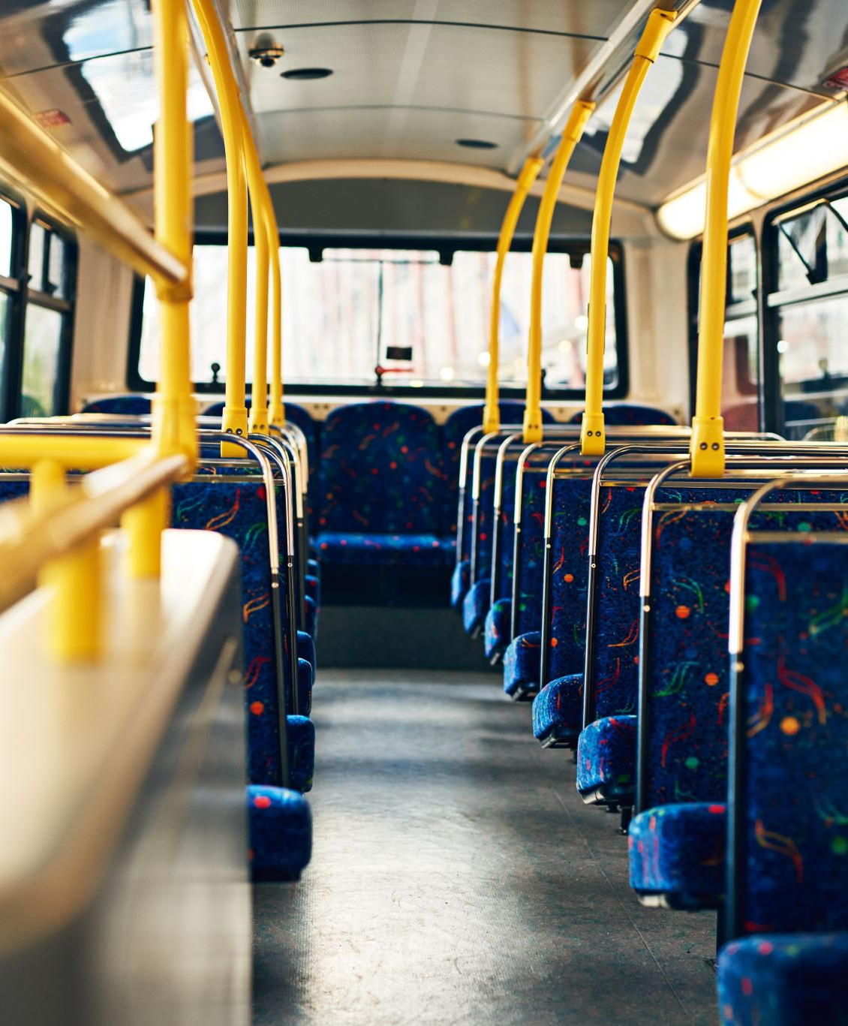
Policing The public
Week 5
21st Century Challenges for the Police Service
Dr. Luke Roach
L.Roach@UWTSD.ac.uk

Slide 2
What challenges do Police face in the 21st Century?
What does policing face - 21st century challenges
What do the police think?
No more plans or targets?
The Winsor Review
Marketing the police
Transactional and transformational
The Neyroud Review
HMCIC view
The holistic approach
The future

Slide 3
What kind of modern challenges do you think face the police?
Which do you think have the most impact on policing?
Which do you think have the most impact on the polices relationship to the public?

Slide 4
Contemporary Challenges
Globalisation
Cyber crime
Elder abuse
Human trafficking
Online child exploitation
HBV/Hate crime
Gun crime/gang culture
Drug Crime
Terrorism
White collar crime
Police culture
Miscarriages of Justice
Ethical Policing
Diversity
Austerity
Police Powers vs Individual Freedom
Legitimacy and confidence in Policing
Free Market Economics
Models of Policing
Media
Have the challenges changed or is it the Culture we live in?

Slide 5
One Example
Cybercrime
https://www.youtube.com/watch?v=eLU_MewF2jg

Slide 6
Cybercrime
From the video you’ve just watched, what kinds of challenges do you think this poses to policing?
What models and sorts of policing do you think apply here? Which ones don’t?
Can you think of any criminological theories or explanations that explain this kind of crime?

Slide 7
The New World - Online
How do these threats fit into the principles of Peel?

Slide 8
Peels Principles (1829) – Part 1
To prevent crime and disorder, as an alternative to their repression by military force and severity of legal punishment.
To recognise always that the power of the police to fulfil their functions and duties is dependent on public approval of their existence, actions and behaviour, and on their ability to secure and maintain public respect.
To recognise always that to secure and maintain the respect and approval of the public means also the securing of the willing co-operation of the public in the task of securing observance of laws.

Slide 9
Peels Principles (1829) – Part 2
To recognise always that the extent to which the co-operation of the public can be secured diminishes proportionately the necessity of the use of physical force and compulsion for achieving police objectives.
To seek and preserve public favour, not by pandering to public opinion, but by constantly demonstrating absolutely impartial service to law, in complete independence of policy, and without regard to the justice or injustice of the substance of individual laws, by ready offering of individual service and friendship to all members of the public without regard to their wealth or social standing, by ready exercise of courtesy and friendly good humour, and by ready offering of individual sacrifice in protecting and preserving life.

Slide 10
Peels Principles (1829) – Part 3
To use physical force only when the exercise of persuasion, advice and warning is found to be insufficient to obtain public co-operation to an extent necessary to secure observance of law or to restore order, and to use only the minimum degree of physical force which is necessary on any particular occasion for achieving a police objective
To maintain at all times a relationship with the public that gives reality to the historic tradition that the police are the public and that the public are the police, the police being only members of the public who are paid to give full-time attention to duties which are incumbent on every citizen in the interests of community welfare and existence.

Slide 11
Peels Principles (1829) – Part 4
To recognise always the need for strict adherence to police-executive functions, and to refrain from even seeming to usurp the powers of the judiciary, of avenging individuals or the State, and of authoritatively judging guilt and punishing the guilty
To recognise always that the test of police efficiency is the absence of crime and disorder, and not the visible evidence of police action in dealing with them.

Slide 12

Video on Solutions for Modern Policing

Slide 13
Hoggett et al. 2013 Survey
A pilot survey was run in 2013 to test out a questionnaire for a 2014 report.
Have a look at those questions and pilot answers.
How would you respond to these questions?
Do you think the percentages for agreement and disagreement are expected?

Slide 14
What do the police think? (Hoggett et al, 2014)
Survey with 13,591 police officers from Constable – Chief Inspector from 43 Forces in England and Wales
Key findings:
Politics and Policing
Only 1.6% of respondents agree the current government supports the police
Only 1.1% positively report confidence in long-term government plans for policing.
95.8% disagree that cuts will not affect police resilience
89.8% agree or strongly agree that the police are under resourced
If public confidence in the police is important, it perhaps follows that police confidence in the government is also important?

Slide 15
What do the police think? (Hoggett et al, 2014)
87.6% agree or strongly agree that some change is needed
But 80.4% agree or strongly agree that the Winsor Proposals if fully implemented, would give criminality the upper hand
92.5% agree or strongly agree change and reform should be independent of politics
But is policing ever independent of politics?

Slide 16
What do the Police think? (Hogget et al. 2014) - Public Support
80.5% of respondents agree or strongly agree that the support of the general public positively impacts on their job.
However, only 8.9% agree or strongly agree that the general public understands what the police do.
81.2% agree that the changes in the Winsor review will negatively impact on the police’s relationship with the public
And only 1.7% agree or strongly agree that the changes being made to the police service are in the public’s best interest

Slide 17
What do the Police think? (Hogget et al. 2014) - Morale
79.6% of respondents agree or strongly agree that policing is a vocation rather than a job.
But only 11.9% -agree or strongly agree that they would join the police today.
64.9% of respondents agreed or strongly agreed that they would consider looking for alternative employment

Slide 18
What do the Police think? (Hogget et al. 2014) - Morale
Only 9.6% of respondents reported that their morale was high
96.0% of respondents agree or strongly agree that they make sacrifices to be a police officer while only 18.9% agree or strongly agree that the sacrifices are still worth it.
Additionally 96.9% of respondents agree or strongly agree that officer goodwill is essential to the success of the police
How important is good morale?

Slide 19
Performance targets – what performance targets?
Theresa May in 2010 speech - shifting away from New Labours performance indicators for the police
What are your opinions on Performance targets?
ITN News https://www.youtube.com/watch?v=I5rooIgIvEY

Slide 20
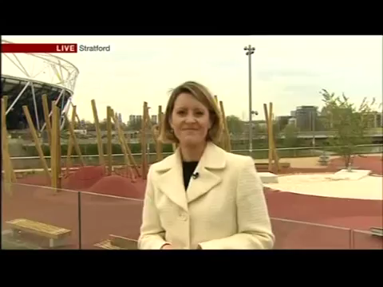
Performance Targets

Slide 21
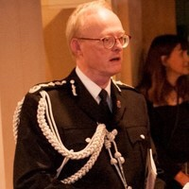
The Winsor Review
Tom Winsor – headed an independent review of police pay and conditions in England and Wales by the Home Office beginning on 1st October 2010 – the first for 30 years
Mr Winsor is a lawyer and economic regulatory professional who held public office at the Railway regulator – he had no previous policing experience.
He was appointed HMCI of constabulary on 1st October 2012, the first HMCI to be appointed from a non-police background.
He was knighted in 2015

Slide 22
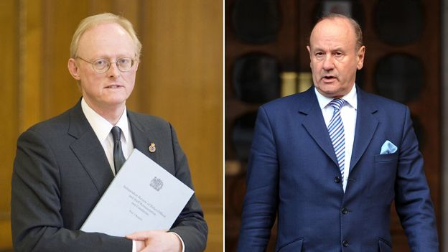
The Winsor Review
Lord Stevens of Kirkwhelpington, a former Metropolitan Police commissioner and crossbench peer, who was asked to head an independent commission on policing by the Labour party last year.
Lord Stevens -personal criticisms of Mr Winsor - "Winsor was not independent" and that his review was "politically driven“ and a "failure to engage" properly with serving police officers before announcing his controversial reform proposals

Slide 23
The Winsor Review
The Review examined;
Basic pay - Changes to pay that would lower police officer starting salaries but allow officers to progress more quickly to higher pay.
Role and skill based pay - stronger link between pay and skills - in the short term, a £600 allowance for officers who use certain skills.
Contribution related pay - A stronger link between pay and performance, with annual pay increase limited to those who have performed satisfactorily.
Recommendations on health and fitness - Proposals on fitness testing to ensure that all officers are fit enough to be deployed to the front line.
Entry routes for police officers - A requirement for applicants to have a policing qualification, A-levels, or relevant experience before becoming a police officer.
A direct entry scheme - to enable individuals of considerable achievement and capacity to join at the rank of Inspector or superintendent.

Slide 24

The Police & Politics
Are Politics and the police ever separate?
Can they be?
Should they be?
Was the appointment of Tom Winsor driven by politics?

Slide 25
The Neyroud Review
‘Policing in the 21st Century: Reconnecting police and the people’,
Coalition government paper published in July 2010

Slide 26
The Neyroud Review
3 key elements;
Transferring power back to the people and away from government with local PCC plans. (Police Reform & Social Responsibility Bill)
Creation of the National Crime Agency (NCA) & phasing out of the National Police Improvement Agency (NPIA)
Severe fiscal constraints and the ‘trimming of fat’ associated with the cuts

Slide 27
The Neyroud Review – Suggestions on Police Leadership and Training
Democratically accountable
Legitimate
Evidence-based
Nationally (and internationally) coherent
Capable, Competent and cost-effective

Slide 28
The Neyroud Review
1. Professionalising the Police Service: creating a Professional Body
2. Building Professional Development
3. Developing Senior and Strategic Leadership
4. Delivery of leadership and training
Overall, the Review report argues that the police service needs to move from being a service that acts professionally to one which is a professional service
A root & branch approach!

Slide 29

Transactional & transformational leadership

Slide 30
Transactional & transformational leadership
Traditional models of leadership in police service built upon Transactional style – rank structure, reward/punishment regime (Engel & Worden 2003)
Transformational approaches are very different and promote – participation, consultation and inclusion. (Silvestri, 2007). Instead of a reward/punishment control of behaviour it relies upon encouraging the individual to buy into organisational culture.

Slide 31
Transactional & transformational leadership
Critics have argued that transformational leadership if difficult to achieve in the hierarchical rank structure of policing which is almost transactional by definition – it may therefore require a mixture of both styles
There are occasions when officers are ordered to do things they would prefer not to do – is this transactional or transformational?

Slide 32
Transactional & transformational leadership
How do you think the public would respond to a transactional or transformational leadership style?

Slide 33
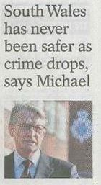
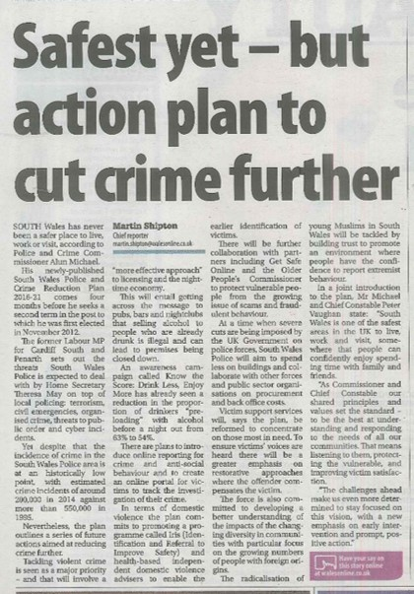


The marketing of the police

Slide 34
Priorities – South Wales Police & Crime Reduction Plan 2017-2021
To reduce and prevent crime and anti-social behaviour to keep people safe and confident in their homes and communities
To improve the way in which they connect with, involve and inform communities
To work to protect the most vulnerable within communities
To make sure that the local criminal justice system works effectively and efficiently, meeting the needs of victims and challenging offenders
To make a contribution to the strategic policing requirement and successfully police major events
To spend public money wisely to protect policing in your community

Slide 35
South Wales Police & Crime Reduction Plan 2017-2021
These are Crime reduction plans but they are also marketing tools that make promises to the public.
But if a police service makes promises the public expects those promises to be kept?

Slide 36
The World of Partnerships
The days of public bodies such as the police service acting unilaterally are clearly extinct
The combined impacts of grant cuts and inflation have resulted in a savings target of £58m between 2010/11 and 2019/20

Slide 37
The World of Partnerships
Economy of scale has probably never been more important (shared services)
Police working directly with public health bodies on initiatives to prevent offending in the first place

Slide 38
The World of Partnerships
Holistic and multi partnership model of problem solving e.g. Adverse Childhood Experiences research (ACE)
  A study conducted in California on almost 17,500 people published in 1998
  Focussed on a questionnaire of adverse childhood experiences such as abuse, neglect, witnessing violence, substance misuse or having a relative in prison.

Slide 39
The Future of Policing
1982 92% of public expressed confidence in policing- 2004 decline to 47% (Bassett et al, 2004,cited in Rogers et al, 201:3)
Satisfaction rose to a national average (W&E) of 52% in 2016
https://www.ipsos-mori.com/Assets/Docs/Publications/sri-public-views-of-policing-in-england-and-wales.pdf

Slide 40
The Future of Policing
Holistic approaches are currently vogue, prevention is better than cure and instead of separating elements of community life such as policing, health, and education. The emphasis is now on integrating them.
Increasing use of private sector, interagency work, involveing communities to make the cohesive community - ‘responsibilisastion strategy’ (Garland, 2001)

Slide 41
The Future of Police
We have talked about different challenges, different crimes and different strategies and tactics, but Peels Principles seem to remain in tact:
“The Police are the People and the People are the Police”

Slide 42

Week 5 Complete!
Any questions?
Thanks for listening!
See you next week!

