Slide 1

Basic infoskills: finding and using information.
Alison Evans.
Academic Liaison Librarian.

Slide 2
The aim of today's session ...
The aim of today's session is to consider the importance of academic information and to demonstrate how to begin finding and managing it using library resources.
We will consider:
How to evaluate information.
Where to begin searching for academic information.
Online resource lists.
How to search for, save and manage information using the library catalogue.
How to find your way around the library web pages – and where to find help.
Notes:
Overview

Slide 3

Students who use library resources outperform those who don't ...

Slide 4






Where does the library fit into the research process?
Make notes, use critical thinking, apply academic integrity.
Explore ideas, information and research from different sources.
Develop original ideas built on attributed sources.

Slide 5

Evaluate all information critically.
Currency. Is it up-to-date?
Relevance. Who is the intended audience? Will it help further your argument?
Authority. What are the author’s credentials?
Accuracy. Can it be verified? Is it supported by evidence?
Purpose. Why has it been produced? Is it objective?

Slide 6
Where to begin searching for academic information.
Library resources.
Good print resources, but most information now available online, 24/7. Subscribed, up-to-date, academically credible content, in your subject area. Explore and build here.
Online Resource Lists.
Find on Moodle or library web pages. Resources recommended by your lecturers, made available by the library. Accessible by direct link. Start here.
Moodle / Teams.
Additional resources from lecturers may be found here. Communication with peers. Be aware of what is happening here.
Google and the internet.
Evaluate - little quality control. Limited ability to refine. Restricted subscribed content. Understand what you are looking at … and what you are not looking at! Be wary here.

Slide 7
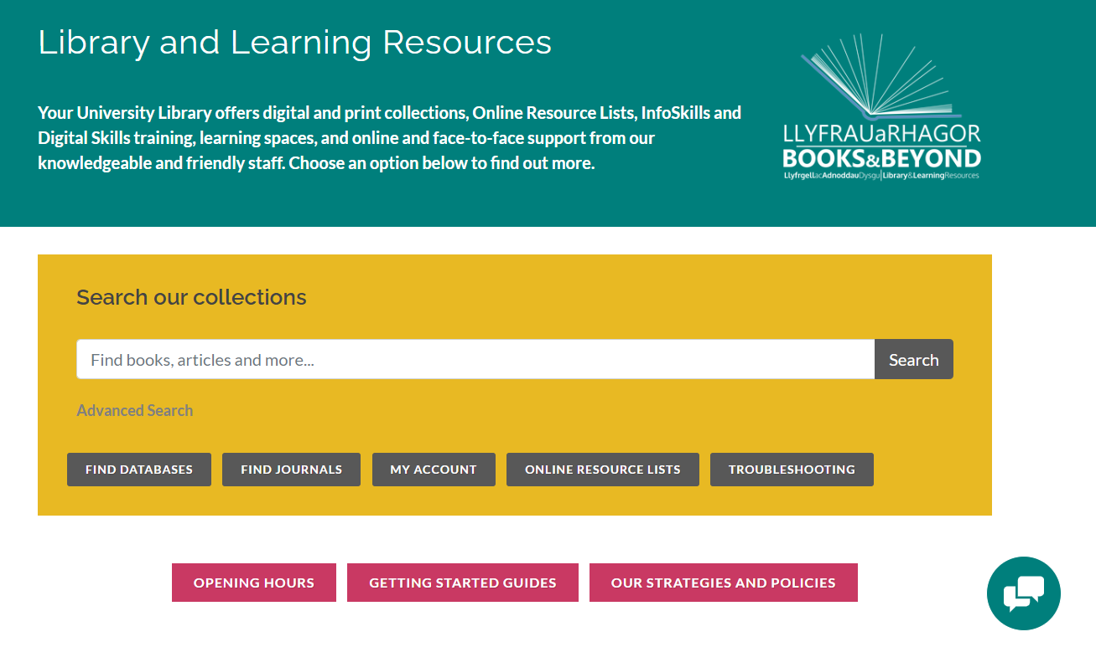
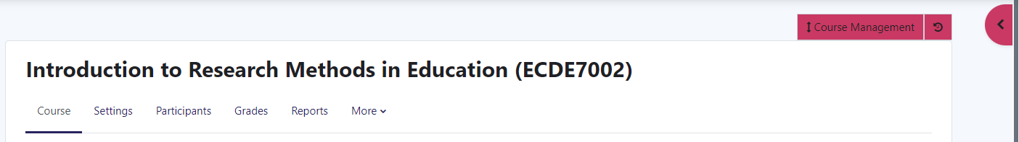
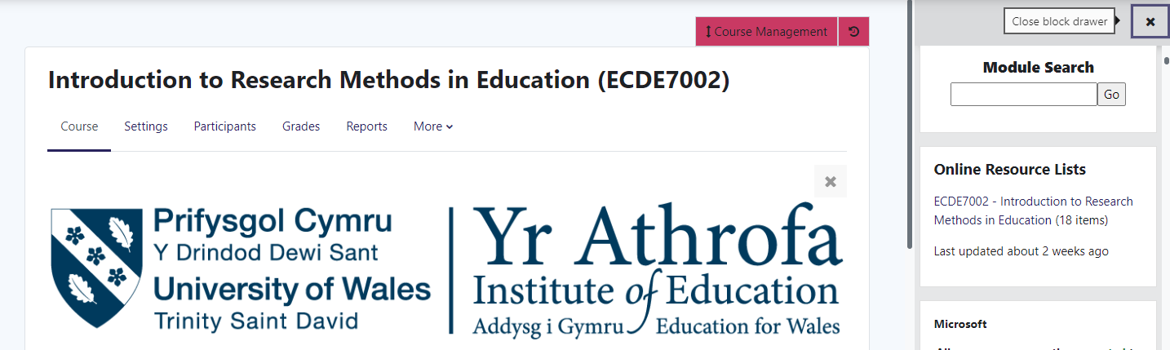
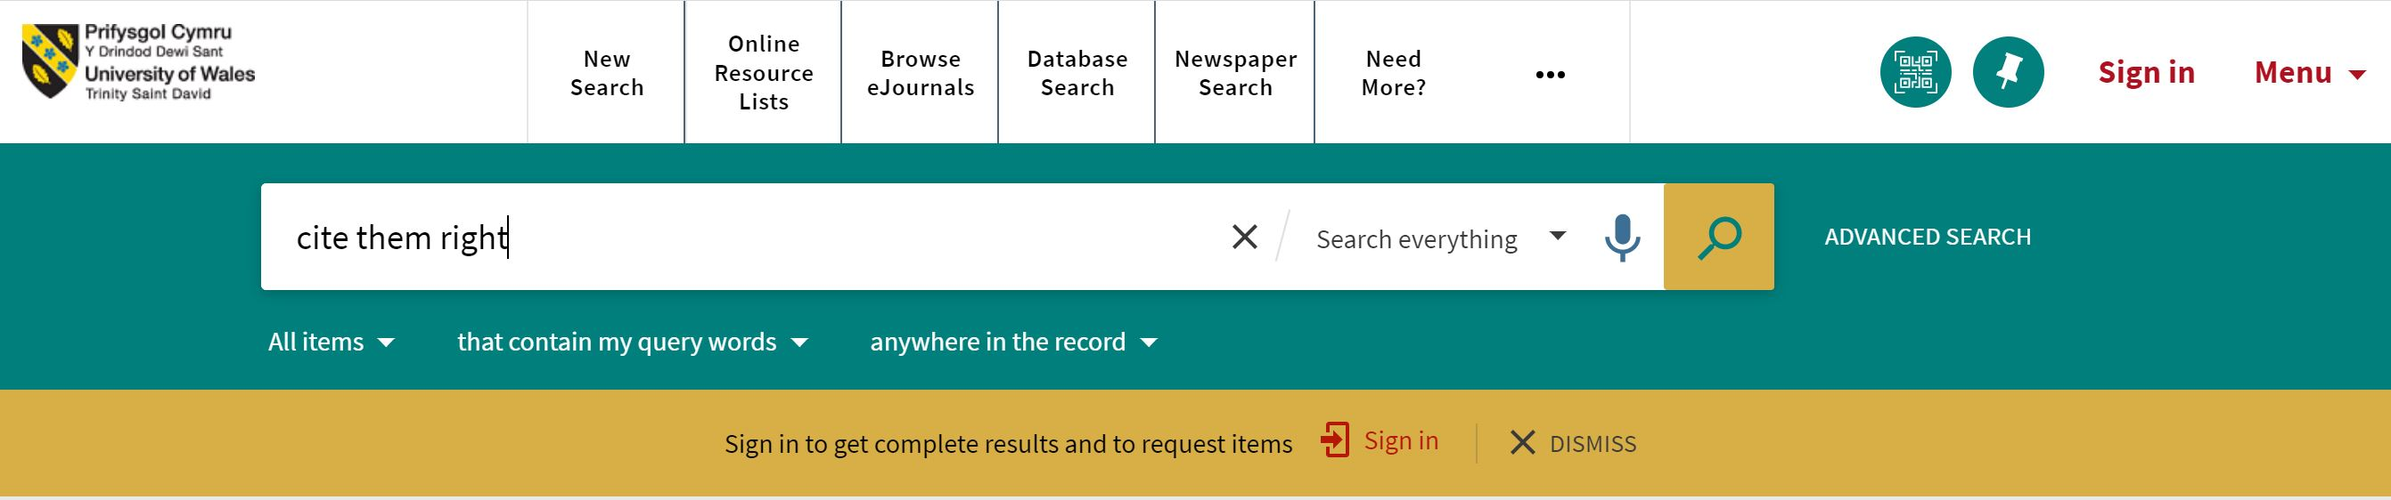
What is an online resource lists?
A prioritised list of print and electronic items recommended by lecturers and made accessible by the library, to support the successful completion of your module.
Moodle – open block drawer.
Library catalogue.

Slide 8
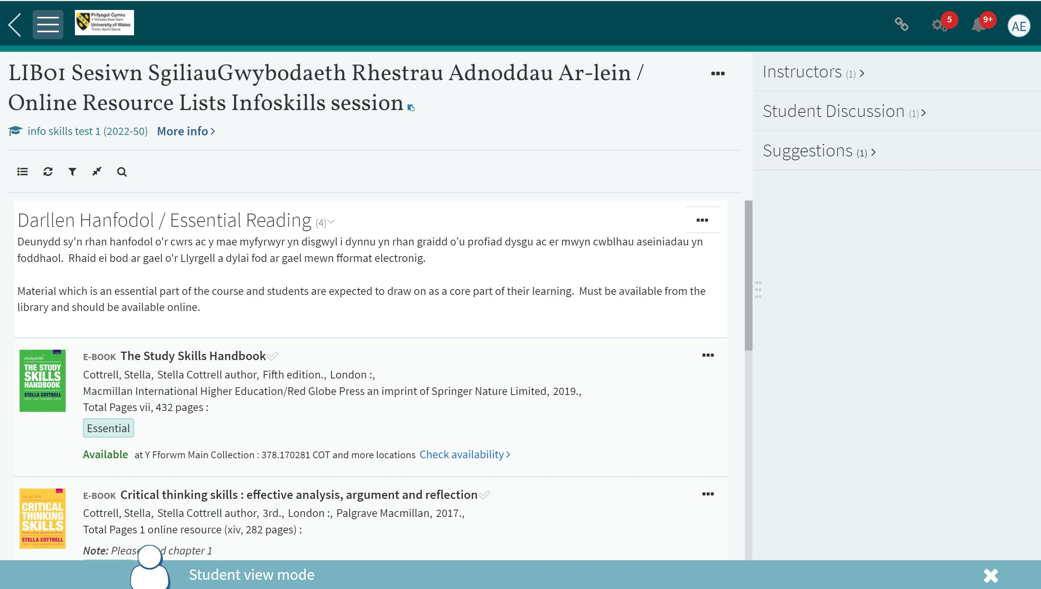
Why use an online resource list?
Prioritised Essential and Further resources recommended by lecturers.
Easy to use, direct links to live content or loan information.
Interact with your lecturers and peers.
Create your own Collection of favourite resources - organise your information and keep details for reference lists.
Online resource lists
Online resource lists are a starting point – do not limit yourself!

Slide 9
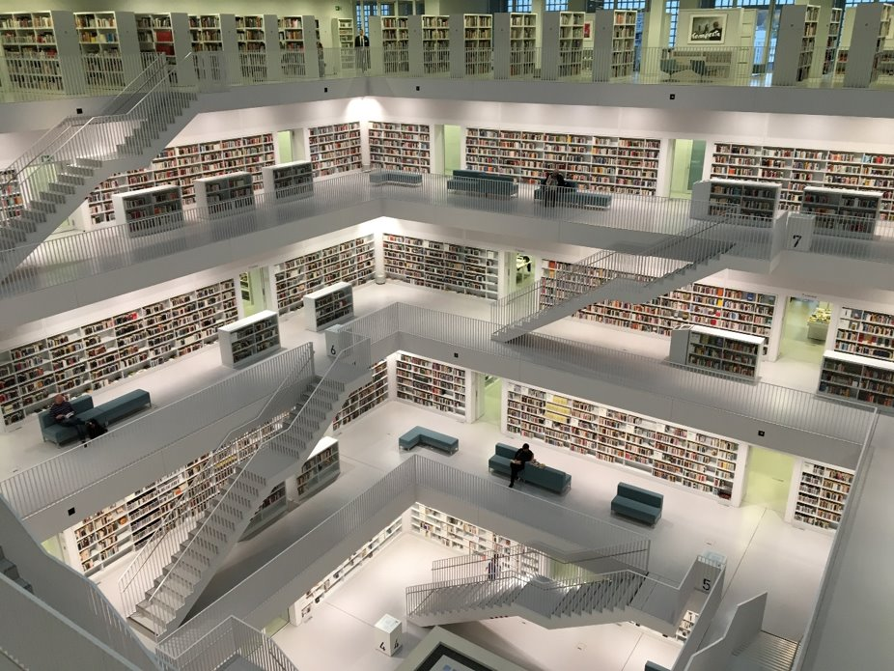
Why use the library catalogue?
The library provides free access to good, up-to-date resources in your subject area, in multiple formats.
Electronic and print based books.
Specialist databases.
Ejournals.
Newspapers.
Conference proceedings.
Reviews.
Legislation.
Statistical data.
Visual media, eg. videos and photographs.
And much more ...

Slide 10

You can also ...
Check loan information, make requests.
Save favourite resources.
Organise saved information - add labels, set alerts.
Find help with referencing, export to RefWorks.
Finding good quality information which you can organise and recall when needed, will help improve you work and ultimately your grade.

Slide 11
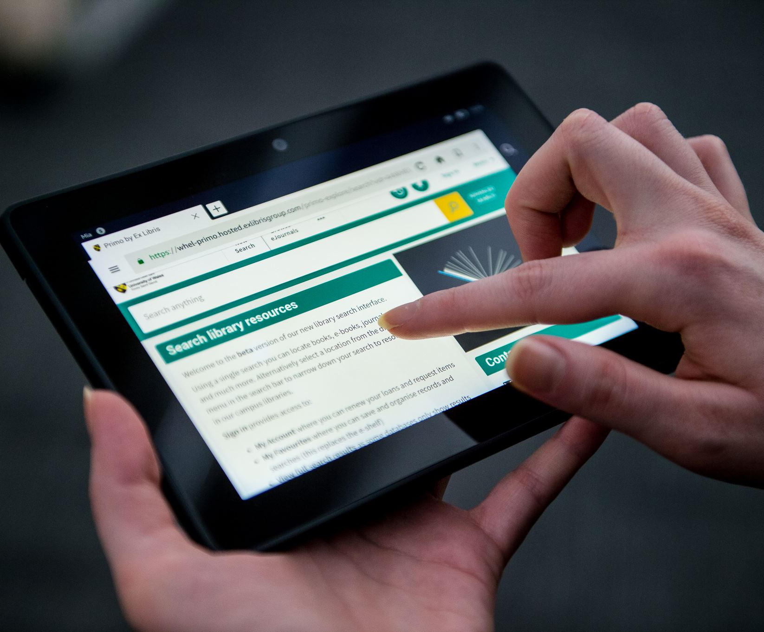
Library catalogue.
Search for information
Books – electronic and print.
Peer reviewed journal articles.
And much more ...
Manage information
Save favourite items and add labels.
Save queries and set alerts.
Also Online Resource Lists.
Database Search.
Need More?
Library Search

Slide 12
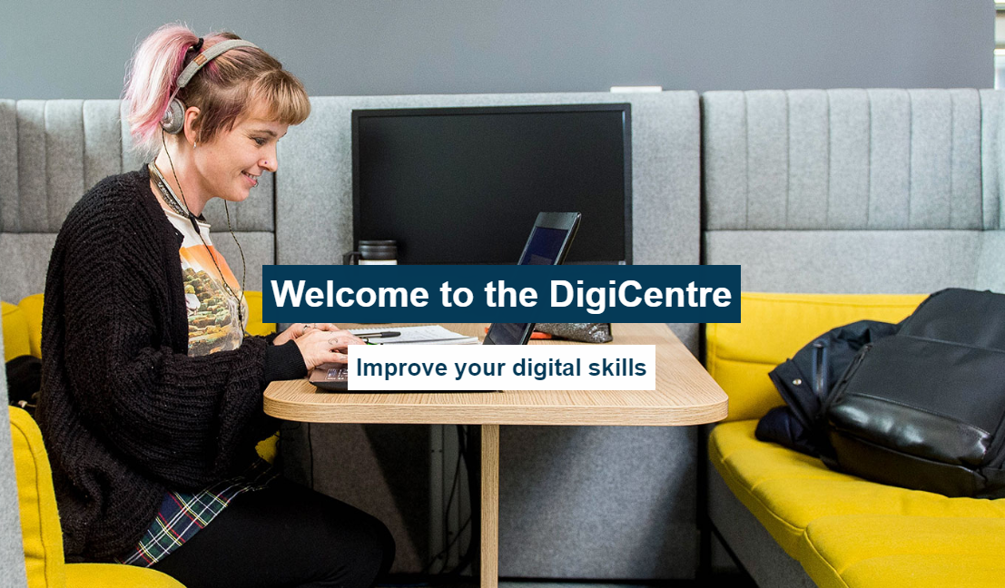
We also provide digital support.
The DigiCentre is a one-stop shop for all the digital skills needs of both staff and students. Explore to find:
A collection of tools and resources to help you develop your digital skills.
Each institute has a Digital Skills Advisor. The IEH advisor is Gwennan Couch.

Slide 13
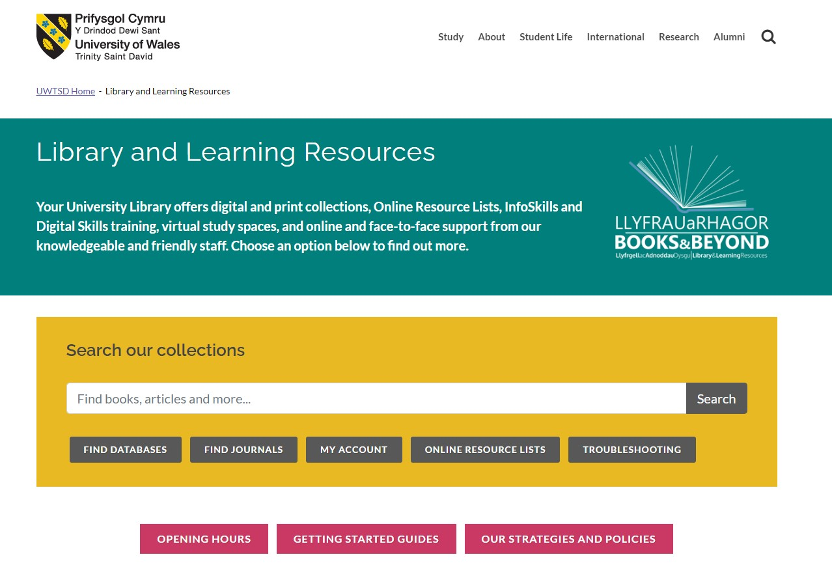
Finding your way around the library web pages.
Virtual tour. Three main sections:
Library catalogue and related resources, - e.g. Search, Save and organise, Online resource lists, Need More?
Help and support - e.g. Support for Staff, Infoskills and Digiskills, Need More? Contact us.
Library events.
The library web pages can be found at: https://www.uwtsd.ac.uk/library/
Also, on Moodle, UWTSD Quick Links - or search for UWTSD library.

Slide 14


Help is always available.
Search and subject related queries:
Alison Evans, Academic Liaison Librarian.
alison.evans@uwtsd.ac.uk
Digital skills queries:
Gwen Couch, Digital Skills Advisor.
g.couch@uwtsd.ac.uk
Database of the Month
Request items not held in the library
Need More?
General queries
library@uwtsd.ac.uk
Infoskills programme

