Slide 2
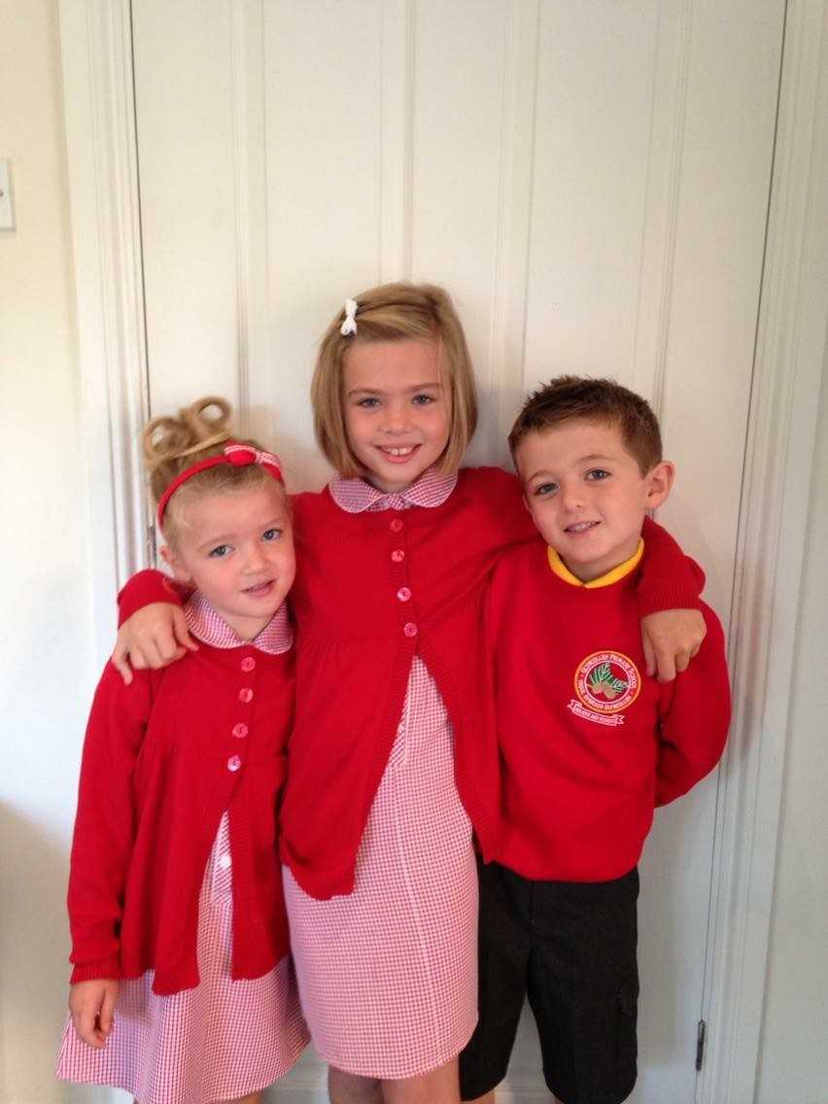


Adler’s Theory of Inferiority and Birth Order
(Moral Development)

Slide 3
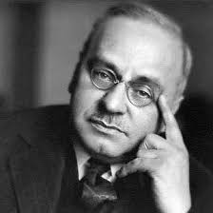
Adler’s Theory of Inferiority and Birth Order
(Moral Development)
Born with a sense of inferiority – A weak and helpless new-born
A crucial part of our personality - The driving force that pushes us to strive in order to become superior.
Birth order as a major factor in the development of our personality.
Character traits and behaviors derive primarily from developmental issues, including birth order.

Slide 4
Adler’s view…
A child arrives in the world wishing to survive
…resources for that survival come from parents
…discovers through trial and error what strategies will maximize those resources.

Slide 5
Adler’s View…
Further, the child needs to establish for itself an ecological niche, one in which it is differentiated from others also competing for resources.
Who are the competitors?
Differences between children in the one family are as great as between any children chosen at random. Up to 45 % of personality is attributable to environment and 80 to 90% of that is attributed to non-shared within-family influences (Plomin & Daniels, 1987)

Slide 6
Adler suggests…
The strategies adopted for survival aim to differentiate and hence protect the ecological niche.
These strategies may be the origin of motives.

Slide 7
First Born Children….
Prone to perfectionism and need for affirmation
tends to become intellectual, conscientious and dominant in social settings.
Adler attributes this to the child losing the parents' undivided attention and compensating throughout life by working to get it back.
In addition, this child may be expected to set an example and be given responsibility for younger siblings.

Slide 8
First Born Children…
Eldest children are more conscientious and seek parental favour through acting as surrogate parents toward younger siblings. They are more responsible, conservative, and defensive (Sulloway, 1996).
"I'll be safe if I can control the resources."
From this strategy it is possible to see the need for power emerging.

Slide 9
Second Born – Middle Children…
Since there is always someone who was there first, this child may grow to be more competitive, rebellious and consistent in attempting to be best.
…may struggle with figuring out their place in the family and, later, in the world.
…are eager for parental praise and thus tend to develop gifts in the arts, sports or academia in order to accomplish this goal.
Due to their "middle" status, they also may be the most flexible and diplomatic members of the family.

Slide 10
Second Born – Middle Children…
Middle children have broader interests, have lower self-esteem and tend to be more independent, innovative, risk tolerant, rebellious and open to experience (Kennedy, 1989; Kidwell, 1982).
"I feel safe if I can prove my own competence and independence".
This strategy may lead to the motive of ’need for achievement’

Slide 11
Youngest Child…
…may be dependent and selfish due to always being taken care of by family members.
However, this child may also possess positive traits of confidence, ability to have fun and comfort at entertaining others.
…less ambitious, less conscientious, and more socially oriented.

Slide 12
Youngest Child…
They are sometimes described as popular, easy going, lazy or spoilt.
Last-borns often enjoy considerable parental investment, though without the burden of parental expectations of 'success’ (which is placed on firstborns).
"I feel safe if I can be loved“
Hence the last-born's anxiety, and motive, is fear of rejection

Slide 13
Adler also believed….
…that first born children
may feel inferior and may even develop inferiority complex once their younger sibling arrives.
…that middle born children
on the other hand, are not as pampered as their older or younger sibling, but they have a sense of superiority to dethrone their older sibling in a healthy competition. Thus they have the greatest potential to be successful in life.
…that youngest born children
may feel like they have the least power to influence other members of the family. Because they are often the most pampered, they may develop personality problems of inferiority just like the first born.

Slide 14
Only Children
…do not have to share their parents' attention.
…may have a hard time when they are told no, and school may be a difficult transition as they are not the sole focus of the teacher.
On a positive note, Adler believed that, compared to others their age, only children tend to be more mature, feel more comfortable around adults and even do better in intellectual and creative pursuits.

Slide 15
Other Family Situations…
With twins…
one is usually seen as the older and is stronger and more active. This one often becomes the leader, though both may develop identity problems due to being treated as one unit instead of two people.
With an only boy among girls…
He suggests this boy may develop into an adult who is always trying to prove his manhood or, conversely, may become effeminate.
An only girl among boys…
may become very feminine or, attempting to outdo the boys, may become a tomboy. She may tend to work hard to please her father.

Slide 16
Adler Acknowledges…
…that for some people birth order may not be as significant an influence as parental attitudes, gender roles or socio-economic issues.
…he encouraged practitioners to understand the psychological situation in each family is different; birth order is simply one possible tool to help guide and assess.

Slide 17



Adler’s theory in practice…
‘…if I can prove own competence & independence’
Need to achieve
‘…if I can control the resources’
Need for Power
‘…if I can be loved’
Fear of Rejection
Broad Interests
Competitive
Self-depreciative
UN Peacekeeper
Constant seek of approval
Perfectionist
Controlling
Bossy
Got to be in-charge
Confident
Fun
Sociable
Entertainer
Constant Cuddles

