Slide 1

Careers
Planning future steps

Slide 2
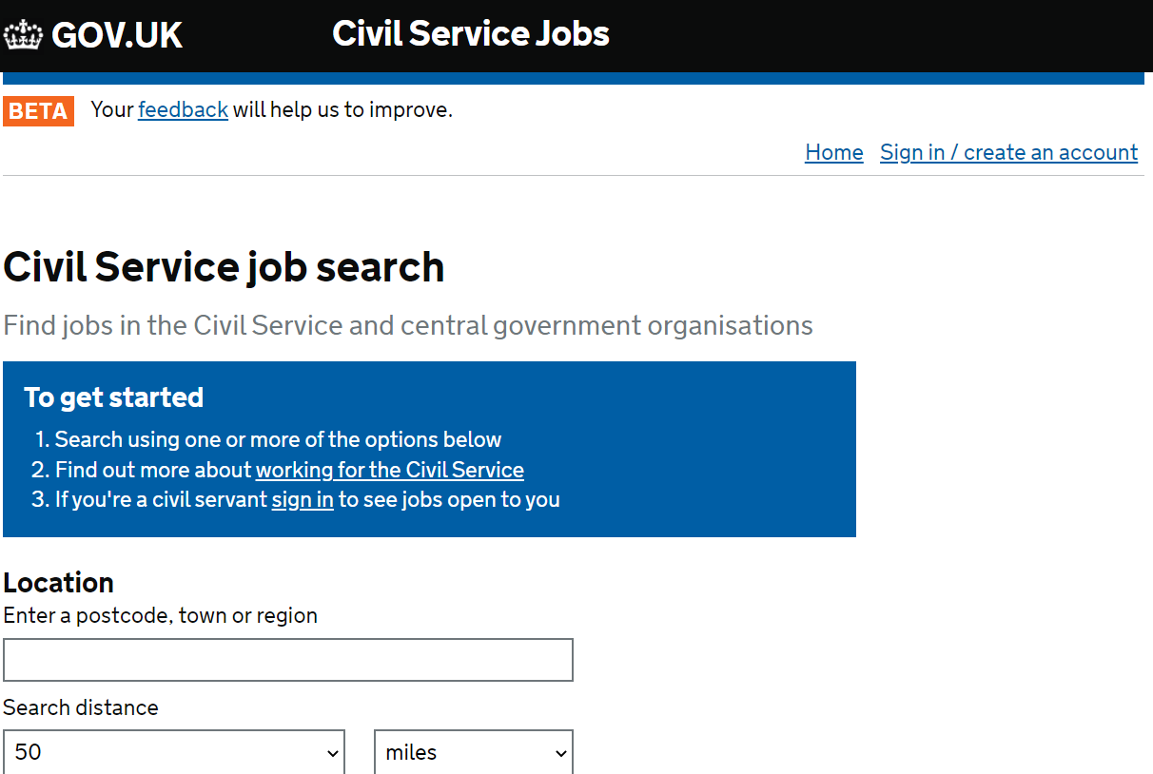

Slide 3
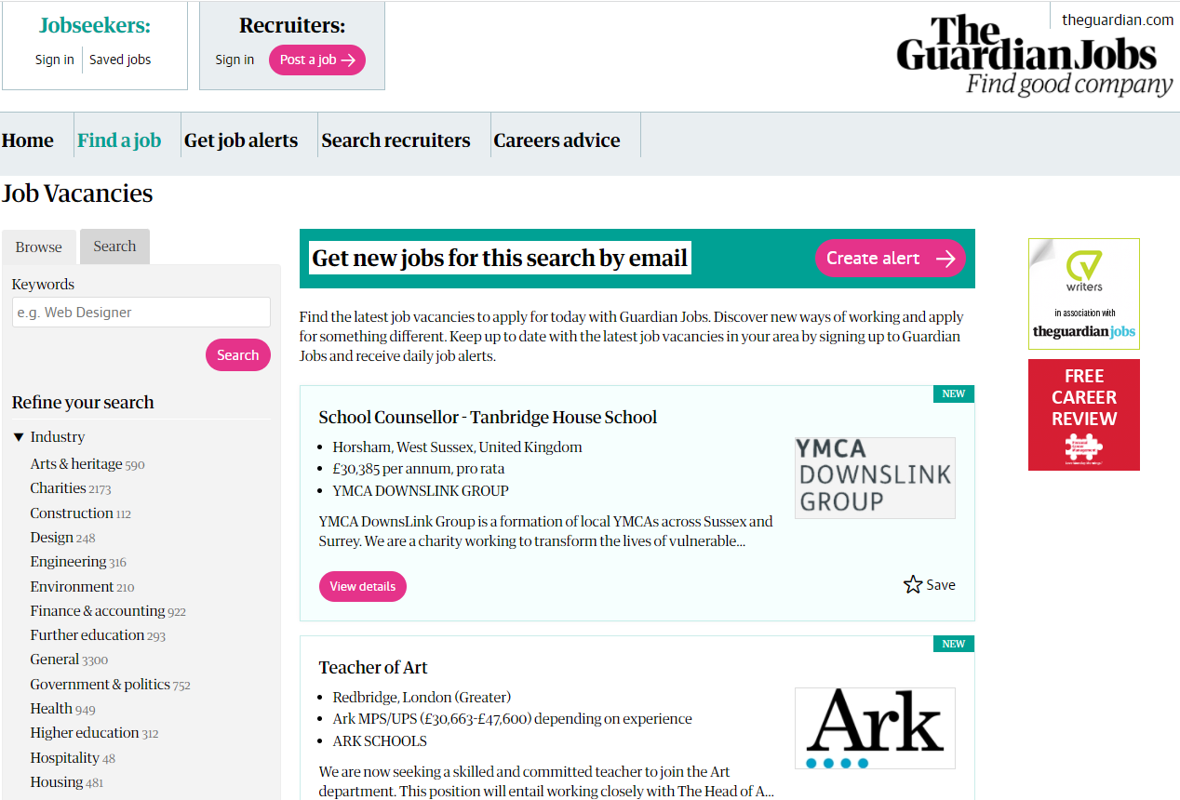

Slide 4
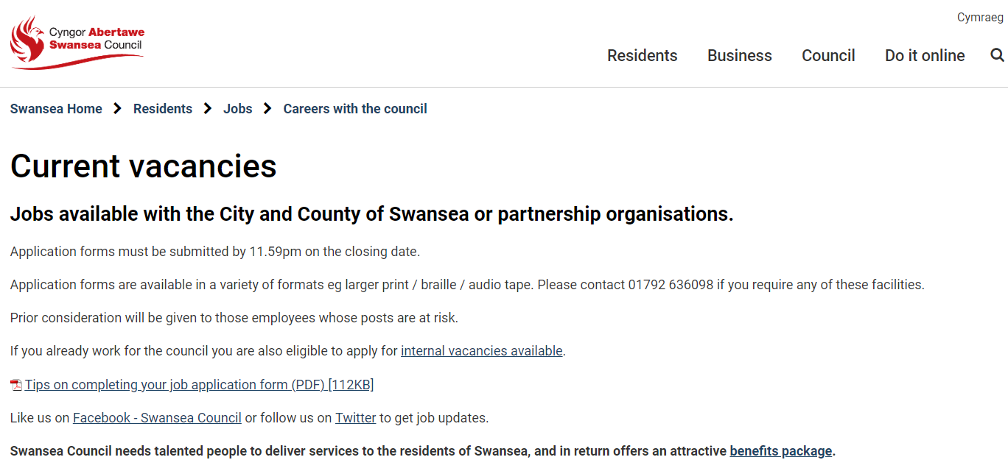
How many Councils in Wales?

Slide 5


Slide 6
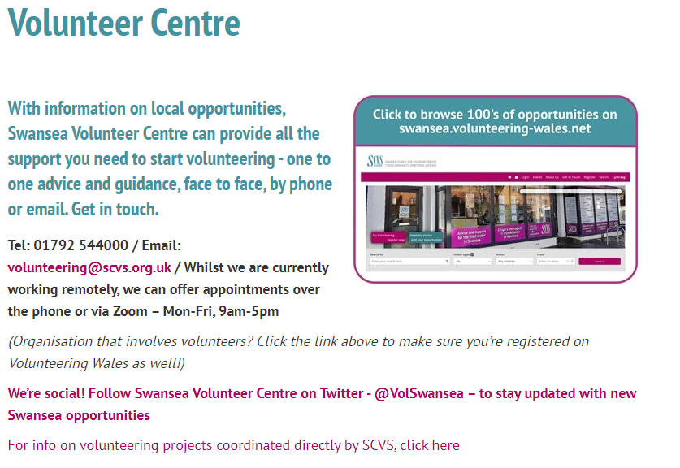

Slide 7


Slide 8


