Slide 1

Human Anatomy & Physiology
Practical – ECG and Heart Rate Variability

Slide 2
Learning Objectives
To understand the basics of electrical activity in the heart and how they produce contractions
To perform and repeat a ECG trace on fellow students, and if time allows take heart rate variability measures.
To be able to record data on excel documents accurately and understand the effects of the measurements you have taken.

Slide 3
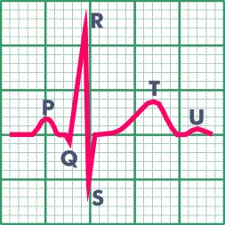
Practical - Electrocardiogram

Slide 4
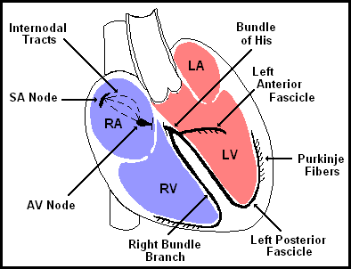
The Normal Conduction System

Slide 5
Rate
HR of 60-100 per minute is normal
HR > 100 = tachycardia
HR < 60 = bradycardia

Slide 6

What is the heart rate?
www.uptodate.com
(300 / 6) = 50 bpm

Slide 7
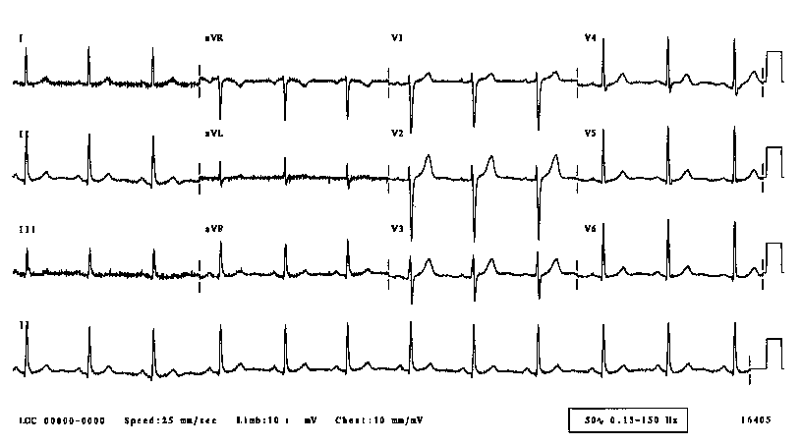
What is this rhythm?
Normal sinus rhythm

Slide 8
Heart Rate Variability is:
A measure of neurocardiac function that reflects heart-brain interactions and autonomic nervous system dynamics.
McCraty & Singer, 2002
Notes:
The HeartMath Institute, under RM’s leadership, has focused on the heart knowledge system, and in particular on finding ways to influence the heart system directly, and use it to influence brain system cognitive and emotional outcomes. They are trying, in other words, to supplement traditional brain-focused techniques (i.e, meditation) for infusing welfare into organizations.
A key measure they have developed is heart rate variability – the subtle variations in the heart rate caused by lack of harmony between P & S system activity.

Slide 9
Heart Rate Variability
2
1.5
70 BPM
76 BPM
83 BPM
m Volts
1
.859 sec.
.793 sec.
.726 sec.
0.5
0
-0.5
0
1
2
2.5 seconds of heartbeat data
© Copyright 1997 Institute of HeartMath
Notes:
As the graph shows, the elapsed time between heart beats in a person is indicative of a second set of information that influences actual heart rate, and which is linked to harmony or cacophony between the P & S systems.

Slide 10
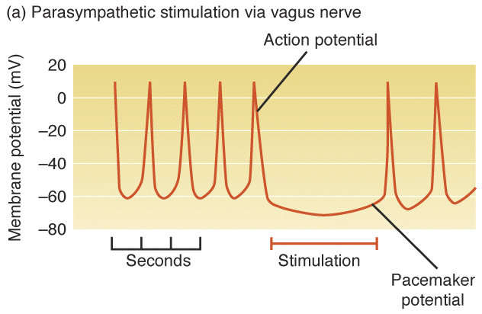
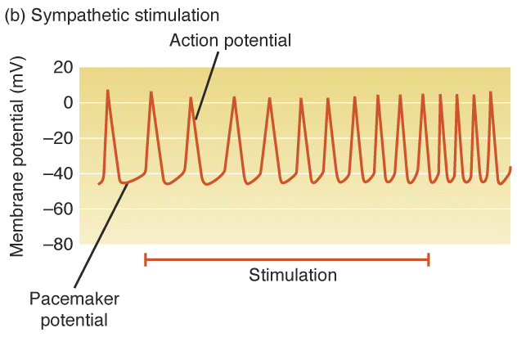
Autonomic Nervous System Effects on the Heart
Parasympathetic Nervous System (PNS),
inhibits cardiac action potentials
Sympathetic Nervous System (SNS),
stimulates cardiac action potentials
Notes:
Autonomic nervous system is the “automatic” part of the central nervous system.
-regulates all body functions including heart rate and blood pressure.
Two arms of the autonomic nervous system.
-Sympathetic=“fight or flight” responses
-Parasympathetic=relaxation and recovery
-Parasympathetic travels on vagus nerve, so parasympathetic also called vagal.

Slide 11
Types of ECG
12 lead – for detailed cardiology analysis
5 lead – for ITU and hospital based checks
3 lead – for training purposes

Slide 12
Use of ECG
Get machine out and power on
Make sure you have the leads and sticky pads available for application to the client
Two pads are placed below the clavicle (one left, one right)
The remaining pad is stuck to the left mid chest region (just below the pectoral crease)
Hold the cable to stop interference
Run print out for 20 cycles
Red – Right Clavicle, Yellow – Left Clavicle, Green – Pectoral crease

Slide 13
After getting your baselines, repeat after performing the light wall task. What result are you expecting to see in relation to heart rate?
Use the calculation to [R1-R2]² + [R2-R3]² +……
Record all your results on the excel document under a separate TAB if feasible
Task

