Slide 1
Module Title: International Financial Management
Module Code: LCBB6002
BA BUSINESS MANAGEMENT
Week 3
Investment Appraisal

Slide 2
Recap

Slide 3
It’s not the numbers, it’s the English you will find difficult!

Slide 4

Lecture Overview
Understanding steps involved in any Investment Process.
What is an investment appraisal? Different types of Investment Appraisal?

Slide 5
The nature of investment decisions
Large amounts of resources are often involved
It is often difficult and/or expensive to bail out of an investment once undertaken

Slide 6
What is an Investment Appraisal?
Method that determine whether an investment is likely to be profitable.
An evaluation of the attractiveness of an investment proposal
Integral part of Capital Budgeting

Slide 7
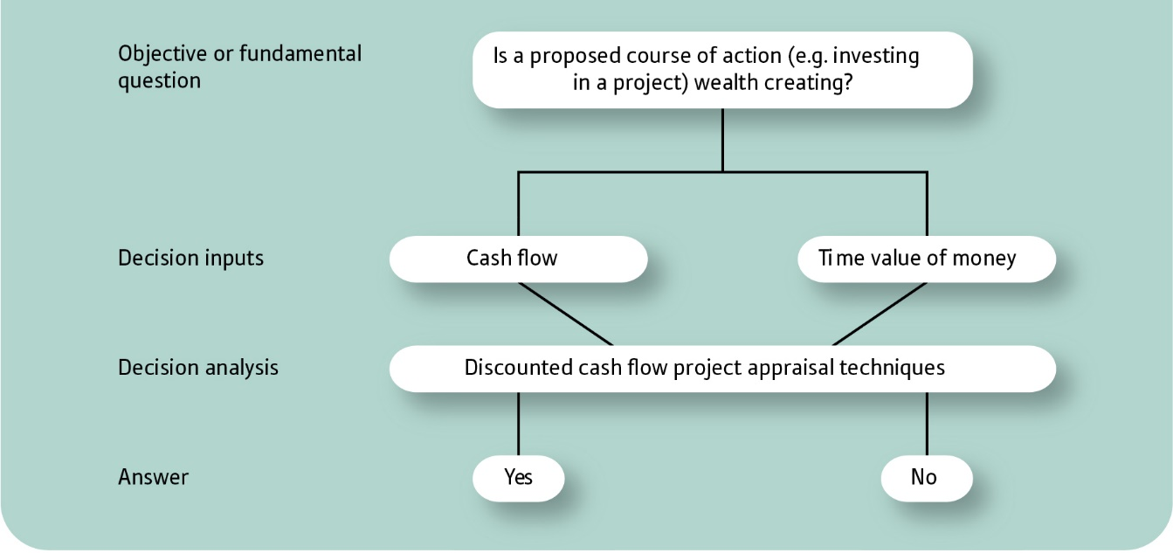
Investment appraisal: objective, inputs and process

Slide 8
Investment appraisal methods
Four methods of evaluation
Net present value (NPV)
Internal rate of return (IRR)
Payback period (PP)
Accounting rate of return (ARR)

Slide 9
The main investment appraisal methods
Investment appraisal methods
Discounted
cash flow methods
Non-discounted
cash flow methods
Net present value
Internal rate
of return
Accounting rate
of return
Payback period

Slide 10

Discounted cash flow (DCF) refers to a valuation method that estimates the value of an investment using its expected future cash flows.

Slide 11
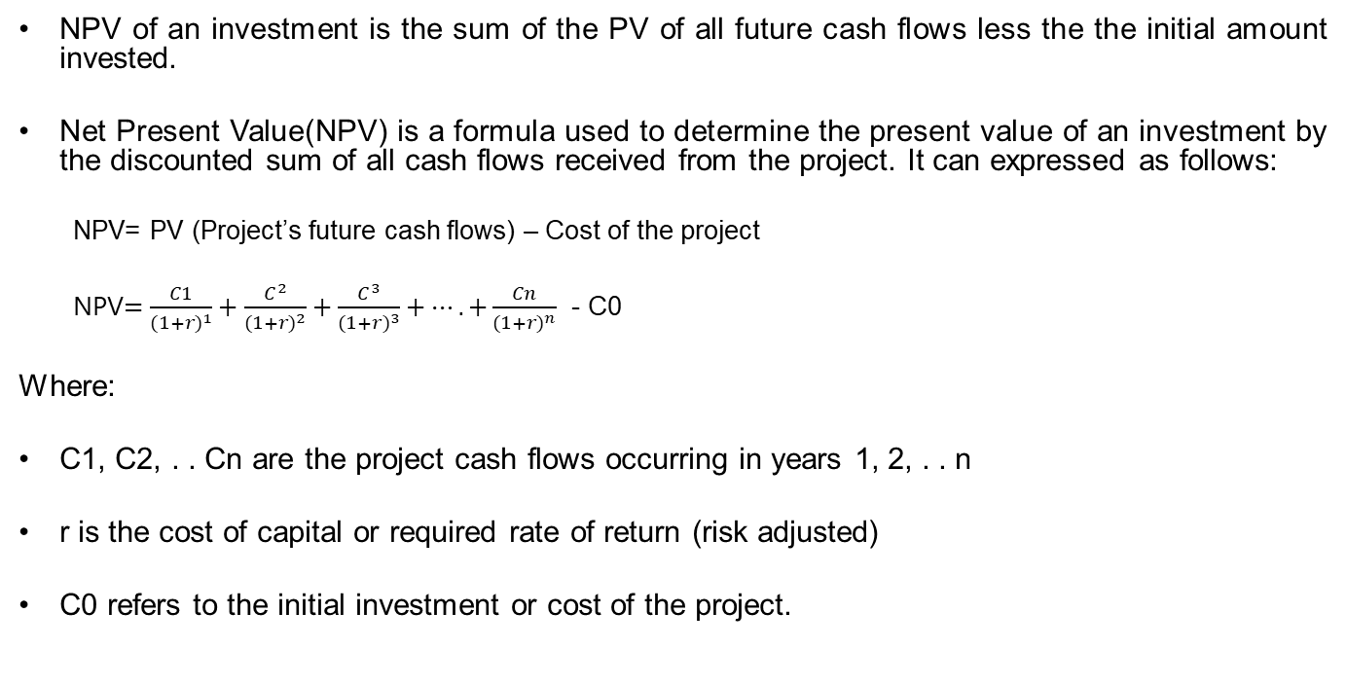
Net Present Value (NPV)
NPV of an investment is the sum of the PV of all future cash flows less the the initial amount invested.
Net Present Value(NPV) is a formula used to determine the present value of an investment by the discounted sum of all cash flows received from the project. It can expressed as follows:
  NPV= PV (Project’s future cash flows) – Cost of the project
  NPV$=\frac{C1}{{(1+r)}^{1}}+\frac{C^{2}}{{(1+r)}^{2}}+\frac{C^{3}}{{(1+r)}^{3}}+….+\frac{Cn}{{(1+r)}^{n}}$ - C0
Where:
C1, C2, . . Cn are the project cash flows occurring in years 1, 2, . . n
r is the cost of capital or required rate of return (risk adjusted)
C0 refers to the initial investment or cost of the project.

Slide 12
Investment Decision Rule using NPV
If project NPV is positive, it should be accepted; if it is negative, it should be rejected
If competing projects have positive NPVs, the one with the highest NPV is selected
NPV 0 ➔ Return from investment's cash inflows same as cost of capital

Slide 13
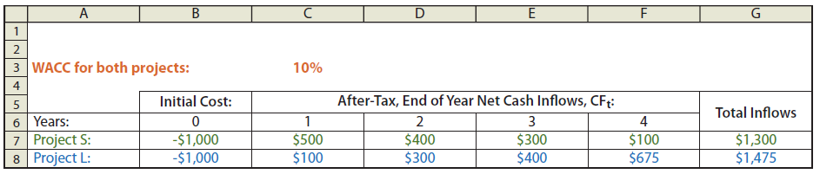

Net Present Value (Example)
r = 10% in our example.

Slide 14
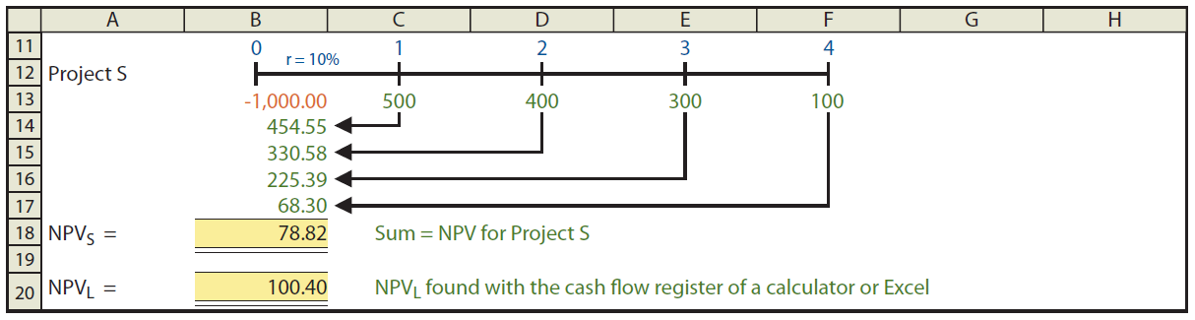

Net Present Value (Example)
NPV for project L?

Slide 15
Net Present Value (NPV)
Advantages
Takes account of time value of money
Uses cash flow, not accounting profit
Takes account of all relevant cash flows over
life of project
Can take account of conventional and non-conventional cash flows, as well as changes
in discount rate during project
Gives absolute measure of project value.

Slide 16
Net Present Value (NPV)
Disadvantages
Project cash flows may be difficult to estimate (but applies to all methods)
Accepting all projects with positive NPV only possible in a perfect capital market
Cost of capital may be difficult to find
Cost of capital may change over project life, rather than being constant.

Slide 17
Internal rate of return (IRR)
Internal rate of return (IRR) is the interest rate at which the net present value of all the cash flows (both positive and negative) from an investment equal zero.
The internal rate of return (IRR) method is to calculate the exact discounted cash flow rate of return which the project is expected to achieve; in other words, the rate at which the NPV is zero.

Slide 18
Internal rate of return (IRR)
Step 1 Calculate the net present value using the company's cost of capital.
Step 2 Having calculated the NPV using the company's cost of capital, calculate the NPV using a second discount rate.
  (a) If the NPV is positive, use a second rate that is greater than the first rate.
  (b) If the NPV is negative, use a second rate that is less than the first rate.
Step 3 Use the two NPV values to estimate the IRR.

Slide 19
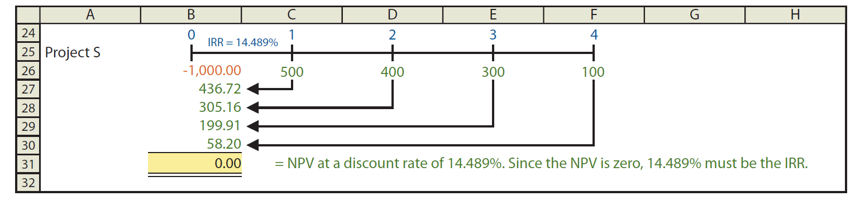
Internal rate of return (IRR) - Example
Note: Project S has an estimated return of 14.489% versus a 10% cost of capital, so its bonus is 4.489%.
Trial and Error
Calculator Solution
MS Excel Solution

Slide 20
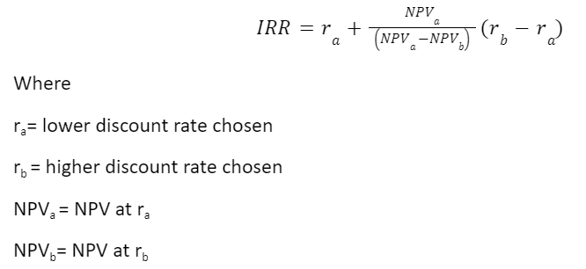
Internal rate of return (IRR) - Formula

Slide 21
Usefulness of IRR
Results are expressed as a simple percentage, and are more easily understood than some other methods.
It indicates how sensitive decisions are to a change in interest rates.
Like NPV, IRR takes full account both of the cash flows and of the time value of money, which is a good basis for decision making.
IRR can not cope with differing required rates of return (hurdle rates). IRR provides an average rate of return for a particular investment project. This rate is normally compared with a required rate of return to make a judgment on the investment.

Slide 22
Drawbacks of IRR
Projects with unconventional cash flows can have either negative or multiple IRR’S. This can be confusing to the user.
IRR can be confused with ARR, since all methods give answers in percentage terms. Hence, a cash-based method can be confused with a profit-based method.
Some managers are unfamiliar with the IRR method.

Slide 23
Payback Period
Payback is the amount of time it takes for cash inflows = cash outflows.
Payback is often used as a 'first screening method' in investment appraisal. By this, we mean that when a capital investment project is being considered, the first question to ask is:
'How long will it take to pay back its cost?’
The organisation might have a target payback, and so it would reject a capital project unless its payback period were less than a certain number of years.
The shorter the payback, the better the project.

Slide 24

Payback Period - Formula

Slide 25
Payback Period - Example
Initial cost still not paid back after three years = $140,000
Net cash inflow in year 4 = $350,000
Therefore the remaining balance of $140,000 would be paid back in $140,000 / $350,000 = 0.4 of a year.
The payback period is therefore 3.4 years.

Slide 26
PB decision rule
Project should have a shorter payback period than the required maximum payback period
If competing projects have payback periods shorter than maximum payback period, the one with the shortest payback period is selected

Slide 27
Usefulness of PB
complements more sophisticated methods
Simple and easy to use
Good for communication with non-specialist
Projects returning cash sooner are ranked higher. Thought to be useful when capital is short supply
Simple measure of a project’s liquidity

Slide 28
Problems with PB
Does not take timing of cash flows fully into account
Ignores cash flows after PP
Does not take risk fully into account
Not related to wealth maximisation objective
Arbitrarily determined target payback period

Slide 29
Accounting rate of return (ARR)
Accounting rate of return is return on investment over the whole life of a project
ARR seeks to provide a measure of project profitability over the entire asset life, it compares average profit of the project with the book value of the asset acquired
ARR method may be known by other names such the return on capital employed (ROCE) or return on investment (ROI)
It is a ratio of the accounting profit for the investment in the project, expressed as percentage. 10%, 20%
Decision rule is that if the ARR is greater than, or equal to, a hurdle rate (pre set rate by the company) then accept the project.

Slide 30
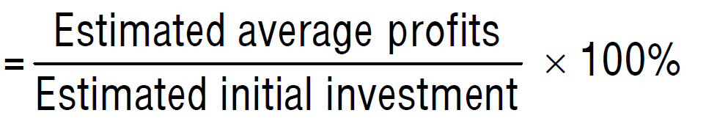
ARR Formula
ARR

Slide 31
Usefulness of ARR
ARR provides a percentage return which can be compared with a target return
ARR looks at the whole profitability of the project
Focuses on profitability – a key issue for shareholders

Slide 32
Drawbacks of ARR
It can be calculated in number of different ways so may bring different answers.
Affected by the depreciation policy
Does not take into account cash flows – only profits (they may not be the same thing)
Takes no account of the time value of money
Treats profits arising late in the project in the same way as those which might arise early
No economic rationale that links a particular acceptance criterion to the foal of maximizing shareholders wealth

Slide 33
IRR, NPV, ARR, PBP
Research indicates in UK and USA same broad range of investment appraisal method applies.
Discounting methods are more commonly used in UK, in contrast with USA where NPV seems more popular than IRR
ARR is not very popular anywhere
PBP ignore the shareholder wealth maximization objective, despite this flaw it is still widely used by both large and smaller UK firms

Slide 34
Some practical points related to investment appraisal
Past costs
Cash flows not profit flows
Common future costs
Year-end assumption
Opportunity costs
Interest payments
Taxation
Other factors

Slide 35
The main investment appraisal methods
Investment appraisal methods
Discounted
cash flow methods
Non-discounted
cash flow methods
Net present value
Internal rate
of return
Accounting rate
of return
Payback period

Slide 36
Investment appraisal in practice
Many surveys have shown the following features:
Businesses tend to use more than one method
NPV and IRR have become increasingly popular
Continued popularity of the PP and ARR methods
Larger businesses rely more heavily on NPV and IRR than smaller businesses

Slide 37

Thank you!

