Slide 1
INTRODUCTION TO PUBLIC HEALTH
Public health challenges and Priorities in UK
LCHS4008

Slide 2
Learning outcomes
Upon successful completion of this module, you should be able to:
Understand different approaches and strategies used to measure, monitor and control the incidence of disease in communities
Investigate the implications of illness and disease in communities for the provision of health and social care services
Understand the factors influencing the health and wellbeing of individuals in health or social care settings.

Slide 3
Today’s Objectives
Review last week session
Discuss public health challenges and Priorities in the following areas;
  Obesity
  Lifestyle choices/behaviour
  Health inequalities

Slide 4

What is Obesity?

Slide 5
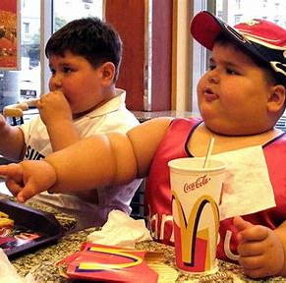
Obesity
The term obesity describes a person who is overweight, that is having a lot of body fat.
Obesity results from an imbalance between energy intake and energy expenditure.
(NHS, 2022; NICE, 2022)

Slide 6
Obesity
Healthy weight — BMI of 18.5–24.9 kg/m².
Overweight — BMI of 25–29.9 kg/m².
Obesity 1 — BMI of 30–34.9 kg/m².
Obesity 2 — BMI of 35–39.9 kg/m².
Obesity 3 — BMI of 40 kg/m² or more.
BMI is calculated by dividing a person's weight in kilograms by the square of their height in metres
BMI = Weight (kg) / Height (m)²
(NHS Digital, 2017; NICE, 2022)
Notes:
Healthy weight — BMI of 18.5–24.9 kg/m².
Overweight — BMI of 25–29.9 kg/m².
Obesity 1 — BMI of 30–34.9 kg/m².
Obesity 2 — BMI of 35–39.9 kg/m².
Obesity 3 — BMI of 40 kg/m² or more.
BMI is calculated by dividing a person's weight in kilograms by the square of their height in metres

Slide 7
Activity
Working in small group discuss
What you think the challenges of obesity in England read the article and share the findings
‘The rising prevalence of obesity: part A: impact on public health’
Share your view with the whole class
25 mins

Slide 8
What are the Obesity challenges?
Notes:
https://www.bbc.co.uk/bitesize/guides/z7gmn39/revision/4

Slide 9
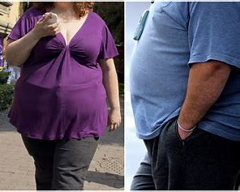
Obesity: challenges
In the UK, “more than 1 in 4 adults is obese (OECD, 2017).
Between 1993 and 2011, obesity rates rose from 13% to 24% in men and from 16% to 26% in women” (NICE, 2014).
In England, “27% of adults are obese (a rise from 15% in 1993) and a further 36% are overweight” (House of Commons, 2017; NHS Digital, 2017).
About “35% of the population are projected to be obese in 2030” (OECD, 2017).
Notes:
Prevalence | Background information | Obesity | CKS | NICE

Slide 10
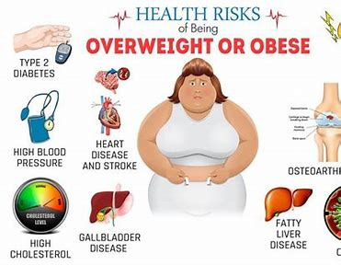
Obesity: challenges
It is estimated that obesity is responsible for more than 30,000 deaths each year.
Obesity is associated with a number of negative mental, physical and social consequences.
Obesity increases the risk of developing a whole host of diseases. Obese people have:
  increased risk of certain cancers, including being 3 times more likely to develop colon cancer
  more than 2.5 times more likely to develop high blood pressure - a risk factor for heart disease
  5 times more likely to develop type 2 diabetes
  (Semeeh, 2011)

Slide 11
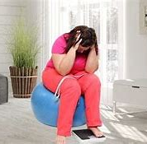
Obesity: challenges
Obesity and its related disease conditions appear to have significant adverse socio-economic implications at individual and population levels.
These include
Work absenteeism,
Reduced productivity,
Psycho-social distress,
Overwhelming health expenditures,
Increased dependency ratio.
(Semeeh, 2011)

Slide 12
Activity
Working in small group using the link below explore the causes and risk factors of obesity
https://cks.nice.org.uk/topics/obesity/background-information/causes-risk-factors/
Share what you have learnt with the whole class
Notes:
Obesity:
What are the causes and risk factors?
Last revised in May 2023

Slide 13
What are the Obesity priorities?

Slide 14

Obesity: priorities
Reducing obesity, particularly among children, is one of the priorities of Public Health England (PHE).
NHS
Managers and health professionals in all primary care settings should ensure that preventing and managing obesity is a priority, at both strategic and delivery levels.
(PHE, 2019)

Slide 15
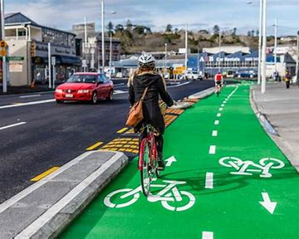
Obesity: Priorities
Local authorities and partners
Local authorities should work with local partners, such as industry and voluntary organisations, to create and manage more safe spaces for incidental and planned physical activity, addressing as a priority any concerns about safety, crime and inclusion, by:
Providing facilities and schemes such as cycling and walking routes, cycle parking, area maps and safe play areas
Making streets cleaner and safer, through measures such as traffic calming, congestion charging, pedestrian crossings, cycle routes, lighting and walking schemes
Ensuring buildings and spaces are designed to encourage people to be more physically active (for example, through positioning and signing of stairs, entrances and walkways)
(PHE 2019)

Slide 16

Obesity: Priorities
Early years settings and Nurseries and other childcare facilities should:
Minimise sedentary activities during play time, and provide regular opportunities for enjoyable active play and structured physical activity sessions
Implement Department for Education and Skills, Food Standards Agency and Caroline Walker Trust guidance on food procurement and healthy catering.
(PHE, 2019)

Slide 17
Obesity: Priorities
Schools
Head teachers and chairs of governors, in collaboration with parents and pupils, should assess the whole school environment and ensure that the ethos of all school policies helps children and young people to maintain a healthy weight, eat a healthy diet and be physically active.
Workplaces
Workplaces should provide opportunities for staff to eat a healthy diet and be physically active, through:
Active and continuous promotion of healthy choices in restaurants, hospitality, vending machines and shops for staff and clients, in line with existing Food Standards Agency guidance
A supportive physical environment, such as improvements to stairwells and providing showers and secure cycle parking
Recreational opportunities, such as supporting out-of-hours social activities, lunchtime walks and use of local leisure facilities.
(PHE, 2015)

Slide 18
What is Lifestyle behaviours?
Notes:
https://www.bbc.co.uk/bitesize/guides/z7gmn39/revision/4

Slide 19
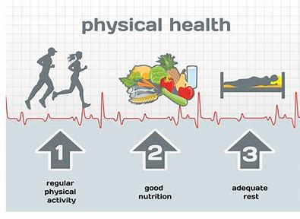
Definition of Lifestyle behaviour
Lifestyle behaviours are “everyday activities that result from individual's values, knowledge, and norms shaped by broader cultural and socioeconomic context”.
“These behaviours affect body weight as well as overall health and are influenced by a number of social characteristics”.
(Jarosz, 2018)

Slide 20
Activity
What are some of the lifestyle choices or behaviours that can affect the health of the population?
Discuss in pairs and then share with the entire group.
10mins

Slide 21
What are the Lifestyle choices/behaviours: challenges?

Slide 22
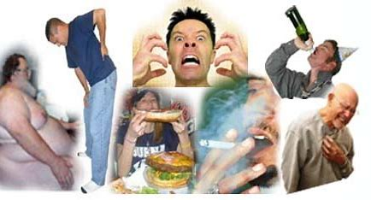
Lifestyle choices/behaviours: challenges
Smoking (leads to cancers)
Unhealthy Diet (CVD, obesity)
Lack of exercise and physical inactivity
Alcohol and drug use (Liver cirrhosis)
Sexual health (HIV, Cervical cancer, hepatitis B, STD)

Slide 23
Life style choices/behaviours: challenges
Statistic (2019/2020)
506,100 hospital admissions attributable to smoking similar to 2018/19 but 10% higher than 2009/10 when it was 461,700 in England (NHS 2021).
7,027 hospital admissions for drug-related mental and behavioural disorders 5% lower than 2018/19 (7,376), but 21% higher than 2009/10 (5,809) (NHS 2021).
By the end of 2016, 150 726 people had been diagnosed with HIV infection in the UK (Brown, 2018)

Slide 24
What are the Lifestyle choices/behaviours: priorities?
Notes:
Lifestyle choices and behaviour statistics | Department of Health (health-ni.gov.uk)

Slide 25
Lifestyle choices/behaviours priorities
Everyone should be encouraged to reduce the amount of sedentary time by:
Reducing time spent watching TV, using a computer or playing video games
Taking regular break to avoid sitting too long during work
Breaking up sedentary time, such as swapping a long bus or car journey for walking part of the way.
(PHE, 2016)

Slide 26
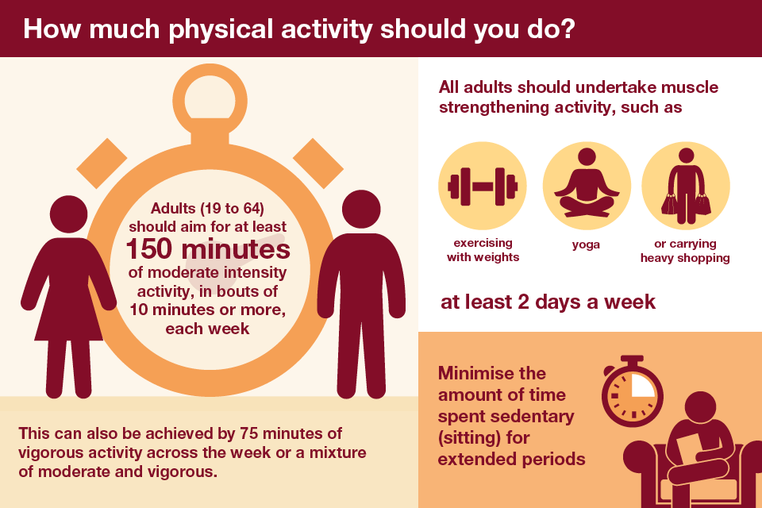
Lifestyle choices/behaviours: priorities
Lifestyle choices Priorities:
ive every day
Guidance PHE Health matters: getting every adult active every day
(PHE, 2016)

Slide 27
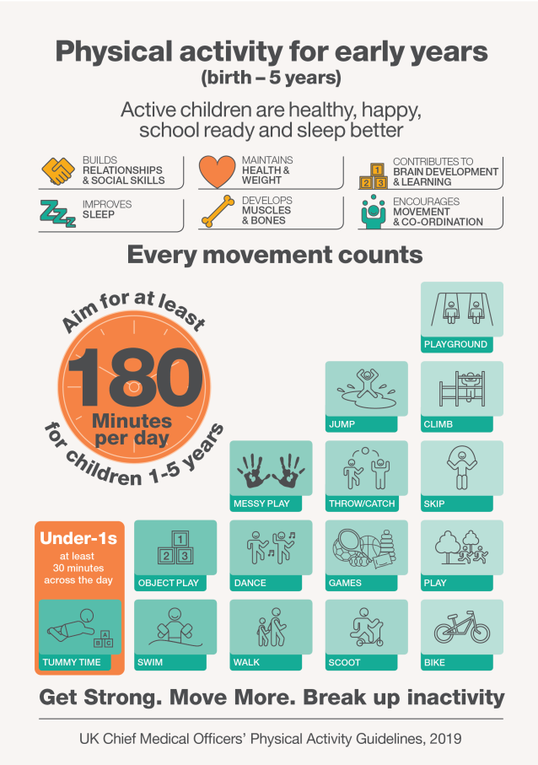

Slide 28
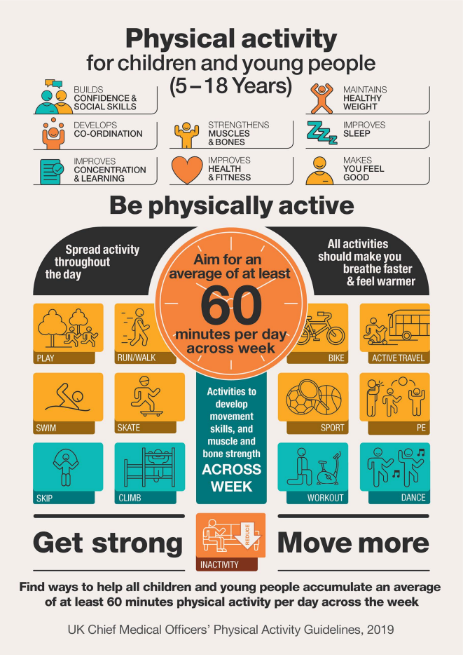

Slide 29
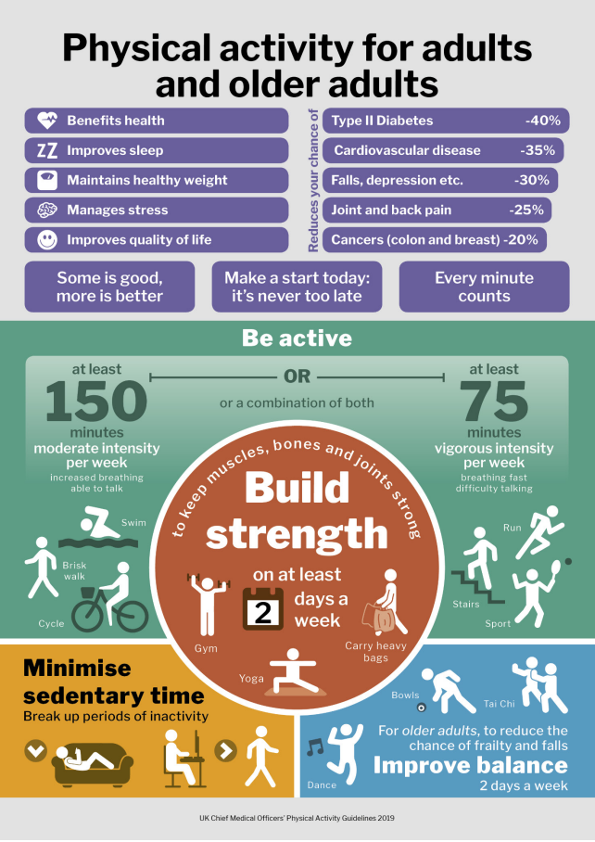

Slide 30
Summary: Lifestyle choices/behaviours: challenges and priorities
Let's watch the video to conclude lifestyle choices and their impact on health and wellbeing.
https://www.youtube.com/watch?v=GyA9O17PuX8
Notes:
Lifestyle Choices – YouTube
THE CHOICE (Short Animated Movie) – YouTube

Slide 31
What is the Health inequalities?
Notes:
Lifestyle choices and behaviour statistics | Department of Health (health-ni.gov.uk)

Slide 32

Health inequality
Health inequalities are “the unjust and avoidable differences in people's health across the population and between specific population groups”.
Health inequalities are ultimately about differences in the status of people’s health.
(Kings fund, 2020)
Notes:
n28au

Slide 33
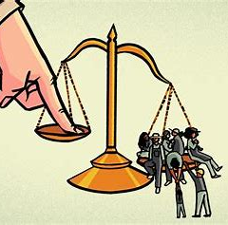
Health inequality
Health inequality is also used to refer to “differences in the care that people receive and the opportunities that they have to lead healthy lives – both of which can contribute to their health status”.
(Kings fund, 2020)

Slide 34
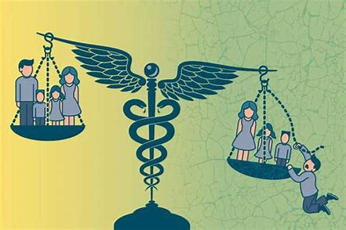
Health Inequality
Health inequality; four types of factors
Socio-economic factors, for example, income
Geography, for example, region or whether urban or rural
Specific characteristics including those protected in law, such as sex, ethnicity or disability
Socially excluded groups, for example, people experiencing homelessness.
(Kings fund, 2022)

Slide 35
What are the Health inequalities Challenges?
Notes:
Lifestyle choices and behaviour statistics | Department of Health (health-ni.gov.uk)

Slide 36
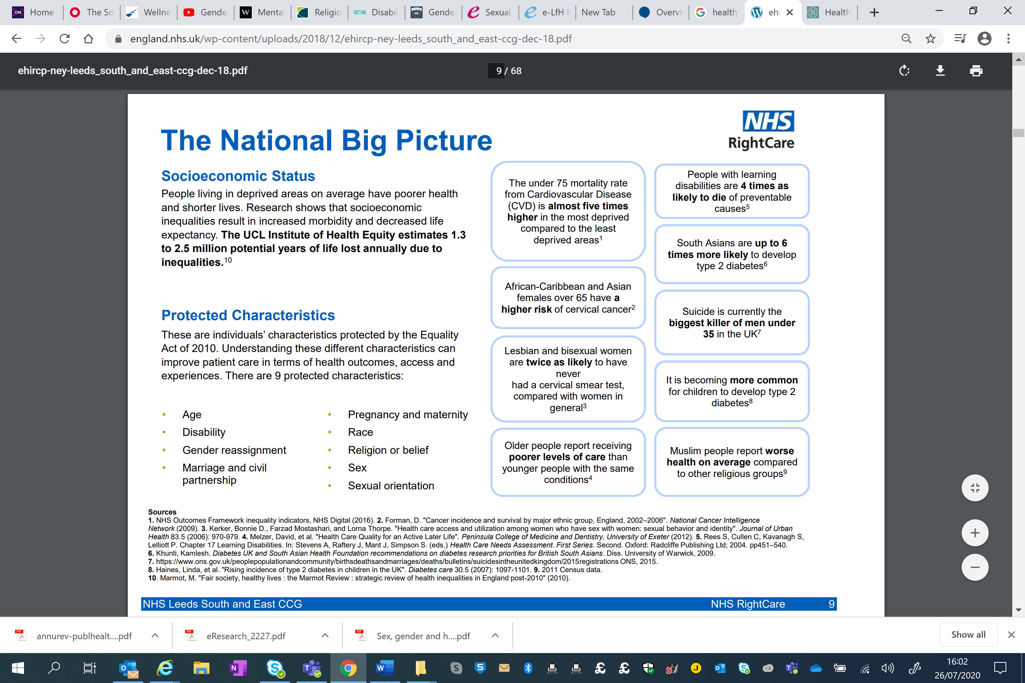

Slide 37
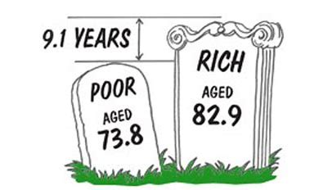
Challenges of Health inequalities
The differences in opportunity, access and resources have impact on health status of the population.
Inequalities in the percentage of babies born with a low birth weight, infant mortality rates, excess weight in children and the level of dental decay in children between different areas according to the level of deprivation.
Differences in life expectancy, healthy life expectancy and mortality rates among adults, there are also differences in the prevalence of many behavioural risk factors between population groups.
(PHE, 2018)

Slide 38
Challenges of Health Inequality
Life expectancy
People in the professional group are more likely to live 7 years longer than those in the unskilled or manual group
Infant Mortality
Children from manual social background are twice as likely to die before the age of 15 as a child born into a non-manual background.
Infant mortality is highest among babies with fathers in semiskilled and unskilled groups.

Slide 39
What are the Health inequalities priorities?
Notes:
Lifestyle choices and behaviour statistics | Department of Health (health-ni.gov.uk)

Slide 40
Activity
Working in groups explore the report
Make 6 groups. Each group will get one policy objective from
‘Fair Society, Healthy Lives The Marmot Review’ Report.
Feedback your findings to the whole class

Slide 41
Marmot Review
The report highlighted the need to take action across the social determinants of health and called for progress to be made on a clear set of policy objectives.

Slide 42
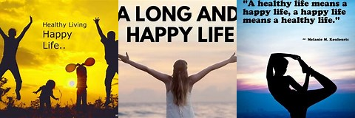
Marmot Review
It argues that, traditionally, government policies have focused resources only on some segments of society.
To improve health for all of us and to reduce unfair and unjust inequalities in health, action is needed across the social gradient.

Slide 43
Activity 2
Working independently research the term social gradient
Feedback your findings to the whole class

Slide 44
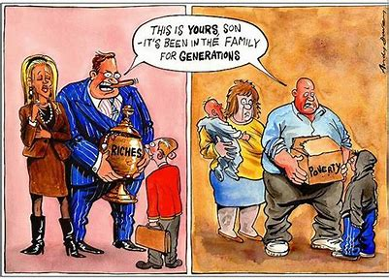
Social Gradient
Institute of Health Equity (2022), "The social gradient in health is a term used to describe the whereby people who are less advantaged in terms of socioeconomic position have worse health (and shorter lives) than those who are more advantaged”.

Slide 45
Priorities of Health inequalities
Marmot (2010) concluded that to reduce health inequalities action is required on six policy objectives:
Give every child the best start in life
Enable all children, young people and adults to maximise their capabilities and have control over their lives
Create fair employment and good work for all
Ensure healthy standard of living for all
Create and develop healthy and sustainable places and communities
Strengthen the role and impact of ill health prevention
(PHE, 2017)

Slide 46
Summary: Activity
Let’s watch the video below to conclude health inequalities to achieve equality: steps in health system in UK.
Improving Access for All – YouTube
Feedback what you have learnt to the whole class

Slide 47
References
Brown, A.E., Nash, S., Connor, N., Kirwan, P.D., Ogaz, D., Croxford, S., De Angelis, D. and Delpech, V.C., 2018. Towards elimination of HIV transmission, AIDS and HIV‐related deaths in the UK. HIV medicine, 19(8), pp.505-512.
Jarosz, E., 2018. Lifestyle behaviours or socioeconomic characteristics? Gender differences in covariates of BMI in Hungary. Obesity Science & Practice, 4(6), pp.591-599.
Marmot Report (2010) 'Fair Society, Healthy Lives Available at: https://www.local.gov.uk/marmot-review-report-fair-society-healthy-lives (Accessed Date: 21st October 2022)
NHS 2022 website available at ; Obesity - NHS (www.nhs.uk)
NHS 2021 Lifestyles - NHS Digital
Scambler, G., 2012. Health inequalities. Sociology of health & illness, 34(1), pp.130-146.
Semeeh, A.O., 2011. Obesity: A major public health challenge of 21st century in the United Kingdom (UK). Journal of Public Health and Epidemiology, 3(12), pp.560-566.
PHE 2019 website available at: Whole systems approach to obesity: A guide to support local approaches (publishing.service.gov.uk)
PHE (2016) Health matters: getting every adult active every day - GOV.UK (www.gov.uk)
PHE 2018 health inequalities website available at ; Chapter 5: inequalities in health - GOV.UK (www.gov.uk)
PHE 2017 Reducing health inequalities: system, scale and sustainability (publishing.service.gov.uk)
Notes:
Behaviour and Lifestyle (teesjsna.org.uk)

