Slide 1

Implications for businesses
and households
Applied microeconomics and macroeconomics
01

Slide 2
Learning outcomes
Explain how inflation and wages affect household purchasing power.
Apply cost and profit calculations to UK business decisions.
Evaluate how investment and economic changes affect different groups.
02

Slide 3
Economic conditions and business decisions
Microeconomics explains choices within a market, including prices, costs and customer demand.
Macroeconomics examines wider conditions, including inflation, interest rates and economic growth.
A UK café experiences both when ingredient costs rise and customers reduce spending.
03

Slide 4

Inflation and the price level
Inflation measures how quickly the general price level rises over time.
When positive inflation falls, average prices continue to rise, but more slowly.
A fall in the general price level is deflation. Individual prices can fall even when overall inflation is positive.
04

Slide 5
A shopping basket over three years
Period | Basket cost | Annual inflation
Starting year | £100.00 | —
Following year | £110.00 | 10%
Next year | £112.20 | 2%
Inflation falls to 2%, but the basket costs £12.20 more than at the start.
05

Slide 6
Nominal wages and real wages
Nominal wages are the amount of money an employee earns.
Real wages describe what those wages can buy after allowing for changes in prices.
If wages rise more slowly than prices, purchasing power falls even though the payslip shows more money.
06

Slide 7
A pay rise and purchasing power
Measure | Before | After
Annual gross pay | £25,000 | £25,750
Pay growth | — | 3%
Price growth | — | 5%
Real wage change = (1.03 ÷ 1.05 − 1) × 100 ≈ −1.9%
07

Slide 8

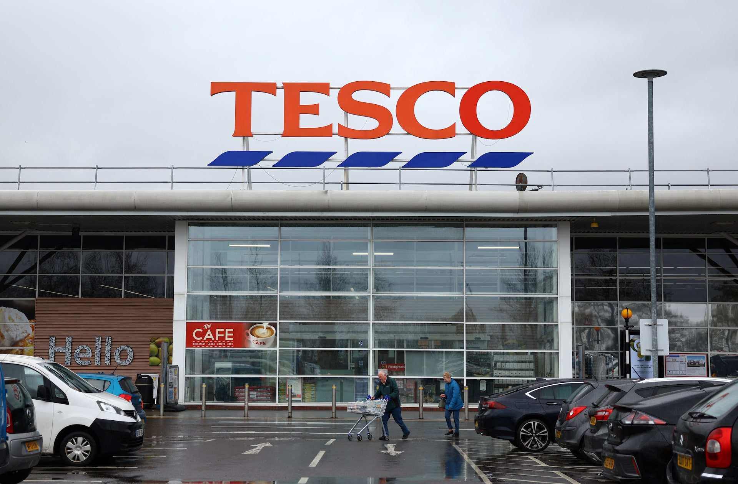
Household spending choices
Households may protect essential spending and reduce purchases they can postpone.
Customers might switch supermarkets, choose cheaper brands or visit restaurants less often.
08

Slide 9
Revenue, costs and profit
Revenue = selling price × quantity sold.
Total costs = fixed costs + variable costs. Fixed costs stay unchanged within the relevant output range.
Profit = revenue − total costs. Higher sales revenue does not automatically mean higher profit.
In the café example, variable cost is the cost of ingredients per meal.
09

Slide 10

Activity 1: The Birmingham café
You manage a fictional café.
Ingredient costs have increased.
Your task is to protect monthly profit.
Use the data on the next slide. Prepare a one-minute recommendation supported by calculations.
12

Slide 11
Activity 1: Monthly café figures
Item | Original | After cost increase
Meals sold | 2,000 | 2,000
Price per meal | £10 | £10
Variable cost per meal | £4 | £5
Fixed costs | £8,000 | £8,000
Assume these are the only costs and fixed costs remain unchanged.
13

Slide 12
Productivity
Labour productivity measures output per worker or per hour worked.
Training, better equipment and improved processes can help businesses produce more with the same working time.
Higher productivity can support lower unit costs, better pay or higher profit. The outcome depends on business decisions.
26

Slide 13
A UK bakery invests in an oven
Measure | Before | After
Loaves produced | 200 | 300
Total labour hours | 20 | 20
Loaves per labour hour | 10 | 15
Productivity rises by 50%. The bakery must also consider the oven’s cost and demand for the extra bread.
27

Slide 14
Investment and borrowing decisions
A business compares the expected benefits of investment with its purchase, running and financing costs.
Higher borrowing costs can make an oven, delivery van or hotel refurbishment less attractive.
Investment can still be worthwhile when expected savings and additional income justify the cost.
28

Slide 15
Economic trade-offs
Change | Potential benefit | Potential difficulty
Higher interest rates | More interest for some savers | Higher costs on some borrowing
Higher wages | More income for employees | Higher labour costs for employers
29

