Slide 1
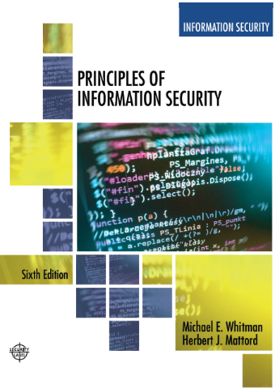
Introduction to Information Security
Lecture 1
Adapted Text
Lecturer: Assoc. Prof. Carlene Campbell
Email: carlene.campbell@uwtsd.ac.uk
Website: https://www.knowledgewithprofit.com/

Slide 2
Learning Objectives
Upon completion of this material, you should be able to:
  Define information security
  Define key terms and critical concepts of information security
  Explain the role of security in the systems development life cycle
  Describe the information security roles of professionals within an organization
Notes:
Upon completion of this material, you should be able to:
Define information security
Recount the history of computer security and how it evolved into information security
Define key terms and critical concepts of information security
List the phases of the security systems development life cycle
Describe the information security roles of professionals within an organization

Slide 3
Introduction
“Enterprise information security is a critical business capability that needs to be aligned with corporate expectations and culture that provides the leadership and insight to identify risks and implement effective controls.”—Martin Fisher, IT Security Manager, North side Hospital, Atlanta, Georgia ‏
Security professionals must review the origins of this field to understand its impact on our understanding of information security today
Notes:
What Is Information Security?
Information security in today’s enterprise is a “well-informed sense of assurance that the information risks and controls are in balance.” – Jim Anderson, Inovant (2002)‏
Before we can begin analyzing the details of information security, it is necessary to review the origins of this field and its impact on our understanding of information security today.

Slide 4
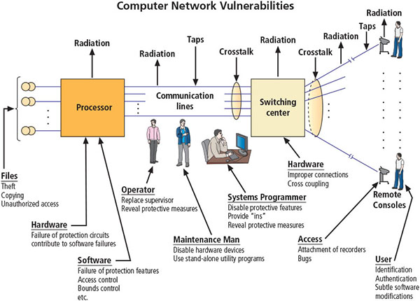
Illustration of computer network vulnerabilities from RAND Report R-609
Source. RAND Report R-609-1. Used with permission.
Notes:
RAND corporation
Much of the early research on computer security centered on a system called Multiplexed Information and Computing Service (MULTICS). Although it is now obsolete,
MULTICS is noteworthy because it was the first operating system to integrate security into its core functions. It was a mainframe, time-sharing operating system developed in the mid-
1960s by a consortium of General Electric (GE), Bell Labs, and the Massachusetts Institute of Technology (MIT).
RAND Report R-609 was the first widely recognized published document to identify the role of management and policy issues in computer security. It noted that the wide use of networking
components in military information systems introduced security risks that could not be mitigated by the routine practices then used to secure these systems. Figure above shows an
illustration of computer network vulnerabilities from the 1979 release of this document.

Slide 5
The 1990s
Networks of computers became more common, as did the need to connect them to each other.
Internet became the first global network of networks.
Initially, network connections were based on de facto standards.
In early Internet deployments, security was treated as a low priority.
In 1993, DEFCON conference was established for those interested in information security.
Notes:
https://defcon.org/
Hacking conference
DEF CON Bahrain
Nov. 5-6, 2025
Training Nov. 3-4, 2025
Aug. 7-10, 2025
Las Vegas Convention Center
in Las Vegas, NV
The 1990s
Networks of computers became more common; so did the need to connect them to each other
Internet became first global network of networks
Initially based on de facto standards
In early Internet deployments, security was treated as a low priority
In 1993, DEFCON conference established for those interested in information security
The defense readiness condition (DEFCON)
Cyber Operations Condition (CYBERCON)
In 1993, the first DEFCON conference was held in Las Vegas. Originally it was established as a gathering for people interested in information security, including authors, lawyers, government
employees, and law enforcement officials. A compelling topic was the involvement of hackers in creating an interesting venue for the exchange of information between two
adversarial groups—the “white hats” of law enforcement and security professionals and the “black hats” of hackers and computer criminals.

Slide 6
2000 to Present
The Internet brings millions of unsecured computer networks into continuous communication with each other.
The ability to secure a computer’s data was influenced by the security of every computer to which it is connected.
Growing threat of cyber attacks has increased the awareness of need for improved security.
The threat environment has grown from the semiprofessional hacker defacing Web sites for amusement to professional cybercriminals maximizing revenue from theft and extortion, as well as government-sponsored cyberwarfare groups striking military, government, and commercial targets.
Notes:
2000 to Present
The Internet brings millions of unsecured computer networks into continuous communication with each other
Ability to secure a computer’s data influenced by the security of every computer to which it is connected
Growing threat of cyber attacks has increased the awareness of need for improved security
Nation-states engaging in information warfare

Slide 7
What Is Security? (1 of 2)
“A state of being secure and free from danger or harm; the actions taken to make someone or something secure.”
A successful organization should have multiple layers of security in place to protect:
  Operations
  Physical infrastructure
  People
  Functions
  Communications
  Information
Notes:
What Is Security?
“A state of being secure and free from danger or harm; the actions taken to make someone or something secure”
A successful organization should have multiple layers of security in place to protect:
Operations
Physical Infrastructure
People
Functions
Communications
Information
Security is protection. Protection from adversaries—those who would do harm, intentionally or otherwise—is the ultimate objective of security. National security, for example, is a multilayered
system that protects the sovereignty of a state, its assets, its resources, and its people.

Slide 8
What Is Security? (2 of 2)
The protection of information and its critical elements, including systems and hardware that use, store, and transmit that information
Includes information security management, data security, and network security
C.I.A. triad
  Is a standard based on confidentiality, integrity, and availability, now viewed as inadequate.
  Expanded model consists of a list of critical characteristics of information.
Notes:
What Is Security? (cont’d.)
The protection of information and its critical elements, including systems and hardware that use, store, and transmit that information
Includes information security management, data security, and network security
C.I.A. triangle
Is standard based on confidentiality, integrity, and availability, now viewed as inadequate
Expanded model consists of a list of critical characteristics of information

Slide 9
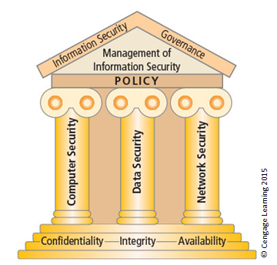
Components of information security (1 of 2)
Notes:
The Committee on National Security Systems (CNSS) model is often referred to as the "McCumber Cube" due to its association with the McCumber Cube framework developed by William (Bill) McCumber in the late 1990s.
The Committee on National Security Systems (CNSS) defines information security as the protection of information and its critical elements, including the systems and hardware that use, store,
and transmit the information.11 Figure 1-5 shows that information security includes the broad areas of information security management, data security, and network security. The CNSS
model of information security evolved from a concept developed by the computer security industry called the C.I.A. triad. The C.I.A. triad (see Figure 1-6) has been the standard for computer
security in both industry and government since the development of the mainframe. This standard is based on the three characteristics of information that give it value to organizations:
confidentiality, integrity, and availability.

Slide 10
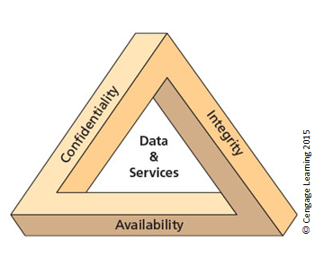
The C.I.A. triad (2 of 2)
Notes:
The C.I.A. triad (see Figure above) has been the standard for computer security in both industry and government since the development of the mainframe. This
standard is based on the three characteristics of information that give it value to organizations: confidentiality, integrity, and availability. The security of these three characteristics is as important
today as it has always been, but the C.I.A.

Slide 11
Key Information Security Concepts (1 of 3)
Access
Asset
Attack
Control, safeguard, or countermeasure
Exploit
Exposure
Loss
Protection profile or security posture
Notes:
Key Terms
Access - a subject or object’s ability to use, manipulate, modify, or affect another subject or object.
Asset - the organizational resource that is being protected.
Attack - an intentional or unintentional act that can damage or otherwise compromise information and the systems that support it.
Control, Safeguard, or Countermeasure - Security mechanisms, policies, or procedures that can successfully counter attacks, reduce risk, resolve vulnerabilities, and otherwise improve security within an organization.
Exploit – a technique used to compromise a system.
Exposure - a condition or state of being exposed.
Loss: A single instance of an information asset suffering damage or destruction, unintended or unauthorized modification or disclosure, or denial of use.
Protection Profile or Security Posture-entire set of controls and safeguards that the organization implements to protect the asset.
Risk - the probability of an unwanted occurrence.
Subjects and Objects – a computer can be either an agent entity used to conduct an attack, or the target entity.
Threat - a category of objects, people, or other entities that represents a danger to an asset.
Threat Agent – the specific instance or a component of a threat.
Vulnerability - weaknesses or faults in a system or protection mechanism that expose information to attack or damage.

Slide 12
Key Information Security Concepts (2 of 3)
Risk
Subjects and objects of attack
Threat
Threat agent
Threat event
Threat source
Vulnerability

Slide 13
Key Information Security Concepts (3 of 3)
A computer can be the subject of an attack and/or the object of an attack.
  When it is the subject of an attack, the computer is used as an active tool to conduct attack.
  When it is the object of an attack, the computer is the entity being attacked.
Notes:
Key Information Security Concepts
When considering the security of information systems components, it is important to understand the concept of the computer as the subject of an attack as opposed to the computer as the object of an attack.
When a computer is the subject of an attack, it is used as an active tool to conduct the attack. When a computer is the object of an attack, it is the entity being attacked.

Slide 14
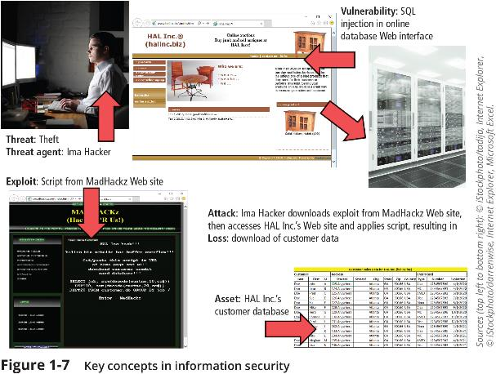
Key Concepts in Information Security

Slide 15
Critical Characteristics of Information
The value of information comes from the characteristics it possesses:
  Availability
  Accuracy
  Authenticity
  Confidentiality
  Integrity
  Utility
  Possession
Notes:
Critical Characteristics of Information
The value of information comes from the characteristics it possesses.
Availability – Enables users who need to access information to do so without interference or obstruction and in the required format. The information is said to be available to an authorized user when and where needed and in the correct format.
Accuracy – Free from mistake or error and having the value that the end user expects. If information contains a value different from the user’s expectations due to the intentional or unintentional modification of its content, it is no longer accurate.
Authenticity –The quality or state of being genuine or original, rather than a reproduction or fabrication. Information is authentic when it is the information that was originally created, placed, stored, or transferred.
Confidentiality – The quality or state of preventing disclosure or exposure to unauthorized individuals or systems.
Integrity – The quality or state of being whole, complete, and uncorrupted. The integrity of information is threatened when the information is exposed to corruption, damage, destruction, or other disruption of its authentic state.
Utility – The quality or state of having value for some purpose or end. Information has value when it serves a particular purpose. This means that if information is available, but not in a format meaningful to the end user, it is not useful.
Possession – The quality or state of having ownership or control of some object or item. Information is said to be in possession if one obtains it, independent of format or other characteristic. While a breach of confidentiality always results in a breach of possession, a breach of possession does not always result in a breach of confidentiality.

Slide 16
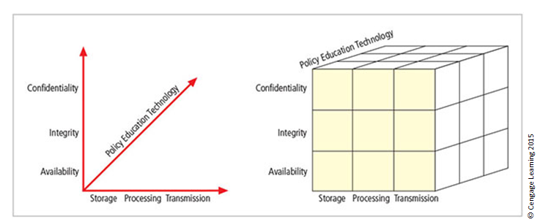
The McCumber Cube Security Model
Notes:
This graphic informs the fundamental approach of the chapter and can be used to illustrate the intersection of information states (x-axis), key objectives of C.I.A. (y-axis), and the three primary means to implement (policy, education, and technology).
The model, which was created by John McCumber in 1991, provides a graphical representation of the architectural approach widely used in computer and information security; it
is now known as the McCumber Cube.

Slide 17
Components of an Information System
Information system (IS) is the entire set of people, procedures, and technology that enable business to use information.
  Software
  Hardware
  Data
  People
  Procedures
  Networks
Notes:
Components of an Information System
Information system (IS) is entire set of people, procedures, and technology that enable business to use information.
Software
Hardware
Data
People
Procedures
Networks

Slide 18
Balancing Information Security and Access
Impossible to obtain perfect information security—it is a process, not a goal.
Security should be considered a balance between protection and availability.
To achieve balance, the level of security must allow reasonable access, yet protect against threats.
Notes:
Security and Access Balancing
When considering information security, it is important to realize that it is impossible to obtain perfect security. Security is not an absolute; it is a process not a goal.
Security should be considered a balance between protection and availability.
To achieve balance, the level of security must allow reasonable access yet protect against threats.

Slide 19
Approaches to Information Security Implementation: Bottom-Up Approach
Grassroots effort: Systems administrators attempt to improve security of their systems.
Key advantage: technical expertise of individual administrators
Seldom works, as it lacks a number of critical features:
  Participant support
  Organizational staying power
Notes:
Bottom-up Approach to Security Implementation
Security can begin as a grass-roots effort when systems administrators attempt to improve the security of their systems. This is referred to as the bottom-up approach.
The key advantage of the bottom-up approach is the technical expertise of the individual administrators.
Unfortunately, this approach seldom works, as it lacks a number of critical features, such as participant support and organizational staying power.

Slide 20
Approaches to Information Security Implementation: Top-Down Approach
Initiated by upper management
  Issue policy, procedures, and processes
  Dictate goals and expected outcomes of project
  Determine accountability for each required action
The most successful type of top-down approach also involves a formal development strategy referred to as systems development life cycle.
Notes:
Top-down Approach to Security Implementation
An alternative approach, which has a higher probability of success, is called the top-down approach. The project is initiated by upper management who issue policy, procedures, and processes; dictate the goals and expected outcomes of the project; and determine who is accountable for each of the required actions.
The top-down approach has strong upper-management support, a dedicated champion, dedicated funding, clear planning, and the opportunity to influence organizational culture.
The most successful top-down approach also involves a formal development strategy referred to as a systems development life cycle.

Slide 21
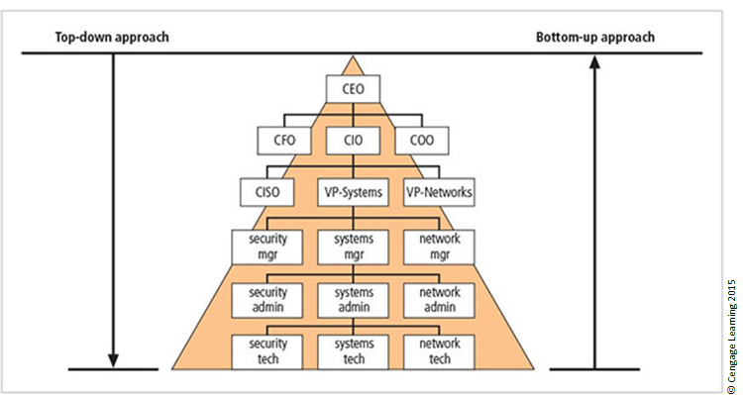
Approaches to information security implementation
Notes:
The key concept here is the direction of the left and right side arrows to show where planning is sourced and from which direction the pressure for success is driven.

Slide 22
Security in the Systems Development Life Cycle
Systems development life cycle (SDLC): a methodology for the design and implementation of an information system
Methodology: a formal approach to solving a problem based on a structured sequence of procedures
Using a methodology:
  Ensures a rigorous process with a clearly defined goal
  Increases probability of success
Notes:
The Systems Development Life Cycle
Systems Development Life Cycle (SDLC): methodology for design and implementation of an information system
Methodology: formal approach to solving a problem based on a structured sequence of procedures
Using a methodology:
Ensures a rigorous process with a clearly defined goal
Increases probability of success
Traditional SDLC consists of six general phases

Slide 23
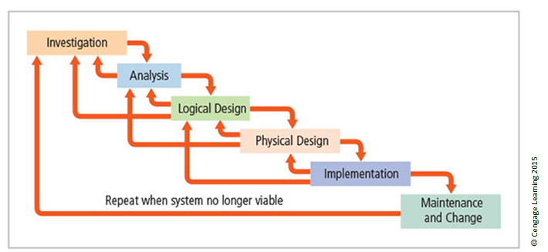
SDLC waterfall methodology
Notes:
Very much a traditional SDLC diagram.

Slide 24
Investigation
What problem is the system being developed to solve?
Objectives, constraints, and scope of project are specified.
Preliminary cost-benefit analysis is developed.
At the end of all phases, a process is undertaken to assess economic, technical, and behavioural feasibilities and ensure implementation is worth the time and effort.
Notes:
Investigation
What problem is the system being developed to solve?
Objectives, constraints, and scope of project are specified
Preliminary cost-benefit analysis is developed
At the end of all phases, a process is undertaken to assess economic, technical, and behavioral feasibilities and ensure implementation is worth time and effort

Slide 25
Analysis
Consists of assessments of:
  The organization
  Current systems
  Capability to support proposed systems
Analysts determine what the new system is expected to do and how it will interact with existing systems.
Analysis ends with documentation of findings and an update of feasibility.
Notes:
Analysis
The analysis phase begins with the information learned during the investigation phase.
This phase consists primarily of assessments of the organization, the status of current systems, and the capability to support the proposed systems.
Analysts begin to determine what the new system is expected to do and how it will interact with existing systems.
This phase ends with the documentation of the findings and a feasibility analysis update.

Slide 26
Logical Design
The first and driving factor is the business need.
  Applications are selected to provide needed services.
Data support and structures capable of providing the needed inputs are identified.
Specific technologies are delineated to implement the physical solution.
Analysts generate estimates of costs and benefits to allow comparison of available options.
Feasibility analysis is performed at the end.
Notes:
Logical Design
First and driving factor is business need
Applications are selected to provide needed services
Data support and structures capable of providing the needed inputs are identified
Specific technologies are delineated to implement the physical solution
Analysts generate estimates of costs and benefits to allow comparison of available options
Feasibility analysis performed at the end

Slide 27
Physical Design
Specific technologies are selected to support the alternatives identified and evaluated in the logical design.
Selected components are evaluated on make-or-buy decision.
Feasibility analysis is performed.
Entire solution is presented to organization’s management for approval.
Notes:
Physical Design
Specific technologies selected to support the alternatives identified and evaluated in the logical design
Selected components evaluated on make-or-buy decision
Feasibility analysis performed
Entire solution presented to organization’s management for approval

Slide 28
Implementation
Needed software is created.
Components are ordered, received, and tested.
Users are trained and supporting documentation created.
Feasibility analysis is prepared.
  Sponsors are presented with the system for a performance review and acceptance test.
Notes:
Implementation
Needed software created
Components ordered, received, and tested
Users trained and supporting documentation created
Feasibility analysis prepared
Sponsors presented with system for performance review and acceptance test

Slide 29
Maintenance and Change
Longest and most expensive phase
Consists of the tasks necessary to support and modify the system for the remainder of its useful life
Life cycle continues until the team determines the process should begin again from the investigation phase
When current system can no longer support the organization’s mission, a new project is implemented
Notes:
Maintenance and Change
The maintenance and change phase is the longest and most expensive phase of the process.
This phase consists of the tasks necessary to support and modify the system for the remainder of its useful life cycle.
Even though formal development may conclude during this phase, the life cycle of the project continues until it is determined that the process should begin again from the investigation phase. When the current system can no longer support the changed mission of the organization, the project is terminated and a new project is implemented.

Slide 30
The NIST Approach to Securing the SDLC
NIST Special Publication 800-64, rev. 2, maintains that early integration of security in the SDLC enables agencies to maximize return on investment through:
  Early identification and mitigation of security vulnerabilities and misconfigurations
  Awareness of potential engineering challenges
  Identification of shared security services and reuse of security strategies and tools
  Facilitation of informed executive decision making
Notes:
NIST: National Institute of Standards and Technology
The NIST Approach to Securing the SDLC
NIST Special Publication 800-64 rev. 2 maintains that early integration of security in the SDLC enables agencies to maximize return on investment through:
Early identification and mitigation of security vulnerabilities and misconfigurations
Awareness of potential engineering challenges
Identification of shared security services and reuse of security strategies and tools
Facilitation of informed executive decision making

Slide 31
Security Professionals and the Organization
Wide range of professionals are required to support a diverse information security program.
Senior management is the key component.
Additional administrative support and technical expertise are required to implement details of the IS program.
Notes:
Security Professionals and the Organization
It takes a wide range of professionals to support a diverse information security program.
To develop and execute specific security policies and procedures, additional administrative support and technical expertise is required.

Slide 32
Senior Management
Chief information officer (CIO)‏
  Senior technology officer
  Primarily responsible for advising the senior executives on strategic planning
Chief information security officer (CISO)‏
  Has primary responsibility for assessment, management, and implementation of IS in the organization
  Usually reports directly to the CIO
Notes:
Senior Management
Chief Information Officer – The senior technology officer, although other titles such as Vice President of Information, VP of Information Technology, and VP of Systems may be used. The CIO is primarily responsible for advising the Chief Executive Officer, President, or company owner on the strategic planning that affects the management of information in the organization.
Chief Information Security Officer – The individual primarily responsible for the assessment, management, and implementation of securing the information in the organization. The CISO may also be referred to as the Manager for Security, the Security Administrator, or a similar title.

Slide 33
Information Security Project Team
A small functional team of people who are experienced in one or multiple facets of required technical and nontechnical areas:
  Champion
  Team leader
  Security policy developers
  Risk assessment specialists
  Security professionals
  Systems administrators
  End users
Notes:
Security Project Team
A number of individuals who are experienced in one or multiple requirements of both the technical and nontechnical areas.
The champion: A senior executive who promotes the project and ensures its support, both financially and administratively, at the highest levels of the organization.
The team leader: A project manager, who may be a departmental line manager or staff unit manager, who understands project management, personnel management, and information security technical requirements.
Security policy developers: Individuals who understand the organizational culture, policies, and requirements for developing and implementing successful policies.
Risk assessment specialists: People who understand financial risk assessment techniques, the value of organizational assets, and the security methods to be used.
Security professionals: Dedicated, trained, and well-educated specialists in all aspects of information security from both technical and nontechnical standpoints.
Systems administrators: People with the primary responsibility for administering the systems that house the information used by the organization.
End users: Those whom the new system will most directly impact. Ideally, a selection of users from various departments, levels, and degrees of technical knowledge assist the team in focusing on the application of realistic controls applied in ways that do not disrupt the essential business activities they seek to safeguard.

Slide 34
Data Responsibilities
Data owners: senior management responsible for the security and use of a particular set of information
Data custodians: responsible for the information and systems that process, transmit, and store it
Data users: individuals with an information security role
Notes:
Data Responsibilities
Data owners: Members of senior management who are responsible for the security and use of a particular set of information. The data owners usually determine the level of data classification (discussed later), as well as the changes to that classification required by organizational change. The data owners work with subordinate managers to oversee the day-to-day administration of the data.
● Data custodians: Working directly with data owners, data custodians are responsible for the information and the systems that process, transmit, and store it. Depending on the size of the organization, this may be a dedicated position, such as the CISO, or it may be an additional responsibility of a systems administrator or other technology manager. The duties of a data custodian often include overseeing data storage and backups, implementing the specific procedures and policies laid out in the security policies and plans, and reporting to the data owner.
● Data users: Everyone in the organization is responsible for the security of data, so data users are included here as individuals with an information security role.

Slide 35
Communities of Interest
Group of individuals united by similar interests/values within an organization
  Information security management and professionals
  Information technology management and professionals
  Organizational management and professionals
Notes:
Communities of Interest
Each organization develops and maintains its own unique culture and values. Within that corporate culture, there are communities of interest. These include:
Information Security Management and Professionals
Information Technology Management and Professionals
Organizational Management and Professionals

Slide 36
Summary
Computer security began immediately after the first mainframes were developed.
Successful organizations have multiple layers of security in place: physical, personal, operations, communications, network, and information.
Security should be considered a balance between protection and availability.
Information security must be managed similar to any major system implemented in an organization using a methodology like the SDLC.
Implementation of information security is often described as a combination of art and science.

