Slide 2
Networks
Network and Cybersecurity
Essentials (ACCA4024)
Applied Computing - WISA

Slide 3
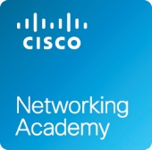
Network Types
Data Transmission
Bandwidth and Throughput
Clients and Servers
Network Components
Local Network Connections
Network Documentation
This week’s Tutorial and Independent learning
  https://www.netacad.com/courses/packet-tracer/introduction-packet-tracer
This session, you will understand the concept of network, its entities (data, devices), metrics (bandwidth, throughput), roles (server, client/host) and components.
You will also understand the importance of documenting the network.
Tutorial session: Sign up to Introduction to Packet Tracer Course, Download the latest packet tracer file, Install and complete a simple activity. Simultaneously, complete the 10 hours independent learning and get your certificate/ digital badge.

Slide 4
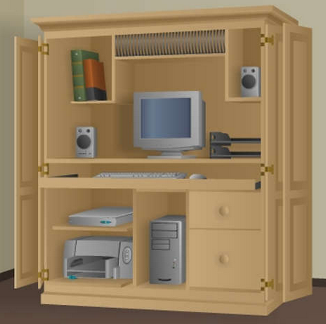
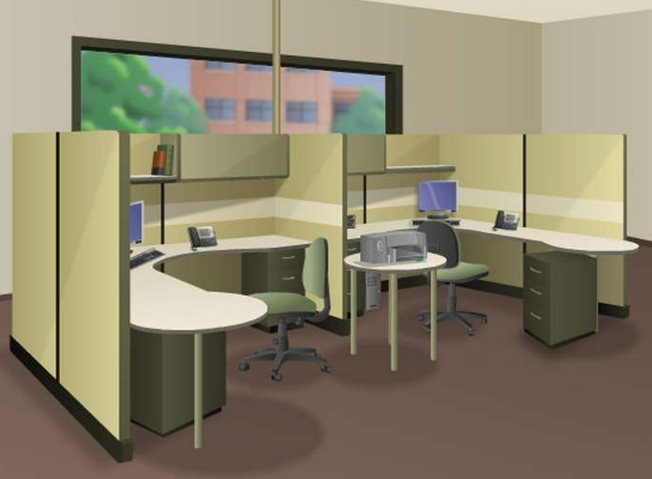
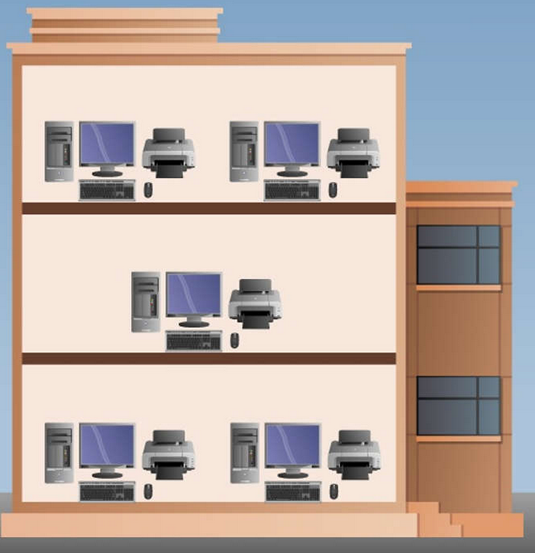
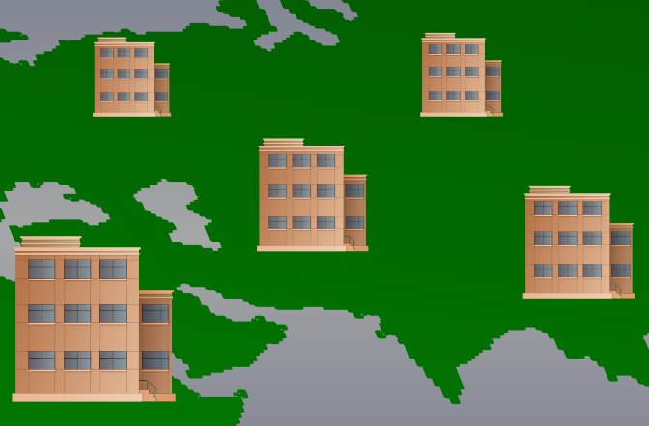
Network Types
Everything is Online – “Internet”
  The internet is a worldwide collection of interconnected networks, cooperating with each other to exchange information using common standards.
Local Networks
Small home networks connect a few computers to each other and to the internet.
The SOHO network allows computers in a home office or a remote office to connect to a corporate network, or access centralized, shared resources.
Medium to large networks, such as those used by corporations and schools, can have many locations with hundreds or thousands of interconnected hosts.
The internet is a network of networks that connects hundreds of millions of computers world-wide.

Slide 5
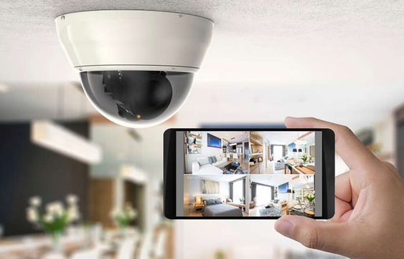
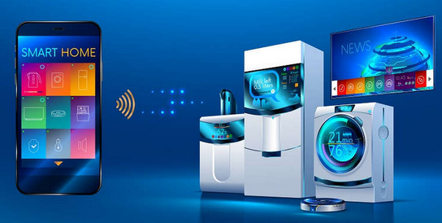
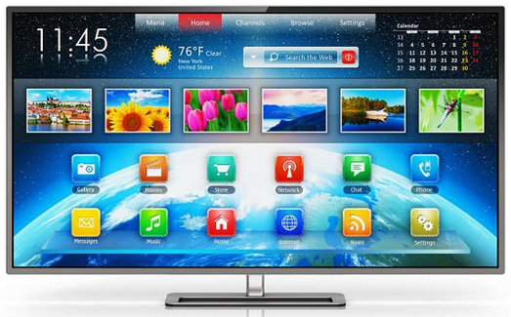
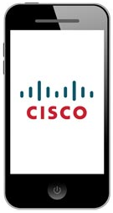
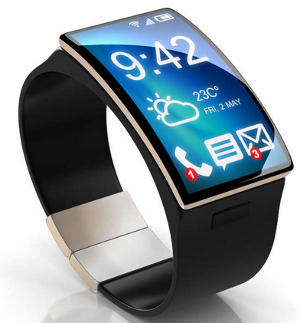
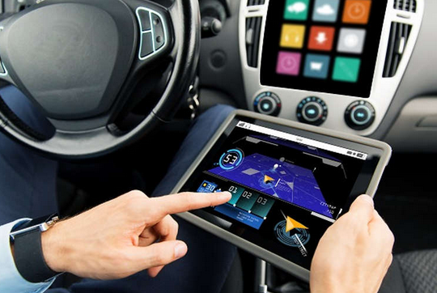
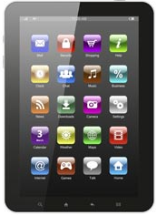
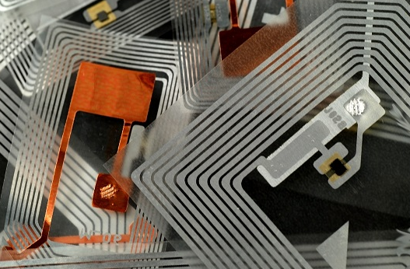
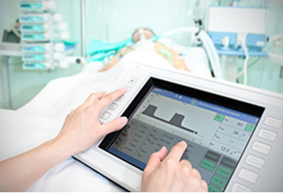
Networks and its Entities
With a connected security system, many items in a home, such as lighting and climate controls, can be monitored and configured remotely using a mobile device.
Mobile devices and Smart devices
Connected home devices
Household appliances such as refrigerators, ovens, and dishwashers can be connected to the internet.
Many modern cars, known as Smart Cars, can connect to the internet to access maps, audio and video content, or information about a destination.
Radio frequency identification (RFIDs) tags can be placed in or on objects to track them or monitor sensors for many conditions.
Smart phones combine the functions of many different products together, such as a telephone, camera, GPS receiver, media player, and touch screen computer.
Medical devices such as pacemakers, insulin pumps, and hospital monitors provide users or medical professionals with direct feedback or alerts when vital signs are at specific levels.

Slide 6
IP Terminology
Bit A bit is one digit, either a 1 or a 0.
Byte A byte is 8 bits,
IP Address Al logical address used to define a single host.
For example, 10.0.0.0, 172.16.0.0, and 192.168.10.0.
Dotted-decimal , as in 172.16.30.56
Binary, as in 10101100.00010000.00011110.00111000
Hexadecimal , as AC. 10. 1E. 38
Mac Address AA12:23bb:56bb

Slide 7
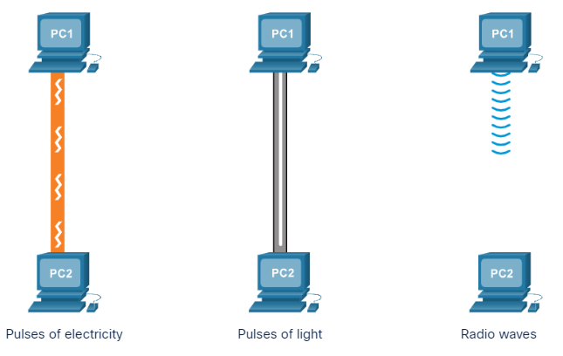
Data Transmission
Electrical signals - Transmission is achieved by representing data as electrical pulses on copper wire.
The data you look/talk about, is different from how a computer looks/works with.
Computers and networks only work with binary digits, zeros and ones?
Each bit can only have one of two possible values, 0 or 1.
The term bit is an abbreviation of “binary digit” and represents the smallest piece of data.
Humans interpret words and pictures, computers interpret only patterns of bits.
Each group of eight bits, such as the representations of letters and numbers, is known as a byte.
Optical signals - Transmission is achieved by converting the electrical signals into light pulses.
Wireless signals - Transmission is achieved by using infrared, microwave, or radio waves through the air.
Notes:
Using the American Standard Code for Information Interchange (ASCII), each character is represented by eight bits. For example:
Capital letter: A = 01000001
Number: 9 = 00111001
Special character: # = 00100011

Slide 8
Bandwidth and Throughput
Bandwidth (Like No. of Lanes in a Highway) and Throughput (No. of Vehicles, Type of commuters, Traffic Congestions etc)
Bandwidth is the capacity of a medium to carry data. Digital bandwidth measures the amount of data that can flow from one place to another in a given amount of time. Bandwidth is typically measured in the number of bits that (theoretically) can be sent across the media in a second.
Like bandwidth, throughput is the measure of the transfer of bits across the media over a given period of time.
However, due to a number of factors, throughput does not usually match the specified bandwidth. Many factors influence throughput including:
The amount of data being sent and received over the connection
The types of data being transmitted
The latency created by the number of network devices encountered between source and destination
Latency refers to the amount of time, including delays, for data to travel from one given point to another.
Unit of Bandwidth | Abbreviation | Equivalence
Bits per second | bps | 1 bps = fundamental unit of bandwidth
Kilobyte: Thousands of bits per second | kbps | 1 kbps = 1,000 bps = 10³ bps
Megabyte: Millions of bits per second | Mbps | 1 Mbps = 1,000,000 bps = 10⁶ bps
Gigabyte: Billions of bits per second | Gbps | 1 Gbps = 1,000,000,000 bps = 10⁹ bps
Terabyte: Trillions of bits per second | Tbps | 1 Tbps = 1,000,000,000,000 bps = 10¹² bps

Slide 9
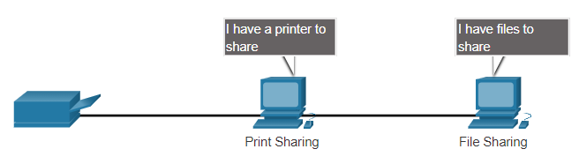
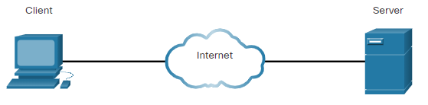
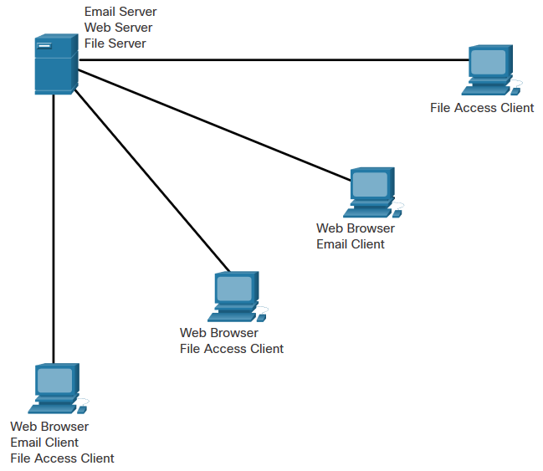
Client/Server
In small businesses and homes, many computers function as the servers and clients on the network. This type of network is called a peer-to-peer (P2P) network.
The simplest P2P network consists of two directly connected computers using either a wired or wireless connection.
Clients are computer hosts that have software installed that enables the hosts to request and display the information obtained from the server.
Servers are hosts that have software installed which enable them to provide information, like email or web pages, to other hosts on the network.
Disadvantages of P2P:
No central administration
Not as secure as other networks
Not scalable
All devices may act as both clients and server which can slow their performance
Advantages of P2P:
Easy to set up
Less complex than other networks
Lower cost
Can be used for simple tasks such as transferring files and sharing printers

Slide 10
LAN
Hosts - Hosts send and receive user traffic. A host is a generic name for most end-user devices. A host has an IP address. Examples of hosts are personal computers and network attached printers.
Peripherals - Shared peripheral devices do not communicate directly on the network. Instead, peripherals rely on their connected host to perform all network operations. Examples of shared peripherals are cameras, scanners, and locally attached printers.
Network devices - Networking devices connect other devices, mainly hosts. These devices move and control network traffic. Examples of network devices include hubs, switches, and routers.
Network media - Network media provides connections between hosts and network devices. Network media can be wired, such as copper and fiber optic, or use wireless technologies.
There are many components that can be part of a local area network (LAN).
Some examples of network components are personal computers, servers, networking devices, and cabling.
These components can be grouped into four main categories:

Slide 11
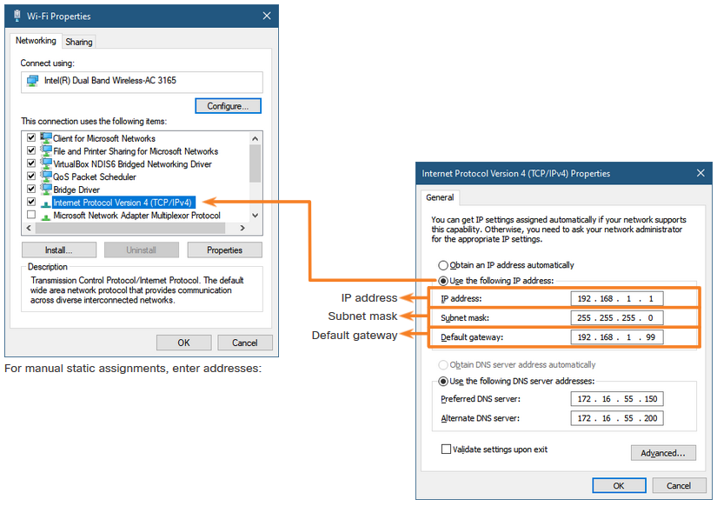
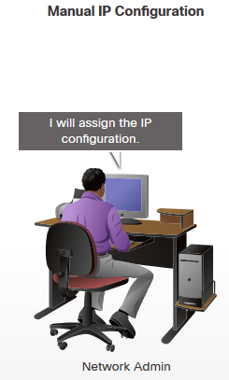
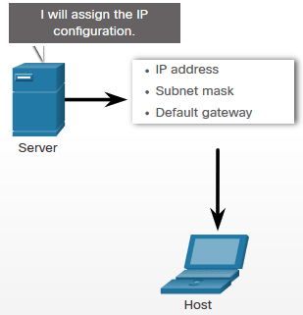
LAN
The IP address that is entered is referred to as a static address and must be unique on the network.
To physically connect to a network, an end-user device must have a network interface card (NIC) and some configuration of the operating system so that the device can participate in the network.
There are three parts to the IP configuration which must be correct for the device to send and receive information on the network:
IP address - This identifies the host on the network.
Subnet mask - This is used to identify the network on which the host is connected.
Default gateway - This identifies the networking device that the host uses to access the internet or another remote network.

Slide 12
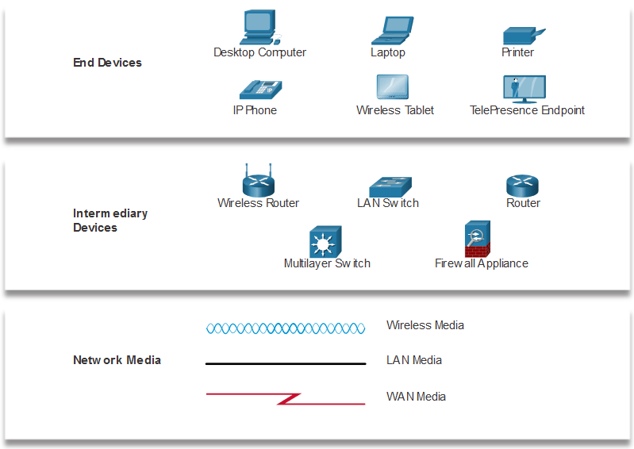
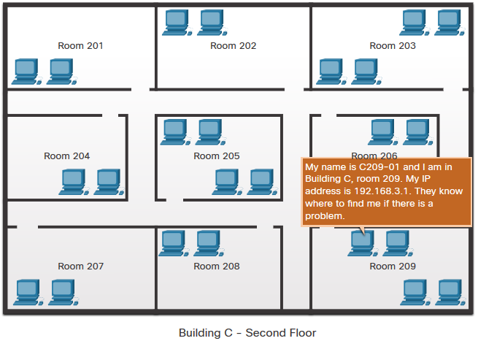
Documentation
The use of logical device naming and addressing conventions that are well documented can greatly simplify the task of training and network management and can help as well with troubleshooting when problems arise.
The physical topology shows where the wiring is installed and the locations of the networking devices that connect the hosts. These diagrams use symbols or icons to represent the different devices and connections that make up a network.

Slide 13
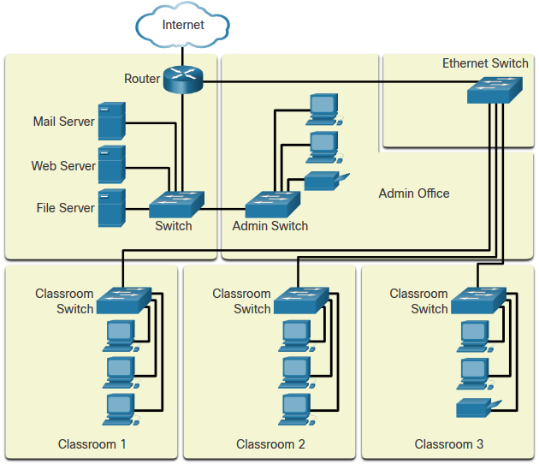
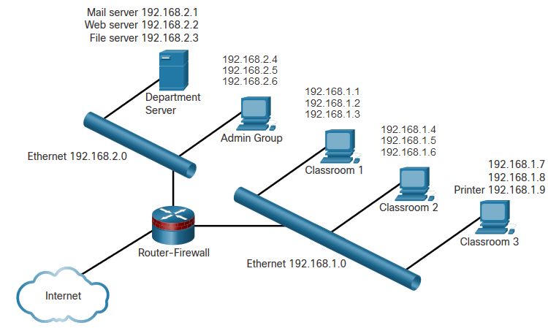
Documentation
A physical topology shows how network devices connect.
A diagram called a logical topology illustrates the relevant network configuration information.
Logical Topology
Physical Topology

Slide 14
Other connected devices include smart cars, RFIDs, sensors/actuators, and medical devices.
Types of personal data are categorized as volunteered, observed, and inferred.
Each bit can only have one of two possible values, 0 or 1. Each group of eight bits is known as a byte.
There are three common methods of signal transmission used in networks: electrical signals, optical signals, and wireless signals.
Bandwidth is typically measured in the number of bits that (theoretically) can be sent across the media in a second.
Many factors influence throughput including: the amount of data being sent and received over the connection, the types of data being transmitted, and the latency created by the number of network devices encountered between source and destination. You can measure your throughput by going to speedtest.net.
Summary
The internet is a worldwide collection of interconnected networks cooperating with each other to exchange information using common standards.
Some types of networks that you may use are small home, SOHO, medium to large networks such as those created by corporations and schools, and the internet.
Mobile devices include smart phones, tablets, smart watches, and smart glasses.
Connected home devices include security systems, smart appliances and TVs, and gaming consoles.

