Slide 1
Shazea Perween
Student Number: 2325347
Module: LCHS4009 - Professional Development within Health and Social Care
Lecturer: Hajra Mustasim
Assignment Title: Self-Awareness Presentation
October 2026

Slide 2


Introduction
My Career Goal
Residential Support Worker
Working with children & young people
My Experience
Foster carer
Mother
Supporting children needs and wellbeing
My Skills
Communication & empathy
Safeguarding & teamwork
My Presentation
Personal SWOT analysis
Career development & future goals

Slide 3

My Chosen Career
Residential Support Worker for children and young people
A Residential Support Worker supports children and young people people in residential care by:
Providing emotional and practical support
Building positive relationships
Promoting independence
Supporting education and development
Maintaining care records
Safeguarding children and young people
Working with families and professionals
Supporting children with their individual needs
The National Careers Service identifies patience, compassion, active listening, communication, teamwork and the ability to remain calm under pressure as important skills for this career (National Careers Service, 2026).

Slide 4


Current Job Advert
Children’s Support Worker – Liverpool
Employer: Keys
Location: Liverpool, L13
Salary: £27,276–£28,696 per year
Hours: 39 hours per week
Posted: 1 October 2026
Job type: Full-time
The advert states:
No experience needed
Full induction and introductory programme
Supporting children with complex needs
Supporting emotional and behavioural development
Building positive relationships
Helping young people achieve positive outcomes
Sleep-in shifts
Full UK driving licence required
(Keys Group, 2026).

Slide 5
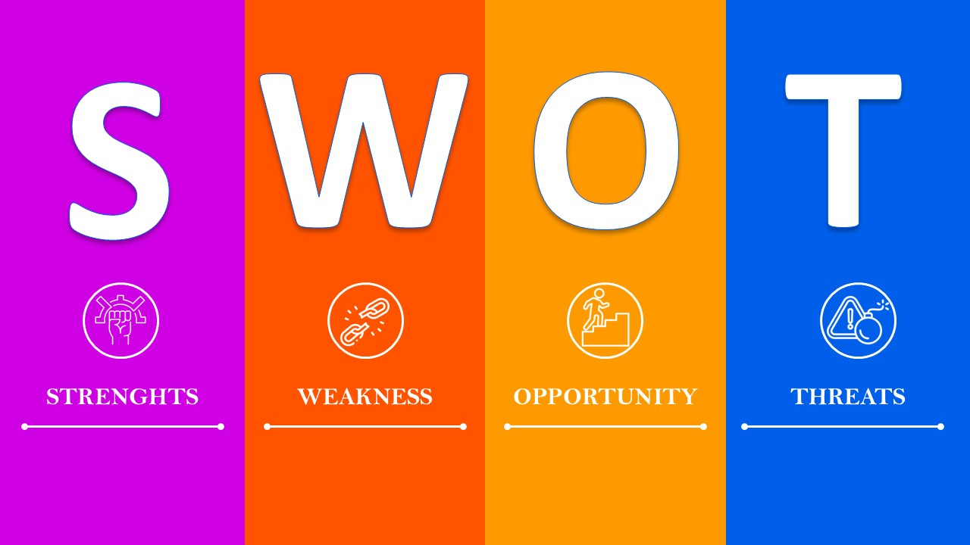
My Strengths
Communication
Communicating with children and professionals and tailoring my communication depending on audience type i.e., calm and age-appropriate or professional and clear.
Patience
Understanding that every child has different needs and complexities.
Empathy and compassion
Listening and responding to children’s feelings. Ensuring that they feel heard and understood.
Safeguarding awareness
Understanding the importance of keeping children safe and protected.
Teamwork
Working with social workers and other professionals effectively.
Resilience
Remaining calm when situations are challenging which is not only important for oneself but also for the young person.
(GOV.UK, 2026a).

Slide 6

My Weaknesses
Areas I Need to Develop
Limited experience working inside a residential setting
Need to develop further professional documentation skills
Need more experience with formal care plans and risk assessments
Continue developing knowledge of behaviour management
Need to build further professional confidence

Slide 7

Opportunities
Education
Continue my Health & Social Care studies which will provide me with the relevant theoretical knowledge
Training through physical experience or online training i.e., interactive modules
Safeguarding
Child Protection
First aid
Mental health
Behaviour management
Work experience
Residential childcare
Volunteering
Shadowing experienced staff
Career progression
Senior Support Worker
Residential Support Manager
Further study towards social work or another care profession
The National Careers Service states that people can enter residential support work through college courses, apprenticeships, working towards the role or direct application. It also specifically states that experience in fostering could be helpful (National Careers Service, 2026).

Slide 8

Threats
Potential Threats
Emotional demands of the job
Challenging behaviour
Working under pressure
Shift work, evenings and weekends
Lack of residential experience
Maintaining professional boundaries
Safeguarding responsibilities
How I can manage them
Training + supervision + teamwork + resilience
(National Careers Service, 2026).

Slide 9

How My Strengths Can Help
Using My Strengths To Overcome Challenges
My Strength | How It Can Help
Communication | Build trust with young people
Patience | Manage challenging situations calmly
Empathy | Understand individual needs
Safeguarding awareness | Help protect vulnerable children
Teamwork | Work effectively with professionals
Resilience | Cope with emotionally difficult situations

Slide 10

Conclusion
My Career Plan
Foster Carer Experience
⬇️
Health & Social Care Education
⬇️
Relevant Training & Experience
⬇️
Residential Support Worker
⬇️
Future Career Progression

Slide 11
References
GOV.UK (2026a) Becoming a foster carer in England. Available at: https://www.gov.uk/becoming-foster-carer⁠ (Accessed: 1 October 2026).
GOV.UK (2026b) Help and support for foster carers in England: Training and development. Available at: https://www.gov.uk/support-for-foster-carers⁠ (Accessed: 1 October 2026).
Keys Group (2026) Children’s Support Worker – Liverpool. Available at: https://jobs.keys-group.co.uk/jobs/job/Childrens-Support-Worker-Liverpool/9291⁠ (Accessed: 1 October 2026).
National Careers Service (2026) Residential support worker. Available at: https://nationalcareers.service.gov.uk/job-profiles/residential-support-worker⁠ (Accessed: 1 October 2026).

Slide 12

For Listening
I hope you enjoyed my presentation

