Slide 1
Certificate of Higher Education – Skills for the Workplace
Health and Social Care
Academic and Employability Skills
(LCHS4001)
Session 7:
Organising ideas
(essay planning)
Deeper reading

Slide 2
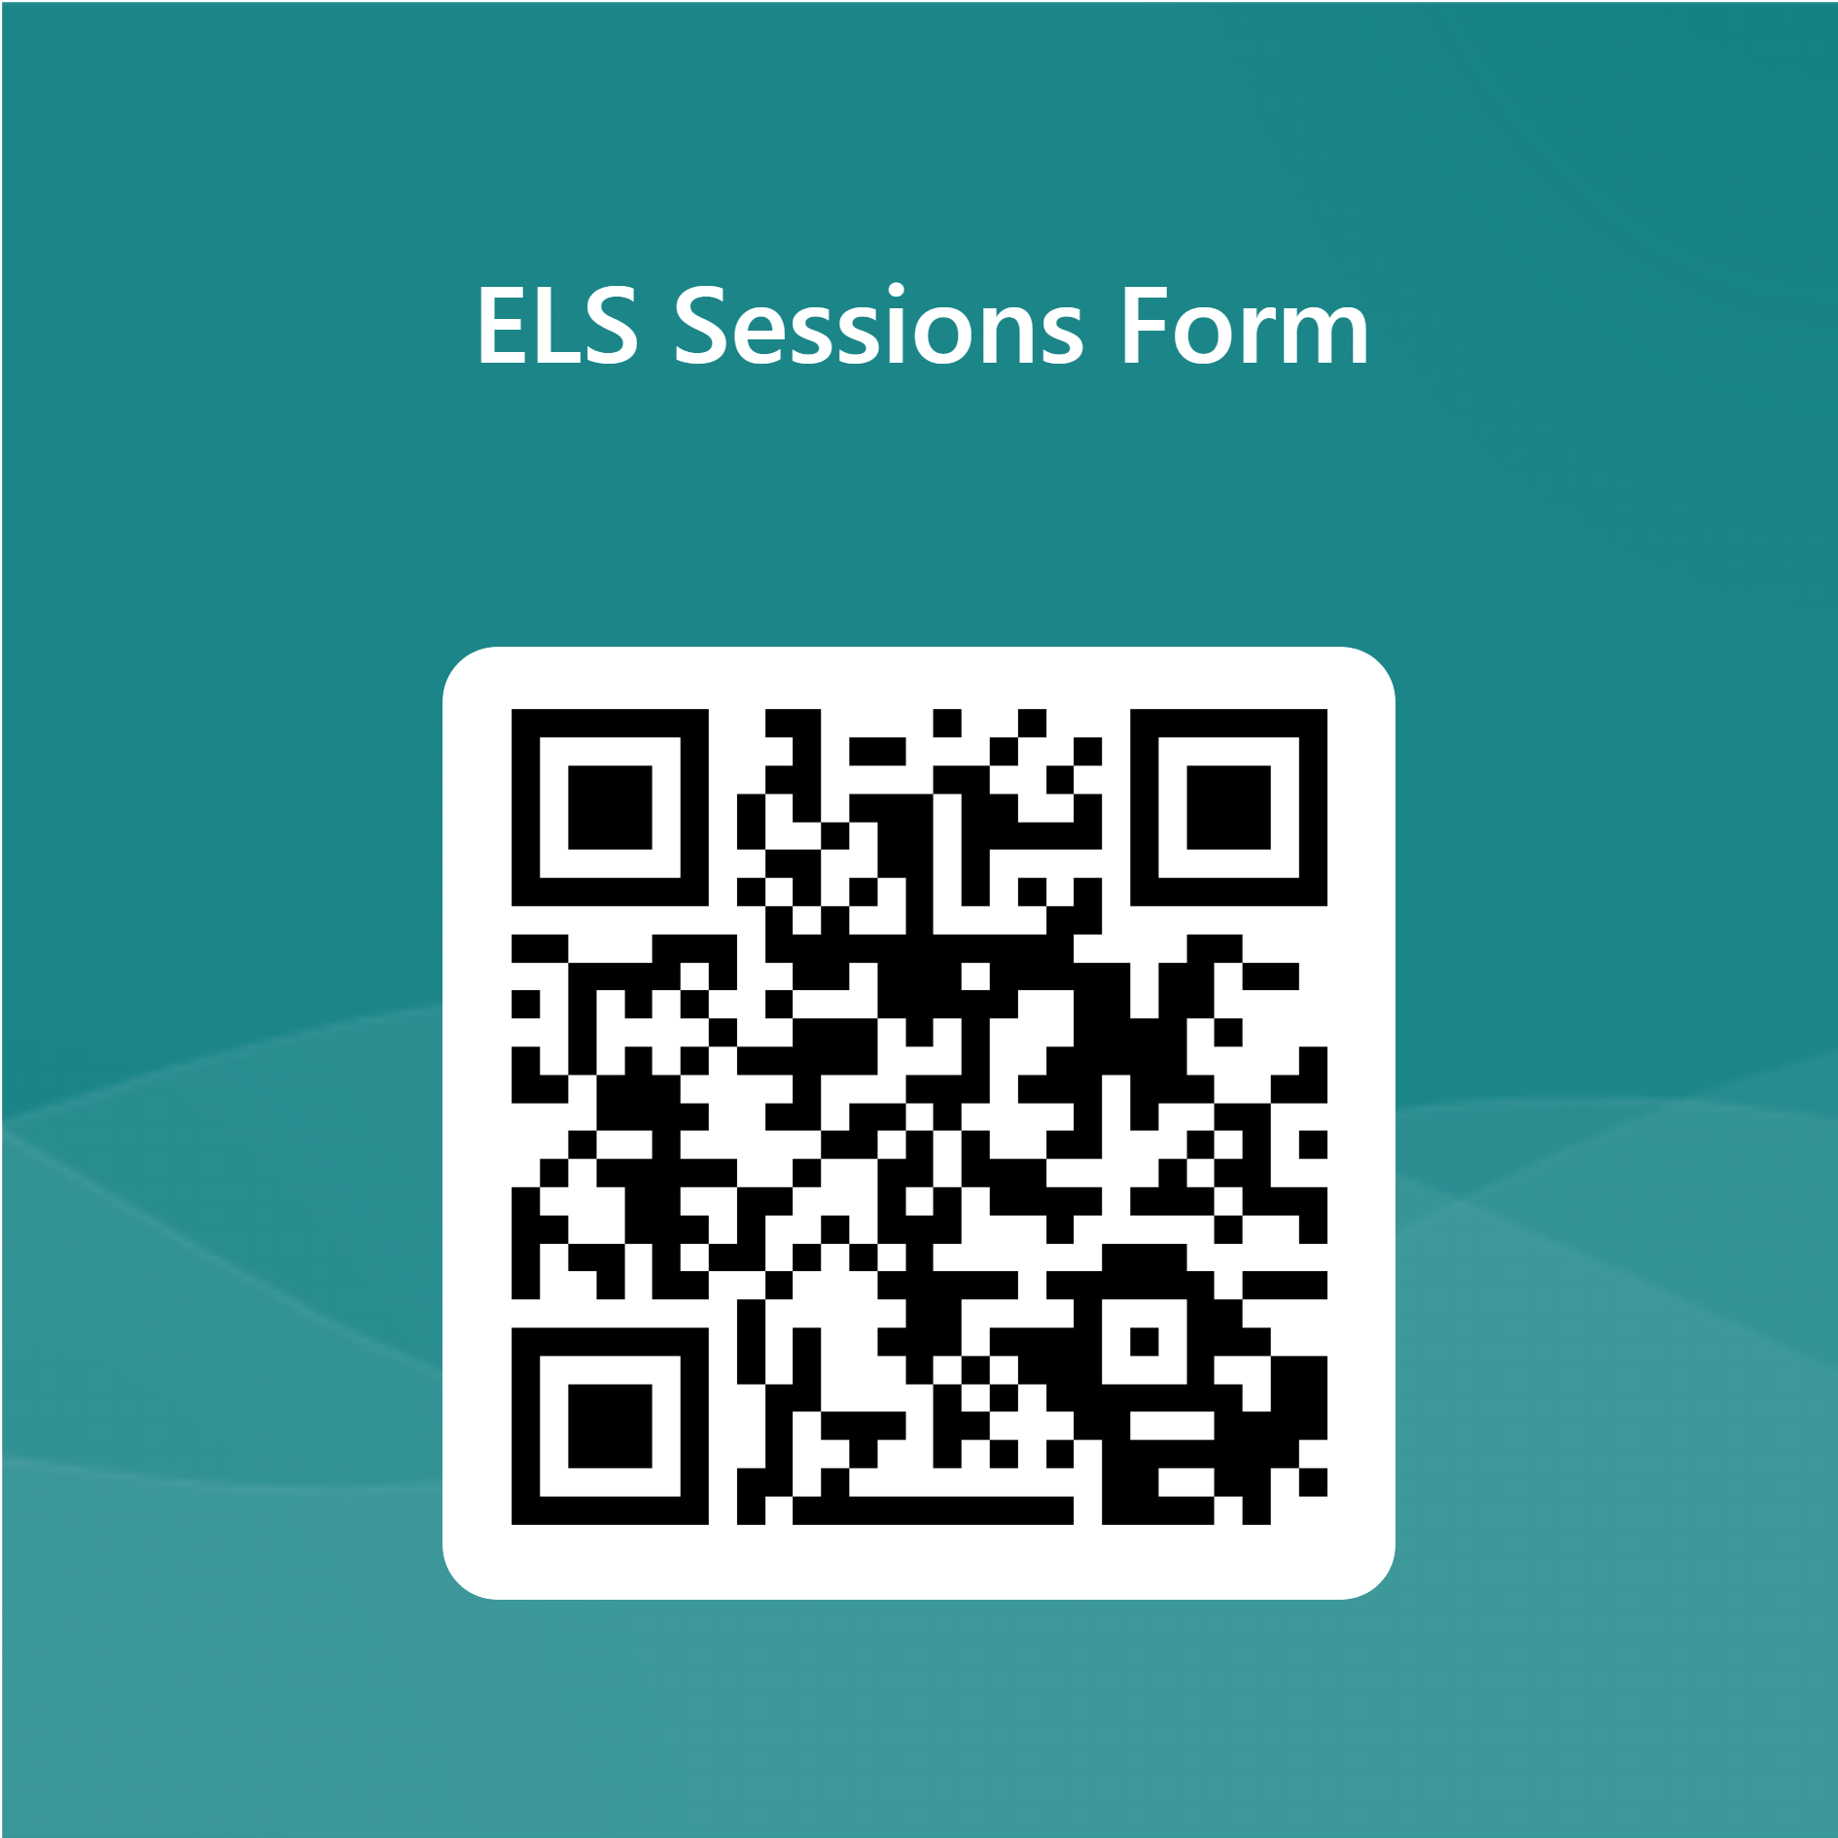
Notices: English Language Support (Quay Place - weekdays)

Slide 3
Notices: Library/Digital Skills Support
Academic Liaison Librarian Support
Book a one-to-one session with one of our Academic Liaison Librarians to develop your research, reading and referencing skills.
Click here to book or email birminghamlibrary@uwtsd.ac.uk
Digital Skills Support
Book a one-to-one session with one of our Digital Skills Advisors to develop your IT skills Click here to book (Or ask for Taran!)

Slide 4

In this session we will…
Learn how to organise ideas (essay planning using sources)
Review reading strategies and do some deeper reading for Task 2
Learn how to reference an edited book
Notes:
4

Slide 5
Organising ideas
(essay planning
using sources)

Slide 6
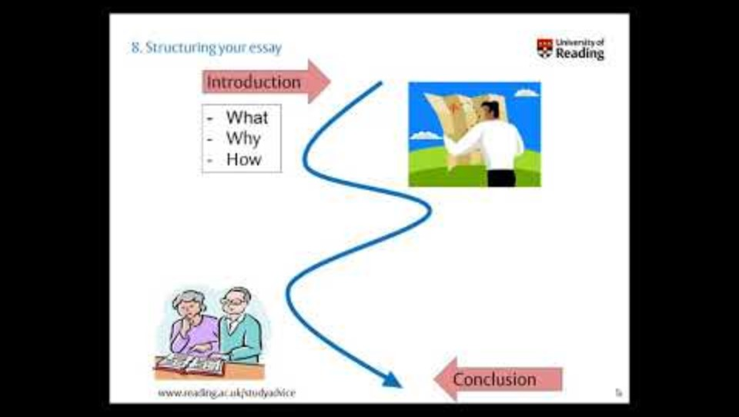
Essay planning
Notes:
https://www.youtube.com/watch?v=woX753eSImU
Lecturers – please break it up into chunks

Slide 7
Essay planning templates
Have a look at the two essay planning templates on Moodle.
What is the main information that should be included when planning?

Slide 8
Critique the sample essay
Read the sample essay on Moodle (the version with problems)
Work in pairs - what problems can you see?

Slide 9
Review of sample essay
As a group, collate key points of feedback about the sample essay.
An acceptable version of the essay
is available for you to look at
Notes:
Lecturers: please circulate the acceptable version to your group when appropriate (it won’t be unhidden on Moodle until the end of Week 6 otherwise later classes will have problems)

Slide 10
BREAK

Slide 11
Reading

Slide 12
Reading strategies revision
What questions can we ask ourselves
before reading?
What three strategies
beginning with ‘S’
can we remember from Session 1?

Slide 13
Questions before reading
Why am I reading this!? Is this article relevant to me/my studies?
What do I already know?
How is this article related to what I already know about the topic/concept?
What do I need to find out?
How will I know when I have read enough?

Slide 14
Strategies beginning with ‘S’
Surveying
Use the contents page/abstract, headings and subheadings, introduction, conclusion and index
Skimming – for the main messages
  Try reading the first and last sentences of each paragraph
Scanning
  Look for key words or phrases

Slide 15
Deeper reading
What are the important points in relation to my essay?
What evidence has the author used?
What questions do I have?
What do I not understand – can I reread a section to make more sense of it?
What do I need to look up?
We will also learn more about critical thinking in Session 9.

Slide 16
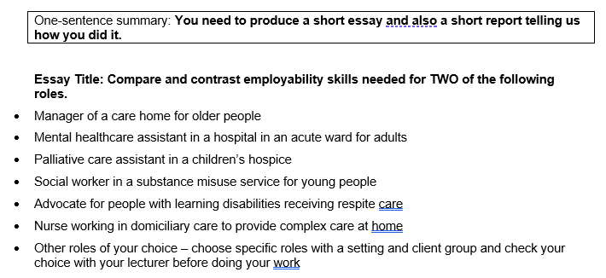
Reading for Task 2 reminder of main question

Slide 17
Reading for Task 2
Choose a source that you would like to read for Task 2
(if you don’t have one, do a search or choose a book from the module reading list e.g. Skills for success: personal development and employability (Cottrell, 2021))
Survey and skim the source - check whether you still think it would be useful to read part of it in depth
Choose a section to read in depth, using the prompts on the “deeper reading” slide. Use an active notetaking method to help you (e.g. Cornell notes or a mind map).

Slide 18
Referencing an
edited book

Slide 19
Edited books
See the activity on Moodle
(which contains information
and examples)

Slide 20
Reflective Journal Entry

Slide 21
Reflective journal entry
Write this week’s entry in your reflective journal. You could consider:
What did I learn from looking at the sample essay, which I could apply to my own writing?
What can I do to deepen my own reading?

Slide 22

Summary
What should flow through an essay?
What should an essay plan include for each paragraph?

Slide 23
References
University of Reading (no date) Essay Writing. Available at: https://www.youtube.com/watch?v=woX753eSImU (Accessed: 14 February 2024).

Slide 24

Next session…..
We will look at:
Introductions and conclusions
AND
Paraphrasing tips

