Slide 1
Fatigue
Based on Chapter 5, Kenney, Wilmore and Costill (2015)

Slide 2
Fatigue and Its Causes
Fatigue: two definitions
  Decrements in muscular performance with continued effort, accompanied by sensations of tiredness
  Inability to maintain required power output to continue muscular work at given intensity
Reversible by rest
(continued)

Slide 3
Fatigue and Its Causes (continued)
Complex phenomenon
  Type, intensity of exercise
  Muscle fiber type
  Training status, diet
Four major causes (synergistic?)
  Inadequate energy delivery/metabolism
  Accumulation of metabolic by-products
  Failure of muscle contractile mechanism
  Altered neural control of muscle contraction

Slide 4
Fatigue and Its Causes:
Energy Systems—PCr Depletion
PCr depletion coincides with fatigue
  PCr used for short-term, high-intensity effort
  PCr depletes more quickly than total ATP
P_{i} accumulation may be potential cause
Pacing helps defer PCr depletion

Slide 5
Fatigue and Its Causes: Energy Systems—Glycogen Depletion
Glycogen reserves limited and deplete quickly
Depletion correlated with fatigue
  Related to total glycogen depletion
  Unrelated to rate of glycogen depletion
Depletes more quickly with high intensity
Depletes more quickly during first few minutes of exercise versus later stages
(continued)

Slide 6
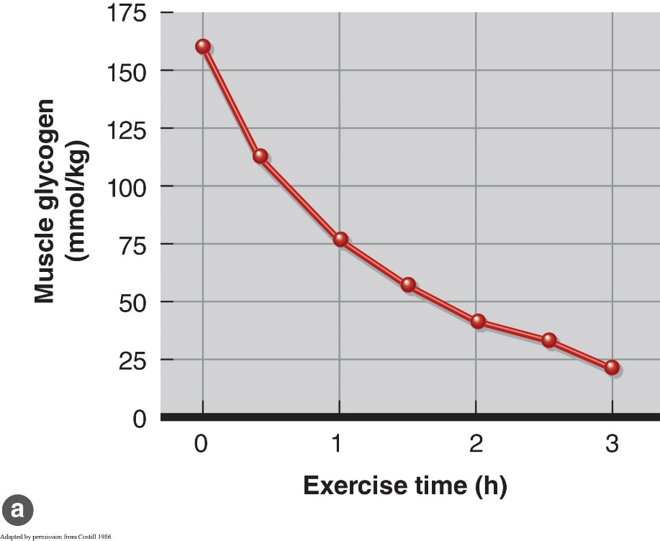
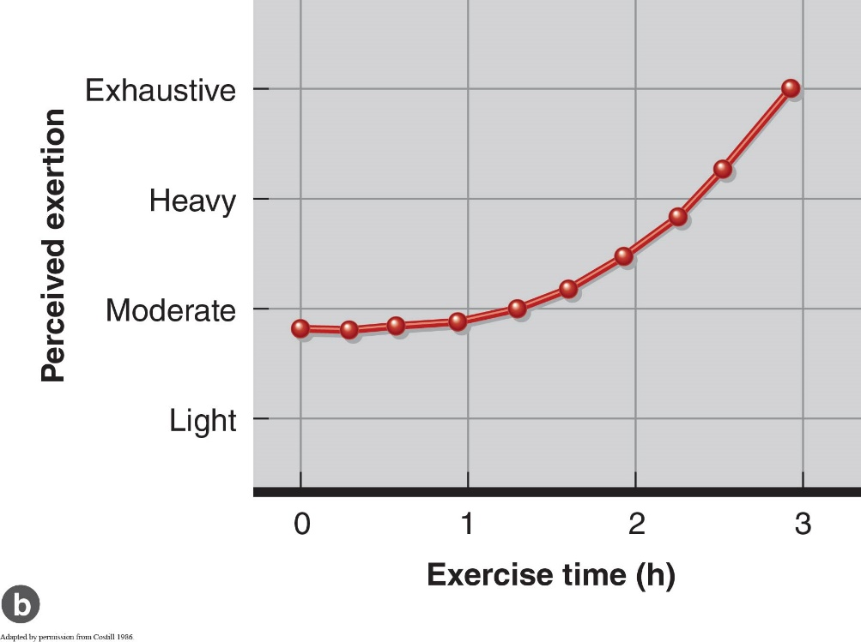

Slide 7
Fatigue and Its Causes: Energy Systems—Glycogen Depletion (continued)
Fiber type and recruitment patterns
  Fibers recruited first or most frequently deplete fastest
  Type I fibers depleted after moderate endurance exercise
Recruitment depends on exercise intensity
  Type I fibers recruit first (light/moderate intensity)
  Type IIa fibers recruit next (moderate/high intensity)
  Type IIx fibers recruit last (maximal intensity)
  (continued)

Slide 8
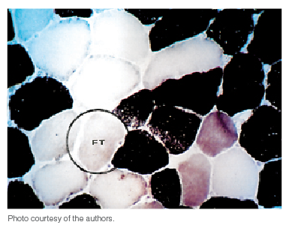
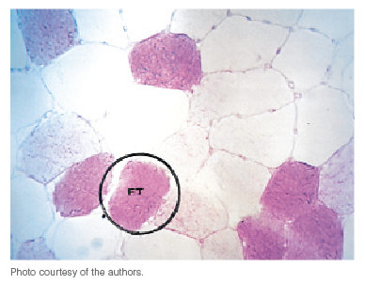
Fibre type staining – white fibres = Fast Twitch, Dark Fibres = Slow twitch
Glycogen staining after 30km run – slow twitch are depleted, fast twitch still contain glycogen

Slide 9
Fatigue and Its Causes: Energy Systems—Glycogen Depletion (continued)
Depletion in different muscle groups
  Activity-specific muscles deplete fastest
  Recruited earliest and longest for given task
Depletion and blood glucose
  Muscle glycogen insufficient for prolonged exercise
  Liver glycogen → glucose into blood
  As muscle glycogen ↓, liver glycogenolysis ↑
  Muscle glycogen depletion + hypoglycemia = fatigue
  (continued)

Slide 10
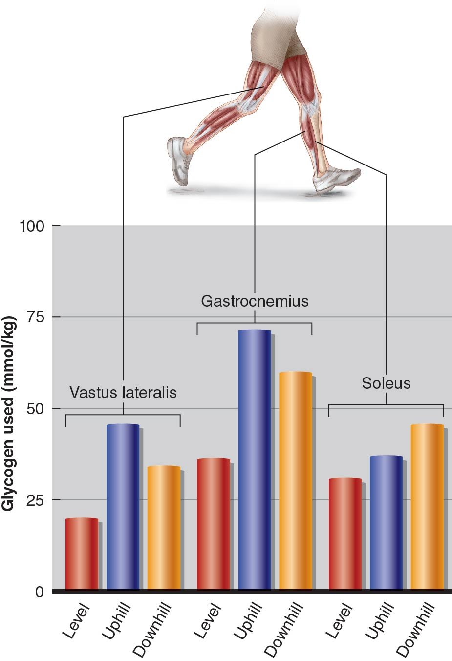
Figure 5.10

Slide 11
Fatigue and Its Causes: Energy Systems—Glycogen Depletion (continued)
Certain rate of muscle glycogenolysis required to maintain
  NADH production in Krebs cycle
  Electron transport chain activity
  No glycogen = inhibited substrate oxidation
With glycogen depletion, FFA metabolism ↑
  But FFA oxidation too slow, may be unable to supply sufficient ATP for given intensity

Slide 12
Fatigue and Its Causes:
Metabolic By-Products
P_{i}: From rapid breakdown of PCr, ATP
Heat: Retained by body, core temperature ↑
Lactic acid: Product of anaerobic glycolysis
H⁺ Lactic acid → lactate + H⁺
(continued)

Slide 13
Fatigue and Its Causes:
Metabolic By-Products (continued)
Heat alters metabolic rate
  – ↑ Rate of carbohydrate utilization
  Hastens glycogen depletion
  High muscle temperature may impair muscle function
Time to fatigue changes with ambient temperature
  11 °C: time to exhaustion longest
  31 °C: time to exhaustion shortest
  Muscle precooling prolongs exercise
  (continued)

Slide 14
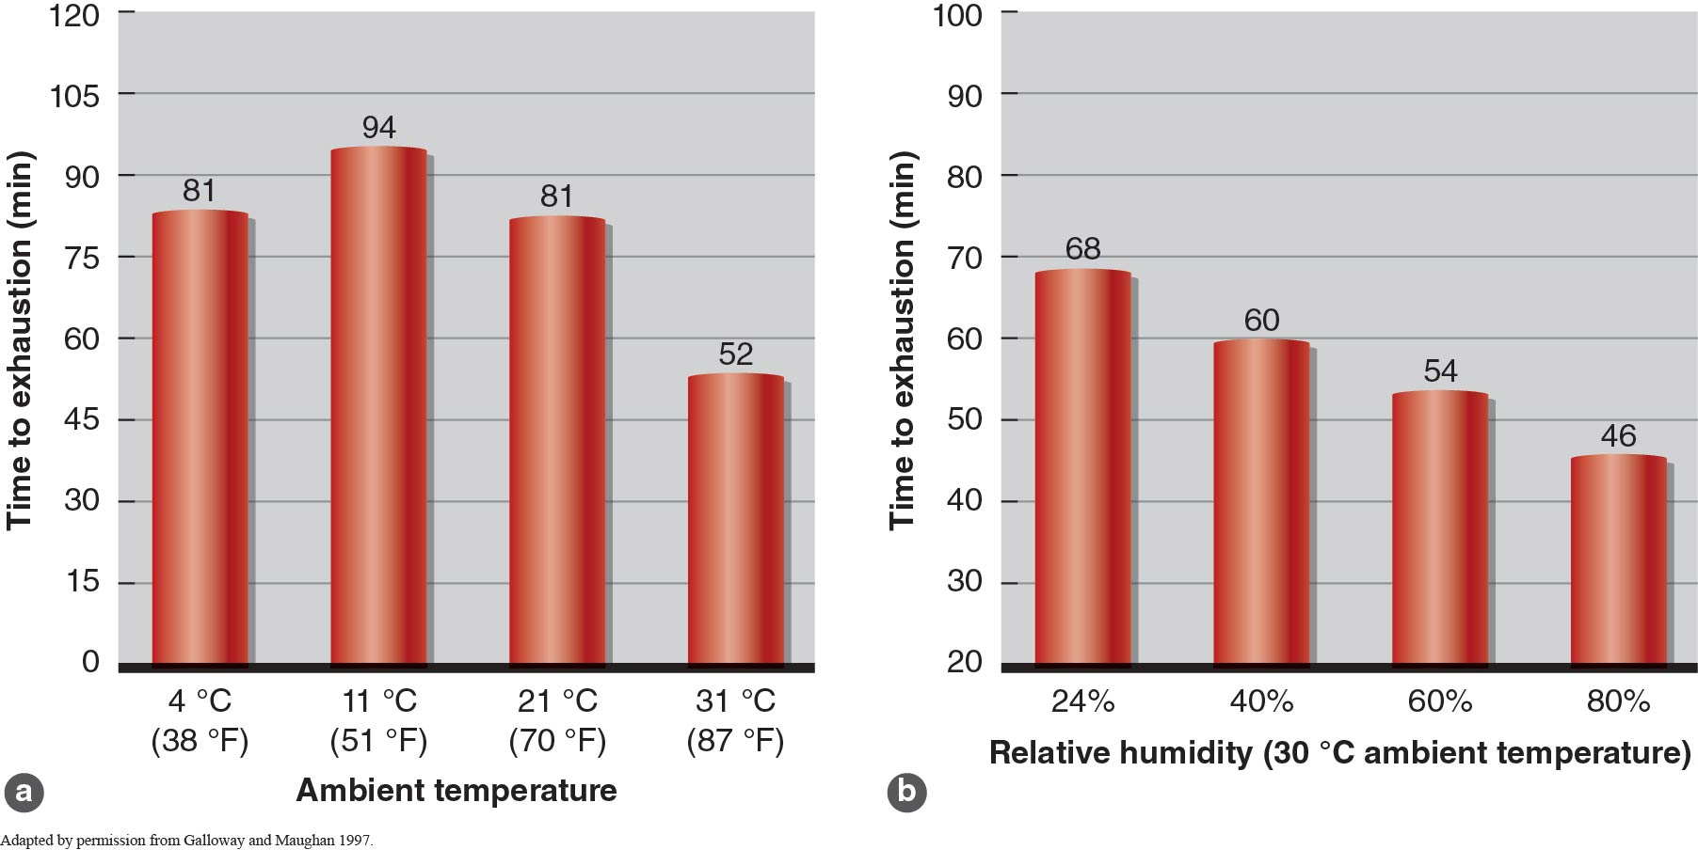
Figure 5.11

Slide 15
Fatigue and Its Causes:
Metabolic By-Products (continued)
Lactic acid accumulates during brief, high-intensity exercise
  If not cleared immediately, converts to lactate + H⁺
  H⁺ accumulation causes ↓ muscle pH (acidosis)
Buffers help muscle pH but not enough
  Buffers minimize drop in pH (7.1 to 6.5, not to 1.5)
  Cells therefore survive but don’t function well
  pH <6.9 inhibits glycolytic enzymes, ATP synthesis
  pH = 6.4 prevents further glycogen breakdown

Slide 16
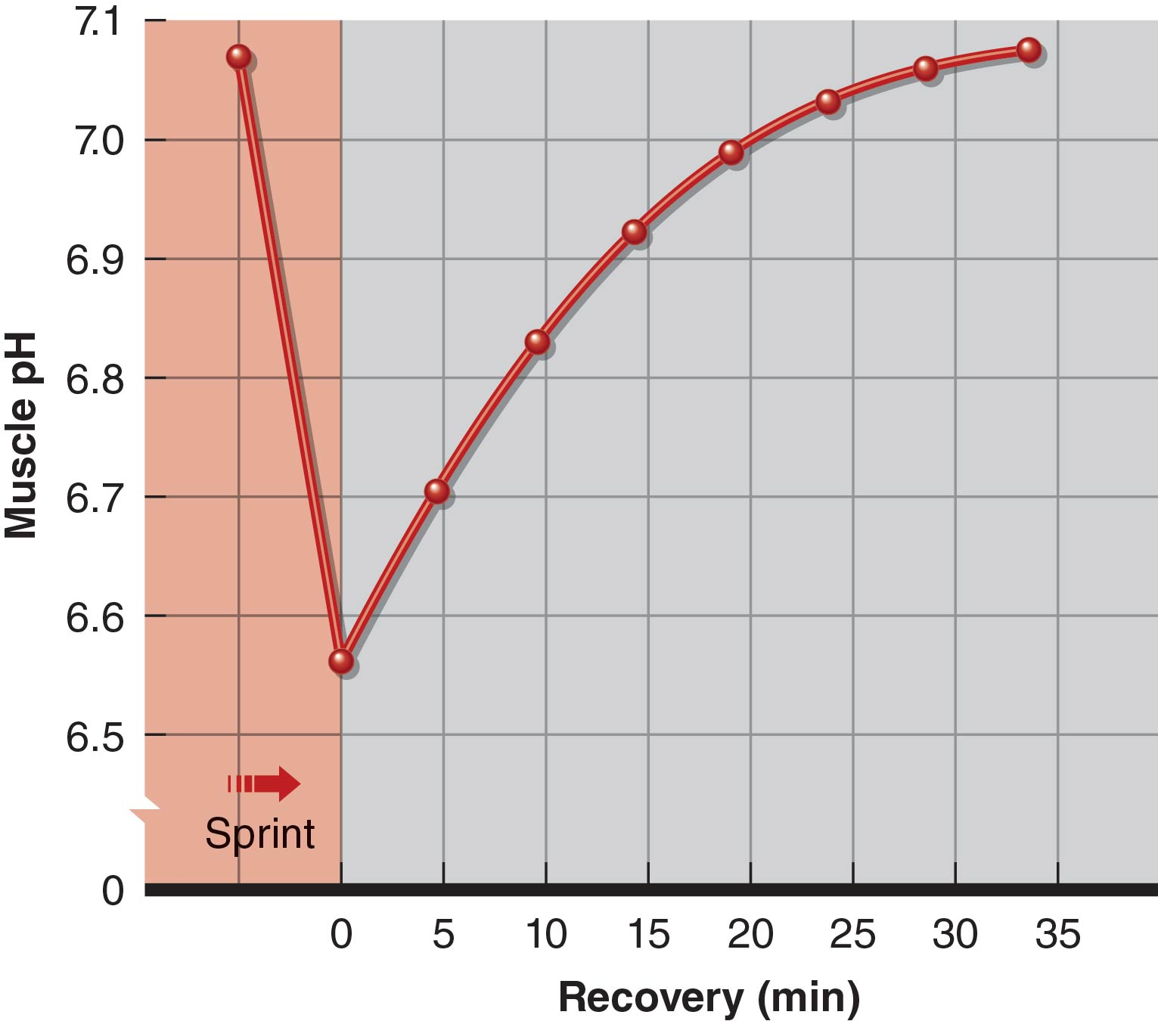
Figure 5.12

Slide 17
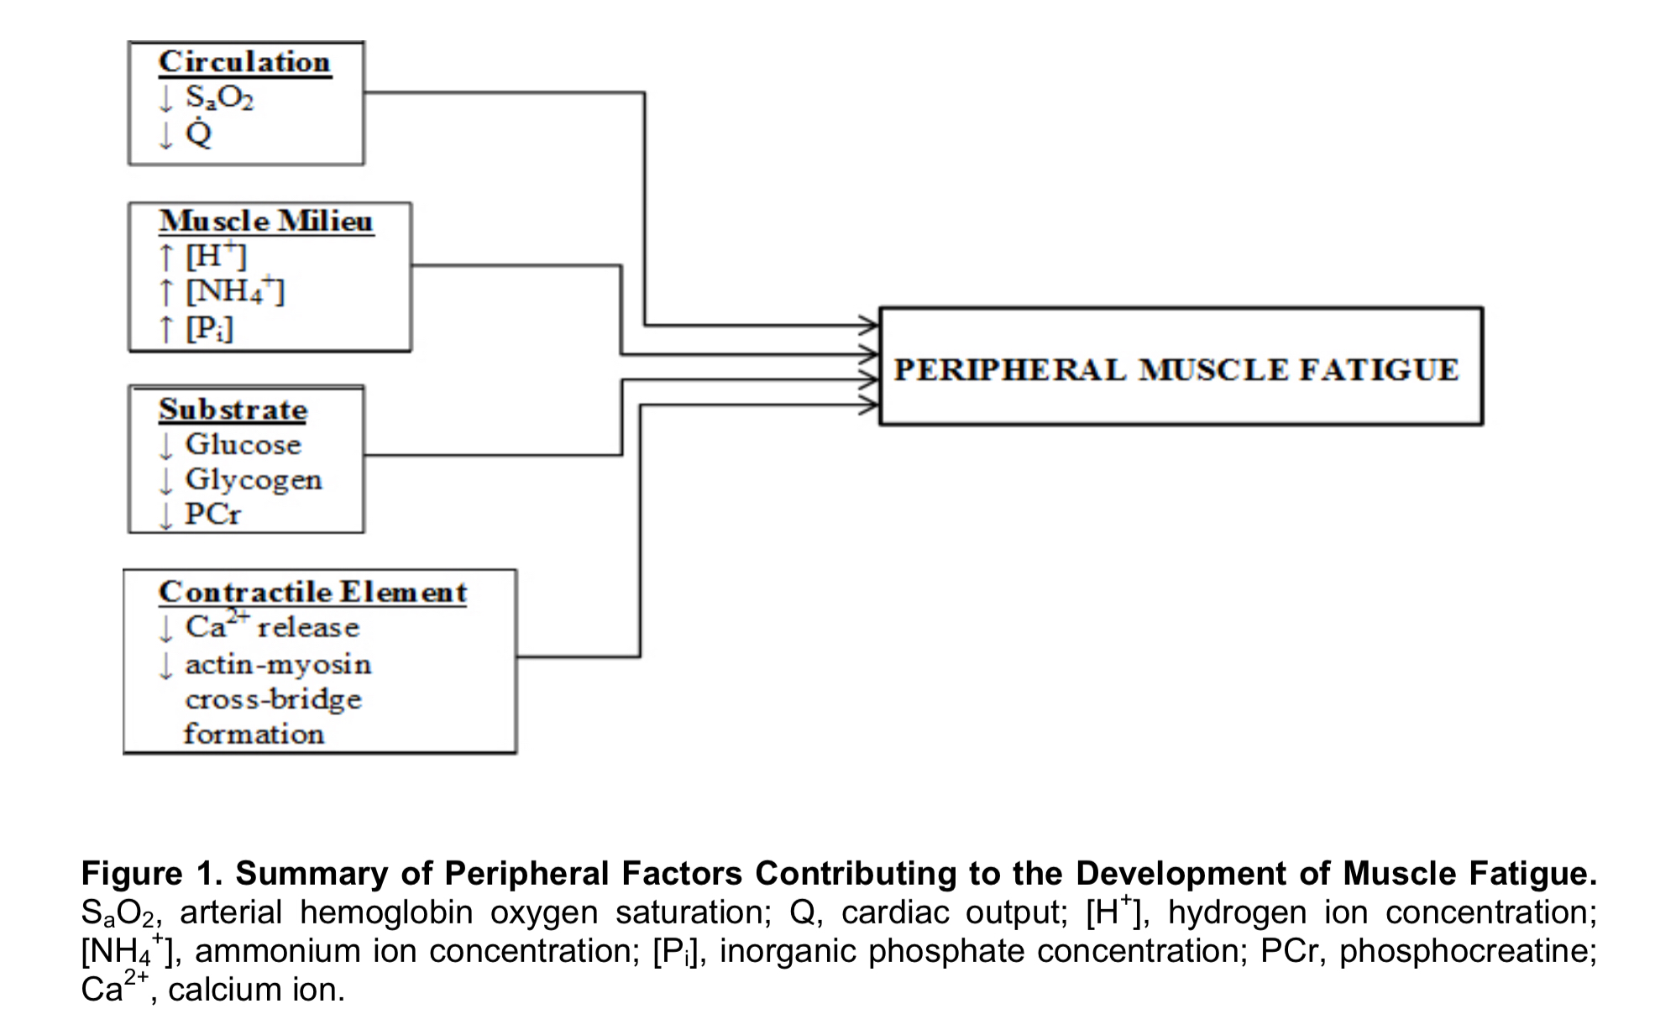
Shei & Mickleborough (2013)

Slide 18
Fatigue and Its Causes:
Neural Transmission
Failure may occur at neuromuscular junction, preventing muscle activation
Possible causes
  – ↓ ACh synthesis and release
  Altered ACh breakdown in synapse
  Increase in muscle fiber stimulus threshold
  Altered muscle resting membrane potential
Fatigue may inhibit Ca²⁺ release from SR

Slide 19
Fatigue and Its Causes:
Central Nervous System
CNS undoubtedly plays role in fatigue but not fully understood yet
Fiber recruitment has conscious aspect
  Stress of exhaustive exercise may be too much
  Subconscious or conscious unwillingness to endure more pain
  Discomfort of fatigue = warning sign
  Elite athletes learn proper pacing, tolerate fatigue

Slide 20
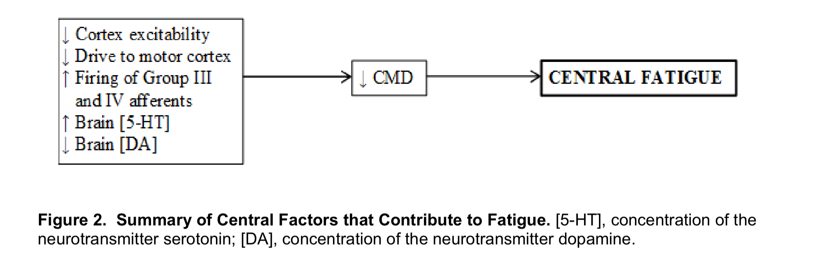
Shei & Mickleborough (2013)

Slide 21
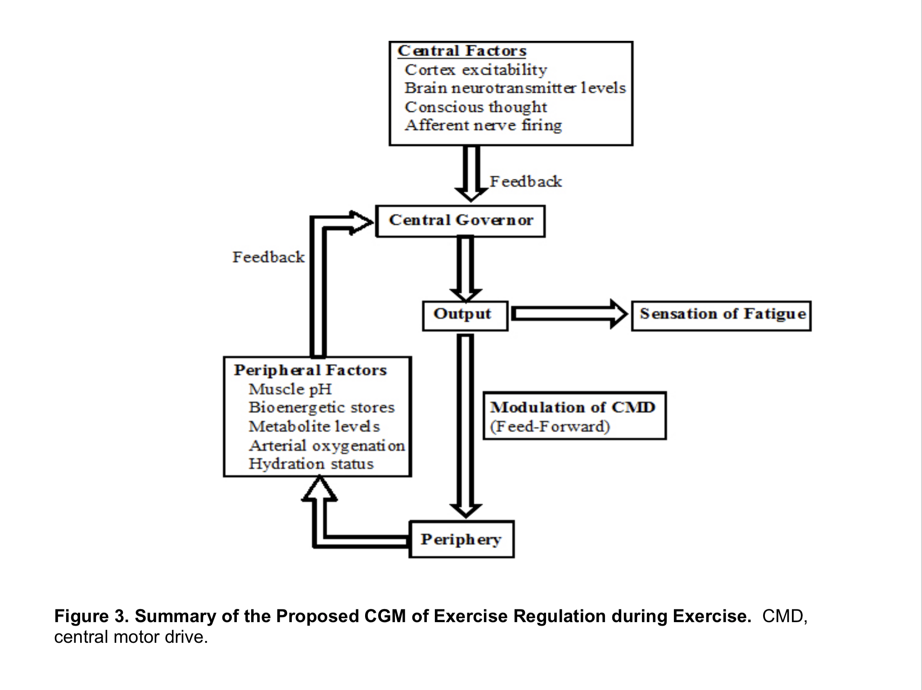
Shei & Mickleborough (2013)

