Slide 1

Young Mothers and social stigma
MArts Humanistic Counselling Practice
Advanced Research Methods ECHC7001
Research Proposal – Assignment One
By
Sophie Grimmett 1601492
Current Proposal Title and Research Question :
How have social stigmas affected young mothers mental health and well-being?

Slide 2
Purpose of research
The purpose of this study is to contribute to research that seeks to understand the mental health and well-being of young
mothers and their experience surrounding parenthood.
‘The stigma surrounding young parents stems from a “shared social belief that young
parents are inferior and unworthy of trust, support or resources.”’ (Rice at al, 2019)
19th century social transgressions in 21st century? (Moorhead, 2015)
Mitigation of social inequities and promotion of social justice where all parents, regardless of their age, immigration status,
gender, income or ethnicity are all treated equally? (Smithbattle,2020)
Equality Act (2010) , Teen Mothers and Young Fathers Support Framework (2019),
Teenage Parent Outcomes Modelling Tools (2016), Teenage Pregnancy Prevention Framework (2018).
What are the experiences and perceptions from young mothers in Wales in 2020?

Slide 3
Literature review
Young mothers experience of young parents support groups – Thematic Analysis, key relationship themes (Mills et al, 2012)
Devalued socioeconomic and racial groups- Shame and vulnerability – shown to lead to higher percentage of drop out from school or college - Experience of pregnancy and parenting are highly gendered (BHANA,2013)
Narratives of ‘Teen Preganancy and Motherhood – unmeditated views, essential and authentic self (Barcelos and Aline (2014)
Negative social construction - motherhood identity – current practice (Brand and Down, 2014)
Labelled ‘chav, chavettes and pramface girls’ (Nayak and Kehily ,2014)
’Young Motherhood, desistance and stigma’ - (Sharpe, 2015)
Birth Stories of Early- Age mother – identity formation as young mothers (Carson et al, 2017)
How Family Support Teams Construct Meaning in their Work With Young Mothers (Leese, 2017)
‘Our lives aren’t over’ - perspective on stigma, discrimination and coping among young parents (Conn et al, 2018)
Breastfeeding stigma shown higher percentages of young mothers encounter barriers at multiple levels (Chopel et al, 2019)
Qualitative exploration of Teenage Mother’s Views on Teen Pregnancy in Contemporaries – (Jones, Whitfield, Seymour and Hayter, 2019)
Young Women’s Perceptions of their mental health and well-being during and after pregnancy – no straight lines (Lucas et al, 2019)
The Stigma of Being a Young Parent - barriers in school and healthcare (Rice et al, 2019)
Stigmatised for violating ’age norms for parenting’ (Smithbattle, 2020)
Stigma and utilization of treatment – depression is common (Kola et al, 2020)

Slide 4
Aims, objectives, limitations and bias
Aims –
To gain deeper understanding of young parents lived experience and perceptions of social stigma in relation to their own mental health and well-being.
To share these findings with other organisations, government bodies, academic and health professionals in order to identify how social stigmas and the negative experiences of young parents and the affect this has on their well-being and how might these be improved.
The researchers own understandings and meaning of social stigma in relation to young parents and well-being.
Objectives –
To undertake an Interpretative Phenomenological Analysis (Smith, Flowers and Larkin,2009) and design semi-structured interviews using a formulation of the YPSS, to find the impact that social stigma and the label ‘young parent’ has on well-being of women who have lived experience, sample size being 5 women, from Wales., UK.
Limitations –
Female participants
Wales, location
Sample size
Age range
Bias –
Morals, views and beliefs are aligned with ethical principles and vales BACP and University of Wales Trinity Saint David (UWTSD)
Researchers lived experience of ‘young parent’ and social stigma/constructs – researcher is aware of own morals, values and beliefs

Slide 5
Methodology - participants
Qualitative – experiential investigation
Young Parent Stigma Scale (Rice et al, 2019)
Interpretative Phenomenological Analysis – (Smith, Flowers and Larkin, 2009)
Participants aged 18-22 – pregnancy or gave birth within the last year.
Social media platform - Instagram and details to contact researcher with information
Data gathered via online semi-structured interviews – discuss experiences and making meaning from the participants lived experience of becoming a ‘young parent’ and how that lived experience feels in association to their well-being and or ’mother identity.’
Following ethical approval –
January - Potential participants social media platform – information packs sent
Participants screened in accordance with inclusion criteria
Feb – participants that have given informed consent participate study
Semi- structured interview will be approximately 60 minutes – one to one individual participants
March - Welfare check post 4 weeks

Slide 6
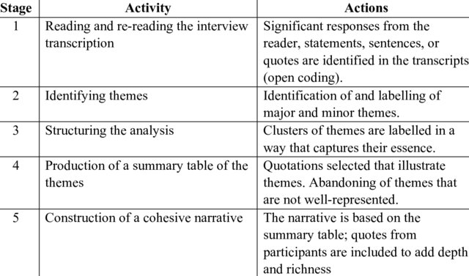
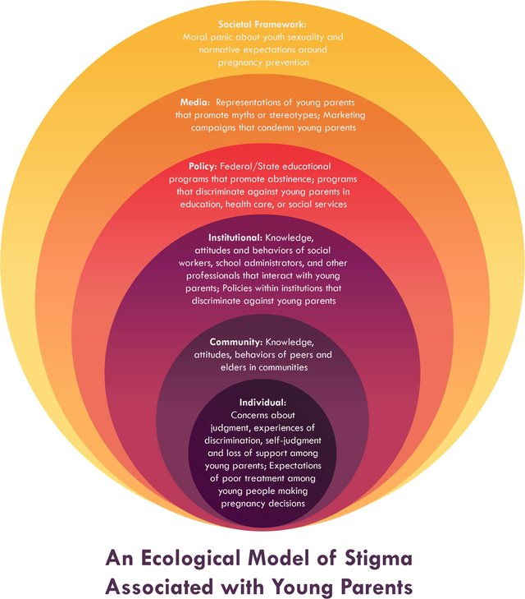
Interpretative Phenomenological Analysis
(Willing,2008)
Young Parents Stigma Scale YPSS (Rice et al, 2019)

Slide 7
Ethical considerations / anticipated risks/ data protection
Risk to investigator – In regards to any emotional distress that may arise the researcher would seek support from:
Academic Supervisor
Personal Therapy
Working within appropriate ethical framework such as BACP and UWTSD ethical framework, codes of practice and research policies.
Withdrawal of participation – researcher to be aware that this could happen at anytime and to be prepared to stop and/or re-arrange interview for another time.
Risk to Participants – In regards to emotional distress and possible triggers in associating with negative emotions:
Researcher will ask how participant is feeling at the end of interview
Offered support from researcher (Qualified Therapist) and/or supported in seeking help from GP or Mental Health Services
Relevant organisation support information to participants in regards to well-being and ‘young parent’ support.
Researchers contact information will be provided if participant is in need of support and a well-being check will be agreed with participant post 4 weeks of interview
Risk to University / Institution - Breach of data protection/ Adverse Publicity :
Researcher aware of professionalism and meeting ethical and professional requirements
Researcher is aware of GDPR requirements and the Data Protection Act (2018)
Researcher is aware and acts in accordance to UWTSD Ethics and Integrity Codes Of Practice (2020) and UWTSD Research Data Management Policy (2020).

Slide 8
Feedback, consent and confidentiality
Informed consent from participants – information pack containing what research is about, how data is going to be collected, date time of interviews
Participant will give written and verbal consent and aware that they can withdraw at anytime and how to do this
Anonymity of participants will be discussed and stated that within the research the participant will be unidentifiable.
One to one interviews between researcher and participant
Participants will be reminded that interviews are being recorded
Audio recording will be saved on a secure file on researchers sole password protected computer, in order to use transcript for use of data in relation to Interpretative Phenomenological Analysis.
The researcher will know names and identities of research participants, contacting them with information provided by participants, apart from researchers academic supervisor there will be no other persons who participants identifiable factors will be known to.
Any participant that would like feedback will be given relevant contact information to contact researcher and same process with complaints

Slide 9
references
BACP (2020) Ethical Framework for the Counselling Professions. Available at : https://www.bacp.co.uk/events-and-resources/ethics-and-standards/ethical-framework-for-the-counselling-professions/ (Accessed on 11th November 2020).
BACP (2020) Ethical Guidelines For Research in the Counselling Professions. Available at: https://www.bacp.co.uk/events-and-resources/research/publications/ethical-guidelines-for-research-in-the-counselling-professions/ (Accessed on 2nd October 2020).
Barcelos, C., and Gubrium, A. (2014) ‘Reproducing Stories: Strategic Narratives of Teen Pregnancy and Motherhood’, Society for the Study of Social Problems, 61 (3), pp. 466-481
Bhana, D., and Mcambi, S. (2013) ‘ When schoolgirls become mothers: Reflections from a selected group of teenage girls in Durban’, Perspectives of Education, 31 (1), pp. 11-19.
Brand, G., and Morrison, P., and Down, B. (2014) ‘ How do health professionals support pregnant and young mothers in the community? A selective review of the research literature’, Women and Birth, 27, pp. 174-178.
Carson, A., and Chabot., C., and Greyson, D., and Shannon, K., and Duff, P., and Shoveller, J. (2017) ‘ A narrative analysis of the birth stories of early-age mothers’, Sociology of health and illness, 39 (6), pp.816-831.
Chopel,A., and Soto, D., and Joiner, B., and Benitez, T., and Konoff, R., and Rios, L., and Castellanos, E. (2019) ‘Multilevel Factors Influencing Young Mothers’ Breastfeeding: A Qualitative CBPR Study’, Journal of Human Lactation, 35 (2), pp. 301-317
Conn, B., and Figueiredo, S., and Sherer, S., and Mankerian, M., and Iverson, E. (2018) ‘”Our lives aren’t over”: A strengths-based perspective on stigma, discrimination, and coping among young parents’, Journal of Adolescence, 66, pp. 91-100.
GOV.UkK (2020) Equality Act 2010. Available at : https://www.legislation.gov.uk/ukpga/2010/15/contents (Accessed on 9th November 2020).
GOV.UK (2020) Data Protection Act (2018). Available at: https://www.legislation.gov.uk/ukpga/2018/12/contents (Accessed on 3rd October 2020)
GOV.UK (2019) Teenage Mothers and Young Fathers: support framework. Available at: https://www.gov.uk/government/publications/teenage-mothers-and-young-fathers-support-framework (Accessed on 10th November 2020)
GOV. UK (2018) Teenage Pregnancy Prevention Framework. Available at: https://assets.publishing.service.gov.uk/government/uploads/system/uploads/attachment_data/file/836597/Teenage_Pregnancy_Prevention_Framework.pdf (Accessed on 12th November 2020).
GOV.UK (2016) Teenage Parent Outcomes Modelling Tool. Available at: https://www.gov.uk/government/publications/teenage-parent-outcomes-modelling-tool (Accessed on 12th November 2020)
Jones, C., and Whitefield, C., and Seymore, J., and Hayter, M. (2019) ‘ Other Girls’ : A Qualitative Exploration of Teenage Mothers’ Views on Teen Pregnancy in Contemporaries’, Sexuality and Culture, 23 (1), pp. 760-773.

Slide 10
references
Kola, L., and Bennett, I., and Bhat, A., and Ayinde, O., and Oladeji, B., and Abiona, d., and Abdumalik, J., Faregh, N., and Collins, P., and Gureje, O. (2020) ‘Stigma and utilization of treatment for adolescent perinatal depression in Ibadan Nigeria’, BMC Preganancy and Childbirth, 20, pp. 294-255
Leese, M. (2017) ‘Engaging on the ‘front line’ : exploring how family support teams construct meaning in their work with young mothers’, Child and Family Social Work, 22, pp. 1207-1215.
Lucas, G., and Olander, E., and Ayers, S., and Salmon, D. (2019) ‘No Straight Lines – young women’s perception of their mental health and wellbeing during and after pregnancy: a systemic review and meta-ethnography’, BMC Women’s Health, 19(152), pp. 1-17.
Mills, A., and Schmied, V., and Taylor, C., and Dahlen, H., and Shuiringa, W., and Hudson, M. (2013) ‘ Someone to talk to: young mothers’ experience of participating in a young parents support programme’, Journal of caring Studies, 27, pp. 551- 559.
Moorhead, J. (2015) The Victorian Women Forced to Give Up Their Babies. Available at: https://www.theguardian.com/lifeandstyle/2015/sep/19/victorian-women-forced-to-give-up-their-babies-new-exhibition (Accessed on 10th November 2020).
Nayak, A., and Kehily, M. (2014) ‘Chav, chavettes and pramface girls’: teenage mothers, marginalised young men and the management of stigma’, Journal of Youth Studies, 17 (10), pp. 1330-1345.
No Teen Shame (2013) No Teen Shame. Available at: http://www.noteenshame.com/about (Accessed on 10th November 2020)
Rice, W., and Sheira, L., and Greenblatt,E., and Blodgett, M., and Cokrill, K. (2019) ‘The Stigma of Being a Young Parent: Development of a Measurement Tool and Predictors’, Journal of Child and Family Studies, 28, pp. 642-655.
Sharpe, G. (2015) ‘ Precarious identities: ‘Young’ motherhood, desistance and stigma’, Criminology and Criminal Justice, 15 (4), pp. 407-422.
Smithbattle, L. (2020) ‘ Walking on Eggshells: An update on the Stigmatizing of Teen Mothers’, California Board of Registered Nursing;, 20 (1), pp.1-8.
UWTSD (2020) Academic Quality Handbook. Available at: https://www.uwtsd.ac.uk/academic-office/academic-quality-handbook/ (Accessed on 2nd October 2020).
Willig, C. (2008) Introducing Qualitative Research in Psychology. 2nd Ed. Berkshire: Open University Press

