Slide 1


Developing Relationships
&
Workplace Achievements

Slide 2
Training & Development
Needs for an
HR Officer
Presented by:
Justin Sanches 2029870
Lecturer: Gregory Cowan

Slide 3
Overview
Introduction
KSB Required in my Role
Personal SWOT Analyses
Relevant Models Applied
Personal vs Organisational Benefits
References

Slide 4

Company Introduction
Falstaff Hotel
Capacity
Run in a XV Century Building
Transitional period to market leader
Image Source: Falstaff Website

Slide 5

Knowledge & Behaviour Required
Recruitment, selection and Training.
Employment laws & government regulations
Knowledge in business management, strategy & resource allocation
Human Behaviour & Performance
Ability to access the guest need (Customer service)
Image Source: https://www.globalrailwayreview.com/article/126555/are-you-taking-advantage-of-knowledge-from-past-projects/

Slide 6

Skills Required
IT literate
Communication Skills
Persuasion
Goal Oriented
Active Listening
Problem Solving
Image Source: https://resources.workable.com/tutorial/how-to-hire-your-first-hr-manager/

Slide 7
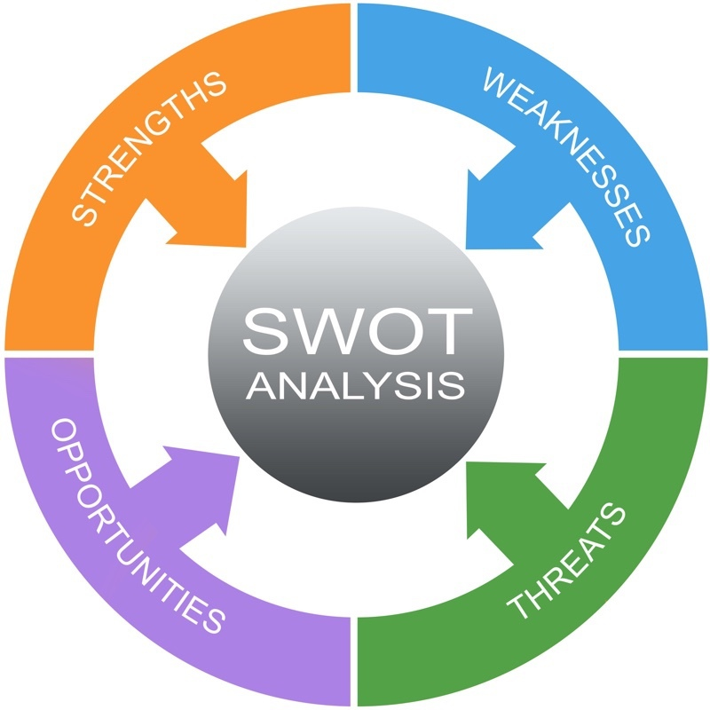
Personal SWOT Analyses
Good IT Skills
I am an active listener
Calm & Patient
Problem Solving Skills
Weakness
Verbal communication Skills
Lack of confidence when speaking in public
Strength
Image Source: https://www.projectsmart.co.uk/tools/swot-analysis.php

Slide 8
Personal SWOT Analyses
Opportunities
  Completing my Studies In Management
  Improve my Verbal Communication Skills
  Improve my Confidence when Speaking in Public
Threats
  High Competition
  Covid-19
Image Source: https://www.projectsmart.co.uk/tools/swot-analysis.php

Slide 9
Relevant Models to the Organisation
The 5-P Model
The European Model

Slide 10

Personal vs Organisational Benefits
  Feel included and perform better(Stakeholders Theory)
  Better Career Development
  More Employable & Competitive
Personal
Organisational
  Happier Employee tends to reciprocate(Social Exchange Theory)
  Improve Development(Human Capital Theory)

Slide 11
References
Armstrong, M. and Taylor, S. (2020) Armstrong’s Handbook of Human Resource Management Practice. [BibliU version] 15th ed. London.
Falstaff Logo 2022 available at https://www.thefalstaffincanterbury.com/ accessed 05 July 2022
Haughey D, SWOT Analyses, 2021 available at https://www.projectsmart.co.uk/tools/swot-analysis.php accessed 06 July 2022

Slide 12
Appendix

Slide 13


