Slide 1
Independent Project
ADPA6000
Session links for 3rd October 2025

Slide 2
Context
The purpose of this session’s selection of discussion topics was to ‘locate’ your work as creative people with creative ideas in a broader landscape.
The links on the next slide signpost influential policy, arts funders, and cutting-edge research bodies.
Your work will sit in tandem to or on the shoulders of previous creative researchers, actors, workshop leaders, political theatre makers and dramatists – and using some of the information in the links to spark ideas now will help you evaluate your work during your creative process.

Slide 3
Links
The names of the documents should hyperlink out to the webpages, but if not please drop me an email:
Wellbeing of Future Generations (Wales) Act 2015
UKRI – UK Innovation and Research
AHRC – Arts and Humanities Research Council
Arts Council of Wales

Slide 4
Words
Output
Data
Metaphor
Dramaturgy – Katalin Trencsenyi
Critical Thinking – Stella Cottrell
Practice as Research & Action Research
Arts based Research - Dr. Helen Kara
Evaluate + Analyse

Slide 5
Bibliography
Please use the UWTSD Harvard Referencing handbook that you will find in the BA Acting tile on the Moodle page for ADPA6000; Independent Project.
I advise that you read the first 10 pages to get a solid understanding of why and how we reference our sources.
Please start to collate your bibliographies now – as ‘Engagement with Literature’ is a fifth of your overall module mark and a good understanding of referencing is key to that criterion.

Slide 6
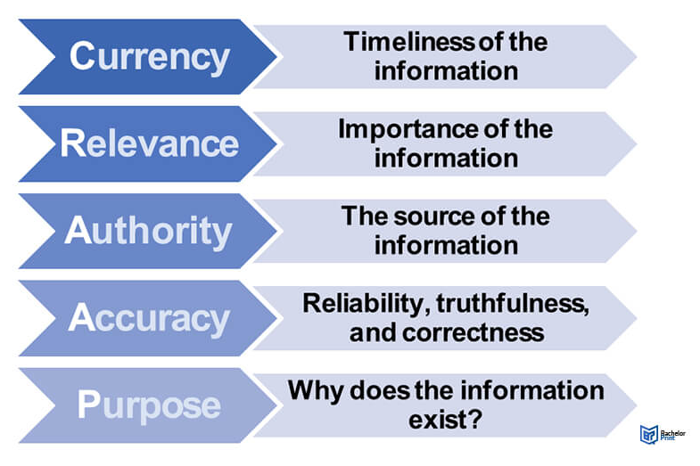
RADAR and CRAAP: Source Evaluation
Notes:
Working with Sources ~ A Complete Guide with Examples

Slide 7
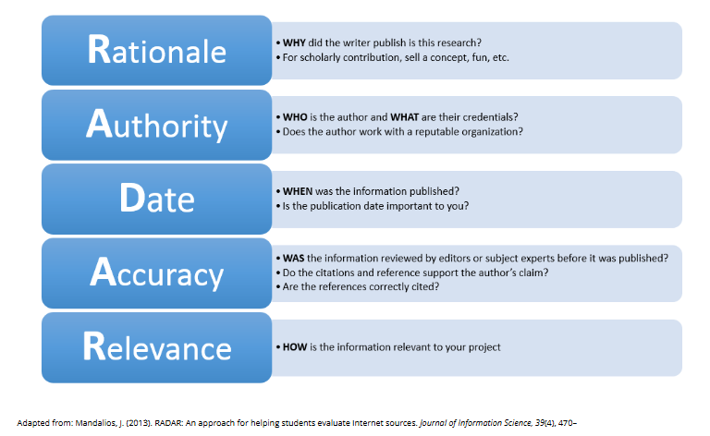
RADAR and CRAAP: Source Evaluation
Notes:
Evaluate your resources (RADAR test) - EEB197: Biodiversity & the City - Research Guides at University of Toronto

