Slide 1
Employee Engagement Presentation
Module nr: BMIH4006
Student name: Cosmin Blaj
ID NR: 2014188

Slide 2
Employee Engagement
To what extent do workers dedicate their mental, emotional, and behavioral resources to achieving the organization's goals is a measure of employee engagement (Satata, 2021).

Slide 3
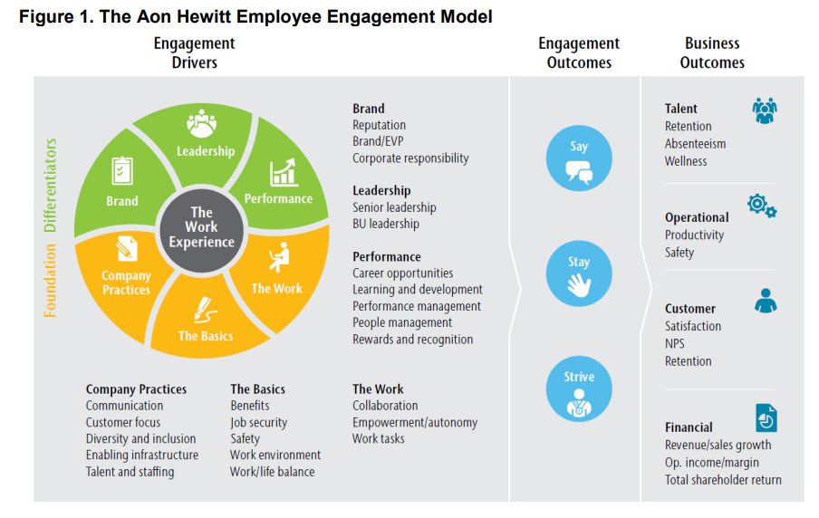
Employee Engagement theoretical model

Slide 4
The AON Hewitt Model
By factoring in organizational results, the Aon Hewitt employee engagement model becomes more comprehensive (Hinzmann, Rašticová and Šácha, 2019).
It acknowledges that customer happiness, earnings, and other KPIs are all influenced by employee engagement (Rawat and B. Dadas, 2019).
This correlation is shown by the data, yet it is nevertheless simple to lose sight of the forest for the trees while focusing on engagement details (Bedarkar and Pandita, 2014).

Slide 5
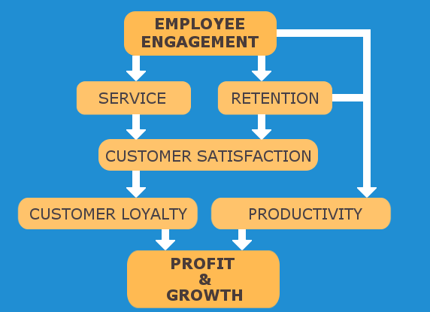
Employee engagement= Profit & Growth

Slide 6
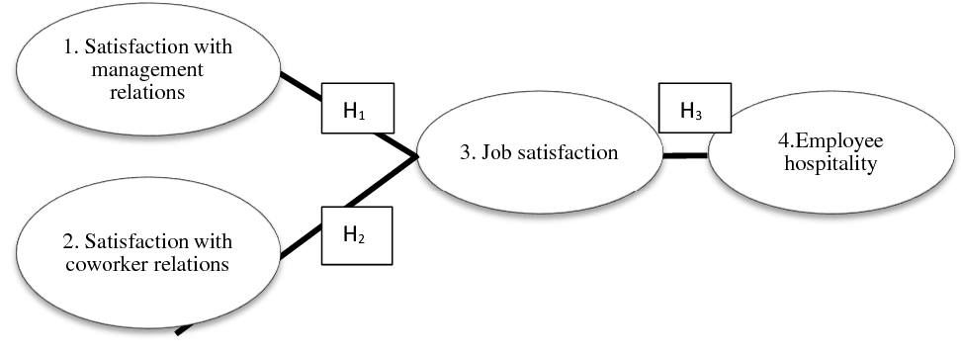
Employee engagement in hotel industry
Source: (Laškarin Ažić, 2017)

Slide 7
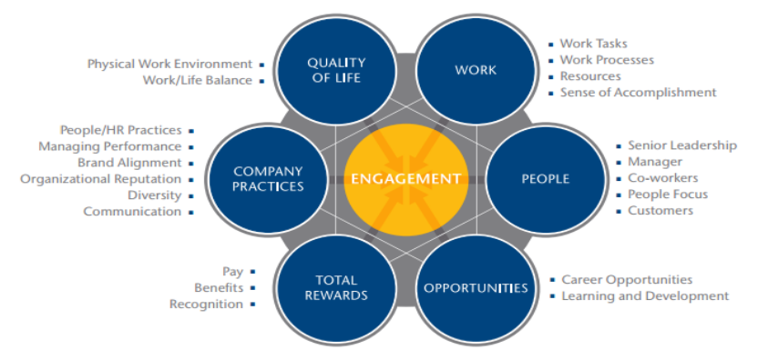
Employee engagement in hotel industry impact

Slide 8
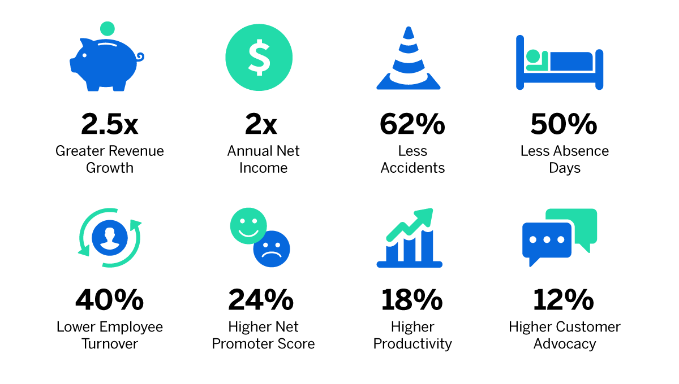
High level engagement impact on the organisation

Slide 9
Ways to enhance employee engagement in hotel industry
Rewards and Recognition (Huertas-Valdivia, Llorens-Montes and Ruiz-Moreno, 2018)
Freebies
Compensatory Time (Tesone, 2017)
Friendly Competitions (Vallen and Vallen, 2018)
Development Opportunities (Bridger, 2022)
Communication Opportunities

Slide 10
Conclusion
Engaged employees are crucial to the success of any company. Positive effects on employee turnover, corporate culture, client relationships, output, and bottom line may result from well-executed methods to increase employee engagement (Bakker and Leiter, 2015).

Slide 11
References
Bakker, A.B. and Leiter, M.P. (2015) Work engagement : a handbook of essential theory and research. Hove England ; New York: Psychology Press.
Bedarkar, M. and Pandita, D. (2014) A Study on the Drivers of Employee Engagement Impacting Employee Performance. Procedia - Social and Behavioral Sciences, [online] 133(1), pp.106–115. doi:10.1016/j.sbspro.2014.04.174.
Bridger, E. (2022) EMPLOYEE ENGAGEMENT : a practical introduction. S.L.: Kogan Page.
Hinzmann, R., Rašticová, M. and Šácha, J. (2019) Factors of Employee Engagement at the Workplace. Do Years of Service Count? Acta Universitatis Agriculturae et Silviculturae Mendelianae Brunensis, [online] 67(6), pp.1525–1533. doi:10.11118/actaun201967061525.
Huertas-Valdivia, I., Llorens-Montes, F.J. and Ruiz-Moreno, A. (2018) Achieving engagement among hospitality employees: a serial mediation model. International Journal of Contemporary Hospitality Management, 30(1), pp.217–241. doi:10.1108/ijchm-09-2016-0538.
Laškarin Ažić, M. (2017) The impact of hotel employee satisfaction on hospitability performance. Tourism and hospitality management, [online] 23(1), pp.105–117. doi:10.20867/thm.23.1.8.
Rawat, P.A. and B. Dadas, Dr.A. (2019) Human Resource Management A STUDY OF EMPLOYEE ENGAGEMENT MODELS TO BUILD NEW BUSINESS APPROACHES. [online] Available at: http://nevillewadia.com/wp-content/uploads/2019/03/HR5.pdf.
Satata, D.B.M. (2021) Employee Engagement as An Effort to Improve Work Performance: Literature Review. Ilomata International Journal of Social Science, 2(1), pp.41–49. doi:10.52728/ijss.v2i1.152.
Tesone, D.V. (2017) Principles of management for the hospitality industry..
Vallen, G.K. and Vallen, J.J. (2018) Check-in check-out : managing hotel operations. Boston: Pearson.

