Slide 1

Terrorism and Cybercrime
Week 8: The Targets and Means of Engaging in Cybercrime
Dr. Luke Roach
l.roach@uwtsd.ac.uk

Slide 2
Session Outline
Hackers and Hacking
Malware and Automated Computer Attacks
Digital Piracy and Intellectual Property Theft
Economic Crimes and Online Fraud

Slide 3
Class Discussion
How much overlap do you see between 'real – world' crime and cyber-crime?
  Where do you think the greater threat is?
  Do you think online Crime experiences the same sort of fear as offline crime?
Should there be specific global offences identifying cyber-crime and deviance or should they just be termed as 'crime' regardless of how or where they occur?
  Does the use of a computer make a crime any worse or better?

Slide 4
Hacking
Not necessarily highly skilled
Subculture
A skill that may be applied in a variety of ways depending on the ethical perspective of the actor

Slide 5
Exploring Hacking
'A 'hack' involves the modification of technology, such as the alteration of computer hardware or software, in order to allow it to be used in innovative ways, whether for legitimate or illegitimate purposes'

Slide 6
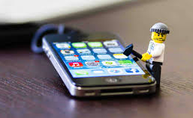
Legitimate Purpose?
'Jailbreaking' or interfering with a programme to enable third parties' programmes to work on a device than normally does not permit it to! (Apple iPhones)
This activity may make your warranty void but they are not Illegal

Slide 7
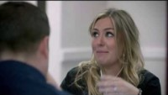
Hacking – Social Engineering

Slide 8
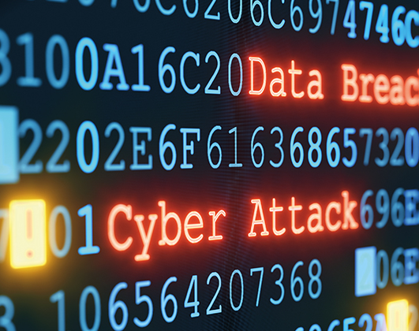
Illegitimate Purposes
Hacks that modify programmes, systems and security protocols are illegal and may be used to obtain information.

Slide 9
Illegitimate Purposes
Shoulder Surfing
Social Engineering
Vulnerabilities
Exploiters
Non-Nation – state-sponsored actors
Nation – state actors

Slide 10
Hacking - Consequences
Theft
Espionage
Terror
Fraud

Slide 11
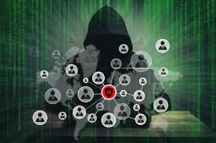
The Hacker Subculture
Primary Norms:
  Technology - Exploration
  Knowledge , and
  Secrecy

Slide 12
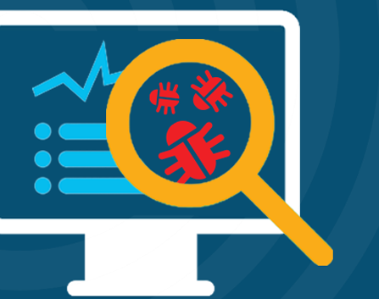
What is Malware ?
Destructive programmes that can be used to harm computer systems, gain access to sensitive information, or engage in other forms of cybercrime.

Slide 13
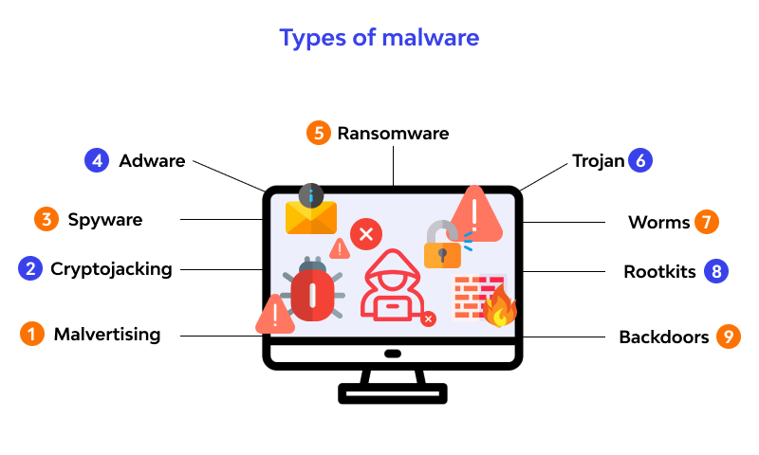
Malware and Automated Attacks
In 2015 431 Million new pieces of Malware identified

Slide 14
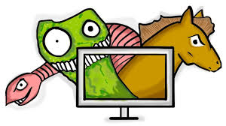
Viruses Trojans and Worms
Most Malware is made of either Viruses, Trojan Horses or Worms, or a combination of all these (a 'blended threat)

Slide 15
What is Malware ?
No specific laws against the creation of malicious Malware
The use of Malware is however illegal.

Slide 16
What is Malware ?
Early Malware:
  Did no damage to the system but was annoying playing loud music or presenting unwanted messages

Slide 17
What is Malware ?
Current Malware:
  Disrupts e mail, networks, access private files, steal sensitive information, delete or corrupt files, or cause general damage to computers, hardware or software

Slide 18

Contemporary Issues with Malware

Slide 19
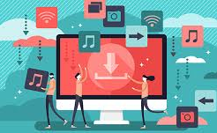
Digital Piracy and Intellectual Property Theft
High speed internet allows us to listen to music, watch films, sport etc on our devices
These entertainment forms can be subverted in order to acquire, copy and unlawfully distribute media that was illegally obtained (digital piracy).

Slide 20

What is Intellectual Property
When an original idea that involves some creative expression is put into a fixed medium it can be identified as being 'Intellectual Property'
To protect this 'idea' being stolen many people use 'copyright', 'trademarks' or 'patents'

Slide 21
What is Intellectual Property
In cases involving 'digital ideas' these methods of protection are more difficult due to the transitory nature of the idea

Slide 22

Legislation and Response
Intellectual Property Act 2014
The main purpose of the Act is to modernise certain aspects of the law relating to intellectual property in order to ensure that the IP system operates more efficiently and is clearer and more accessible, thus increasing legal certainty.

Slide 23
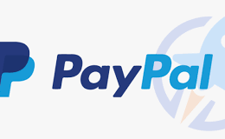
Economic Crimes and Online Fraud
Services such as Amazon, iTunes allow customers to make purchases with oine click by storing credit and debit card numbers or by using a third-party payment system such as 'Paypal'.

Slide 24
Economic Crimes and Online Fraud
The ability to easily buy goods online offers an opportunity for personal banking information to be compromised by the companies trusted to hold and use it. Resulting in Theft and Fraud.

Slide 25
Economic Crimes and Online Fraud
Do you use PayPal?
Do you trust it?
Do you think older/younger people are more/less accepting of this as a medium for online transaction?

Slide 26
Two-Factor Authentication
Have you heard of it?
Do you use it?
What do you think of it?

Slide 27
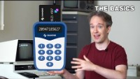
Two Factor Authentication

Slide 28
Any questions?
About todays content?
About the assignment?
About anything else?

Slide 29
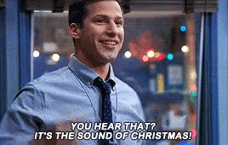
Week 8 Complete!
Thank you for listening!
See you all next week!

