Slide 1
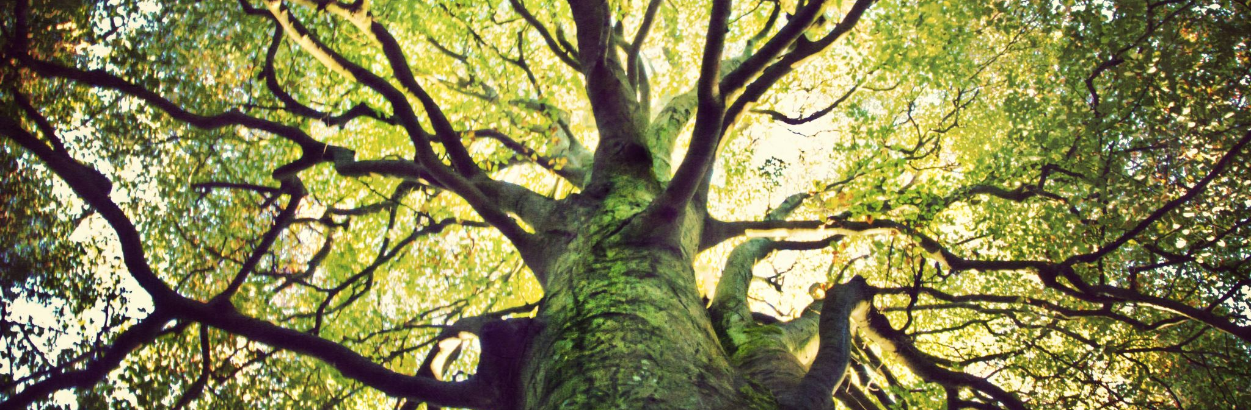
Philosophical Roots of Humanistic Counselling
Thoughts for the week! Familiarise yourself with the PowerPoint prior to our lesson

Slide 2
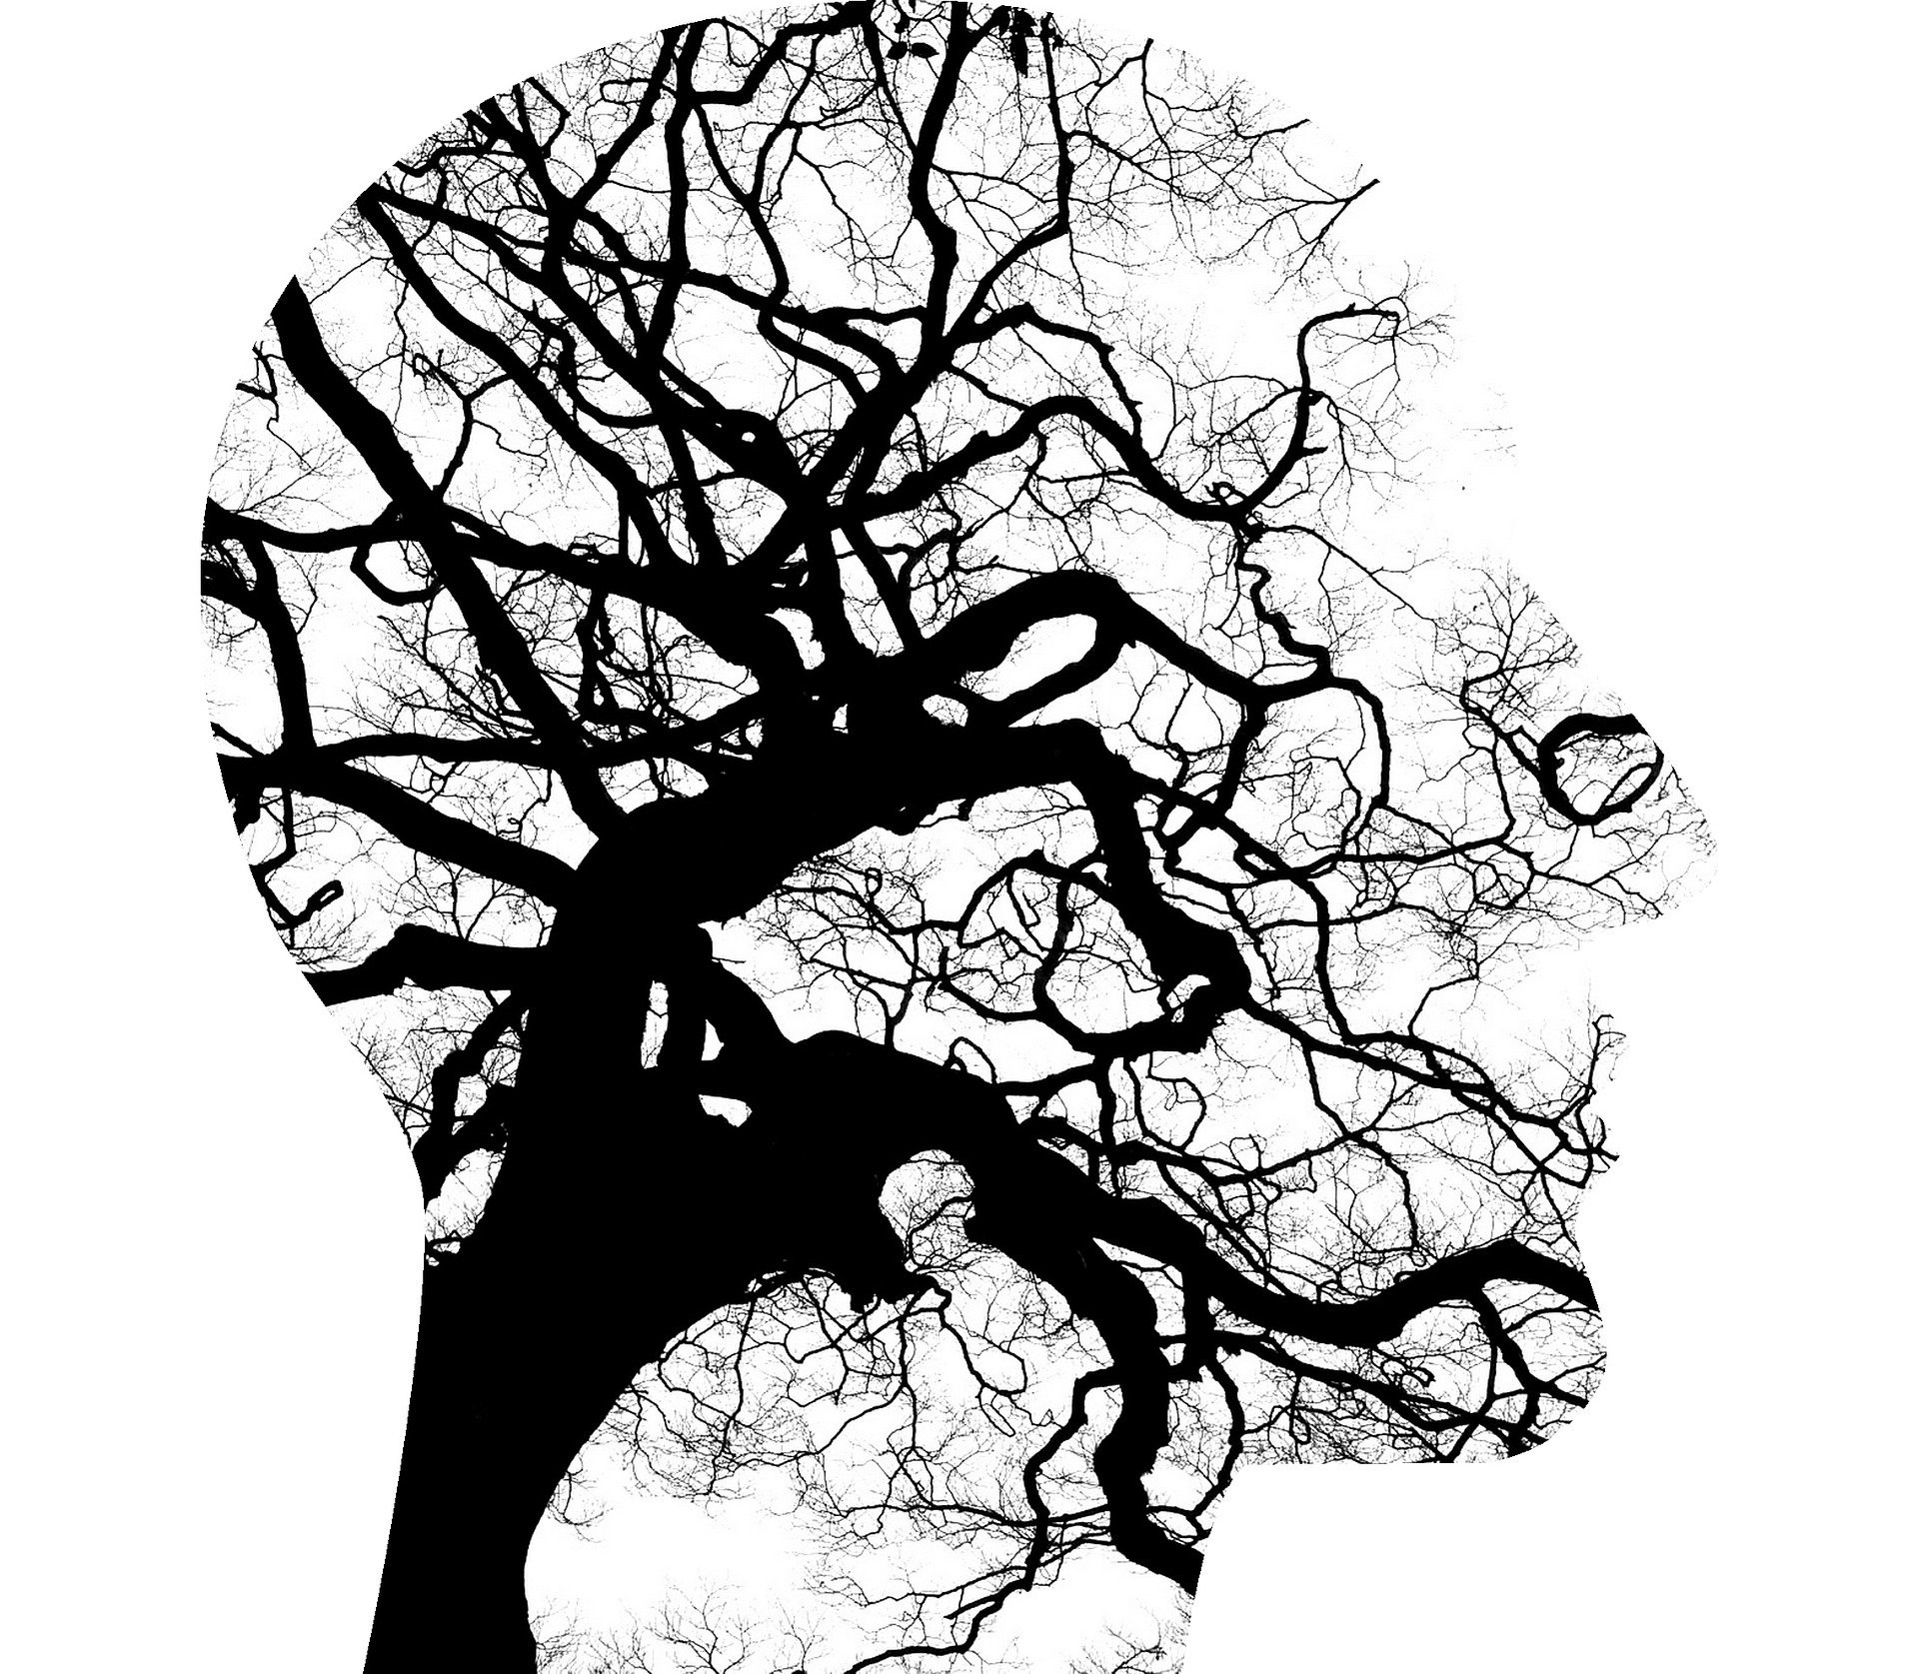
When did the story of Counselling begin?
Spend a few minutes just reflecting on this question. Jot a few points down and consider these in more detail as you move through this PowerPoint.
Image by Tumisu from Pixabay

Slide 3
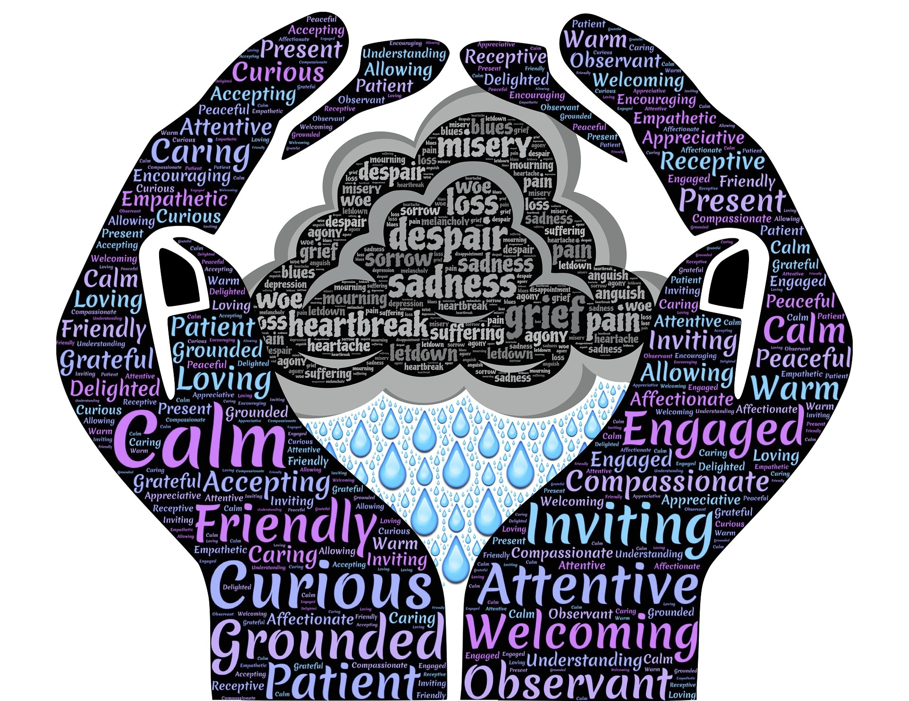
Roots of Counselling
In the last 300 years we have had great advances in industry and in the last 50-70 years this has largely been technological advances.
Do you think we are now more knowledgeable?
Are we more compassionate, caring or sensitive?
Do we support each other, or is our communication becoming more limited and destructive?
These are questions to ask yourself ready for our discussion this week.

Slide 4
Why study the philosophy of Humanistic Counselling?
Roots in ancient philosophy
Looking at new ideas and a broader outlook
Encourages further questioning.

Slide 5
Finding a Humanistic Identity
Greek thinkers and healing, direction and meaning

Slide 6
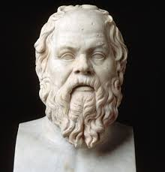
Socrates (470-399 BCE)
Research further ….
Greatest Philosopher of all time?
Socratic Method
Research further ….

Slide 7
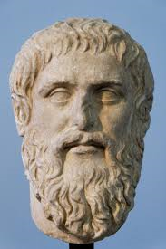
Plato (428-348 BCE)
Pupil of Socrates
Temperance
Mental health and Happiness come together.
Three aspects to the human soul (psyche): Logistikon, Epithumetikon and Thumoeides
Plato and Freud?
Research further ….

Slide 8
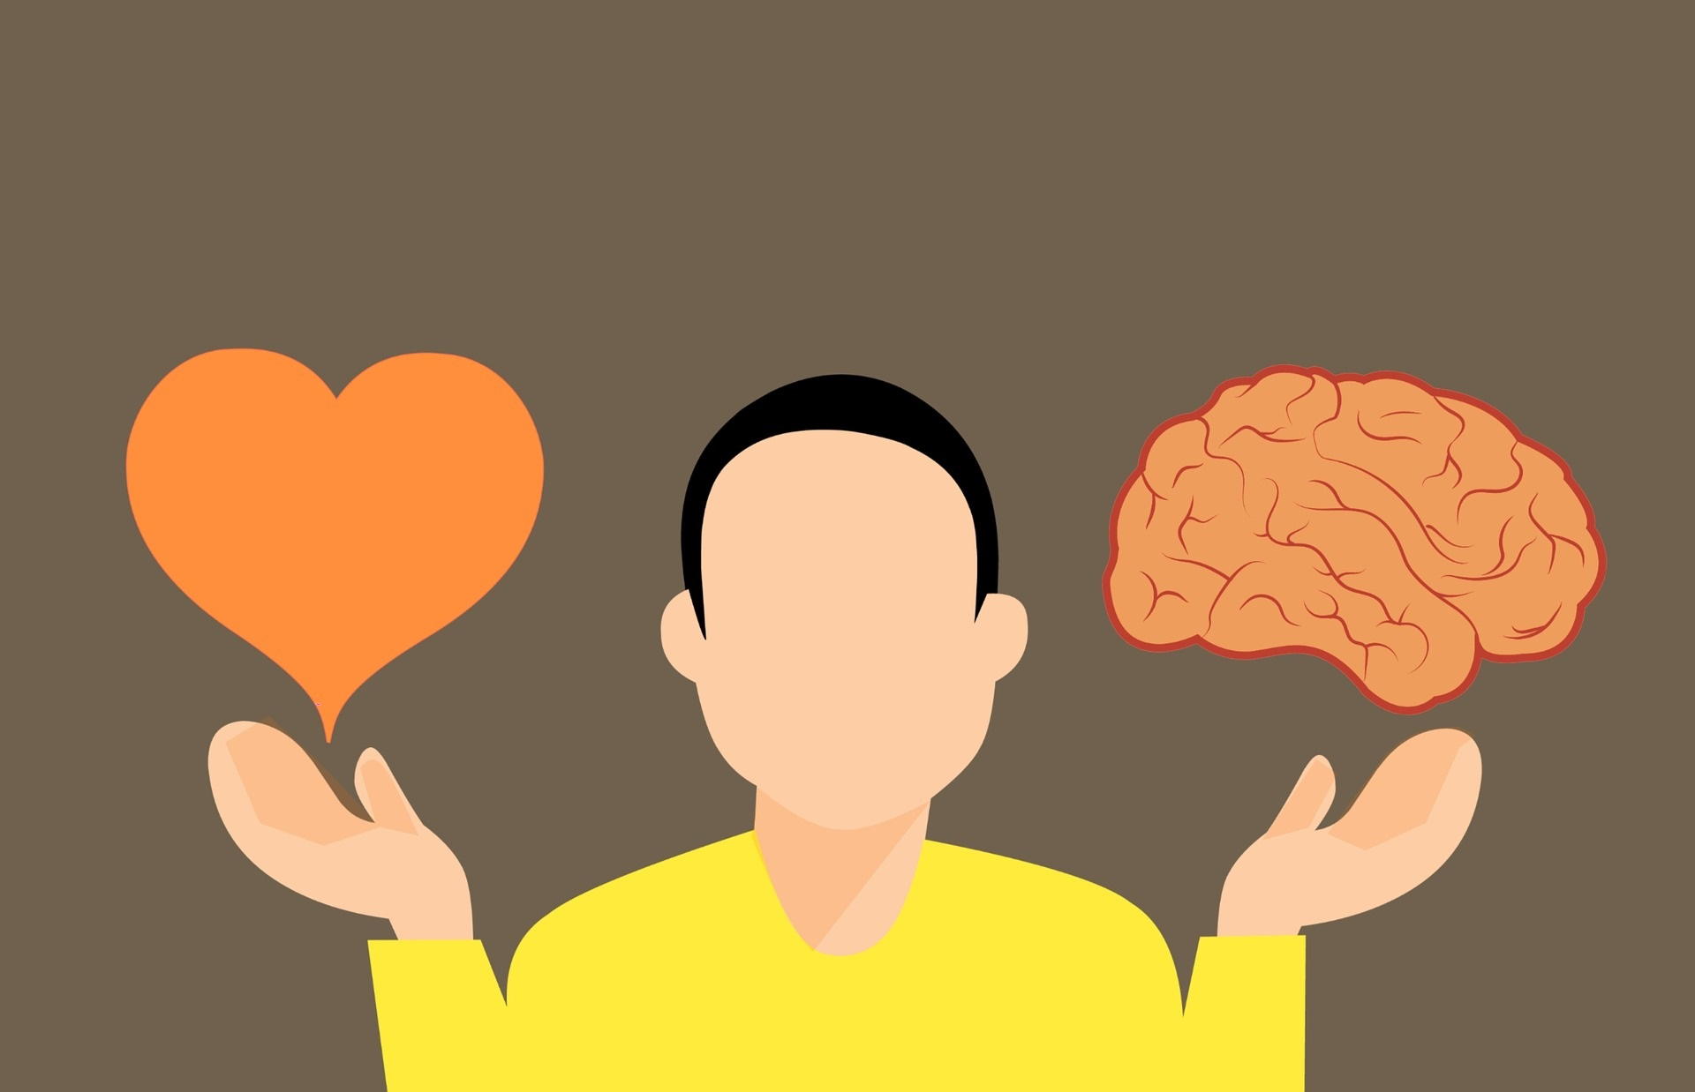
Are these three concepts still useful?
Reason (Logistikon)
Appetite (Epithumetikon)
Spirit (Thumoeides)
Research further ….
Image by mohamed Hassan from Pixabay

Slide 9
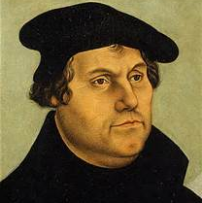
Martin Luther (1483-1546)
Catholic Church and Repentance
Authenticity and repentance
Research further ….

Slide 10
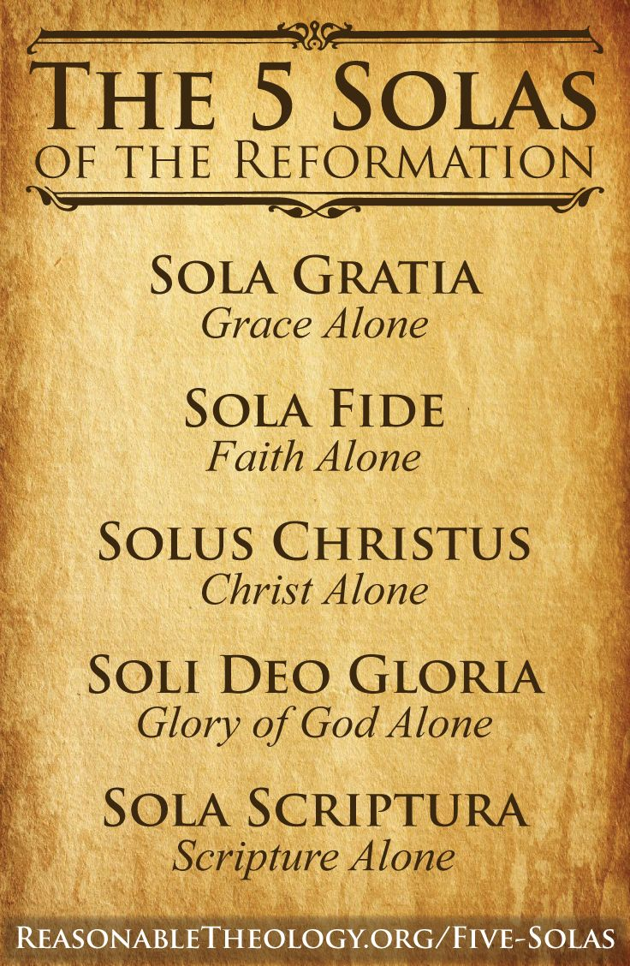
Luther Continued..
Protestant Principles and authenticity
More autonomy
Levels of Protestantism
How does this relate to counselling today?

Slide 11
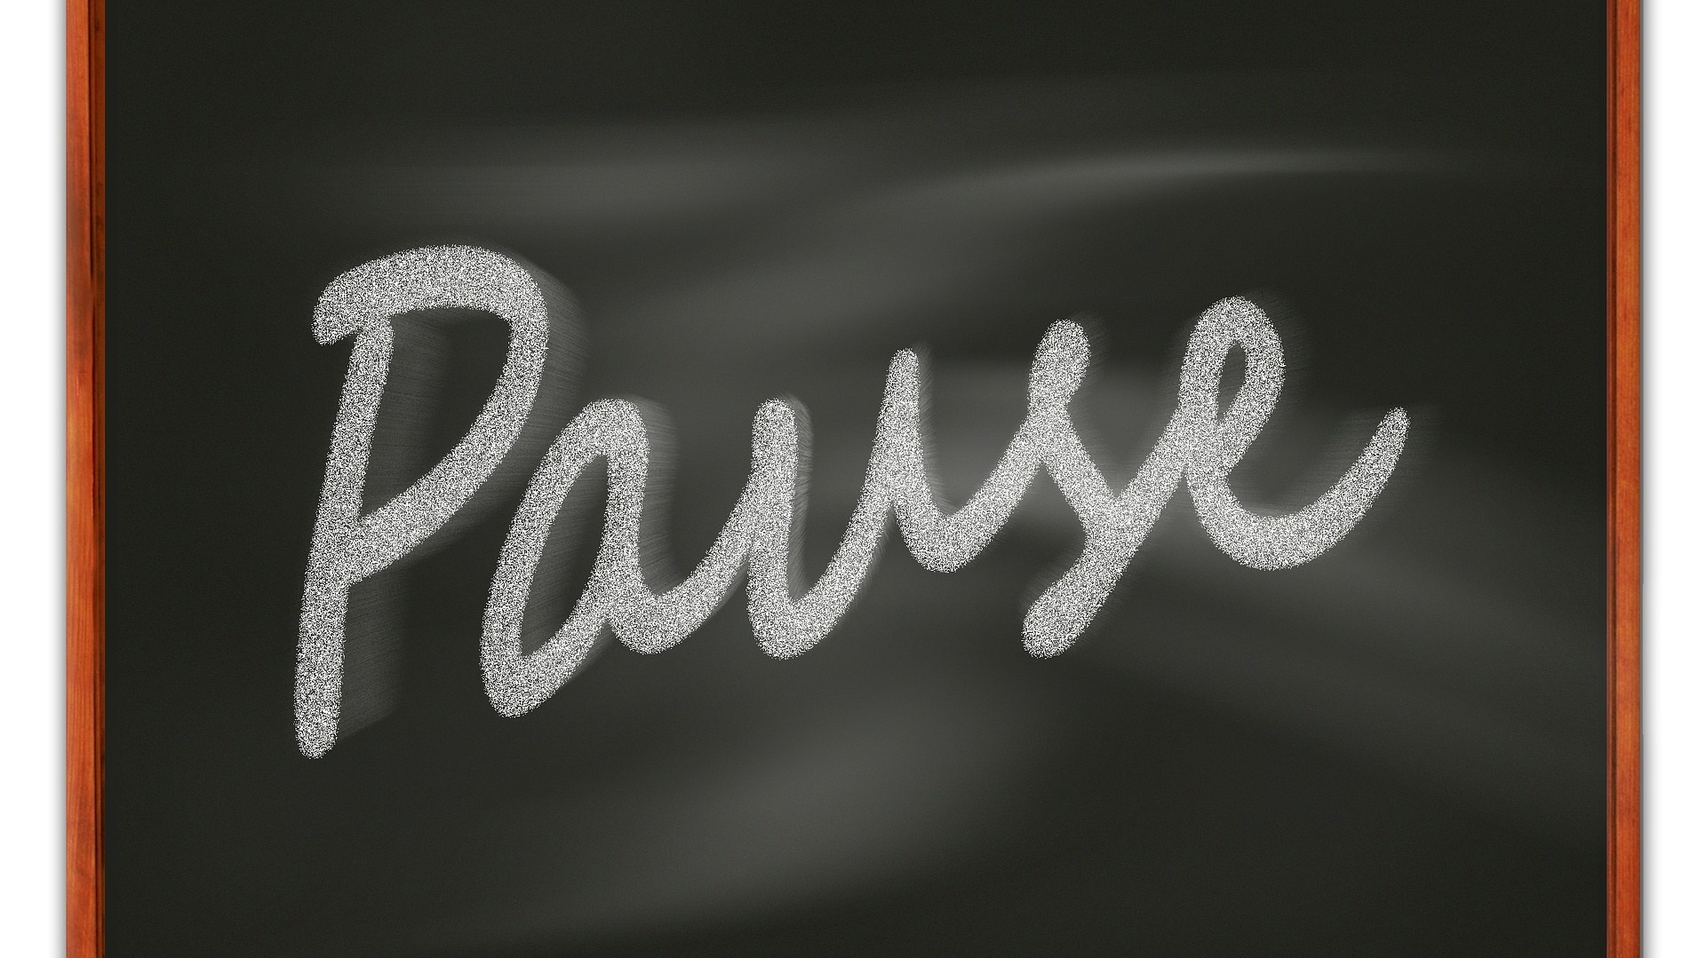
Pause and Thoughts So far?
Make a note of your thoughts for discussion at our lesson

Slide 12
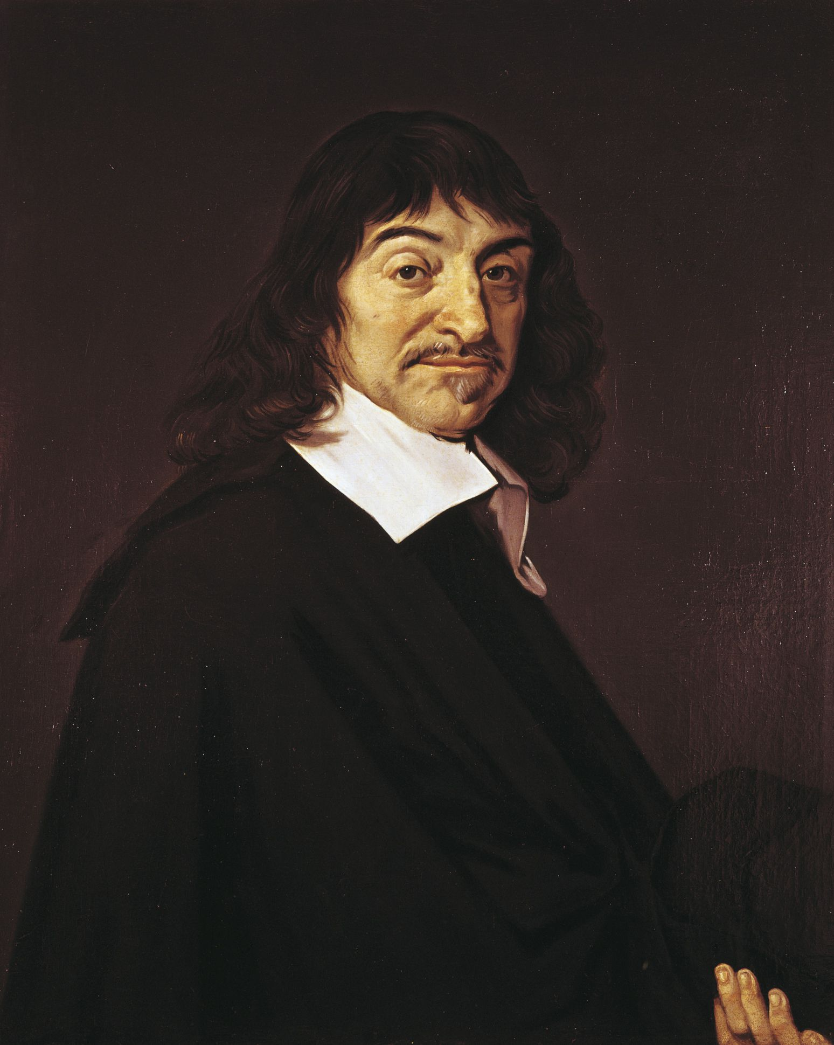
Rene Descartes (1596-1650)
Decartes: 'I think, therefore I exist'
"Doubting everything there was to doubt"
"Whatever else gets torn away, I remain, tearing, thinking, thinking. Even my body is less substantial than 'me'".
COGITO ERGO SUM
When clients come to us, seeking to find their identity, they want to figure out what "me" is, it's almost a Cartesian way of thinking.
Research further ….

Slide 13
What meaning do you make of this ? Once you’ve read it, check out the next slide …
I attentively examined what I was and as I observed that I could suppose that I had no body, and that there was no world nor any place in which I might be; but that I could not therefore suppose that I was not; and that, on the contrary, from the very circumstances that I thought to doubt of the truth of other things, it most clearly and certainly followed, that I was. (Descartes, Discourse on Method. p.27)

Slide 14
Descartes continued..
ME: This is the basis on which so much of our current thinking is based.
We want to work on our 'selves'
As Self is the 'real thing' we must therefore work towards satisfying this self. We need to find someone to help us find ourselves.

Slide 15
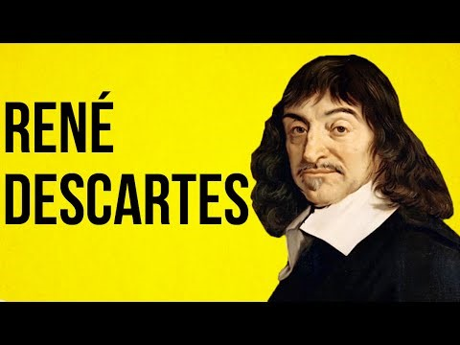
Descartes
Check out this link Lhttps://www.bing.com/videos/search?q=Descartes&&view=detail&mid=3252679F9EC15CA86AFD3252679F9EC15CA86AFD&&FORM=VRDGAR

Slide 16
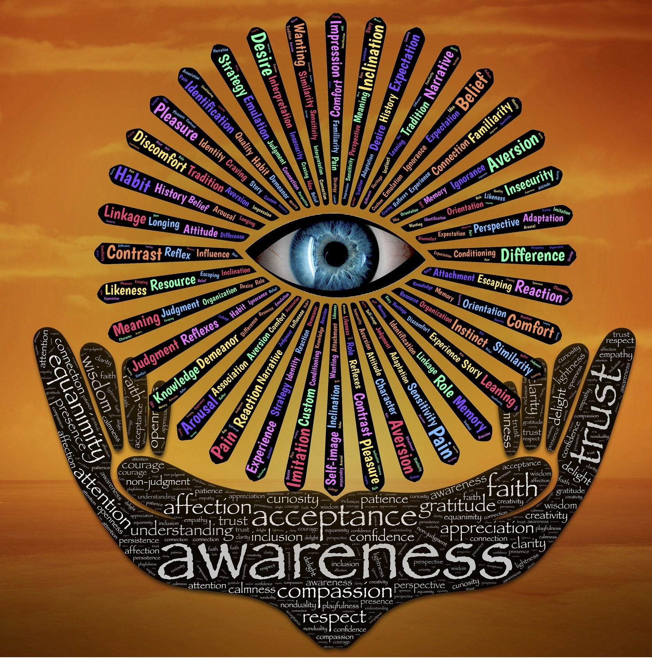
Therapeutic Aspects of Self
What terms can you think of that are used within psychotherapy that can be considered as aspects of self?
Image by John Hain from Pixabay

Slide 17
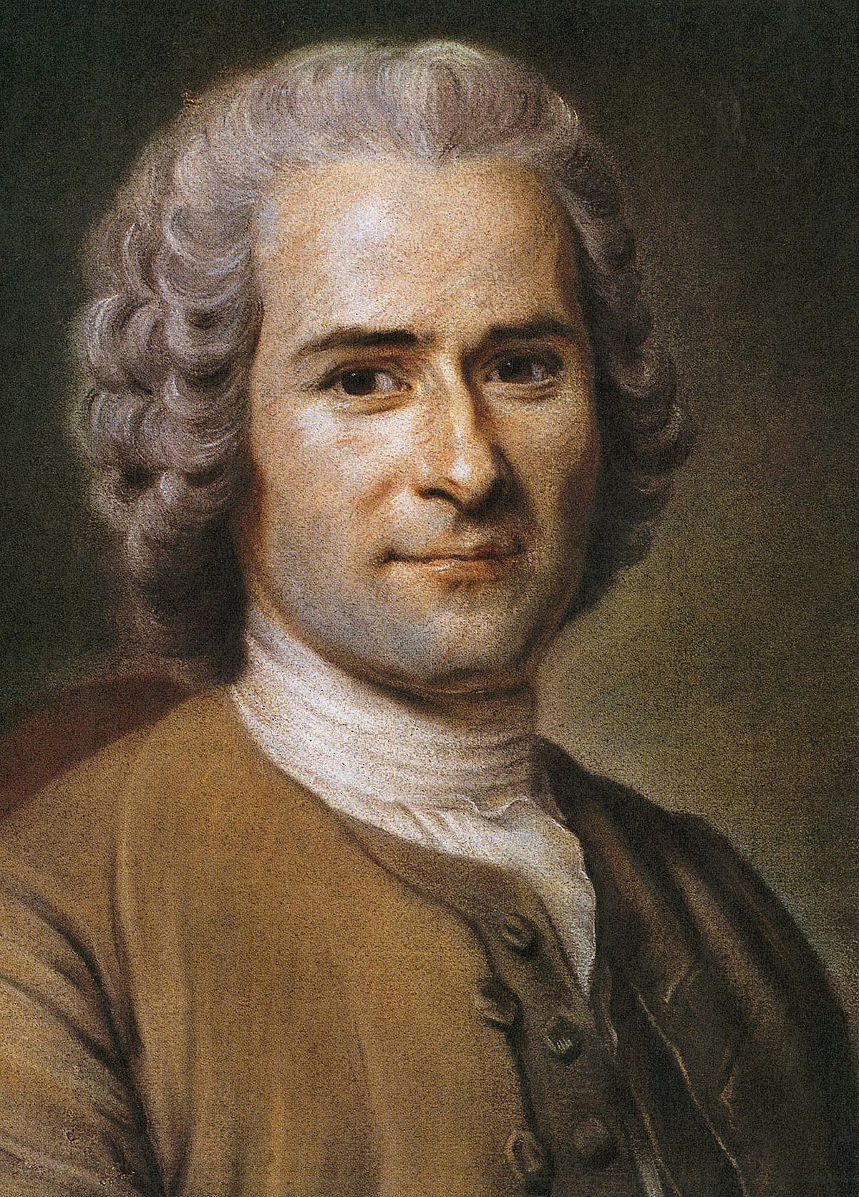
Jean Jacques Rousseau
Full and authentic lives
Move away from people and back to nature
'Cities are the abyss of the human nature...Men are not made to be crowded into anthills but to be dispersed over the earth which they should cultivate. The more they come together, the more they are corrupted (Rousseau 'Emile: Ou, de l'education, p.59)
What else can you find out about Jean Jacques Rousseau

Slide 18
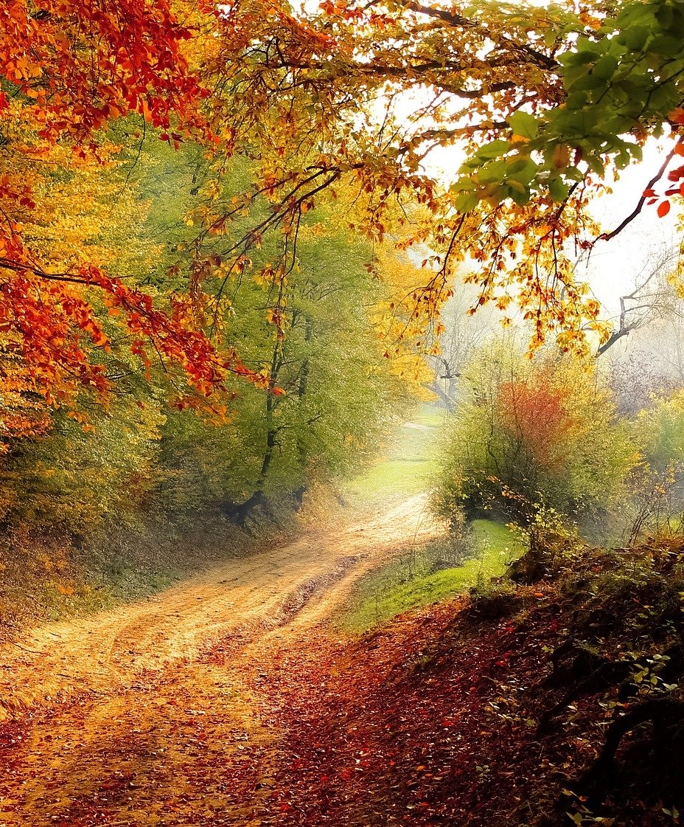
Rousseau cont..
For Rousseau returning to nature is the best approach to gain an authentic and lived life. It will lead to health, happiness and holism.
Turn away from politics, priests, physicians and move back to nature and fresh air and exercise.
This begins at birth. According to Rousseau mothers create a connection with their child, but children should also be allowed to explore to be free to develop their natural curiosity.

Slide 19
Rousseau cont..
He believed in 'person-centred' learning. The teacher needs to engage and empathise with the learner, in order to gain an understanding of what was important for the learning. Teachers had to be 'real' to allow the child to explore and to make mistakes, otherwise they would lose motivation.
Nurturing the child would encourage the child to want to learn more

Slide 20
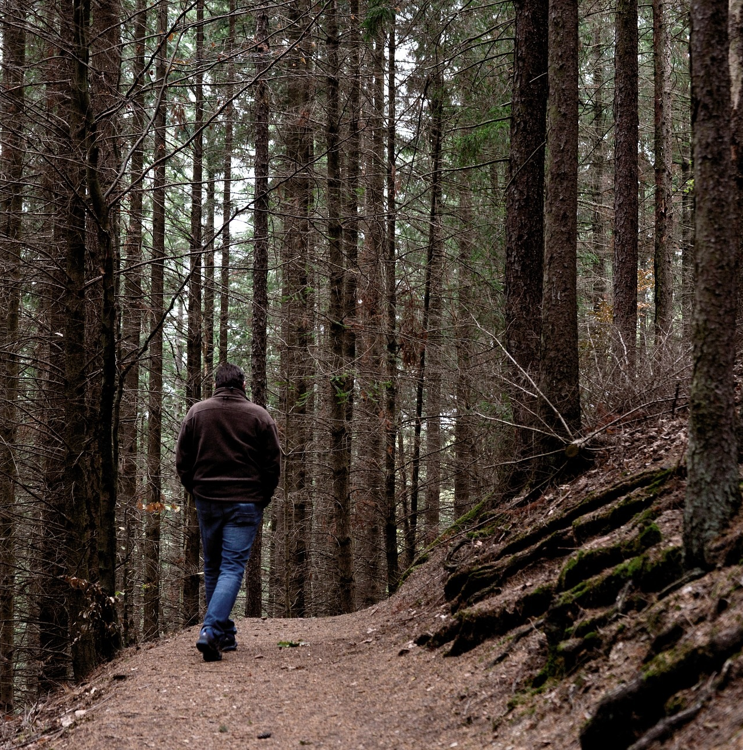
Pandemic, Nature and Finding ourselves...
During the Pandemic many people have found that being 'in nature' or outside has allowed them the time to find peace, to be at rest and to get away from the stresses and the news of the Pandemic.
Do you think we can actually 'find ourselves' in a more pastoral, rural setting, away from urban life?

Slide 21
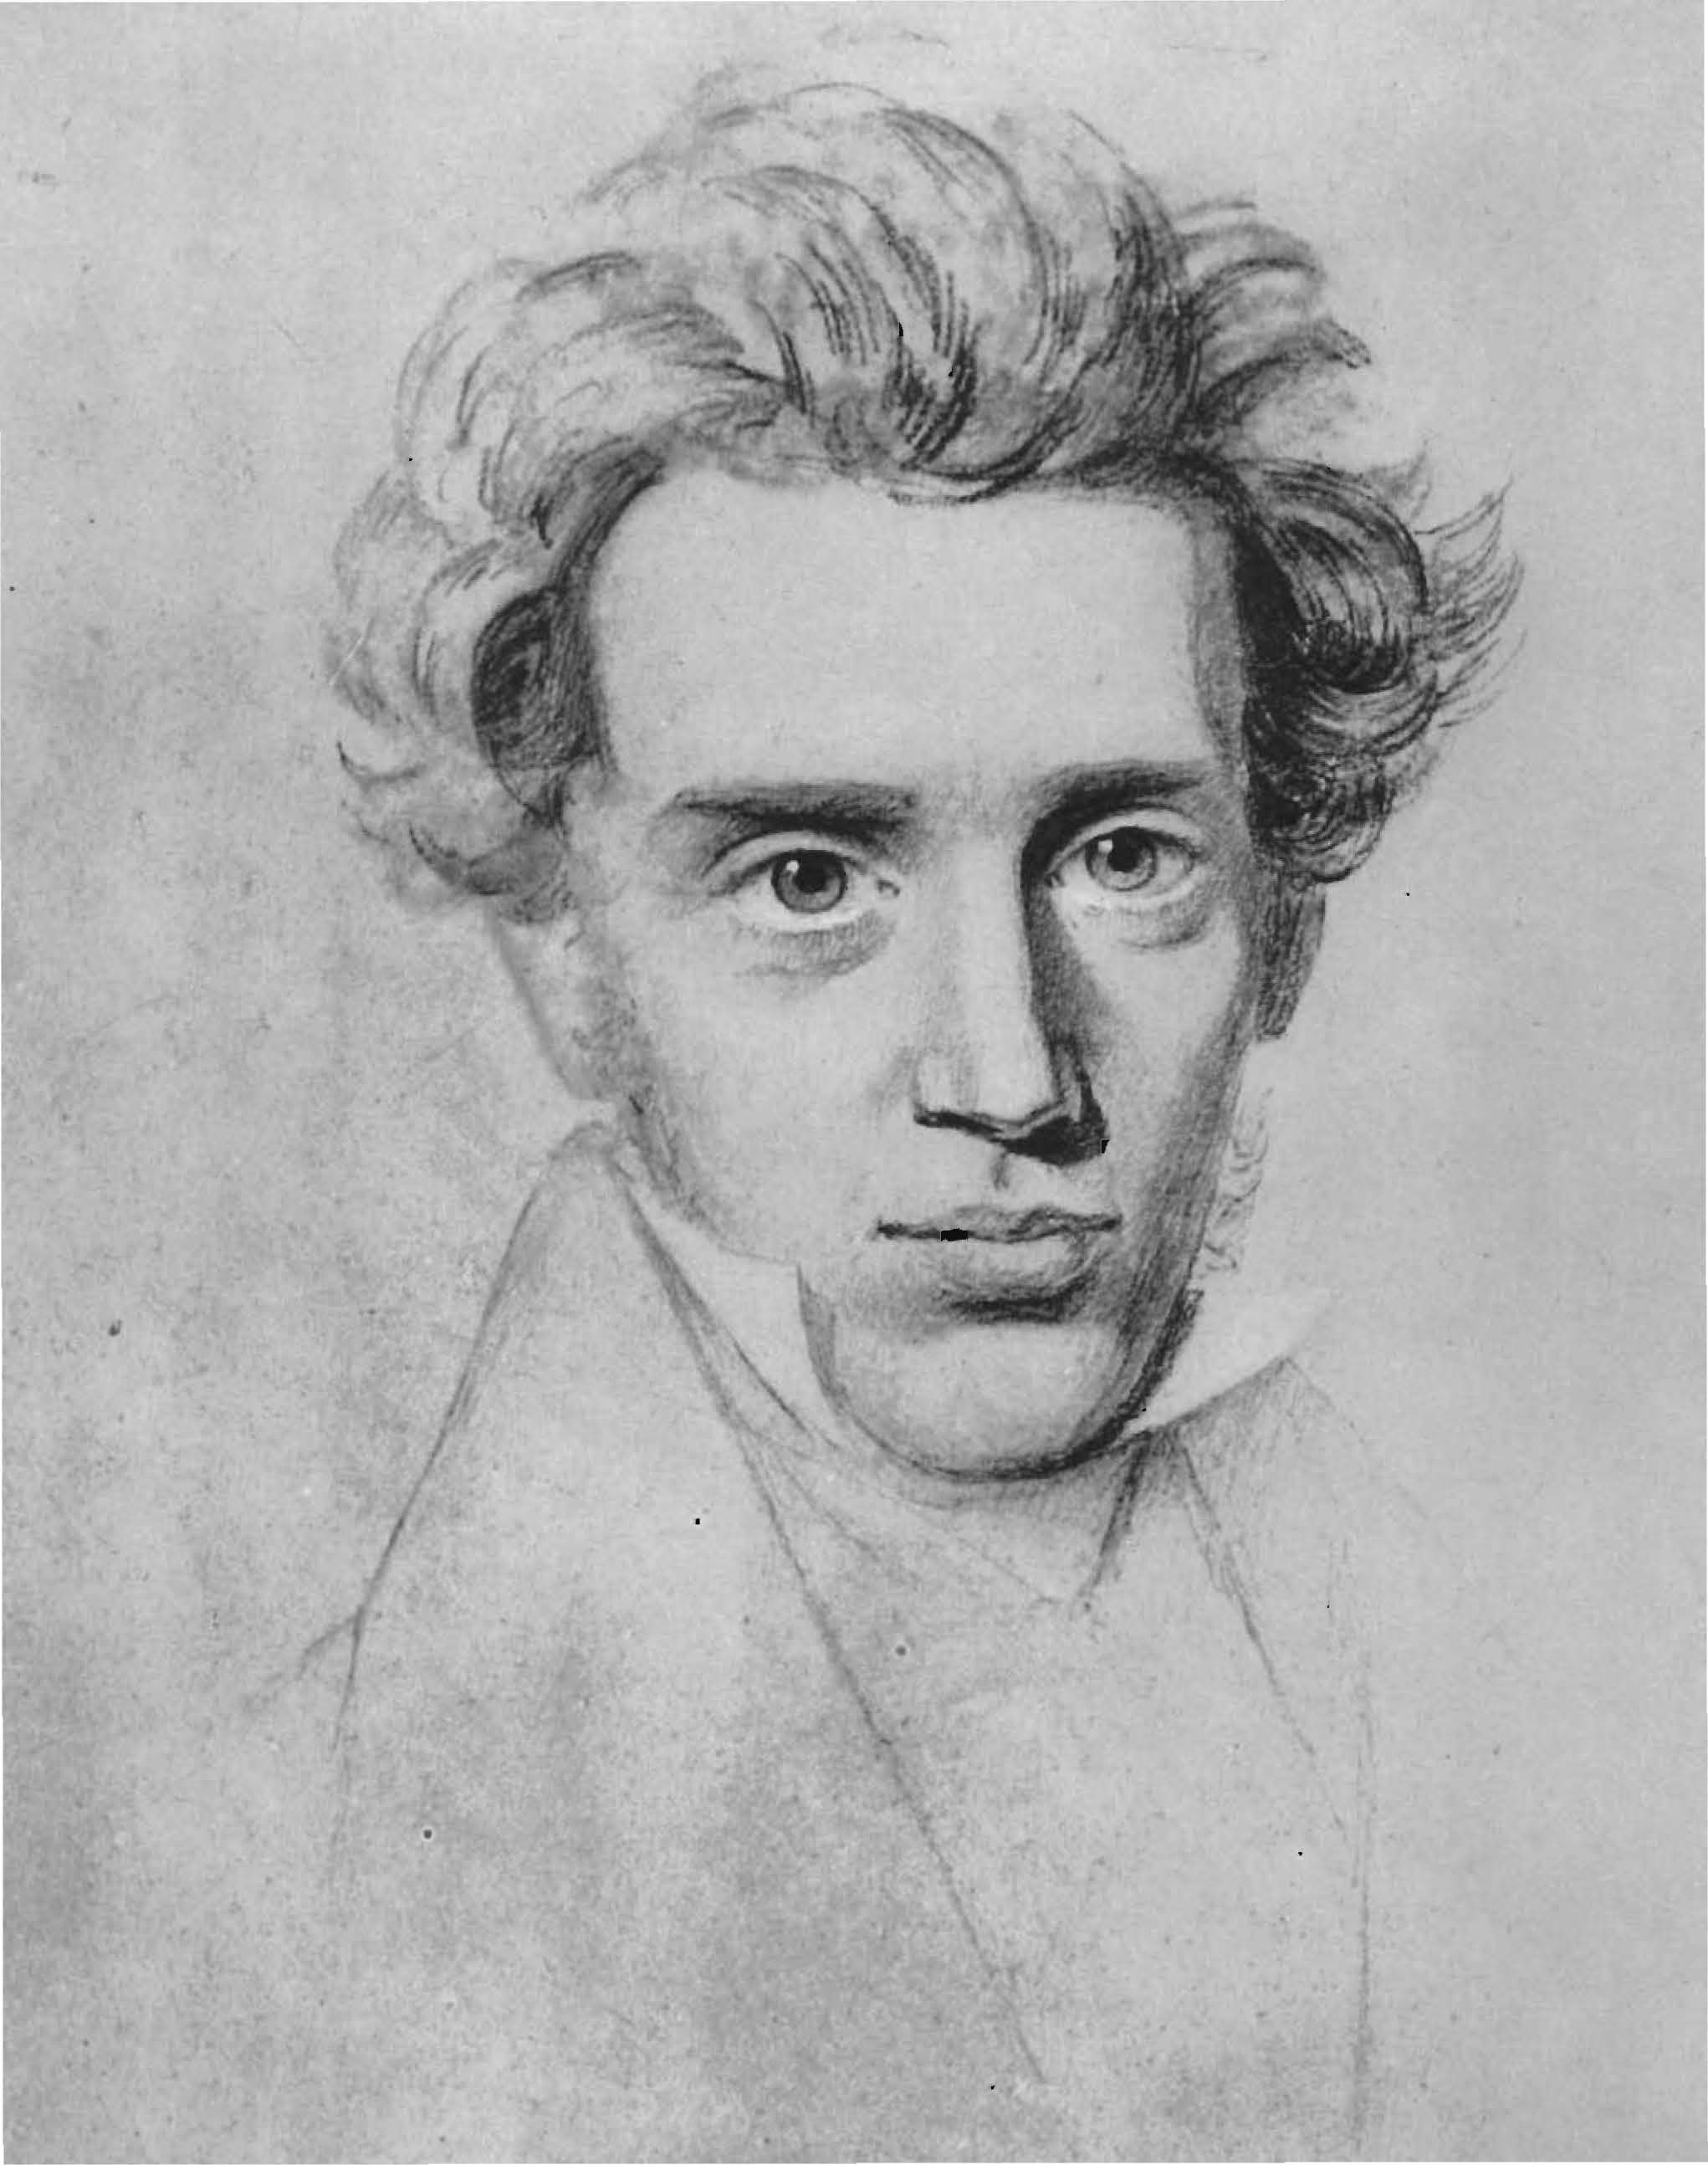
Soren Kierkegaard (1813-1855)
Explore the ideas of Soren Kierkegaard. Look at his ideas of 'self’.
Consider how far existential perspectives inform your own work and thoughts.
What are the consequences of this?

Slide 22
Thoughts? We’ll discuss these at our lesson!
What ideas or thoughts have arisen for you today?
Has anything challenged your ideas , or do you feel you need to know more about a particular strand of philosophy?

