Slide 1


Cyfnewid Cyfnod – BA3
Phase Swap – BA3
23-24.3.2023

Slide 2
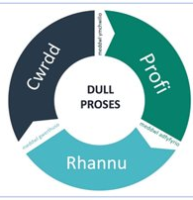
Amcanion
Archwilio arfer ysgol uwchradd.
Profi addysgu a dysgu o fewn cyfnod oedran a chyd - destun gwahanol i'r cyfnod oedran o'ch dewis.
Trawsnewid arfer bersonol drwy dri chyfnod o gymhwyso ymarfer: cwrdd, profi, rhannu.

Slide 3
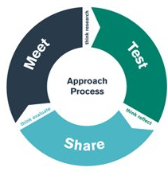
Aims
Explore practice in a secondary school.
Experience teaching and learning within a different age phase and context to your chosen age phase.
Transform personal practice through three phases of applied practice – meet, test, share.

Slide 4




Ffocws: Trefniadau trosglwyddo
Focus: Transitions

Slide 5

Trafodaeth / Discussion
Mathau o drosglwyddo
Types of transition
Ystyriaethau
Considerations
Trefniadau trosglwyddo effeithiol
Effective transitions
Tystiolaeth
Evidence
Notes:
Padlet elicitation task

Slide 6

Adrodd nôl
Feedback

Slide 7

Trefniadau trosglwyddo a dilyniant
Mae rhannu’r cwricwlwm yn gyfnodau ar wahân, sy’n tueddu i gynnwys athroniaethau a dulliau gweithredu penodol, wedi arwain at greu pwyntiau trosglwyddo ychwanegol. Gwelir effeithiau negyddol yn y trosglwyddo rhwng y Cyfnod Sylfaen a Chyfnod Allweddol 2, rhwng Cyfnodau Allweddol 2 a 3, a rhwng Cyfnodau Allweddol 3 a 4. Ym mhob achos, mae’r newid yn yr athroniaeth neu’r dull gweithredu ar bwyntiau trosglwyddo yn gallu llesteirio dilyniant ac roedd tystiolaeth bod hyn yn gallu cyfrannu at ymddieithrio gan bobl ifanc wrth iddynt fynd drwy’r ysgol.
Donaldson 2015

Slide 8
Transitions and progression
Division into the separate stages, which tend to have distinctive philosophies and approaches, has had the effect of creating additional transition points. Negative effects are evident in the transitions between the Foundation Phase and Key Stage 2, Key Stages 2 and 3, and Key Stages 3 and 4. In each case, shifts in philosophy or approach at transition points can hinder progression and there was evidence that this could contribute to disengagement as young people progress through school.
Donaldson 2015

Slide 9
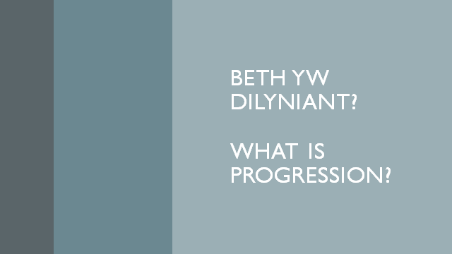

Slide 10
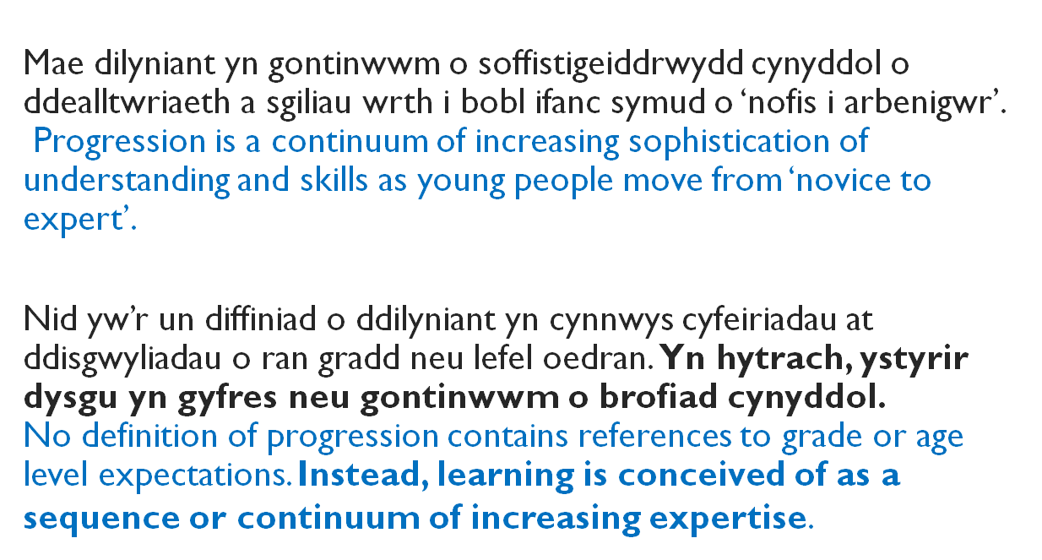

Slide 11
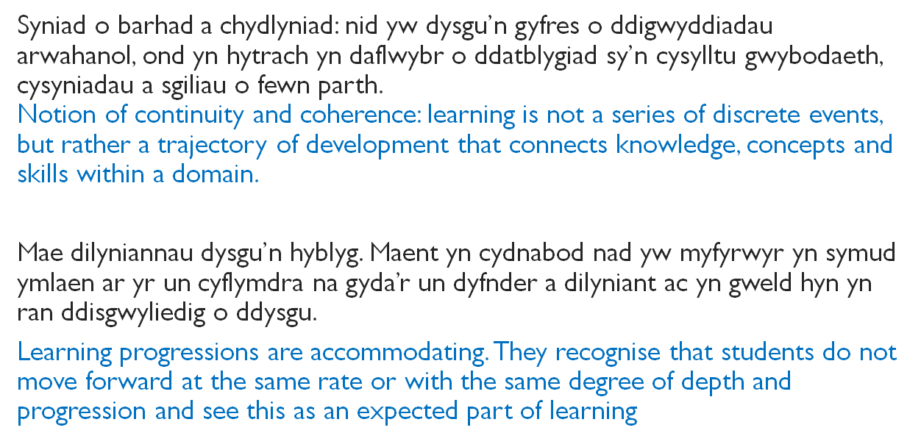

Slide 12


Beth yw patrwm dilyniant?
What pattern does progression follow?

Slide 13


5
4
3
2
1

Slide 14
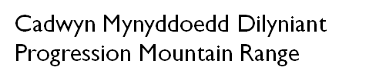




Slide 15
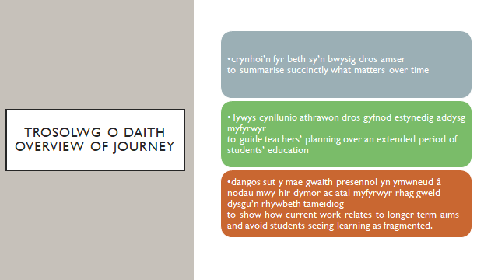

Slide 16
Gweithgaredd clip fidio
How transition arrangements support progression in the Jubilee Park Primary School cluster - YouTube
Ystyriwch y pwyntiau canlynol i’ch helpu i ofyn cwestiynau am y strategaethau trosglwyddo yn eich ysgol cyfnewid cyfnod:
Datblygu cyd-ddealltwriaeth o Gwricwlwm i Gymru
Datblygu cyd-ddealltwriaeth o ystyr dilyniant i bob plentyn – “Stori’r plentyn”; “profiad plentyn cyfannol”
Y strategaethau i gwrdd â’r her o gefnogi continwwm dysgu ar gyfer pob plentyn e.e. dysgu a datblygu athrawon ar y cyd ar draws clwstwr o ysgolion

Slide 17
Video clip activity
How transition arrangements support progression in the Jubilee Park Primary School cluster - YouTube
Consider the following points to help you to ask questions about the approach to transition strategies in your Phase Swap school:
The development of a shared understanding of Curriculum for Wales
The development of a shared understanding of the meaning of progression for each child – “The story of the child”; “the holistic child experience”
The strategies to meet the challenge of supporting the continuum of learning for each child e.g. joint learning and development of teachers across a cluster of schools
Notes:
Padlet review

Slide 18


