Slide 1

TITLE: REVITALIZING GREEN HAVEN FLORISTS: ADDRESSING CHALLENGES AND ADAPTING TO MARKET CHANGES
MODULE CODE: LCLM4004 AND PROBLEM SOLVING AND DECISION MAKING
Student Name : Florin Uta
Student ID : 2229344

Slide 2

Introduction
  Business Overview: Green Haven Florists was founded in 2016 by Liam and Priya Patel in Norwich, UK, and is known for its unique floral arrangements.
  Key Features: The business specialises in bespoke arrangements, eco-friendly packaging, and sustainable practices.
  Community Engagement: Strong ties with the local community through participation in events, fostering a loyal customer base.
  Customer Base: Serves a diverse clientele, including walk-in customers, corporate clients, and couples seeking wedding arrangements.
  Current Challenges:Facing a decline in revenue and foot traffic due to online competition and rising operational costs.
Notes:
This presentation has discussed the case of Green Haven Florists, which is a start-up company that was established by Liam and Priya Patel in Norwich, UK, in 2016. The company has also been identified with its bespoke floral arrangements and sustainability that have seen the company a customer favourite. However, the present threat to Green Haven is the loss of revenue and pedestrian traffic, which is mostly contributed by the intensifying competition in the web and the rising costs of operation (Mehta, 2025). These issues are taken up step by step and strategic recommendations to modernise the business are being discussed as part of the presentation. The overall suggestions include; to enhance the site, to buy more digital marketing, and to offer flexible delivery systems so as to be ahead of the fast-evolving market.

Slide 3
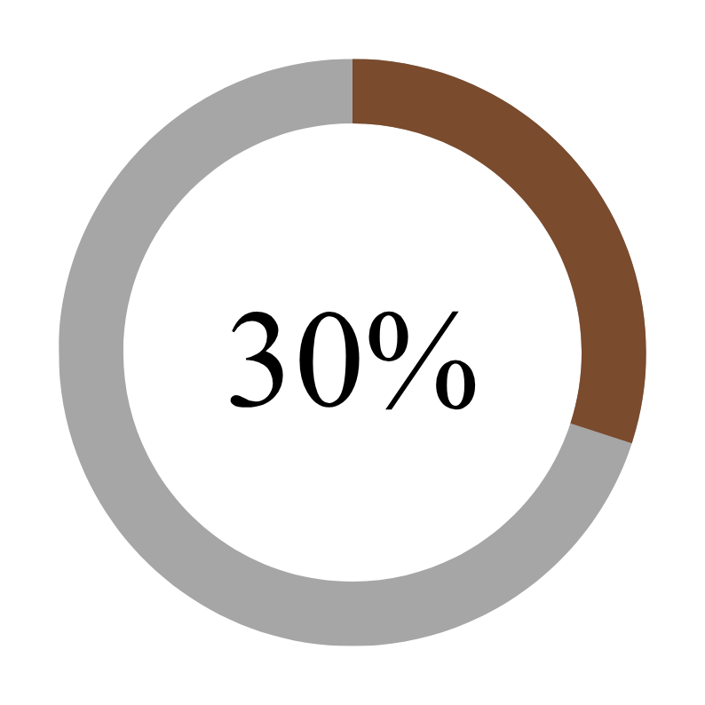
Key Challenges Facing Green Haven Florists
  Declining Sales: 30% drop in in-store sales over the past year.
  Reduced Foot Traffic:Business closures and the shift to online shopping have decreased customer visits.
  Increased Online Competition:More online florists are offering lower prices and convenience.
  Rising Operational Costs:Increased costs for flowers and eco-friendly packaging are straining profitability.
Notes:
Green Haven Florists has had a number of challenges, with a 30% decline in in-store sales throughout the past year. The business has seen a decrease in foot traffic with the closures of businesses nearby and a general increase in online shopping (Shabnam Pangtu et al., 2023). In addition, more competition from online florists with their lower prices and convenient delivery services has put much pressure on. Increasing costs of operations, particularly for flowers and eco-friendly packaging, are taking a toll on profitability, making it a challenge to offer competitive prices and keep it green (Haron et al., 2024).

Slide 4
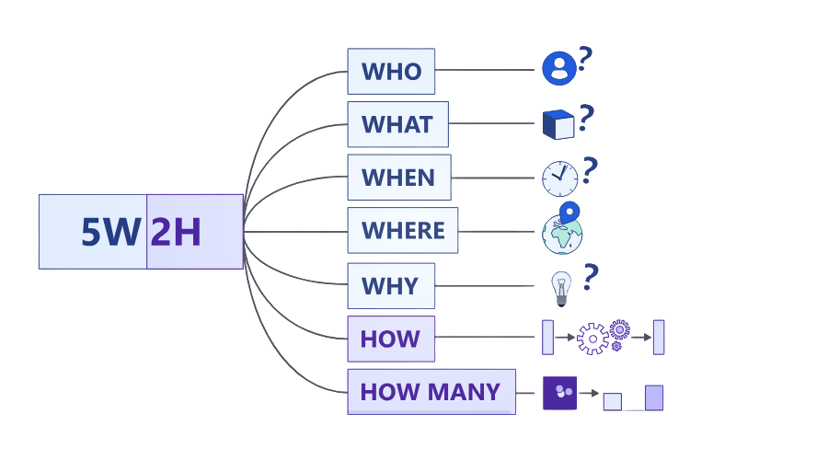
5W2H Method: Nature and Scope of the Problem
  Who: Green Haven Florists (Liam and Priya Patel).
  What: Declining revenue, reduced foot traffic, operational challenges.
  When: Over the past year.
  Where: Norwich, UK.
  Why: Increased online competition, rising costs, changing consumer preferences.
  How: Lack of modern digital marketing, outdated website.
  How Much: 30% decrease in in-store sales.
Notes:
The 5W2H Method is used to provide the structured analysis of Green Haven Florists' challenges. The who is owners of the business, Liam and Priya Patel, and the what is down declining revenue, less foot traffic and operational issues. These problems have happened in Norwich, UK, over the past year. This is due to the increasing online competition, increasing costs, and changing consumer preferences (Mehta, 2025). The why is because of the absence of present-day web-based advertising and an obsolete site. 30% of shop-floor deals have been down, defining how much of the issue there's been. This case analysis involves identifying the major factors influencing Green Haven Florists (NSch, 2025).

Slide 5
PESTEL Analysis (External Factors)
Factor | Description
Political | Post-Brexit regulations and local tax policies increase operational costs.
Economic | Rising flower and material costs, plus a cost-conscious consumer base, impact profitability.
Social | Shift toward online shopping and demand for sustainable products affect foot traffic.
Technological | Outdated website and limited digital marketing hinder online engagement.
Environmental | Rising eco-material costs and sustainability regulations increase expenses.
Legal | Packaging and environmental compliance laws raise operational challenges.
Notes:
The PESTEL analysis of Green Haven Florists shows several environmental factors that influence the internal aspects of the business. Political factors Post post-Brexit regulations, and local tax policies, which add to operational costs (Green Haven). Increasing flower and material costs are creating a tight profit margin as well, while each consumer is becoming more conscious of their spending (Citilci and Akbalik, 2019). The foot traffic has been lower due to more people shopping online and a demand for sustainable products. If we are talking about digital marketing of the business, then we may be faced with technological difficulties, like an outdated website. Moreover, increased eco-material prices as well as legal requirements increase operational loads (Ljubojevic et al., 2022).

Slide 6

Customer Sentiment and Feedback
Positive Feedback
Customers praise the creativity and quality of Green Haven's floral arrangements, highlighting its strength in product offerings.
Negative Feedback
Customer Demands
The website's navigation is a concern, and there's demand for flexible delivery options and subscription services.
Customers seek more digital engagement and modern delivery services to improve convenience and experience.
Notes:
Customer Sentiment and Feedback, New Zealand client opinion is very positive for Green Haven Florists, offering both positive and negative feedback from clients. The creativity and quality of the floral arrangements, which is one of the strengths of the business, is referred to as positive feedback. The site navigation, however, has negative feedback, as it is uneasy for the customer to navigate (Quan et al., 2025). Moreover, the customers have also requested flexible delivery and subscription services, meaning that they have more convenient requirements. To compensate for such concerns, customers are looking for more digital interaction and modern delivery services to improve the whole shopping experience and customer satisfaction (Ye Yujian, 2022).

Slide 7


Competitor Analysis
  Local Competitor: A boutique florist with a strong Instagram presence, attracting younger, social-media-focused customers.
  National Competitor: A chain offering competitive pricing and wider delivery options, including same-day delivery and subscriptions.
  Key Threats: Competitors' superior digital presence and delivery flexibility challenge Green Haven’s market position.
Notes:
Green Haven Florists has both internal and external competition. One of the local competitors has a strong Instagram presence with younger, social-media-savvy customers and generates brand loyalty with engaging content (OECD, 2021). On the other hand, a national competitor has competitive pricing and a variety of delivery options, including same-day delivery and subscriptions, making them more attractive to consumers who value convenience. The superiorities of competitors in digital visibility and accommodating delivery choices may impede Green Haven Florists in the competitive landscape (Quan et al., 2025). But in order to remain competitive, the business needs to improve its online marketing and delivery flexibility.

Slide 8
Cause-and-Effect Diagram
Root Causes
High Operational Costs
Outdated Website
  Rising prices for flowers, materials, and sustainable packaging.
Declining Foot Traffic
  Poor user experience, limiting online engagement and sales.
  Impacted by business closures nearby and the shift to online shopping
  Limited online presence and outdated systems make it harder to reach new clients.
  Competitors offer better pricing, delivery options, and digital presence.
  Decreased in-store sales due to lower foot traffic and competition.
Difficulty in Attracting New Customers
Increased Competition Pressure
Reduced Revenue
Effects
Notes:
The cause-and-effect diagram presents the most prominent issues that Green Haven Florists is experiencing. It is due to the reduction in foot traffic because of the closures of nearby businesses, and the mode of shopping has changed towards online shopping and also its outdated website, which doesn't help in online engagement (Mehta, 2025). The high costs of flowers, materials and eco-friendly packaging also contribute to the considerable operating costs that are a major drain on profitability. These elements result in problems of customer acquisition and growing pressure of competition from local florists and those with a Web presence. The end impact of these challenges is diminished revenue, as a result of diminished in-store sales and failing to effectively compete within the digital and price-based market (Haron et al., 2024).

Slide 9
Strategic Decision-Making
Website Revamp
Flexible Delivery Options
Subscription Services
Digital Marketing
Notes:
The four major areas of focus for the Strategic Decision Making for Green Haven Florists are
Website Revamp: Changing the website to better serve users, be mobile-friendly and increase online sales (Chen and Huang, 2020).
Digital Marketing: Commitment to specific social media advertising and online ads to build an audience in an attempt to raise brand awareness and reach out to a more significant part of the general population.
Subscription Services: Tests to establish a recurring income stream through flower delivery subscriptions to generate acquisition of client loyalty (OECD, 2021).
Flexible Delivery Structure: The flexible delivery structure could be conducted by adopting a same-day delivery system and timed delivery slots as a delivery option in order to give convenience and differentiate the firm among its competitors, thus resulting in high customer satisfaction and business.

Slide 10
Conclusion and Key Findings
Green Haven Florists needs to adapt to survive in a rapidly changing market by modernizing its digital presence and business model
Outdated Website
Rising Costs
Customer Feedback
Increased Competition
Strategic Imperative
Notes:
The Green Haven Florists needs to be flexible in the market, which is fast changing. Major conclusions are as follows: The old-fashioned site does not facilitate online communication and purchases, which leaves the number of attracted clients small. Competition pressure is implied by other local florists and national franchises with better online presence and more flexible delivery services. The profitability is being affected by the skyrocketing costs of flowers and sustainable materials. The feedback obtained by customers indicates that they would like to have an opportunity to select their delivery models and experience the Internet better. It is consequently apparent that to secure the future in the marketplace, the strategic value of modernising its digital image, introducing mobile delivery opportunities and addressing the rising costs, Green Haven must face.

Slide 11
References
Chen, L.-C. and Huang, L.-C. (2020). The Motivation, Strategies, and Barriers for Adopting Social Media Marketing in the Flower Retailing Business. Horticulturae, [online] 6(4), p.80. doi:https://doi.org/10.3390/horticulturae6040080.
Citilci, T. and Akbalik, M. (2019). The Importance of PESTEL Analysis for Environmental Scanning Process. Advances in Marketing, Customer Relationship Management, and E-Services, [online] pp.336–357. doi:https://doi.org/10.4018/978-1-7998-2559-3.ch016.
HARON, H., DEWANTI, R., HERIYANTI, P. and GUI, A., (2024). SUSTAINABILITY OF FLOWER VENDORS AT PASAR BUNGA RAWA BELONG, JAKARTA, INDONESIA. In ICCD (Vol. 6, No. 1, pp. 574-583).
Ljubojević, M., Narandžić, T., Ostojić, J., Božanić Tanjga, B., Grubač, M., Kolarov, R., Greksa, A. and Pušić, M., (2022). Rethinking horticulture to meet sustainable development goals—the case study of Novi Sad, Serbia. Horticulturae, 8(12), p.1222.
Mehta, T. (2025). Revitalizing Green Haven Florists: Strategies for Survival and Growth. [online] prezi.com. Available at: https://prezi.com/p/cid94g7ccp8b/revitalizing-green-haven-florists-strategies-for-survival-and-growth/.
.NSch, R.T., (2025). Revival and Survival: is the British cut flower industry prepared for a 2-degree warming world?.
OECD (2021). OECD Studies on SMEs and Entrepreneurship The Digital Transformation of SMEs. [online] Available at: https://www.oecd.org/content/dam/oecd/en/publications/reports/2021/02/the-digital-transformation-of-smes_ec3163f5/bdb9256a-en.pdf.
Quan, L., Han, H., Ariza-Montes, A., Ryu, H.B. and Yu, J. (2025). Emerging nature café: Boosting customer quality of life, emotional well-being, and positive approach behavior. Acta Psychologica, [online] 254, p.104845. doi:https://doi.org/10.1016/j.actpsy.2025.10484.
Shabnam Pangtu, Sharma, P., Dhiman, S.R., Thakur, D. and Negi, M. (2023). Impact of Covid-19 on Floriculture Industry-Challenges and Strategies Introduction. [online] Available at: https://www.researchgate.net/publication/371781828_Impact_of_Covid-19_on_Floriculture_Industry-Challenges_and_Strategies_Introduction.
Ye Yujian (2022). Modelling and Analysing the Market Integration of Flexible Demand and Storage Resources. Springer Nature.
Notes:
Chen, L.-C. and Huang, L.-C. (2020). The Motivation, Strategies, and Barriers for Adopting Social Media Marketing in the Flower Retailing Business. Horticulturae, [online] 6(4), p.80. Doi: https://doi.org/10.3390/horticulturae6040080.
Citilci, T. and Akbalik, M. (2019). The Importance of PESTEL Analysis for the Environmental Scanning Process. Advances in Marketing, Customer Relationship Management, and E-Services, [online] pp.336–357. Doi: https://doi.org/10.4018/978-1-7998-2559-3.ch016.
HARON, H., DEWANTI, R., HERIYANTI, P. and GUI, A. (2024). SUSTAINABILITY OF FLOWER VENDORS AT PASAR BUNGA RAWA BELONG, JAKARTA, INDONESIA. In ICCD (Vol. 6, No. 1, pp. 574-583).
Ljubojević, M., Narandžić, T., Ostojić, J., Božanić Tanjga, B., Grubač, M., Kolarov, R., Greksa, A. and Pušić, M., (2022). Rethinking horticulture to meet sustainable development goals—the case study of Novi Sad, Serbia. Horticulturae, 8(12), p.1222.
Mehta, T. (2025). Revitalising Green Haven Florists: Strategies for Survival and Growth. [online] prezi.com. Available at: https://prezi.com/p/cid94g7ccp8b/revitalizing-green-haven-florists-strategies-for-survival-and-growth.
NSch, R.T., (2025). Revival and Survival: Is the British cut flower industry prepared for a 2-degree warming world?
OECD (2021). OECD Studies on SMEs and Entrepreneurship: The Digital Transformation of SMEs. [online] Available at: https://www.oecd.org/content/dam/oecd/en/publications/reports/2021/02/the-digital-transformation-of-smes_ec3163f5/bdb9256a-en.pdf.
Quan, L., Han, H., Ariza-Montes, A., Ryu, H.B. and Yu, J. (2025). Emerging nature café: Boosting customer quality of life, emotional well-being, and positive approach behaviour. Acta Psychologica, [online] 254, p.104845. Doi: https://doi.org/10.1016/j.actpsy.2025.104845.
Shabnam Pangtu, Sharma, P., Dhiman, S.R., Thakur, D. and Negi, M. (2023). Impact of Covid-19 on Floriculture Industry-Challenges and Strategies. Introduction. [online] Available at: https://www.researchgate.net/publication/371781828_Impact_of_Covid-19_on_Floriculture_Industry-Challenges_and_Strategies_Introduction.
Ye Yujian (2022). Modelling and Analysing the Market Integration of Flexible Demand and Storage Resources. Springer Nature.

Slide 12



QUESTIONS
AND
ANSWERS
Notes:
Chen, L.-C. and Huang, L.-C. (2020). The Motivation, Strategies, and Barriers for Adopting Social Media Marketing in the Flower Retailing Business. Horticulturae, [online] 6(4), p.80. Doi: https://doi.org/10.3390/horticulturae6040080.
Citilci, T. and Akbalik, M. (2019). The Importance of PESTEL Analysis for the Environmental Scanning Process. Advances in Marketing, Customer Relationship Management, and E-Services, [online] pp.336–357. Doi: https://doi.org/10.4018/978-1-7998-2559-3.ch016.
HARON, H., DEWANTI, R., HERIYANTI, P. and GUI, A. (2024). SUSTAINABILITY OF FLOWER VENDORS AT PASAR BUNGA RAWA BELONG, JAKARTA, INDONESIA. In ICCD (Vol. 6, No. 1, pp. 574-583).
Ljubojević, M., Narandžić, T., Ostojić, J., Božanić Tanjga, B., Grubač, M., Kolarov, R., Greksa, A. and Pušić, M., (2022). Rethinking horticulture to meet sustainable development goals—the case study of Novi Sad, Serbia. Horticulturae, 8(12), p.1222.
Mehta, T. (2025). Revitalising Green Haven Florists: Strategies for Survival and Growth. [online] prezi.com. Available at: https://prezi.com/p/cid94g7ccp8b/revitalizing-green-haven-florists-strategies-for-survival-and-growth.
NSch, R.T., (2025). Revival and Survival: Is the British cut flower industry prepared for a 2-degree warming world?
OECD (2021). OECD Studies on SMEs and Entrepreneurship: The Digital Transformation of SMEs. [online] Available at: https://www.oecd.org/content/dam/oecd/en/publications/reports/2021/02/the-digital-transformation-of-smes_ec3163f5/bdb9256a-en.pdf.
Quan, L., Han, H., Ariza-Montes, A., Ryu, H.B. and Yu, J. (2025). Emerging nature café: Boosting customer quality of life, emotional well-being, and positive approach behaviour. Acta Psychologica, [online] 254, p.104845. Doi: https://doi.org/10.1016/j.actpsy.2025.104845.
Shabnam Pangtu, Sharma, P., Dhiman, S.R., Thakur, D. and Negi, M. (2023). Impact of Covid-19 on Floriculture Industry-Challenges and Strategies. Introduction. [online] Available at: https://www.researchgate.net/publication/371781828_Impact_of_Covid-19_on_Floriculture_Industry-Challenges_and_Strategies_Introduction.
Ye Yujian (2022). Modelling and Analysing the Market Integration of Flexible Demand and Storage Resources. Springer Nature.

