Slide 1
Daxon Hotel by
Narcisa –Maria Ieremie
Madalina –Andreea Popa
Iulian –Cristian Iorgulescu
Alexandru Tuta
Giulia Villa
Autograph Collection

Slide 2
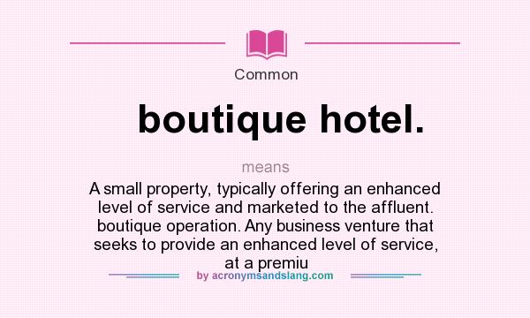
Introduction
Daxon – 5 star boutique hotel in Hyde Park, London
Boutique hotels have started to appear on the market beginning with 1980 , differentiating themselves by creating the ambiance of being a guest in a private home rather than just a hotel occupant.

Slide 3
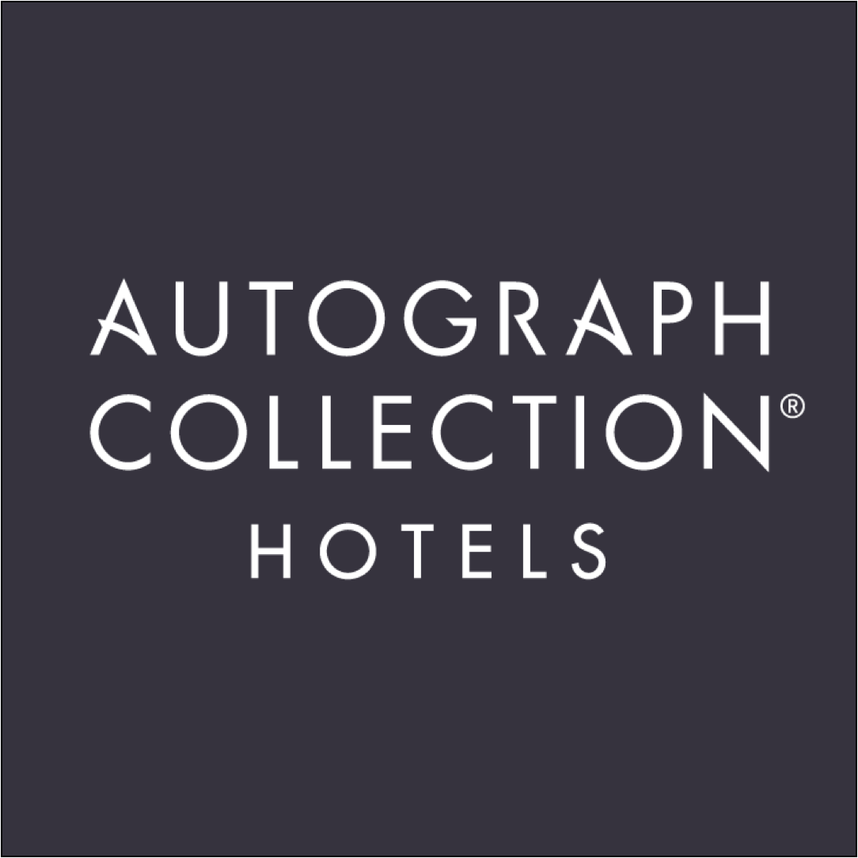
Brand recognition
Autograph Collection
Luxury brand hotels owned by Marriott international
The brand has started in 2010 originating in Saint Augustine, Florida
Created by Richard Kessler for travellers who seek memorable and immersive experiences. No two hotels are the same.
Autograph collection bring the art of stories telling by hand selecting hotels that are rich in character design architecture and with unexpected back stories.

Slide 4

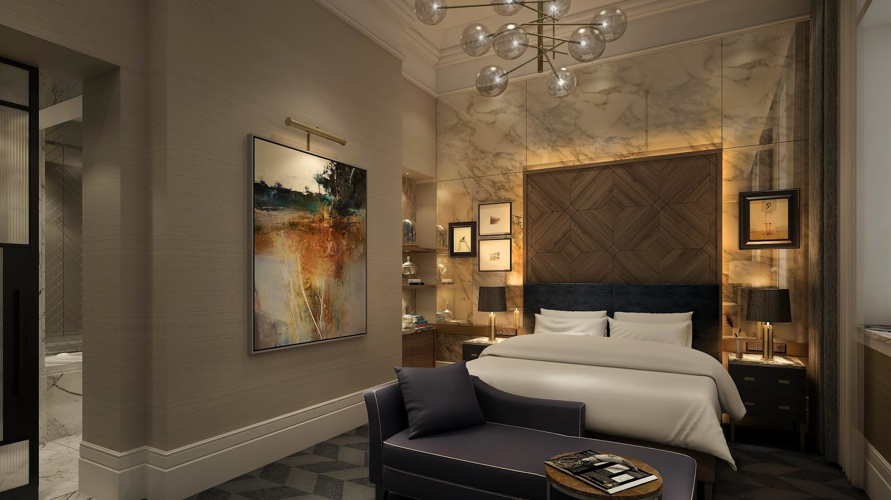
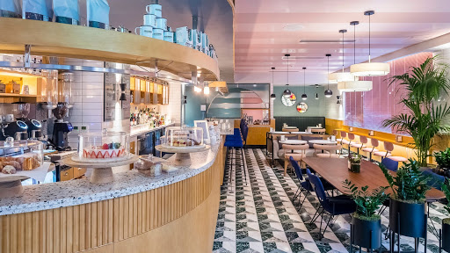
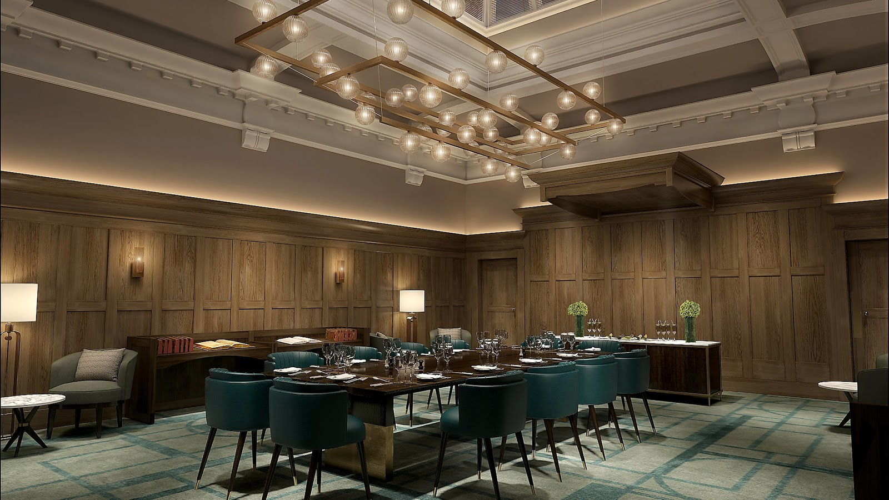
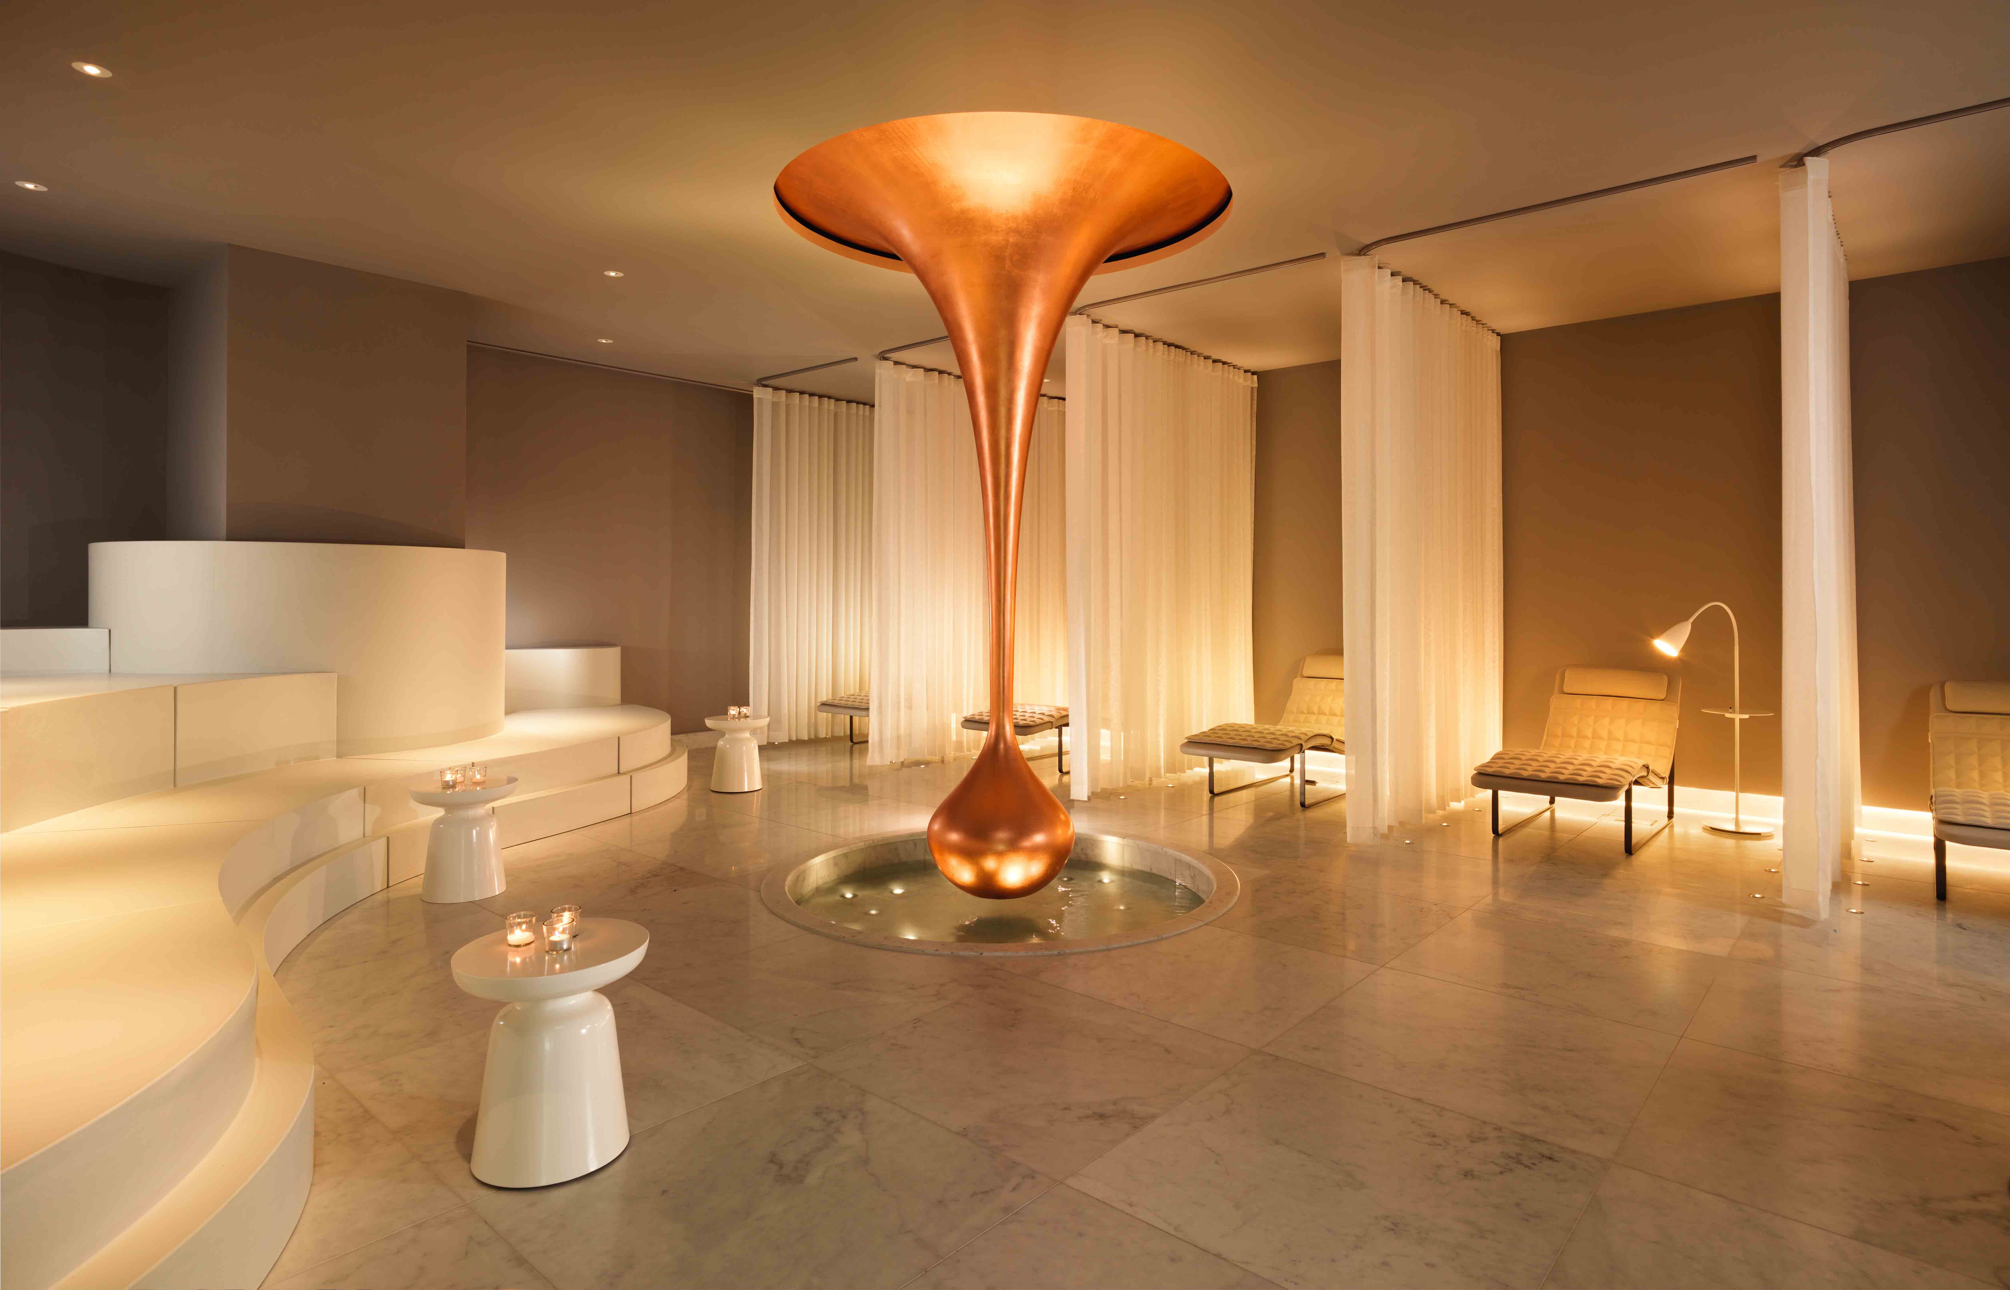
Brand recognition
Daxon hotel
On its journey as any other Autograph Collection Daxton is planning to celebrate artistry that surprise.
Trough its 179 rooms and 14 suits Daxon brings together avant –garde features containing imagery and local legendary
In terms of food services Daxon it’s combining the classic with modern flavours presenting them within Hugo Grill restaurant and Zeke Bar
A list of amenities designed for and by Daxon contains 2 events room, industrial aesthetic roof top spa, indoor swimming pool and art of the state gym.

Slide 5






Marketing and commercial environment
Market indicators
Boutique hotel
London Edition
W Hotels
Deluxe hotel
Hilton Waldorf hotel
Ritz hotel
Budget hotel
Travelodge hotel
Holiday Inn Express

Slide 6
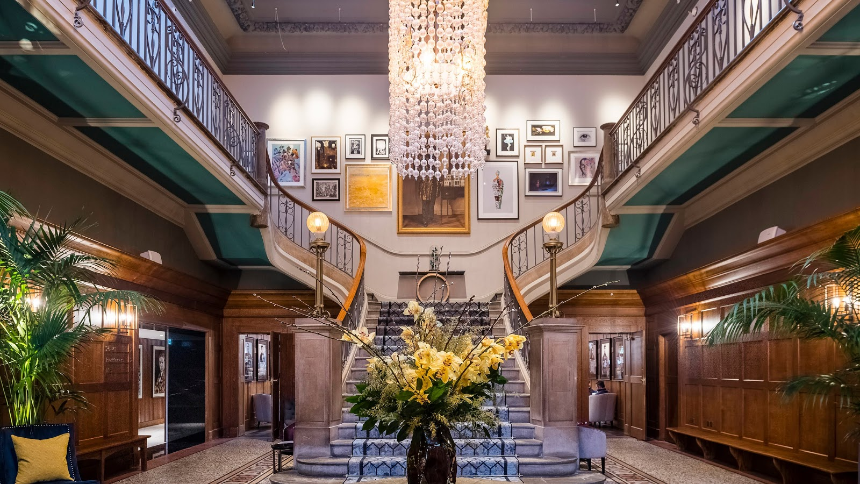
Marketing and Commercial environment
London Edition
Indigo
W Hotels
Competitors
SWOT
Strengths
Personalised service
Location
Weakness
New business on the market
High competition
Autograph collection brand membership
Clean slate brand image
Opportunities
Threats
Governmental legal changes
Bad media reviews

Slide 7


Marketing and commercial environment
Micro and Macro environment
Partnership
Food and beverage partnership with Social Company – international restaurant group run by Jason Atherton with establishment on 6 continents and 14 cities
Events partnership with Restaurant Associates – worldwide events planning company run by Compass Group
Suppliers
KMS provider of housekeeping services
Off to Work recruitment - specialised in out sourcing casual staff within F&B department
Zenith Hygiene Group – industry leading chemical and hygiene products supplier.

Slide 8
Marketing mix
Price – Daxon is planning to go with a sum of a minimum of £199/night. To come up with this amount a set of market condition ability to deliver high level services, luxury products has been analysed and put in to a strategy which takes into account all the different market segment.
Products – as establish before the services and products provided by Daxon and its team are: accommodation, F&B services and extras(spa ,gym etc.)
Place –the board management of Daxon has decide on the present location based on public amenities of Hyde Park area as: easy access to Harrods, Buckingham Palace, museums, natural parks.
Promotion
Marriott Bonvoy – a new program designed for Marriott customer in where by using direct booking, they have access to 120.000 destination and adventures, and they can earn double points on their second stay .
Online booking through booking .com , expedia.com, hotels.com
Direct marketing through social media and online surveys

Slide 9
Conclusion and recommendations
Decision process
Management structure
Board
General manager
Head of department
Middle level management
Steps to take
Market research
Information analyses
Writing reports
Decision making

Slide 10
Conclusion and recommendations
Plans for the future
The Daxon team is looking forward to become number one choice for all the customers who are searching for personalised experiences and luxury environment.
Based on the outline defined by the Autograph Collection, Daxon Hotel is looking to be as unique and individual as any of its customers.
The outcome desired by the Daxon Hotel is to be example to follow by the competitors.

Slide 11
References
Connolly, D. J., & Lee, S. (2006). Developing information technology proficiencies and fluency in hospitality students. Journal of Hospitality & Tourism Education, 18(3), 15-29.
Kinicki, A. and Williams, B. (2008). Management. New York: McGraw-Hill/Irwin.
Singh, A. J., & Kasavana, M. L. (2005). The impact of information technology on future management of lodging operations: A Delphi study to predict key technological events in 2007 and 2027. Tourism and Hospitality Research, 6(1), 24-37.
Stone, M. and Foss, B. (2003). Successful Customer Relationship Marketing. London: Kogan Page.
SCN Education B. V, S. (2008). Customer Relationship Management. Wiesbaden: Vieweg & Teubner
Westwood, J. (2002). The marketing plan. London: Kogan Page
Baker, M. (2010). The Strategic Marketing Plan Audit. Axminster, Devon: Campridge Strategy Pu

